Slide 1

AirBnB Dashboard
Contributors: Reza, Radhika, Nicole, & Katy

Slide 2
Welcome to our Dashboard!
The AirBnB Dashboard provides guests a fun and interactive way to plan their vacation, get information of the area of their rental, and review listings statistics , such as:
Can you walk to nearby destinations?
Is the cleaning fee outrageous?
What kind of neighborhood is the listing in?
How much rental income do hosts generally make?
What are the rental rates in the area and other general statistics?

Slide 3
Sources
https://rapidapi.com/
https://www.mashvisor.com/dat
a-methodology
https://www.ers.usda.gov/webdocs/publications/45014/30940_err140.pdf
https://www.census.gov/data/developers/updates/new-discovery-tool.html
https://www.kaggle.com/kritikseth/us-airbnb-open-data
https://www.kaggle.com/mikejohnsonjr/united-states-crime-rates-by-county

Slide 4
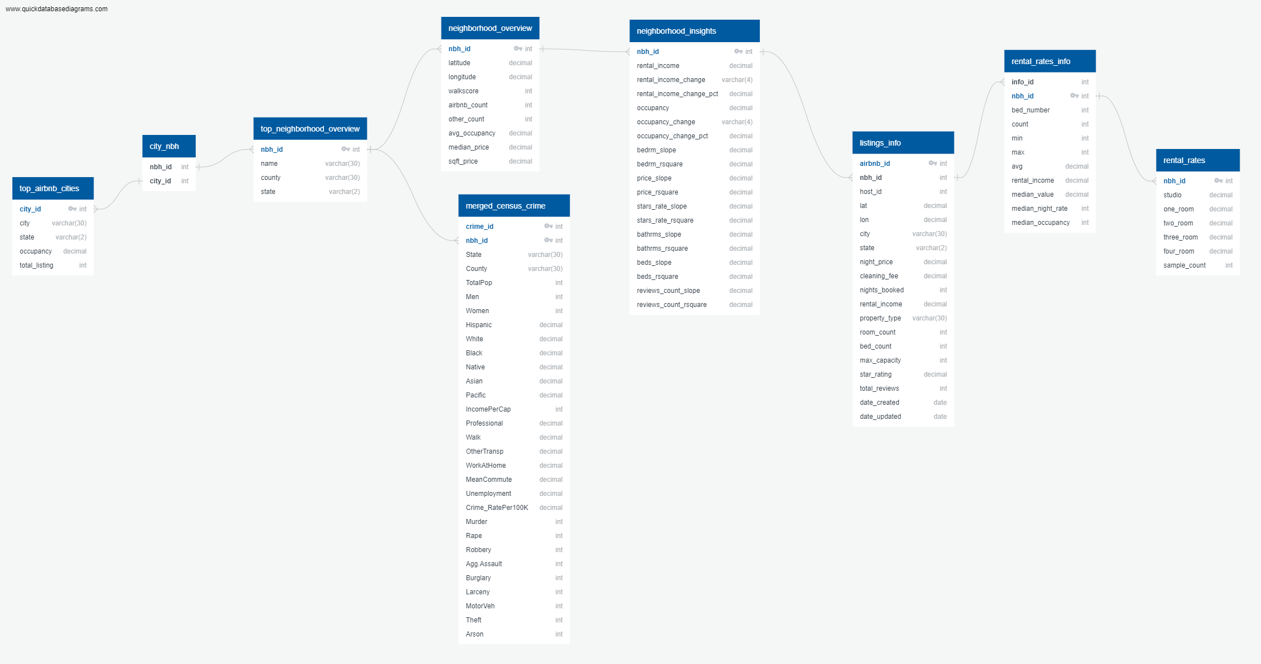
Database Sql-airbnb_db

Slide 5
Process
API Calls and data updates on Jupyter
CSV cleanup and data updates on Jupyter
SQL database creation
Flask
Javascript file creation
HTML integration

Slide 6
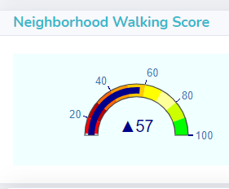
Walking Score
Walking Score scale:
0-24 is Almost All Car-Dependent
25-49 is Most Car-Dependent
50-69 Somewhat Walkable
70-89 is Very Walkable
If you are booking your AirBnB to be close to certain attractions, this score is valuable in helping you find the perfect place for your vacation and determine if you need to make transportation arrangements.

Slide 7
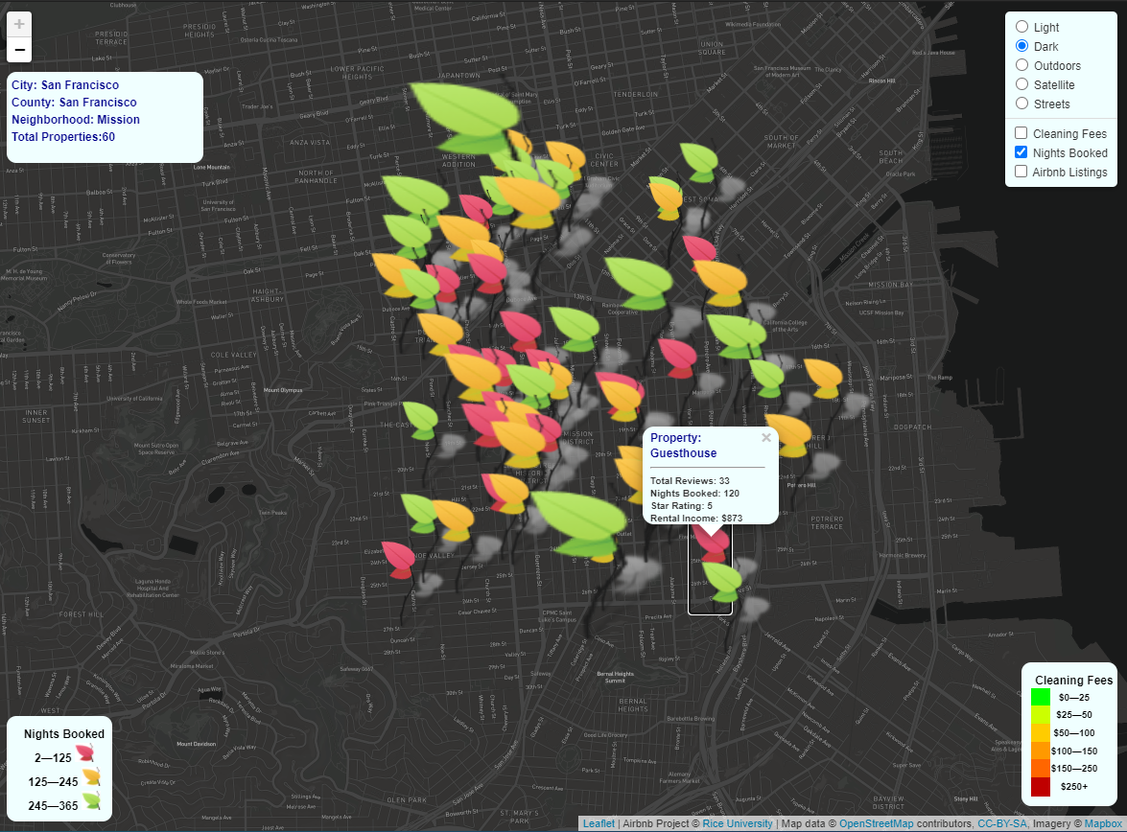
Map
Leaf's represent nights book, different color leaf’s represent total days. Split the year into thirds, dropped the ones that were booked for only once. Size of the leaf corresponds to the total reviews. Assumed more reviews are good reviews, a limitation was not being able to identify if a review was good or not.

Slide 8
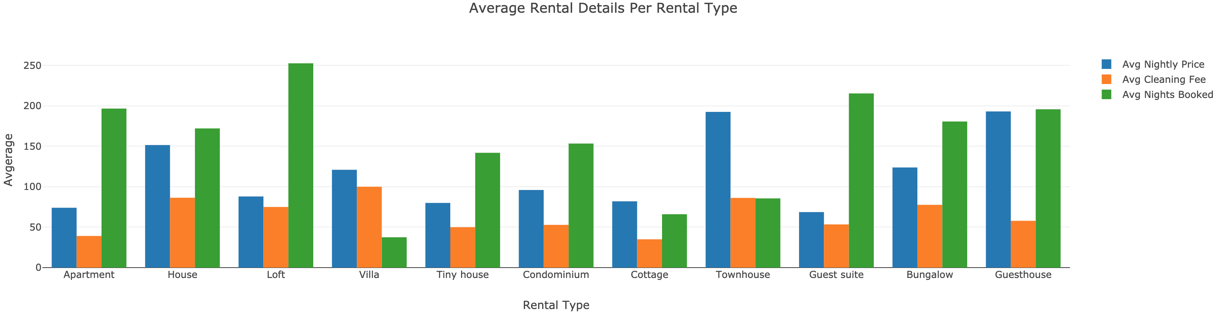
Cleaning Fees
The cleaning fee is set by whatever each host desires and can vary widely, sometimes outrageously and unexplainably. Currently on AirBnb, guests are not able to see the associated cleaning fee until they are at the checkout stage just prior to the final booking.

Slide 9
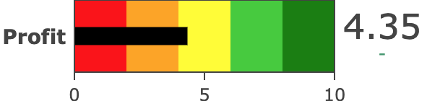
Return on Investment (ROI)
Compare rental income to home values and assess the potential return on owning an AirBnB in a certain city or neighborhood.

Slide 10
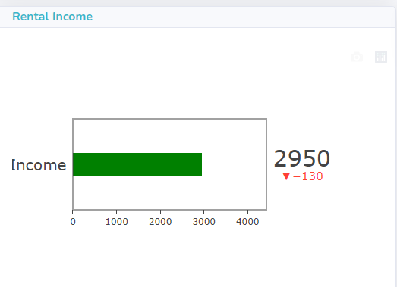
Rental Income
Discover how much rental income hosts make in the area you will be visiting.

Slide 11
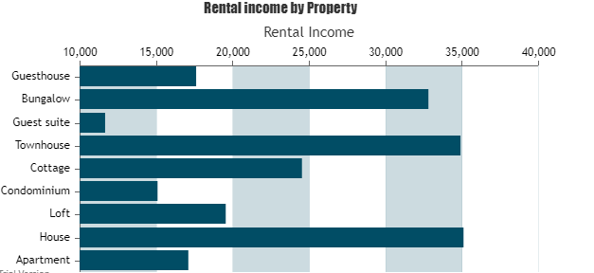
Income By Property Type
Evaluate the rental incomes by Property Type

Slide 12
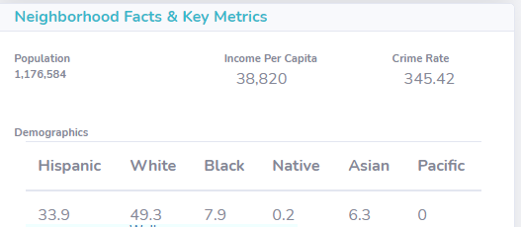
Demographics
Obtain general information about the area where the listing is located including population, income, demographics, and crime rates.

Slide 13
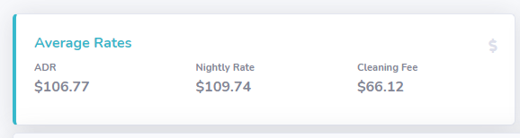
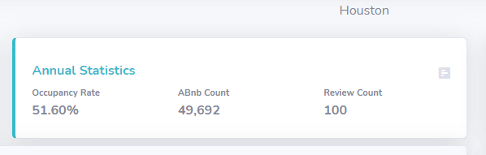
Statistics
Rental Statistics depending on the city and the neighborhood

Slide 14
AirBnB Interesting Facts
On December 10, the company’s first day of being publicly traded, shares skyrocketed at 113% taking the market capitalization all the way to $100.7 billion. The initial public offering price of $68 closed at $144.71.
During AirBnB’s first year of operations, they booked 400 guests. Now, a decade later, roughly 400 guests check in to an AirBnB every two minutes. That’s a check-in increase of 26,280,000%.
AirBnB is active in every country in the world except Iran, Sudan, Syria, and North Korea. That is 97.95% of countries!

