Slide 1
Skeleton-based Rigid Skinning for Character Animation
Andreas Vasilakis and Ioannis Fudos
Department of Computer Science
University of Ioannina, Greece
{abasilak,fudos}@cs.uoi.gr
Notes:
Hello,
My name is Andreas Vasilakis and I will present the research work that we have pursued jointly with Ioannis Fudos on
”Skeleton-based Rigid Skinning for Character Animation”.

Slide 2
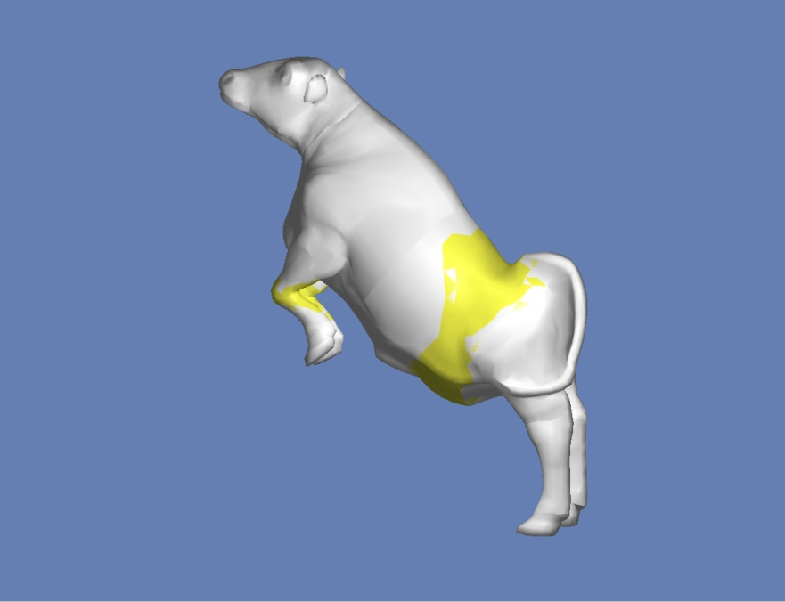
Abstract
A new skeletal animation framework:
    Addresses vertex weighting
    Works on a single mesh
    Produces refined skeleton extraction
    Derives robust rigid skinning with blending patches
Notes:
We have envisioned a system that eliminates the tedious task of vertex weight tuning which often requires increased storage and production costs for the commonly used training example set of model poses.
In a nutshell we have developed a new integrated skeletal animation framework of 3D character models
to achieve plausible skin motion given a single mesh.
The aim of our approach is twofold:
First, a visually satisfactory skeleton is extracted using kernel’s centroids and principal axes. Then new refinement techniques are used to enhance the obtained local skeletons using local and neighbor features.
In addition we introduce a novel method using classic rigid skinning and intuitive mesh deformations based on rational Bezier patches.

Slide 3
Talk Structure
  Introduction
  Skeletonization
  Improved Rigid Skinning
  Results
  Summary
  Future Work
Notes:
The rest of this presentation is organized as follows.
First, i will provide the motivation and problem statement of real-time animation of articulated deformable models
Next, i will present our refined skeletonization and advanced rigid skinning methods.
Then, i will report the evaluation of our proposed algorithms with respect to quality and performance.
Finally, i will offer conclusions and present some directions for future work.

Slide 4
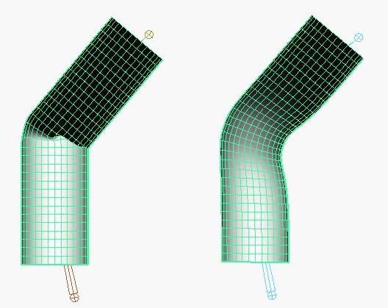
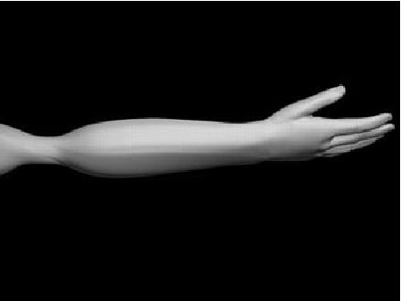
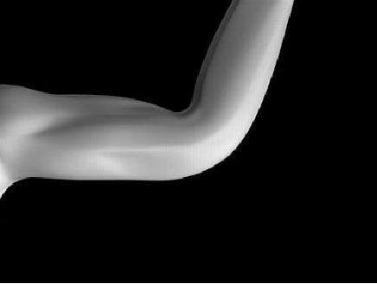
Introduction
  Realistic mesh animation in Movie/Game industry
  Skeletal animation
  Rigid Skinning
    self-intersections
  Linear Blend Skinning - LBS
    volume loss
    vertex weighting
      training pose set
      over-fitting
Rigid Skinning
LBS
candy wrapper
collapsing joint
Notes:
In many graphics-based applications, movies and games achieving natural character mesh deformation is key issue.
Animating a character model described as a polygon mesh by moving each vertex in the mesh is impractical. It is more convenient to specify the motion of character modules through the movement of an internal articulated skeleton from which the movement of the surrounding polygon mesh may then be deduced.
With Rigid Skinning a skin vertex follows one bone as a drive. However artifacts arise caused by self-intersections in areas around joints.
On the other hand with LBS in which each vertex is influenced by more than one bones we have more control over the results.
The linear nature of the transformation blending causes volume loss when rotating to extreme angles which results in artifacts
such as collapsing joint and candy wrapper effect.
The necessity of an appropriate weight selection process often based on a training set of examples poses may require lot of artist intervention and over-fitting avoidance.

Slide 5
Related Work
  Skeletonization
    Geometric Methods
      Reeb graphs
    Volumetric Methods
      Field functions
    Other Methods
      Training pose set
      Mesh contraction
      Mesh decomposition
  Skinning
    Geometric Methods
      Simple/Dual quaternions
      Spherical blending
    Example-based Methods
      Skeletal-Subspace Deformation
      Multi-weight Enveloping
      Animation Space
Notes:
Skeletonization algorithms may be classified according to whether they are based on processing the boundary surface. Often called Geometric Methods that can be realized using Reeb graphs.
OR
They are based on processing the inner volume often called (Volumetric Methods) that can be realized by constructing discrete field functions by means of the object’s volume.
Other methods generate skeletons based on a training example set of poses or based on mesh contraction and mesh decomposition methods
Skinning techniques may be classified according to whether they are based on using one input mesh (often called Geometric Methods)
that can be realized by replacing the linear blending domain with an alternative, for example with simple, dual quaternions or spherical blending.
OR
they work on a training example set of model poses (called Example-based Methods) that can be realized by using more than one weight per matrix.
Skeletal-Subspace Deformation, Multi-weight enveloping and
Animation Space are 3 popular Example-based methods.

Slide 6
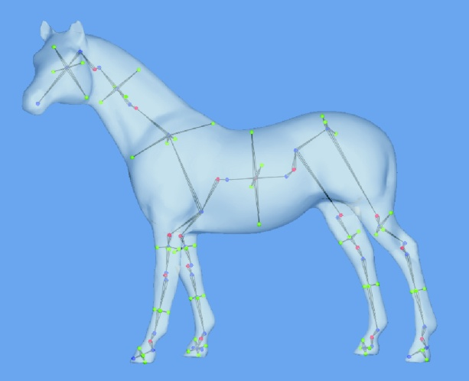
Skeletonization
  Centroid - Principal Axis Methods *
  Approximate refinements using local and neighbor features
    Improve skeleton orientation
    Global alignment of OBBs (for skinning)
(*): Lien J.M., Keyser, J. and Amato N.M., “Simultaneous shape decomposition and skeletonization”.
In proceeding of 2006 ACM symposium on Solid and Physical Modeling.
Notes:
The process of extracting a skeleton from a solid model is called skeletonization.
We extend the work proposed by Lien et al by improving their skeletonization methods with respect to the purpose of our application.
In their work, two local skeletonization methods are introduced based on centroids and principal axes.
We introduce approximate refinements using local and neighbor features to improve the effectiveness of the generated skeleton morphs.
Also, these refinements are used for aligning the OBB to better serve the purposes of our skinning technique.

Slide 7
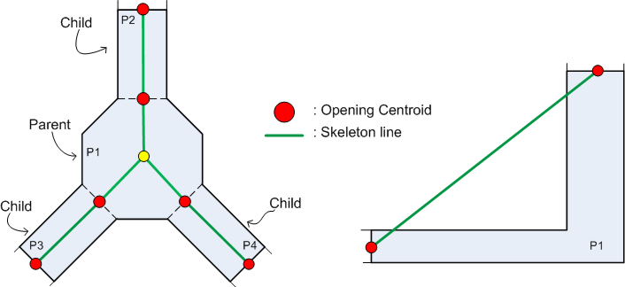
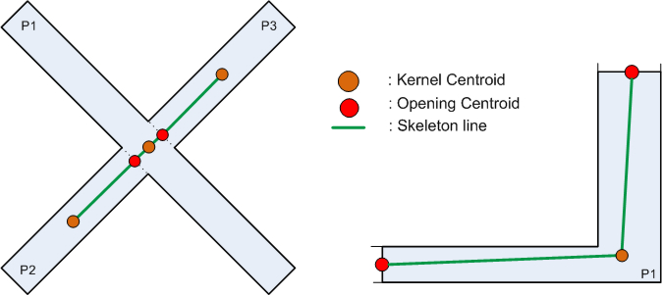
Opening Method
  Opening centroid - OC
  Boundary: common joint points between neighbor components
  Skeletal segments intersect component borders
Centroid Method
  Addresses previous flaws
  Kernel's centroid
  Lacks topological information
Notes:
A straightforward approach to building the skeleton of a component is to connect the centroids of its boundaries. We call them opening centroids.
We define the boundary as the common joint points of two adjacent components.
Although the method is very efficient, skeletal segments intersect arbitrarily the component borders generating unacceptable skeletons.
To address effectively the flaws of the opening method, Lien et al proposed the centroid method where we connect the opening centroids to component's centroid.
Sometimes, however, the component’s centroid may lie outside the component boundary producing erroneous skeletons. To overcome this shortcoming we propose to use the centroid of its kernel.
However, frequently neither this approach is sufficient for capturing component shape accurately.

Slide 8
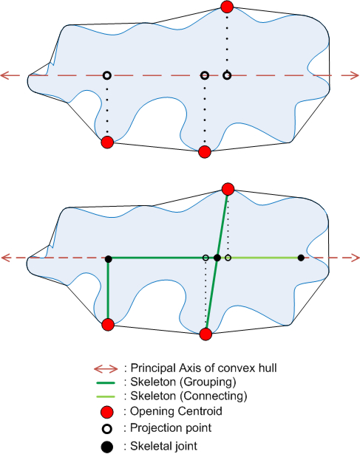
Principal Axis Method
  Algorithm:
    through centroid of kernel and resides within component
    subdivision with OC projections
    sort OCs
    grouping algorithm
    connecting algorithm
  Slightly slower than previous
  High quality skeleton morphs
Notes:
We overcome shortcomings of previous methods by extracting a skeleton from a component by connecting the opening centroids to a principal axis segment.
To ensure that skeleton segments have the least number of intersections with
the component borders we use an axis parallel to the principal axis that goes
through the kernel centroid of the component. In addition, we select the principal axis segment that resides within the interior of the component.
we propose to subdivide the pa in a number of uneven segments by picking as link
points the projections of the opening centroids on pa.
Then, we sort opening centroids according to their projection points by observing that two centroids are likely to be grouped when their closest points are close.
Moreover, we use a dynamic programming matching algorithm enhanced with new score functions which aims at minimizing the total interconnection length and the number of link points used and maximizing the length of the utilized pa.
Beyond the standard connections between opening centroids and link points and
link points to each other, we construct extra skeleton edges based on the mapping result.
The principal axis algorithm is more expensive to compute than the other two methods due to the principal axis and kernel centroid computations but obtains a high quality skeleton by encoding the topology of the component shape efficiently.

Slide 9





Grouping Algorithm
  F1: Normalized Merging Function between OCs:
    average of distances of OCs to PA
    ratio of non utilized PA length
  F2: Normalized Separating Function between 2 groups:
    average of distances of OCs to PA
    complement of ratio of generated PA length
Notes:
To solve this optimization problem we define new score functions.
The Normalized Merging Score Function for the projection of an opening centroid set is defined as
1)average of the normalized distances of OCs to PA
we use this factor to measure the mapping length
2)plus the ratio of length of PA we lose due to this grouping.
The Normalized Separating Score Function for two groups is defined as
average of the normalized distances of OCs to pa
Again we use this factor to measure the mapping
length
2)plus the complement of the ratio of the length of the PA which is generated by not merging these groups.

Slide 10
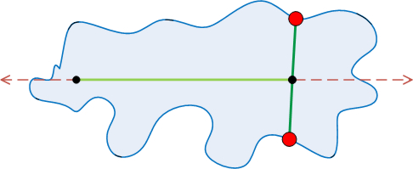
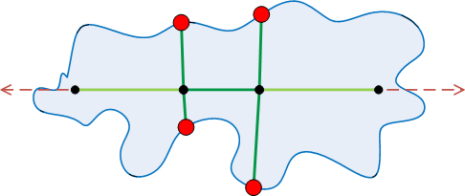
Connecting Algorithm
  OCs -> 1 link point and is close to
    PA's centroid
    PA's end point
  OCs -> k>1 link points and are close to
    PA's centroid
    PA's end point
Notes:
To create extra skeleton edges we set the following rules.
1. If all opening centroids are grouped to one link point and this point is close to:
pa’s centroid, we connect it to both end points of the pa segment.
one of pa’s end points, we connect it to the other pa end point
Similarly, we do the same in the case where all oc are grouped to more than one link points

Slide 11
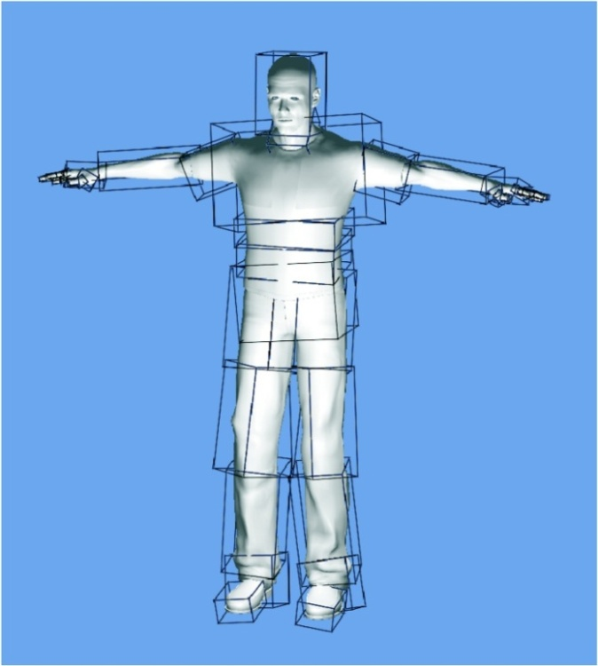
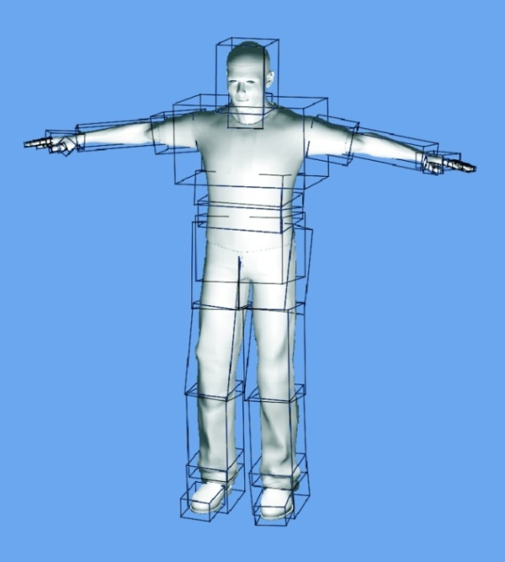
Skeleton Refinements
  PCA is limited on cuboid and spherical shapes
  Approximate slight modifications
  Perfection of PA orientation by 2 novel methods:
    Local Refinement
    Hierarchical Refinement
Notes:
Based on the observation that the PCA algorithm fails to derive a unique valid solution when applied on cuboid or spherical shapes, we can improve the skeleton orientation by using approximate delta corrections.
Our approach adjusts the principal axes orientation using two individual processes, the first one uses local features and the second one uses knowledge derived from its parent node.

Slide 12
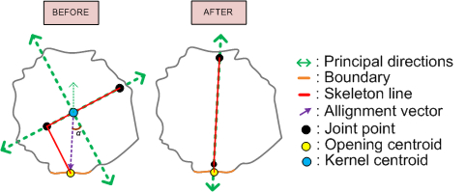
Local Refinement
  OC = 1: match closest PD with vector
  OC > 1: weighted vector alignment with
    angle = a * weight
    a = angle between vector and closest PD
    weight = 1 / (|OC|+1)
Notes:
This algorithm performs weighted vector alignment for each oc using as feature the vector going from the kernel centroid to an oc.
If a component has only 1 OC we simply match its closest PD to the feature vector.
On the other hand , for each oc we rotate all PDs by an angle equal to the angle between the feature vector and its closest axis multiplied by a weight factor that depends on the cardinality of OCs.

Slide 13
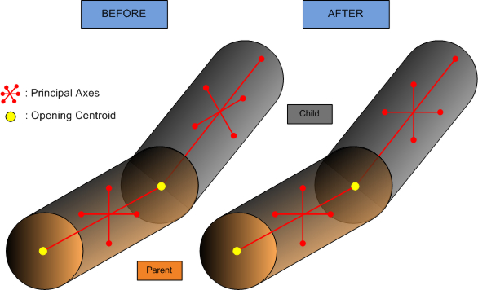
Hierarchical Refinement
  Skeletal uniformity
  Algorithm:
    Align closest parent PD with child PA
    Align the closest pair of remaining child-parent PDs
  Limitation : Initial PD orientation of root node
Notes:
HR performs optimal fitting of the PD of neighbor components to achieve skeletal uniformity.
For each component, traversing from the children of the root to the skeleton leaves,
1) we first align the parent’s PD which is closest to the child’s PA.
2) Subsequently, we detect from the rest of the child’s and parent’s PD those that are closer and we align them.
Its limitation is the dependence on the initial PD orientation of the root component.

Slide 14
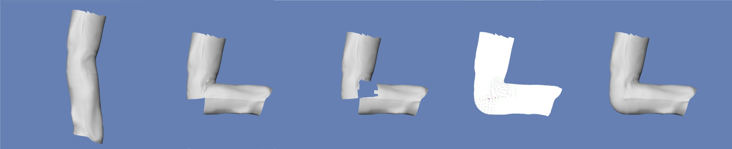
Advanced Rigid Skinning
  Our skinning algorithm
    Removing vertices
    Adding vertices
    Blending mesh
    Computing mesh normal vectors
Notes:
We develop a novel mesh deformation technique to address the major RS ﬂaws.
This technique is performed in four steps:
1. Remove skin vertices of overlapping components.
2. Add new vertices in this area to fill the gap.
3. Construct a smooth mesh by using a triangulation method around the new vertices area
4. Compute the normal vectors of the patch faces.

Slide 15
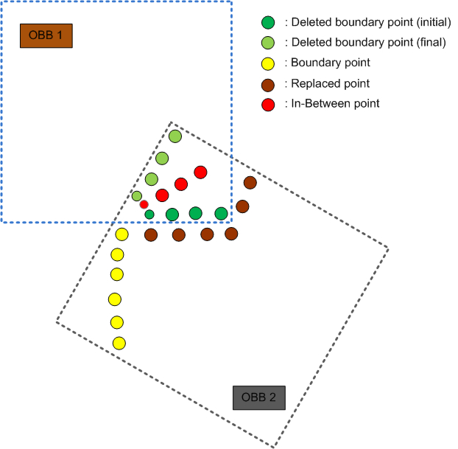
Removing Vertices
  Detect which points are inside neighbor's OBBs
  Optimal cut due to previous refinements
  Vector Classes
    Boundary
    Replaced
    In-Between
Notes:
The first step of our technique is to detect which vertices from each of the collided components are located inside the other one.
A fast approximate test is to use OBBs.
Uniform and optimal intersections will be derived from the OBB refinements of our skeletonization process.
In this process 3 point set are produced.
Boundary is the set of boundary points which have not been removed. - Yellow
Replaced is the point set which replace the points that have been removed. – Brown
In-between is the point set which consists of the average of the initial and final positions of the boundary points which have been removed. - Red

Slide 16
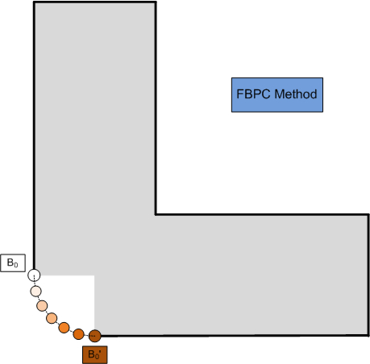
Adding Vertices - FBPC
  Boundary points -> circular arc
  interpolation between before - after rotation
  QLERP
Notes:
The observation behind the Front Blending Patch Construction process is that rotation of a component results in movement of every Boundary point on a circular arc.
We find new points by interpolating from the point’s position before the rotation to the point’s position after the rotation.
We use fast linear interpolation of quaternions (QLERP).

Slide 17
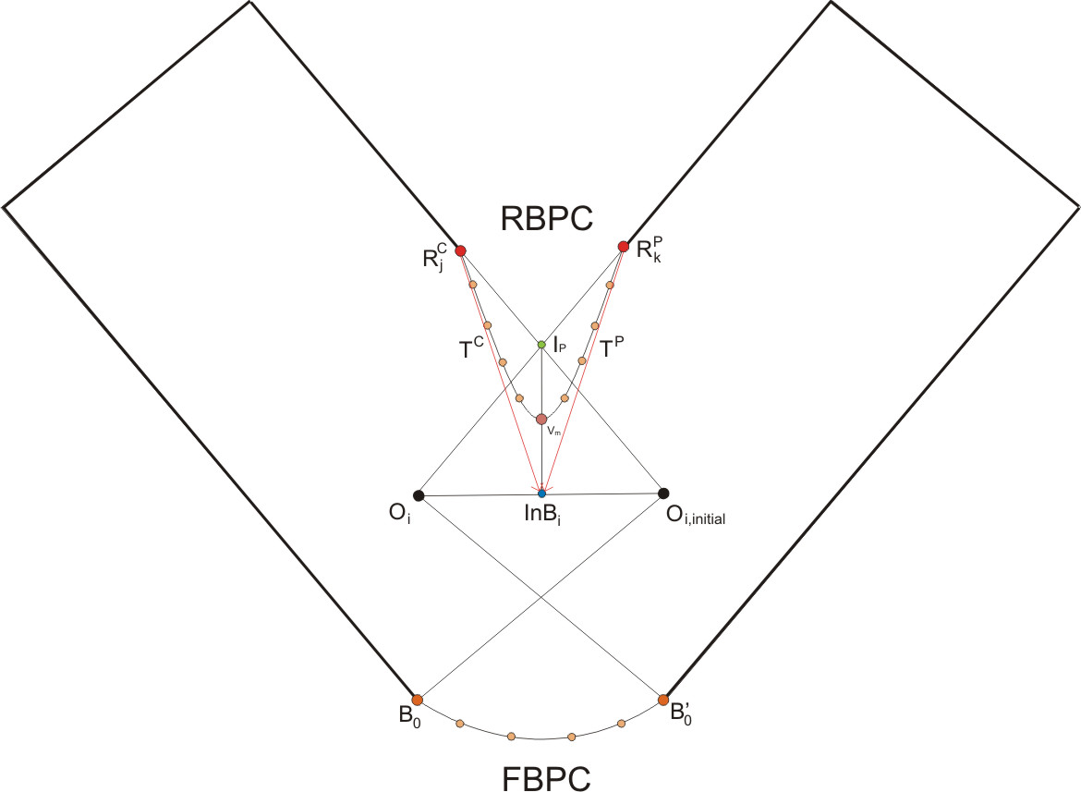
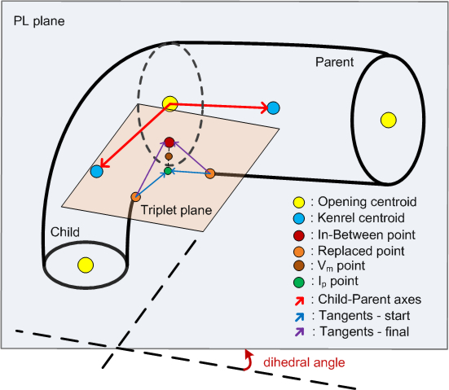
Adding Vertices - RBPC
  Triplet
    In-Between, child-parent Replaced sets
    min {dihedral angle of planes}
    Rational Bezier arc
    Replace In-Between with Vm
Notes:
Rear Blending Patch Construction process fills the gap in the area where we have removed points from both components.
The goal is to create triplets from each In-B and one point from child’s and parent’s Replaced sets
The characteristic of each triplet is that the plane defined by its points has the minimum dihedral angle with the plane defined by the joint position and the kernel centroids of the participating components.
Finally we construct blending arcs using the triplet vertices as control points of a Rational Bezier curve.
To prevent the generated meshes from exhibiting volume loss we replace InB point with the average of the InB point and the intersection of tangents of the Replaced points.

Slide 18
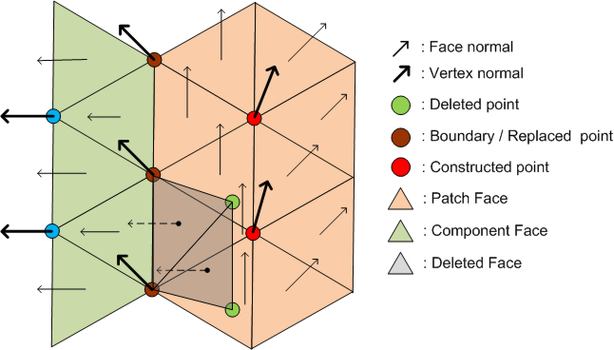
Blending Mesh
  Tight Cocone algorithm *
Computing normals
  Patch Normal = average { new + old normal faces }
(*): Dey T.K and Goswami S.. “Tight cocone: a water-tight surface reconstructor”.
In proceeding of 2003 ACM symposium on Solid Modeling and Applications.
Notes:
In this work, we use the Tight Cocone algorithm to built water-tight surfaces around the newly inserted points.
We estimate the normal of each patch end point as the average of the normals of the patch faces and the normals of the original component faces which have not been removed and share this vertex.

Slide 19
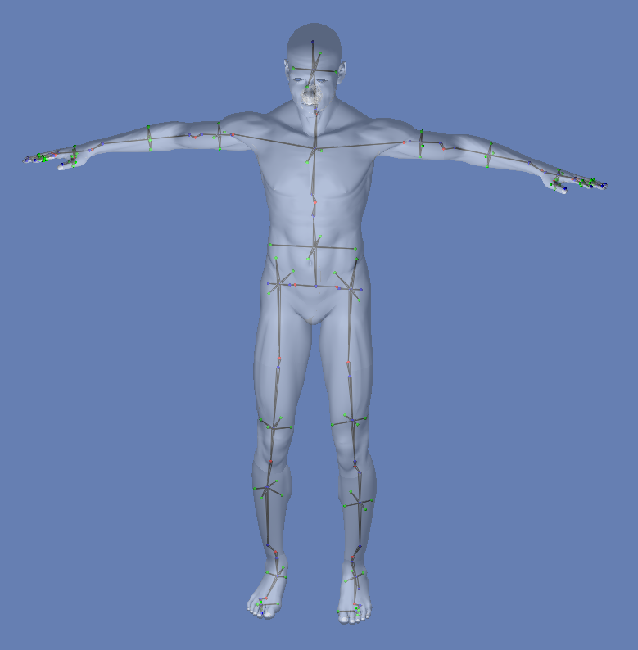
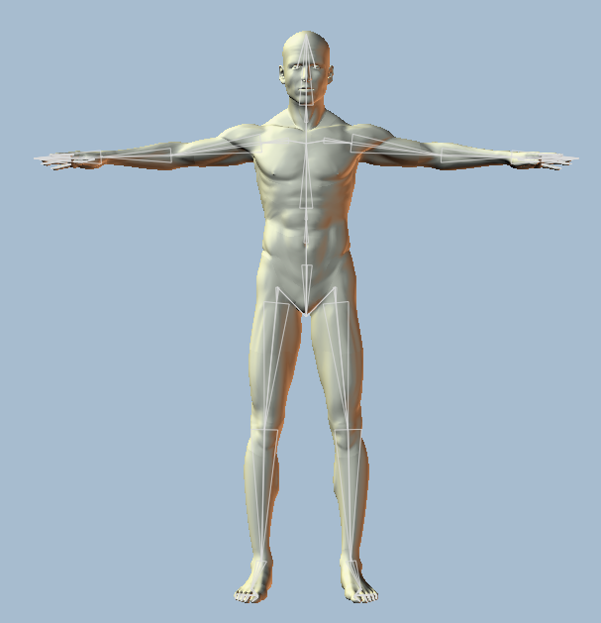
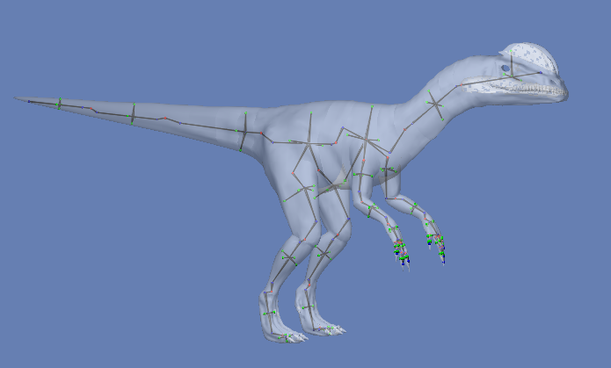
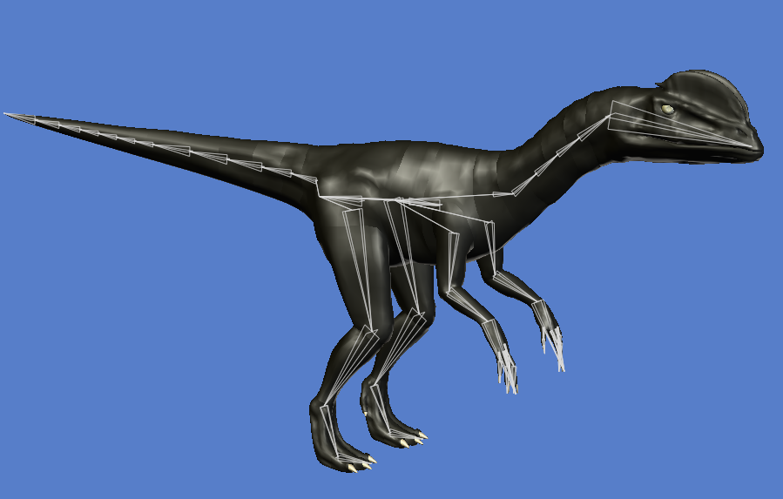
Results - Skeletonization
Human Model:
Dinosaur Model:
Notes:
These figures demonstrate the similarity between the skeletons extracted by a modeling software and our method.
In general, our method generates refined skeletons in a dozen of seconds for dense models due to the pa and kc computation times.
The processing times of our refinements are negligible compared to the overall performance.

Slide 20

Results - Skinning
Notes:
This video demonstrate the quality and robustness of our skinning process.
A drawback is that the overall processing time is too high for real-time animation
(half a second for each frame)
We are working on overcoming this by using alternative triangulation algorithms.

Slide 21
Conclusions
  Refined skeleton extraction technique
  Robust rigid skinning without using weights
Future work
  Skeletonization
    Local refinement: optimization method
  Skinning
    GPU implementation
Notes:
We have proposed a new skeletonization technique using kernel centroid and principal axis and approximate local and hierarchical refinements.
We have presented an integrated skeletal rigid skinning framework that eliminates the skin attachment portion and overcomes LBS flaws
given a single character mesh.
Considering completeness, we intent on replacing the angle-weighted algorithm with an optimization approach.
Finally, to achieve real-time animation we should investigate the GPU implementation of our skinning process.

Slide 22
Thank You
Questions ???
Notes:
Thank You very much….
Do you have any questions please ?

