Slide 1
S-buffer: Sparsity-aware
Multi-fragment Rendering
Andreas A. Vasilakis and Ioannis Fudos
Department of Computer Science,
University of Ioannina, Greece
{abasilak,fudos}@cs.uoi.gr
Notes:
Good morning, my name is Andreas Vasilakis. I am a PhD student at the
University of Ioannina. This is joint work with my advisor
Ioannis Fudos.
Today, I will present an efficient and memory-friendly algorithm built on A-buffer’s architecture in a parallel multifragment processing setting,
that exploits image-space sparsity (the fact that in many scenes there are many fragmentless pixels)
without relying at linked-lists or fixed-array structures.
(45sec)

Slide 2
Why processing multiple fragments?
A number of image-based applications require operations on more than one (maybe occluded) fragment per pixel:
  transparency effects
  volume and csg rendering
  collision detection
  shadow mapping
  global illumination
  voxelization
  …
Notes:
Capturing efficiently global fragment information of a rasterized 3D scene is an important feature in many graphics applications that simulate complex rendering effects.
Example effects include order independent transparency, volume and csg rendering, trimming, collision detection, voxelization and other, all of which require processing of multiple fragments per pixel.
(35sec)

Slide 3

Prior Art
Geometry Sorting Methods
  Object sorting
  Primitive sorting
Fragment Sorting Methods
  Depth Peeling
  Buffer-based
Notes:
For these effects to be correctly rendered, fragments must be processed according to their distance form the camera. Thus, we can use sorting as the criteria to classify current methods into the following categories:
Geometry-sorting: sort geometry (either meshes or at a finer granularity, primitives) before rasterization.
However, artifacts arise from interpenetrating geometry and out of order arrival of fragments.
(that can be solved with a computationally expensive primitives splitting method. Also artifacts can arise from out of order arrival of fragments since object sorting is approximate and does not guarantee correct ordering at the primitive level.)
Fragment-sorting: sort rasterization fragments before processing them using Depth Peeling or Buffer-based techniques. The main advantage of fragment sorting methods is the quality of the image when compared with geometry sorting methods. On the other hand, the computational cost and/or memory footprint re considerably higher.
(60 sec)

Slide 4
Prior Art
Multi-Fragment Rendering Design Goals
  Quality: Fragment extraction accuracy (A)
  Time performance (P)
  Memory allocation (Ma) and caching (Mc)
  Gpu capabilities - (G)
Notes:
Before clarifying depth peeling and buffer-based methods, let’s see 4 key characteristics of a fragment sorting architecture.
Should guarantee robust and accurate fragment extraction, meaning that it should not miss to capture some fragments.
Must be fast
Precise allocation of memory and fast memory access are of outmost importance and
Finally, implementations must be portable to a wide range of hardware.
(35sec)

Slide 5





Prior Art
Depth Peeling Methods [Everitt01,Bavoil08,Liu09]
  A: z-fighting artifacts
  P: slow due to multi-pass rendering
  Ma: low/constant budget, Mc: fast
  G: commodity and modern cards
1st pass
2nd pass
3rd pass
background
Notes:
Depth peeling methods extract layers of visibility from a graphics scene using multiple rendering passes.
Layers are captured in depth order which eliminates the need to sort the resulting fragments.
Despite of the low memory requirements, the rendering passes can be a bottleneck for scenes with high depth complexity. Also, accurate extraction may not be possible when we are faced with depth coplanarity at the fragment space.
Depth peeling methods are supported both in older and recent graphics cards.
This figure illustrates the multi-pass extracting process of 3 non-coplanar planes and the final transparency result.
(60sec)

Slide 6
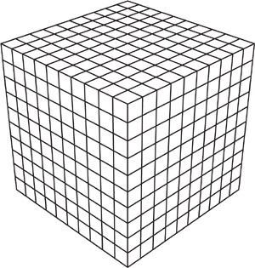
Prior Art
Buffer-based Methods
  Fixed-sized Arrays
    Ma: huge (most of them goes unused)
    Mc: fast
    G:
      Commodity: K-buffer [Bavoil07], SRAB [Myers07]
        A: 8 fragments per pixel
        P: fast (possible multi-pass)
      Modern: FreePipe [Liu2010]
        A: 100% if enough memory
        P: fastest (single pass)
Notes:
In general, Buffer-based methods use a buffer to store fragments while they are generated followed by a post-sorting process that correctly reorders fragments by depth.
K-buffer and SRAB were the first gpu-accelerated structures able to capture up to 8 fragments per pixel in a single rendering pass. If there were more than 8 fragments per pixel, overflow occurs and additional rendering passes are needed.
In terms of performance, KB and SRAB are up to 8 times faster than basic depth peeling but much slower than single pass FreePipe.
FreePipe was the first attempt to perform the entire rasterization process capturing all fragments per pixel based on fixed-size arrays in CUDA However, limit users to switch from traditional hardware pipeline to a software rasterizer.
The major limitation for this class of buffer-based methods is the requirement for potentially large memory requirements due to the allocation of the same number of entries per pixel, regardless of whether or not the pixel contains any fragments. Obviously, this may lead to a significant waste of memory space.

Slide 7

Prior Art
Buffer-based Methods
  Linked Lists [Yang10]
    A: 100% if enough memory
    P: fast (fragment congestion)
    Ma: high
      if overflow: accurate reallocation
      (extra pass needed)
      else: wasted memory
    Mc: low cache hit ratio
    G: only modern cards
Notes:
To alleviate high memory consumption, dynamic creation of gpu-accelerated linked lists per pixel were recently proposed which aim at avoiding allocation for pixel that are not covered. Two buffers are used. One which represents the index per pixel to the last rasterized fragment. This index points to a location to the second buffer which maintains all fragments generated for all pixels.
However, performance bottlenecks arise due to the heavy access on the gpu shared memory.
The random memory accesses of linked lists when operating on stored fragments also degrade performance.
In the context of memory allocation,
if overflow occurs a dynamic memory reallocation is employed followed by an additional rendering pass.
Otherwise, much of the pre-allocated memory space goes unused.

Slide 8
Prior Art
Buffer-based Methods
  Variable-length Arrays
    A: 100% if enough memory
    P: fast (2 passes needed)
    Ma: precise
    Mc: fast
    G:
      Commodity:
        PreCalc [Peeper08] (common prefix sum)
        L-buffer [Lipowski10] (randomized prefix sum)
Notes:
To improve memory caching and data bus occupancy,
we can organize storage into variable contiguous regions for each pixel,
packing pixel fragments physically close in the memory.
At first, an additional rendering pass is performed for counting fragments per pixel
which enables us to allocate the exact amount of total memory that we shall need.
Prefix sums on the counter buffer have been used in [Pee08] to generate the access location of
all pixels in the node buffer.
To avoid overheads for pixels with zero fragments, [Lip10] perform a prefix sum only on the non-empty pixels in a linear fashion, regardless of the order pixels are processed.
After this process, the fragments for each pixel are stored sequentially beginning with the pixel’s head pointer up to the fragment counter entry employing a second rendering pass.

Slide 9
Example: (PreCalc, L-buffer)
PreCalc
Memory Offsets
0 | 0 | 0
0 | 0 | 2
2 | 2 | 5
7 | 8 | 9
10 | 10 | 10
11 | 11 | 11
L-buffer
Memory Offsets
- | - | -
- | 5 | -
- | 8 | 0
7 | 2 | 4
- | - | 3
- | - | -
Counter Buffer
0 | 0 | 0
0 | 0 | 0
0 | 0 | 0
0 | 0 | 0
0 | 0 | 0
0 | 0 | 0
Counter Buffer
0 | 0 | 0
0 | 1 | 0
0 | 1 | 0
1 | 1 | 0
0 | 0 | 0
0 | 0 | 0
Counter Buffer
0 | 0 | 0
0 | 2 | 0
0 | 2 | 1
1 | 1 | 0
0 | 0 | 0
0 | 0 | 0
Counter Buffer
0 | 0 | 0
0 | 2 | 0
0 | 3 | 2
1 | 1 | 1
0 | 0 | 1
0 | 0 | 0
Notes:
Now, I will give an example illustrating the fragment counter rendering pass
differences between memory indexing process of precalc and l-buffer.

Slide 10
S-buffer
Fragment Count Rendering Pass
  Number of fragments per pixel
  Total generated fragments
Memory Referencing
  Parallelized randomized prefix sum
    S multiple shared counters:
    Simple hash function:
    Sequential prefix sum on shared counters:
    Inverse Mapping
      Slit to two groups:
      Final memory offset:
Notes:
We introduce an efficient and memory-aware A-buffer implementation
on the gpu based on real-time concurrent construction of per-pixel variable-length fragment bins.
Similary, we compute the number of
fragments which influence a pixel into a counter buffer by performing a fast rendering prepass.
To alleviate congestion from all pixels trying to update
the same memory location, we propose to apply S multiple
gpu-accelerated shared counters:
More specifically, non-empty pixels are decomposed into non-uniform groups using a simple hash function: H(P) = (P.x + width ∗ P.y)%S, where P.x and P.y denote the pixel position.
We associate one shared counter to each group and carry out in parallel the prefix sums for all groups. After the completion of this process, each group of pixels maps to its own memory space by performing a prefix sum on the final values of the shared counters: where Cpr(i) is the i-th resulting memory reference value.
An inverse mapping technique is applied to boost by a factor of two the latter prefix sum process using the information from the total number of the rendered fragments captured at the first rendering pass.
We accomplish that by splitting the shared counters into two groups, G1 and G2.
The key idea is to perform forward prefix sum for the G1 group and inverse prefix sum for the G2 group.
We define as inverse, the prefix sum that starts accumulating from the end of the processing set towards the start. Then, the memory offset for each pixel P is computed
using the following equation:…

Slide 11
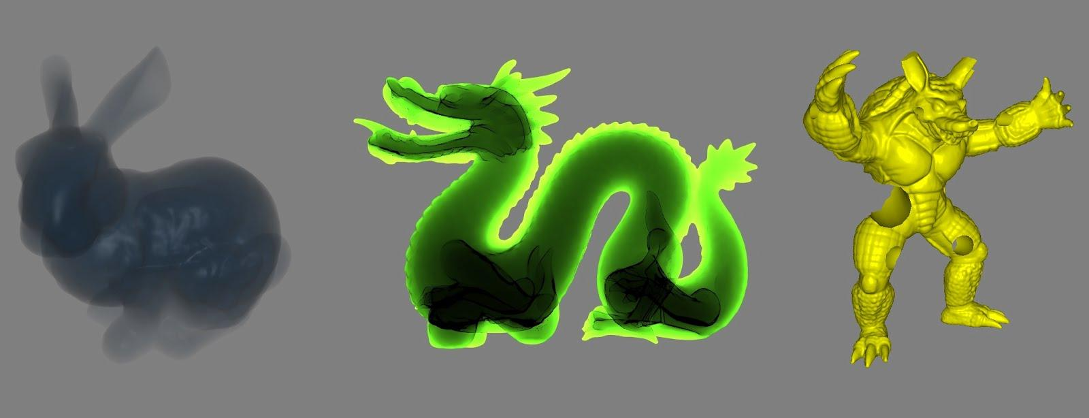
S-buffer
Fragment Storing Rendering Pass
Fragment Sorting
  Insertion Sort
Resolve
Notes:
(2) In the next phase, we perform an additional rendering pass to store pixel fragment data to each bin indicated by the location information generated in the previous phase.
The associated fragment information is then written out to the given buffer index.
The address buffer for the current pixel is then adjusted to the next free space.
(3) Similar to all buffer-based methods a sorting mechanism is employed to correct the ordering of the captured sample fragments. We use insertion sort since it performs well when the number of generated fragments per pixel remains small.
(4) A large repertoire of multi-fragment effects can be supported after the completion of this step. The Figure illustrates transparency effects and CSG operations using S-buffer.

Slide 12
Example: S-buffer(3)
Inverse mapping
Counter Buffer
0 | 0 | 0
0 | 2 | 0
0 | 3 | 2
1 | 1 | 1
0 | 0 | 1
0 | 0 | 0
Local Address Buffer
- | - | -
- | 0 | -
- | 2 | 0
0 | 5 | 2
- | - | 3
- | - | -
Memory Offsets
- | - | -
- | 1 | -
- | 3 | 7
0 | 6 | 9
- | - | 10
- | - | -
Memory Offsets
- | - | -
- | 1 | -
- | 3 | 10
0 | 6 | 8
- | - | 7
- | - | -
C(i) | 1 | 6 | 4
Cpr(i) | 0 | 1 | 7
Cpr(i) | 0 | 1 | 0
Notes:
Now,

Slide 13
Results
Time and Memory Efficiency
PreCalc_OpenCL
  Parallel Implementation of Prefix Sum [NVIDIA SDK]
PreCalc_Fixed
  One rendering pass (Fixed-size Structure)
  Memory Offsetting:
FreePipe_OpenGL
  CUDA-free implementation [Crassin10]
Advanced l-buffer
  S-buffer using only 1 shared counter
OpenGL 4.2 API - NVIDIA GTX 480
Notes:
We present an experimental evaluation of our S-buffer approach versus the other A-buffer realizations. We have measured performance in terms of frames per second (fps) and milliseconds (ms) and memory requirements in terms of MBytes for a set of different testing conditions.
For the purposes of comparative time and space complexity evaluation,
we have developed PreCalc_OpenCL, a faster variation of PreCalc which
handles memory offsetting using an OpenCL-accelerated parallel prefix sum solver (provided by NVIDIA Corporation).
Moreover, we have implemented PreCalc_Fixed,
the fastest A-buffer which exploits a onepass scheme by adapting per-pixel fixed-size arrays based
on [Pee08]. This allows prefix sums to be efficiently obtained in constant time.
Instead of using the software rasterizer
of FreePipe [LHLW10], we have used an OpenGL-based
implementation [Cra10] which performs similarly with the
CUDA one.
Finally, our variation that uses only one shared
counter may be consider as an advanced l-buffer implementation.
All methods are implemented using OpenGL 4.2 API and were tested on NVIDIA GTX 480 hardware.

Slide 14
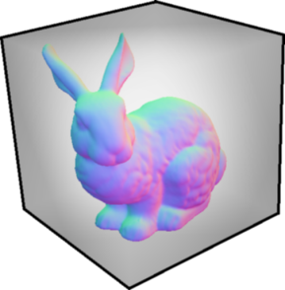
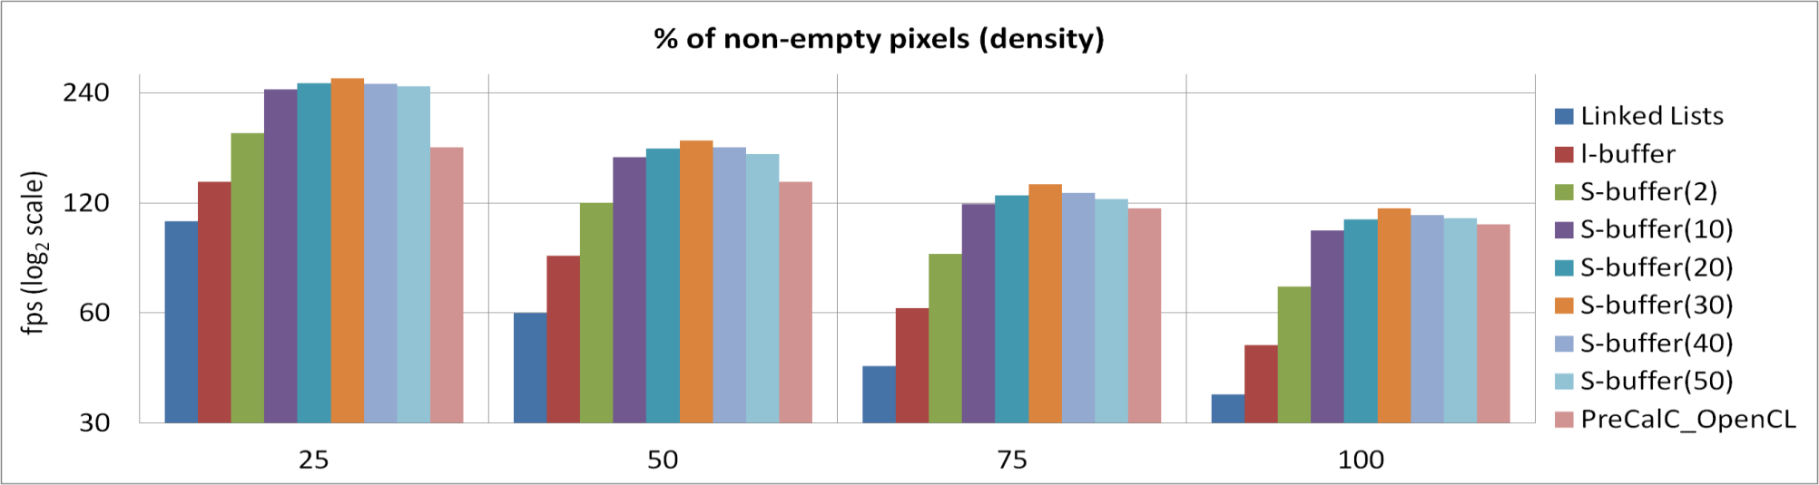
Results
Performance (70000 faces, 12 layers, 1024² viewport)
  Linked Lists: O(m), m(>n) = total fragments
  L-buffer: O(n), n = non-empty pixels
  S-buffer’s speed up: n/S, S = shared counters
  PreCalc_OpenCL: OpenGL/OpenCL syncing time
Notes:
This Table shows how the performance of the memory-friendly A-buffer variants scales by moving from a sparse to
a dense rendering of the Stanford Bunny positioned inside a cube (69463 faces, 12 depth layers) under a 1024×1024 viewport.
We use a Cube to affect pixel sparsity.
The Linked Lists technique, using only one rendering pass, has the worst behavior since it suffers from an O(m) complexity, where m(≫ n) is the number of generated fragments.
l-buffer exhibits performance downgrade due to the linearization of prefix sum which leads to O(n) time
complexity, where n is the number of the non-empty pixels.
Performance is significantly boosted by increasing the number of S-buffer shared counters.
Observe that our buffer exhibits its performance peak using about 30 counters.
Since, this gpu has only 35 multiprocessors,
performance starts downgrading when the number increases out of proportion.
Finally, an interesting observation is that the performance of PreCalc_OpenCL converges to S-buffer when the number of used pixels increases rapidly. Even when the rendering scene covers all pixels, our buffer performance is slightly
better (7% faster) PreCalc_OpenCL. Why the parallel solver is slower?
Due to the synchronization penalties of OpenGL/OpenCL interoperability

Slide 15
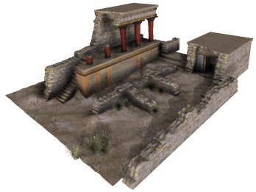
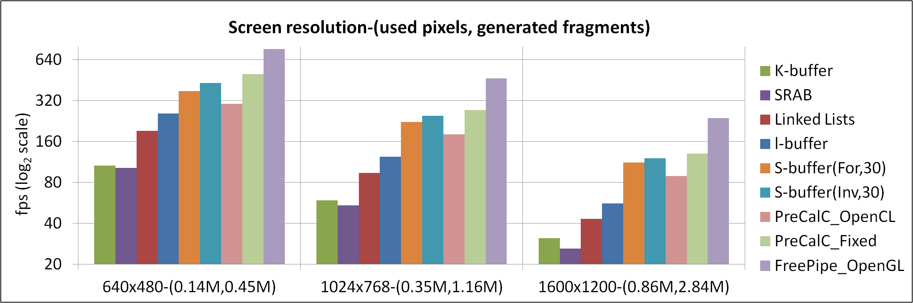
Results
Performance (110000 faces, 25 layers, 55% sparsity)
  Different Resolutions
  S-buffer = 85% of PreCalc_Fixed
  Forward vs Inverse Mapping
Notes:
This Table illustrates performance evaluation of all buffer-based methods on rendering the Minoan Palace of the Knossos model for a set of different screen resolutions.
In general, we observe that fixed-size FreePipe and PreCalc_Fixed solutions outperform memory-aware variants.
But this comes with the burden of memory limitations which is discussed later on.
KB and SRAB have the worst behavior since they have to carry out multiple iterations for capturing the entire scene information.
S-buffer using 30 counters outperforms the other memory-friendly A-buffer variants, rendering at a 85%-to 90% of the optimal frame rate of PreCalc_Fixed.
Note that inverse memory mapping boosts S-buffer performance by (13%,10%,6%)
However this benefit is constant and does not depend on the screen size
?? leading the boost is decreasing when moving to higher resolutions.

Slide 16
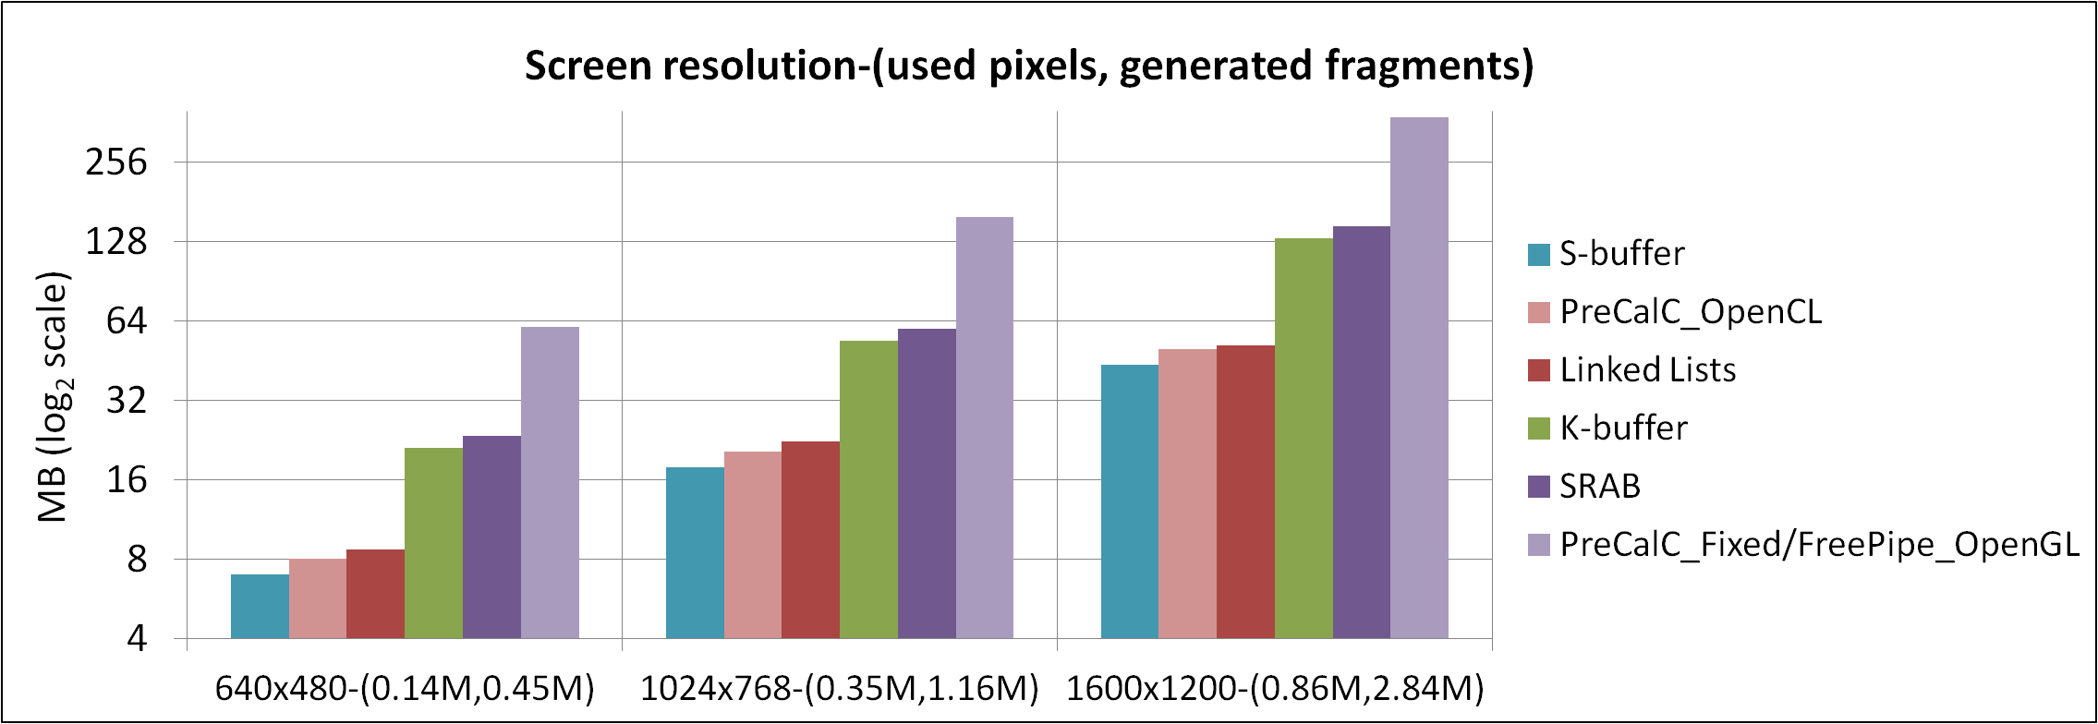
Results
Memory Allocation (25 depth layers)
  Fixed Sized Arrays
    Wasted resources (88%)
    KB,SRAB: 30% less memory due to 8 fragments/pixel
  Linked Lists
    Extra memory for storing pointers to next fragment
Notes:
In the context of storage requirements for the latter scenario, FreePipe and PreCalc_Fixed lead to increased
memory requirements most of which is not actually used (88%) due to their strategy to allocate the same memory for each pixel. K-Buffer and SRAB due to their nature, capture up to 8 fragments per pass and therefore need 30%
less memory resources than previous bounded buffers.
Conversely, PreCalc_OpenCL and S-buffer allocate the exact amount of memory needed since the number of fragment
insertions is known apriori.
Linked Lists needs slightly more memory resources for storing fragment next pointers with an extra linked list.

Slide 17
Conclusions
S-buffer
  Gpu-accelerated A-buffer
    Fragment distribution and pixel sparsity
    Parallelism – Inverse Mapping
    OpenGL Pipeline
Limitations
  Additional rendering pass
  Unbounded storage requirements and Per-pixel post-sorting
  OpenGL 4.2
Future Work
  Tessellation
  History-based
Notes:
We have presented S-buffer, an efficient gpu-accelerated A-buffer in terms of memory and performance by exploiting the fragment distribution and the sparsity in the pixel space. To increase parallelism, we have introduced multiple shared counters and inverse memory mapping strategy.
S-buffer successfully integrates into the standard graphics pipeline,
avoiding switches back and forth between CUDA/OpenCL and OpenGL contexts
and taking advantage of features as multi-sample rendering, gpu instancing and tessellation.
However, there are some limitations that should be mentioned.
(1) First of all, the need of an additional rendering step may result at a performance downgrade when compared to the fixed-size array buffers.
A neat idea is to perform the preliminary fragment count pass rendering a lower-detailed subdivision of the initial 3d scene by employing tessellation shaders.
(2)
Implementation-wise, the necessity of the most recent API makes it infeasible for mobile, console, older gpus and web-browser applications.
(3)
Similarly to all previous unbounded A-buffer implementations, gpu memory recourses may be exceeded and per-pixel sorting may stall rendering when the number of generated fragments becomes too high.
Tiled Rendering may be used to reduce memory demands.
(4)
Finally, history-aware solutions may be combined with our buffer based on the observation that successive frames typically have the same or very similar number of fragments
located at the same screen pixel location.

Slide 18
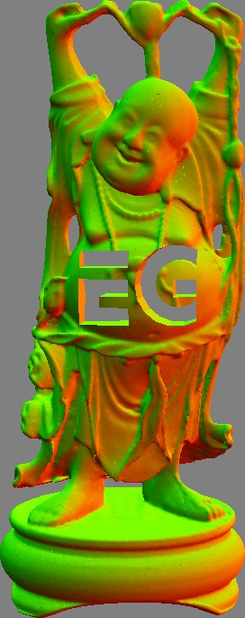
Thank You - Questions?
Source Code Available at: www.cs.uoi.gr/~fudos/sbuffer.html

Slide 19
Notes
# shared counters
GeForce 480 GTX
  35 multiprocessors
OpenCL prefix sum from NVIDIA SDK
  256 threads [16,16] ?
Notes:
The s-buffer depends on the number of global counters. I think this number depends on the GPU to get top performance, just like how to decide the number of thread/blocks in a CUDA program.

Slide 20
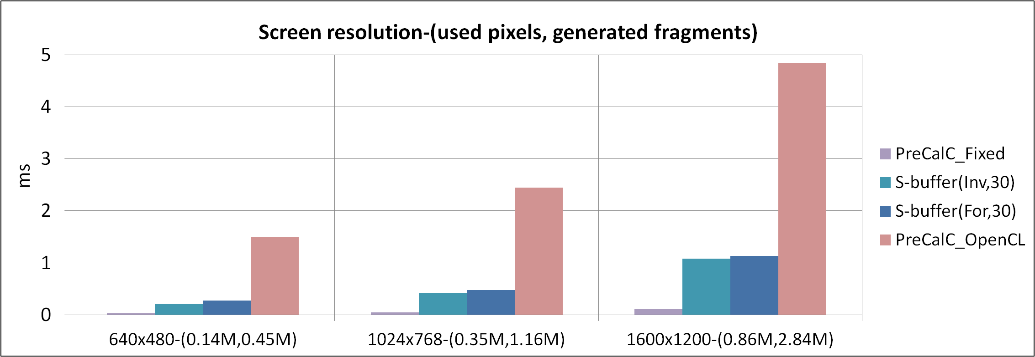
Results
Performance - Memory Referencing
  Inverse Mapping
  OpenGL/OpenCL interoperability
Notes:
We further provide a time comparison of the memory referencing step for the buffers that include this step.
S-buffer with 30 counters needs (0.215ms, 0.425ms, 1.08ms) to compute memory offsets which is ≈ 10× slower than the fastest PreCalc_Fixed (0.027ms,0.05ms,0.11ms).
Moving from inverse to forward mapping results at an extra 0.05ms cost for all resolutions which explains why inverse mapping boost is decreasing when moving to higher resolutions.
PreCalc_OpenCL takes (1.5ms,2.45ms,4.85ms) to compute the parallel prefix sum regardless of the pixel sparsity, which is 5× to 7× slower than our method.
Finally, fragment-aware Linked Lists exhibits the worst performance by taking
which is 20× slower than our method due to the heavy access to the gpu shared memory. (not included it this graph)

