Slide 1
Accelerating k⁺-buffer using efficient fragment culling
Andreas-Alexandros Vasilakis and Georgios Papaioannou
{abasilak,gepap}@aueb.gr
Department of Informatics,
Athens University of Economics and Business, Greece

Slide 2
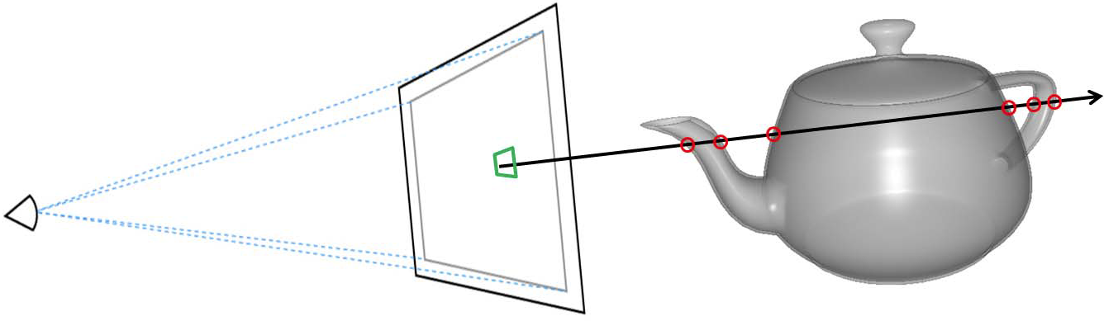
Multi-fragment Visibility Determination
A number of image-based applications require operations on more than one (maybe occluded) fragment per pixel:
Photorealistic Rendering
[global illumination]
[order-independent transparency]
[shadowing]
Visualization & Processing
[flow], [molecular], [hair], [solid] geometry

Slide 3
Prior Art
1. A-buffer methods
capture [all] fragments per pixel → [sort] them by depth
[memory overflow] & [fragment contention]

Slide 4
Prior Art
1. A-buffer methods
capture [all] fragments per pixel → [sort] them by depth
[memory overflow] & [fragment contention]
2. k-buffer methods
capture [k-closest] ones → [reduce] memory & sorting costs
prior solutions suffer from
[RMW hazards], [geometry pre-sorting], [k < 32]
[extra rendering pass], [depth precision conversion]
[unbounded memory]

Slide 5
Prior Art
1. A-buffer methods
capture [all] fragments per pixel → [sort] them by depth
[memory overflow] & [fragment contention]
2. k-buffer methods
capture [k-closest] ones → [reduce] memory & sorting costs
prior solutions suffer from
[RMW hazards], [geometry pre-sorting], [k < 32]
[extra rendering pass], [depth precision conversion]
[unbounded memory]
k⁺-buffer solution (I3D’14, Vasilakis & Fudos)
[overcomes] all previous limitations
[fragment culling] & [pixel synchronization]

Slide 6
Accelerating k⁺-buffer
k⁺-buffer’s fragment culling
Concurrently [discards] an incoming fragment that is farther from all currently maintained fragments (guided by the [max element]).
[Limitations]
Depends on the [fragment arrival order].
Requires k⁺-buffer to [be initially filled] before starts culling.
Fragment elimination is performed inside the [pixel shader].

Slide 7
Accelerating k⁺-buffer
k⁺-buffer’s fragment culling
Concurrently [discards] an incoming fragment that is farther from all currently maintained fragments (guided by the [max element]).
[Limitations]
Depends on the [fragment arrival order].
Requires k⁺-buffer to [be initially filled] before starts culling.
Fragment elimination is performed inside the [pixel shader].
Ideal fragment culling
Knowing the exact depth of the k-th fragment a priori allows us to insert all fragments with ≤ depth in constant time, discarding the rest (farther ones).

Slide 8
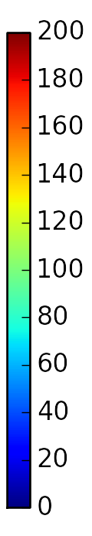
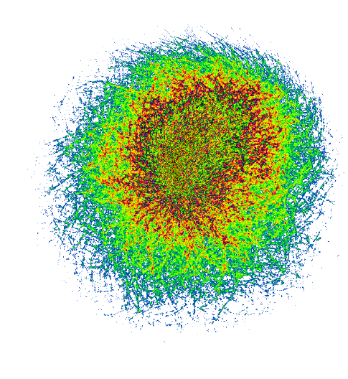
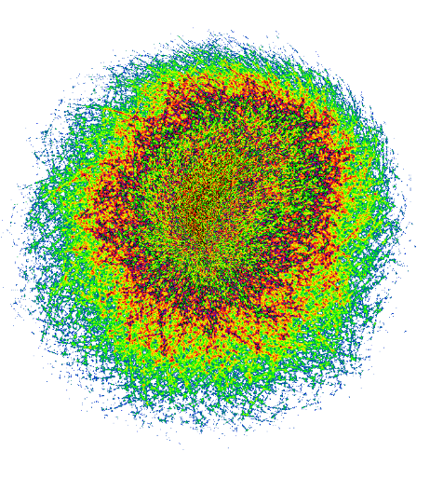
Accelerating k⁺-buffer
Our Idea:
Approximate this value via fragment occupancy maps !!!
k⁺-buffer culling
our culling
63.66%
98.28%
layers

