Slide 1
Pose-to-Pose Skinning of Animated Meshes
Skinning mesh animations
efficient compression, processing and reproducing
gpu-accelerated rendering
rest-pose editing and collision detection
skinning components from rest-pose
Pose-to-pose scheme
low entropy
temporal coherence
reduced error
rest-pose skinning reproduction scheme
Notes:
Hello,
My name is Andreas Vasilakis and I will present the research work that we have pursued jointly with George Antonopoulos and Ioannis Fudos on Pose-to-pose Skinning of Animated Meshes (8sec)
In computer animation, skinning techniques can be essential for efficient storage, processing and gpu-accelerated reproducing of animation sequences. Skinned animations can further support additional applications such as
rest pose editing and collision detection.
A number of control bone influences and transformations from the rest-pose–to each pose are extracted by employing least-squares data fitting .
We present a novel pose-to-pose approach to skinning animated meshes by observing that only small deformation variations will normally occur between sequential poses.
The transformations are applied so as a new pose is derived by transforming the vertices of the previous pose, thus maintaining temporal coherence and reducing error. Although fitting is performed from pose to pose, a reproduction scheme from the rest pose to an arbitrary pose can be produced efficiently.
(40sec)

Slide 2
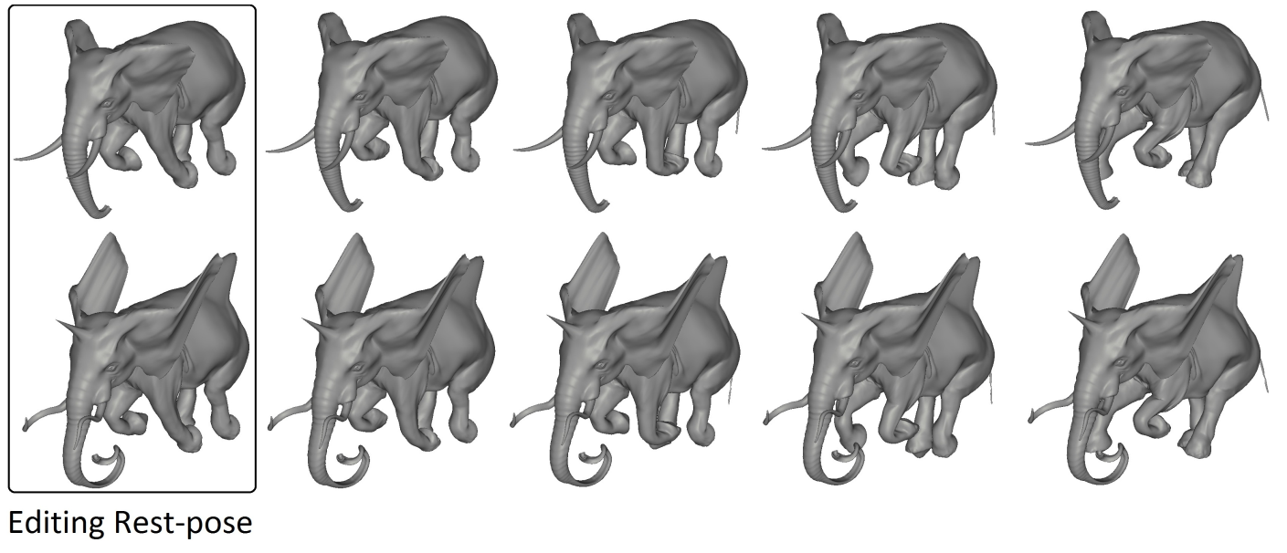
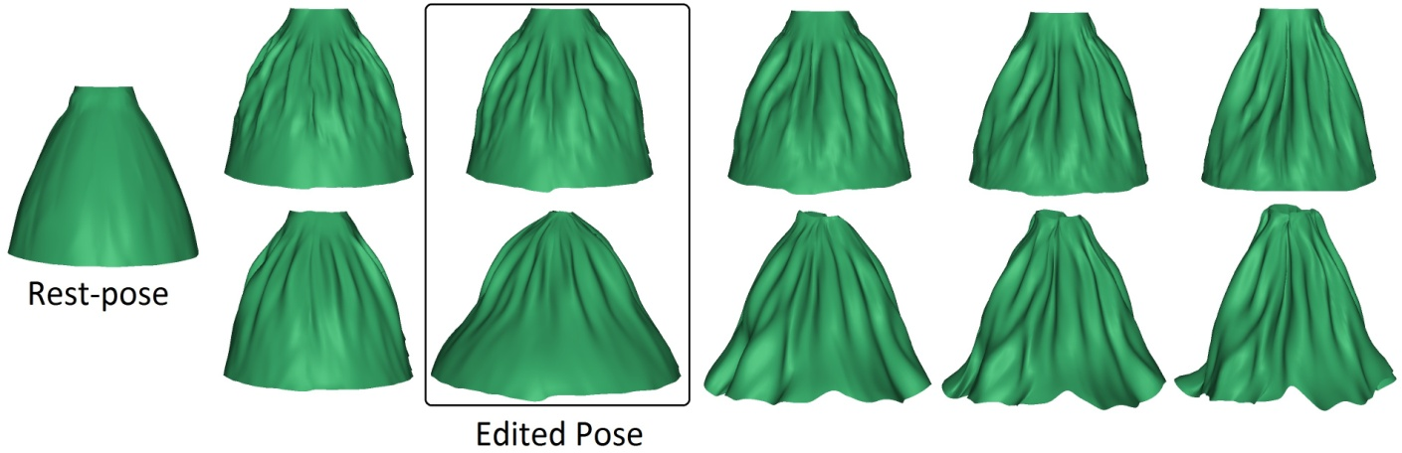
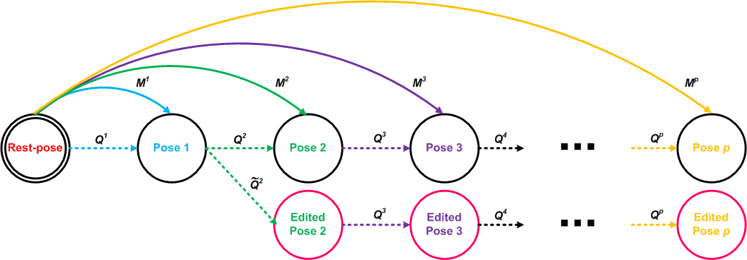
Pose-to-Pose Skinning of Animated Meshes
Rest-pose Editing
No need for displacement corrections
Pose Editing
Forward-propagated editing of arbitrary animation frames
Minimum extra cost
Notes:
Previous methods limit users to perform efficient editing on the original reference mesh due to rest-pose displacement corrections.
Our scheme enables modification-free geometry editing in the reference pose in conjunction with a novel pose editing of arbitrary animation frames, which can be smoothly propagated at the subsequent frames generating new deforming mesh sequences without altering the skinning representation.
(20sec)

