Slide 1
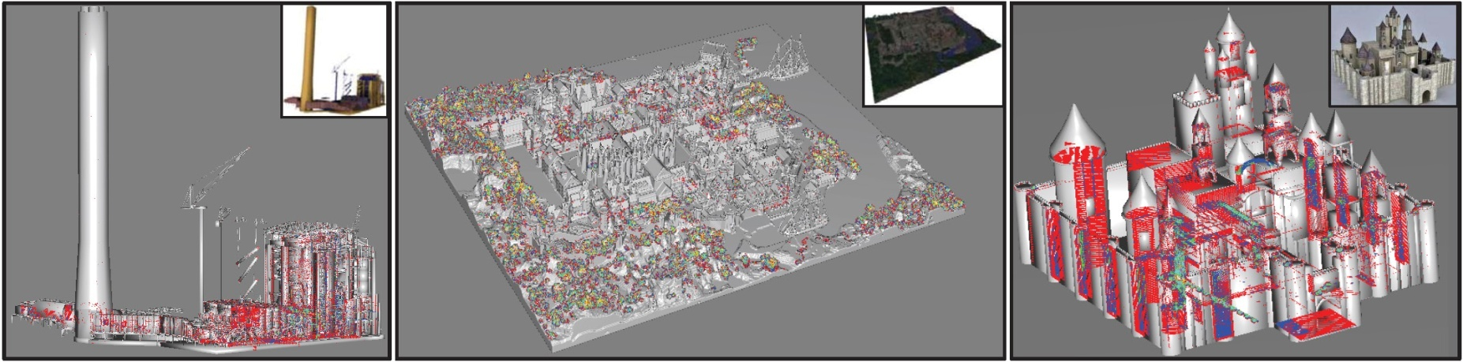
Depth-fighting aware Methods for Multifragment Rendering
Andreas A. Vasilakis and Ioannis Fudos
Department of Computer Science,
University of Ioannina, Greece
{abasilak,fudos}@cs.uoi.gr
Notes:
(35+) (35+)
Good morning, my name is Andreas Vasilakis. I am a PhD student at the University of Ioannina. This is joint work with my advisor Ioannis Fudos.
Several approaches have been introduced that process for each pixel one or more fragments per rendering pass, so as to produce a multifragment effect.
However, artifacts arise when two or more generated fragments have identical depth values.
In this work, we introduce several depth-fighting aware algorithms for reducing, eliminating and/or highlighting multifragment rendering flaws, in scenes suffering from coplanar geometry.

Slide 2
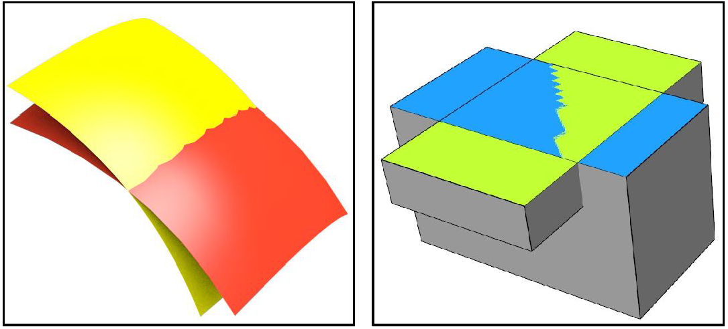
Depth-fighting Artifact
Z-fighting is a phenomenon in 3D rendering that occurs when two or more primitives have identical depth values in the Z-buffer:
  Intersecting surfaces
  Overlapping surfaces
Blender 2.5
Google SketchUp
Z-fighting cannot be totally avoided but may be reduced using:
  Higher depth buffer resolution
  Inverse mapping depth values
  Depth bias
But for coplanar polygons, the problem is inevitable !!!
Multifragment rasterization is even more susceptible to z-fighting
Notes:
(55+) (1:30+)
Z-fighting is a phenomenon in 3D rendering that occurs when two or more primitives have the same or similar values in the Z-buffer.
The overall effect is a flickering, noisy rasterization of two fragments "fighting“ in the z-buffer to color the screen pixels.
These figures illustrate unpleasant effects when rendering (left) intersecting or (right) overlapping surfaces on popular modeling programs.
Z-fighting cannot be totally avoided and may be reduced by using
1) higher depth buffer resolution
2) inverse mapping of depth values in the z-buffer
3) Or using depth bias
However for coplanar polygons, the problem is inevitable.
Multifragment capturing techniques are even more susceptible to Z-fighting,
because they need to examine all fragments (even those that are not visible).

Slide 3
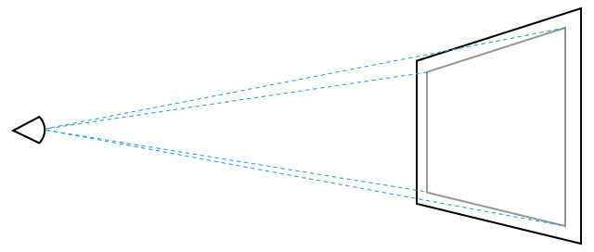
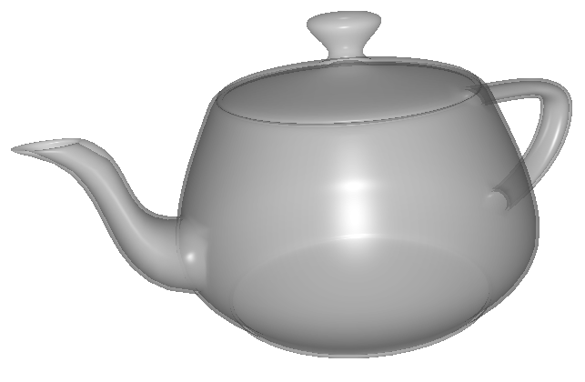
Why processing multiple fragments?
A number of image-based applications require operations on more than one (maybe occluded) fragment per pixel:
  transparency effects
  volume and csg rendering
  collision detection
  visualization
    self-trimming surfaces
    intersecting surfaces
  global illumination
  …
Fragment Extraction using Ray Casting:
Notes:
(25+) (1:55+)
A number of image-based applications (from visualization to content creation tools) require operations on multiple fragments to simulate complex rendering effects.
The global fragment information of a rasterized 3D scene is efficiently captured by finding the surface-intersections when ray casting from the eye through each screen pixel

Slide 4
Prior Art
Fragment Sorting Methods
  Depth Peeling
  Hardware-implemented buffers
Multi-Fragment Rendering Design Goals
  Quality: Fragment extraction accuracy (A)
  Time performance (P)
  Memory allocation (Ma) and caching (Mc)
  GPU capabilities - (G)
Notes:
(35+) (2:30+)
For these effects to be correctly rendered, fragments must be processed according to their distance from the camera using either Depth Peeling methods or Hardware-implemented buffers.
Before clarifying these categories, let’s see four key characteristics of a multifragment rendering architecture.
Should guarantee accurate fragment extraction, meaning that it should not miss to capture some fragments.
Must be fast
Precise allocation of memory and fast memory access are of outmost importance and
Finally, implementations must be portable to a wide range of hardware.

Slide 5
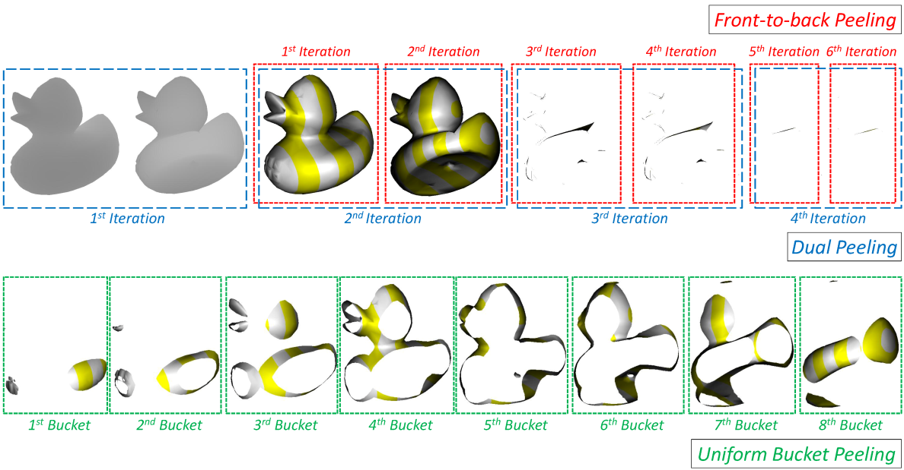
Prior Art: Depth Peeling Methods
Front-to-Back (F2B) [Everitt01]
Dual direction (DUAL) [Bavoil08]
Uniform bucket (BUN) [Liu09]
A: depth-fighting artifacts
P: slow due to multi-pass rendering
Ma: low/constant budget, Mc: fast
G: commodity and modern cards
Notes:
(60+) (3:30+)
Depth peeling methods extract layers of visibility from a graphics scene using multiple rendering passes.
1) Probably, the most well-known multipass depth peeling technique is front-to-back depth peeling, which works by peeling off a single fragment layer per pass.
2) Dual depth peeling speeds up rendering by capturing both the nearest and the furthest fragments in each pass.
3) Finally, Uniform bucket peeling performs DUAL depth peeling per uniformly divided depth intervals.
Despite of the low memory requirements, the rendering passes can be a bottleneck for scenes with high depth complexity.
Moreover, they cannot deal with fragments of equal depth, thus detecting only one of them and missing the others.

Slide 6
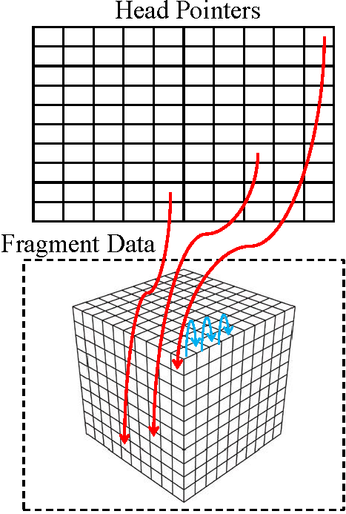
Prior Art: Buffer-based Methods (1)
Fixed-sized Arrays
  Ma: huge (most of them goes unused)
  Mc: very fast
  G: - Commodity:
    K-buffer (KB) [Bavoil07]
    Stencil-routed A-buffer (SRAB) [Myers07]
  A: 8 fragments per pixel
  P: fast (possible multi-pass)
    - Modern:
    FreePipe (FAB) [Liu10, Crassin11]
  A: 100% if enough memory
  P: fastest (single pass)
Notes:
(1:10+) (4:25+)
In general, Buffer-based methods use a buffer to store fragments while they are generated followed by a post-sorting process that correctly reorders fragments by depth.
K-buffer and SRAB were the first gpu-accelerated structures able to capture up to 8 fragments per pixel in a single rendering pass. If there were more than 8 fragments per pixel, overflow occurs and additional rendering passes are needed.
In terms of performance, both methods are up to 8 times faster than F2B peeling but much slower than single pass FreePipe.
FreePipe was the first attempt to perform the entire rasterization process capturing all fragments per pixel based on fixed-size arrays in CUDA.
To avoid users switch from traditional hardware pipeline to a software rasterizer, an opengl version of FreePipe was implemented
The major limitation for this class of methods is the requirement for potentially large memory requirements due to the allocation of the same number of entries per pixel, regardless of whether or not the pixel contains any fragments..

Slide 7
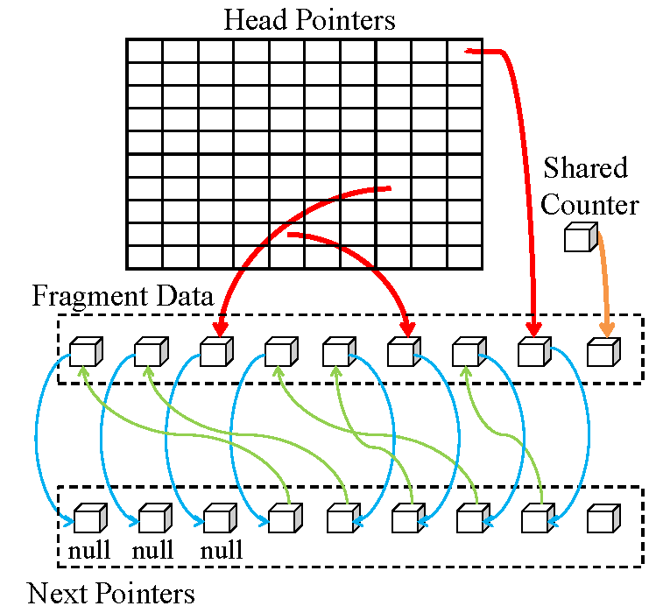
Prior Art: Buffer-based Methods (2)
Per-pixel Linked Lists (LL) [Yang10]
  A: 100% if enough memory
  P: fast (fragment contention)
  Ma: high
    if overflow: accurate reallocation (extra pass needed)
    else: wasted memory
  Mc: low cache hit ratio
  G: only modern cards
Notes:
(25+) (4:50+)
To alleviate high memory consumption, dynamic creation of gpu-accelerated linked lists per pixel were recently proposed which aim at avoiding allocation for pixel that are not covered.
However, performance bottlenecks arise due to the heavy access on the gpu shared memory.
The random memory accesses of linked lists when operating on stored fragments also degrade performance.

Slide 8
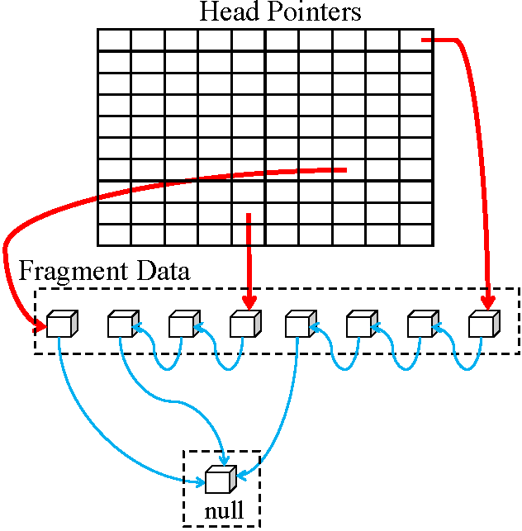
Prior Art: Buffer-based Methods (3)
  Variable-length Arrays
  A: 100% if enough memory
  P: fast (2 passes needed)
  Ma: precise
  Mc: fast
  G:
    Commodity:
    PreCalc [Peeper08]
    L-buffer [Lipowski10]
    Modern:
    S-buffer (SB)[Vasilakis12]
    Dynamic fragment buffer (DFB) [Maule12]
Notes:
(25+) (5:15+) – (6:00+)
To avoid memory and performance limitations of previous structures, we can organize storage into variable contiguous regions for each pixel, packing pixel fragments physically close in the memory.
However, the need of an additional rendering pass performed for counting the needed memory space results in a performance downgrade when compared to Freepipe

Slide 9
Correcting Raster-based Pipelines
Adapting depth peeling methods based on
  Primitive identifiers
  Buffer-based solutions
MSAA - Tessellation - Instancing
Robustness ratio = captured/generated fragments
  Robust
    Low Memory - Slow
  Approximate
    High Memory - Efficient
Notes:
(60+) (6:15+)
We have investigated two approaches to treat fragment coplanarity in image space that can be applied to several depth peeling methods.
First, we introduce an additional term to the depth comparison operator using primitive identifiers.
Second, we present an efficient pipeline that can capture multiple coplanar fragments per depth layer by exploiting the advantages of buffer-based techniques.
Both approaches can be successfully integrated into the standard graphics pipeline and can take advantage of features such as multisample antialising, GPU tessellation and geometry instancing.
We classify our algorithms based on the Robustness ratio (i.e., the total number of extracted fragments over the total number of generated fragments).
Robust algorithms succeed to capture all fragment information of a scene regardless of the coplanarity complexity. On the other hand, approximate algorithms are not guaranteed to extract all fragments.
The main advantage of the latter is the superiority of the performance over the robust methods at the expense of higher memory space requirements.

Slide 10
Robust Algorithms (1)
Extending F2B, DUAL (F2B-2P, DUAL-2P)
  Base methods extract only one coplanar fragment
  Extracts 2 fragments/iteration – Constant memory
  Neat idea: Extra accumulation rendering pass
    Primitive ID (OpenGl: gl_PrimitiveID, DirectX: SV_PrimitiveID)
    Store min/max IDs of the remaining non-peeled fragments:
    Subsequent pass:
      Extract fragment information using captured IDs
      Move or not to next depth layer (fragment coplanarity counter)
Extending F2B (F2B-3P)
  Additional pass: (ATI: Pre-Z pass, NVIDIA: Lay Down Depth First)
  Better performance – Same memory resources
Notes:
(2:00+) (8:15+)
The F2B algorithm starts by rendering the scene normally with a depth test, which returns the closest per-pixel fragment to the observer.
In a second pass, the the next nearest layer is returned by discarding the previously extracted fragments based on the depth value extracted during the last iteration. Unfortunately, fragments with depth identical to the depth layer detected in the previous iteration are not captured and thus not considered in the underlying application.
We introduce F2B-2P, a robust coplanarity aware method by adapting the F2B algorithm so as to peel all fragments located at the current depth before moving to the next depth layer. This method extracts a maximum of two coplanar fragments per iteration, implemented with a constant video-memory budget. The core methodology can similarly be applied to the DUAL depth peeling.
The basic idea of this technique is to use an extra rendering pass to count per pixel the (non-peeled) coplanar fragments at a specific depth layer. We use an autogenerated primitive identifier that is unique per primitive geometric element
and is inherited downward to fragments produced by this primitive.
To decide, at iteration i, which fragments among the remaining coplanar ones to extract, we store the minimum and maximum identifiers of these fragments. This strategy guarantees that all coplanar fragments will be extracted.
Finally, a subsequent rendering pass extracts the fragment information of the corresponding identifier and decides whether the next depth layer underneath should be processed by accessing the counter information. If the counter is larger than 2, we have to keep peeling at the current layer since there is at least one more fragment to be peeled.
Moreover, we introduce the F2B-3P technique, a F2B-2P variant which follows the Pre-Z general rendering technique. The idea is to carry out the first rendering pass of F2B-2P in two passes.
An efficient double-speed depth rendering pass is performed to compute the (next) closest depth layer. Then, by exploiting early-Z culling, we perform the fragment counting and primitive identifier queries.
This modified version uses the same video memory resources and performs slightly better than its predecessor in some cases despite the cost of the extra rendering pass.

Slide 11
Robust Algorithms (2)
Combining F2B, DUAL with LL (F2B-LL, DUAL-LL)
  Handle fragment coplanarity of arbitrary length per pixel
Rendering workflow (2 passes/depth layer)
  Double speed depth pass
  Fragment linked lists at the current depth layer
Linked lists limitations
  Performance bottlenecks
  Only modern hardware
Notes:
(60+) (9:15+)
To reduce the rendering workload, we handle fragment coplanarity of arbitrary length per pixel in one iteration using linked-list structures.
A double speed depth pass is carried out to compute the (next) closest depth layer followed by a construction of per-pixel linked lists of the fragments located at the captured depth.
However, both methods inherit the performance bottlenecks of linked lists despite the reduced fragment thread set created per depth layer.
Finally, the necessity of linked lists—available only in the state-of-the-art graphics hardware and APIs—makes it non-portable to other platforms such as mobile, game consoles, and so on.

Slide 12
Robust Algorithms (3)
Limited performance of previous extensions (multipass)
Linked Lists bottlenecks at
  Storing process: # generated fragments
  Sorting process: # per-pixel fragments
Combing Uniform Buckets with Linked Lists (BUN-LL)
  Single-pass nature
  Uniformly split of the depth range
    Maximum : 5 consecutive subintervals
  Assign a linked list to each subdivision
Notes:
(50+) (10:05+)
Despite the accurate depth-fighting feature of the previous introduces extensions, their performance is rather limited when the depth complexity is high due to their strategy to perform multiple iterations.
Furthermore, LL may exhibit some serious performance bottlenecks when
1) the total number of generated fragments (storing process) or
2) the number of per-pixel fragments (sorting process) increases significantly.
To alleviate the above limitations, we propose a single-pass coplanarity-aware
depth peeling architecture combining the features of BUN and LL.
In this variation, we uniformly split the depth range of each scene and assign each subdivision to one bucket. Then, we concurrently (in parallel) store all fragment information in each bucket using linked lists. Due to the current shader restrictions, we can divide the depth range into five uniformly consecutive subintervals.

Slide 13
Approximate Algorithms
Combine F2B-DUAL methods with fixed-size arrays
  Modern : FreePipe :(F2B-FAB, DUAL-FAB)
    Bounded-length vectors per pixel
    Precise fragment accuracy if
      max {coplanar fragments/depth layer}
      No memory overflow
  Commodity: K-buffer (F2B-KB, DUAL-KB)
    Max of 8 coplanar fragments/layer
    Data Packing: 32 coplanar fragments/layer
    No sorting needed: RMW hazard-free
    SRAB: no support of MSAA, stencil operat., data packing
Notes:
(1:15+) (11:20+)
To partially treat fragment coplanarity, we adapt the previously described core methodology of linked list extensions by exploiting the fixed-size array architectures for efficient storage.
These extensions can perform precisely, if we know the maximum number of coplanar fragments at a depth layer and that allocation do not result in a memory overflow.
To support efficiently this approach in commodity hardware, we may employ a KB framework in place of FAB. While KB is restricted by MRT to peel a maximum of eight fragments, data packing may be used to increase the output by a factor of 4.
This method is not suffering from RMW hazards since there is no need for sorting coplanar fragments.
SRAB is a promising option but in this context it is ruled out because it cannot support MSAA, stencil and data packing operations.

Slide 14
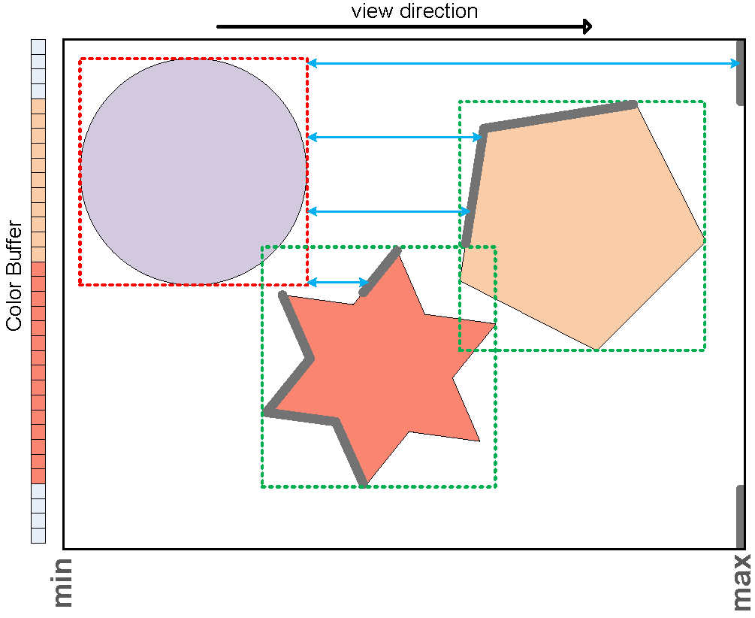
Optimizing multi-pass rendering of multiple objects
Occlusion culling mechanism
  Geometry is not rendered when is hidden by objects closer to the camera
Avoid rendering completely-peeled objects
  Goal: Rendering load reduction of the following passes
  If object’s bounding box is behind current depth layer then cull
  Hardware occlusion queries
  Reuse query results from
  previous iterations
Depth Buffer: Thick gray line strips
Notes:
(50+) (12:10+)
In this section, we propose a performance optimization when multipass rendering is performed on multiple objects.
Inspired by the occlusion culling mechanism (where geometry is not rendered when it is hidden by objects closer to the camera), we propose to avoid rendering objects that are completely peeled from previous iterations
aiming to reduce the rendering load of the following passes.
We discard an object when its bounding box ends up entirely behind the current depth buffer. This is easily realized in the gpu using hardware occlusion queries. (for example see the sphere object at the figure)
Finally, we reuse the results of the occlusion queries from previous passes based on the observation that objects that are culled during a specific iteration will be always culled in the successive ones.

Slide 15
Results
Experimental analysis under different testing scenarios:
  Performance
  Robustness
  Memory requirements
  Portability
    FAB/LL-based extensions cannot be used in older hardware
OpenGL 4.2 API
NVIDIA GTX 480 (1.5 GB memory)
Notes:
(30+) (12:40+)
We present an experimental analysis of our extensions focusing on performance, robustness, and memory requirements under different testing scenarios.
Methods that exploit the FAB or the LL structures cannot be used in older hardware, web/mobile applications, consoles.
All methods are implemented using OpenGL 4.2 API and performed on an NVIDIA GTX 480 graphics card with 1.5 GB memory.

Slide 16
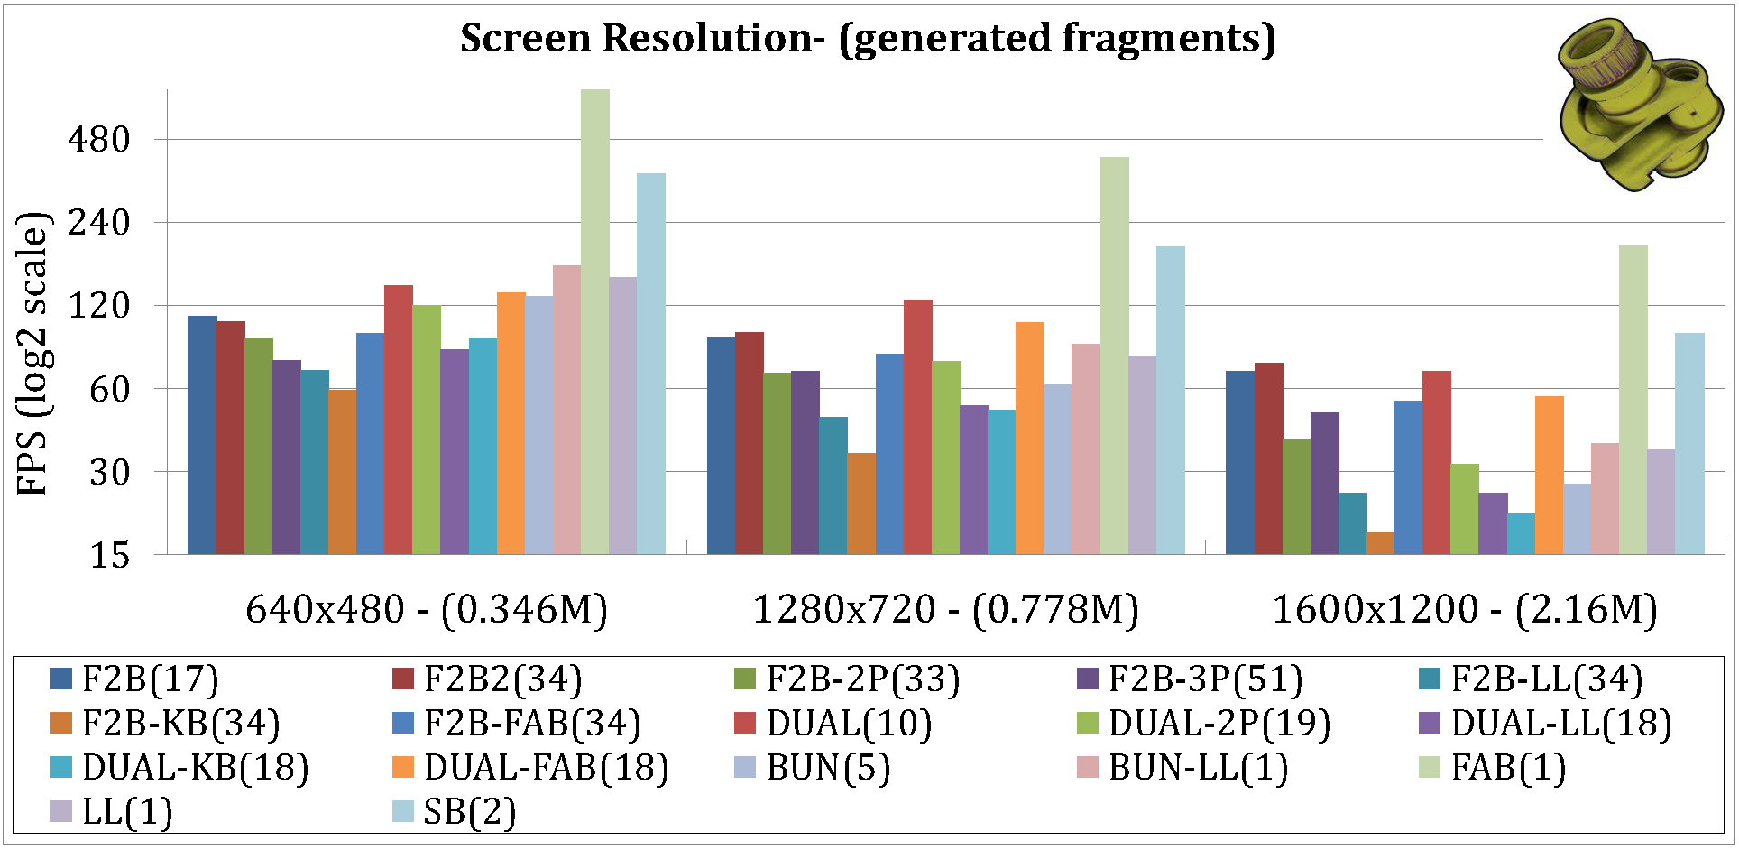
Results – Performance Analysis (1)
Impact of Screen Resolution
  Crank (10K triangles, 17 depth layers, no coplanarity)
(rendering passes)
Notes:
(60+) (13:40+)
This Figure shows how the performance scales when rendering a z-fighting free crank model which consists of 17 depth layers.
Fixed-size Array buffers (FAB,SB) are highly efficient in this scenario due to the low rate of used pixels that require heavy fragment post-sorting.
On the other hand, rendering bottlenecks appear in all LL-based methods when the resolution is increased due to higher fragment serialization.
Our FAB-based extensions exhibit slightly worse performance than their base methods (10 percent in average) despite of the extra rendering passes.
A change on the behavior of F2B-2P extensions as compared to the F2B-3P when moving from low-to-high screen dimensions is observed. GPU optimizations becomes meritorious when image size is increasing rapidly.

Slide 17
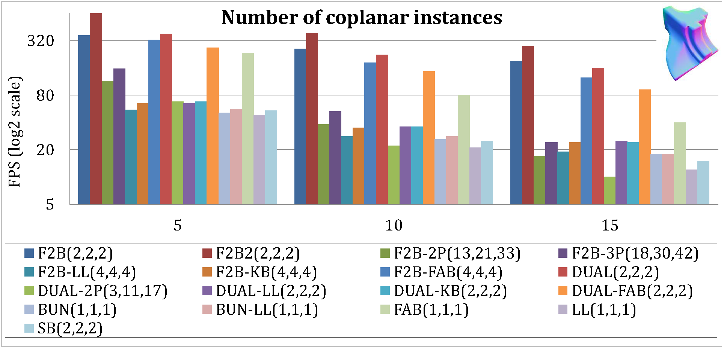
Results – Performance Analysis (2)
Impact of Coplanarity
  Fandisk (2K triangles, 2 depth layers, fragments/layer=#instances)
(rendering passes)
Notes:
(60+) (14:40+)
This Figure illustrates how the performance scales when rendering overlapping instanced objects.
1) Our FAB extensions exhibit improved performance as compared to single-pass ones despite of they have to carry out extra rasterizations (fragment postsorting results in a rendering stall when the number of coplanarity is increasing rapidly).
2) Similarly, we observe that F2B-3P outperforms F2B-2P and DUAL-2P, enhanced by the full potential of GPU optimizations. Similar behavior is observed for F2B-FAB as compared to its corresponding dual variation.
3) Conversely, DUAL-LL performs better than F2B-LL alleviating the increased fragment contention at high instancing.
4) Finally, BUN-LL is slightly superior than LL and SB, but is not suitable for scenes with non-uniform depth distribution.

Slide 18
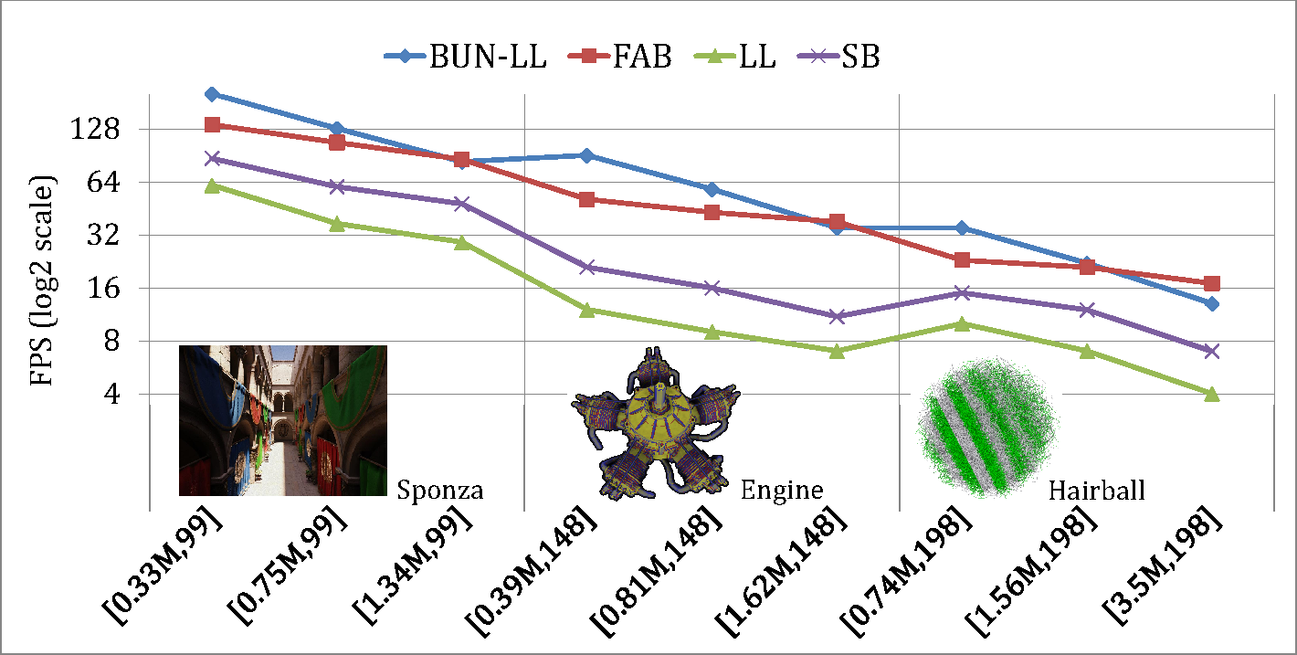
Results – Performance Analysis (3)
Impact of High Depth Complexity
  Sponza (279K) – Engine (203K) – Hairball (2.85M) triangles
[# generated fragments, depth complexity]
Notes:
(40+) (15:20+)
This Figure illustrates performance comparison of the single-pass peeling solutions when rendering three uniformly distributed scenes that consist of high depth complexity.
1) We observe the superiority of our BUN-LL due to the reduced demands for per-pixel post-sorting of the captured fragments.
2) However, when the total generated fragments are rapidly increased, fragment contention in the BUN-LL storing process results at a performance downgrade as compared with FAB.

Slide 19
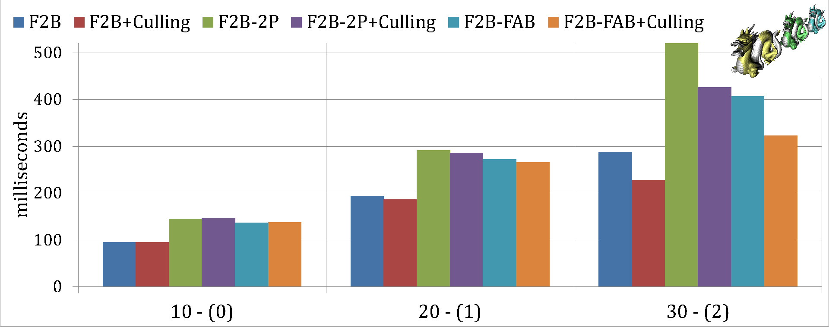
Results – Performance Analysis (4)
Impact of Geometry Culling
  Dragon (870K triangles, 10 depth layers)
The lower, the better
peeling iterations – (completely peeled models)
Notes:
(50+) (16:10+)
This Figure illustrates how the performance scales when our geometry culling mechanism is exploited under a set of increasing peeling iterations.
Three representative multi-pass peeling methods were tested.
Similar behavior is observed for the rest variations.
The scene consists of three non-overlapping, aligned at Z-axis, dragon models.
The scene is rendered from a viewport that the third dragon is occluded by the second one, which is similarly hidden by the first.
We observe that all testing methods are exponentially enhanced by the use of our geometry culling process when the number of completely peeled objects is increasing.
Note that when we have not completely peeled any instance, the additional cost of our culling process slightly affects the overall performance (0.01 percent).

Slide 20
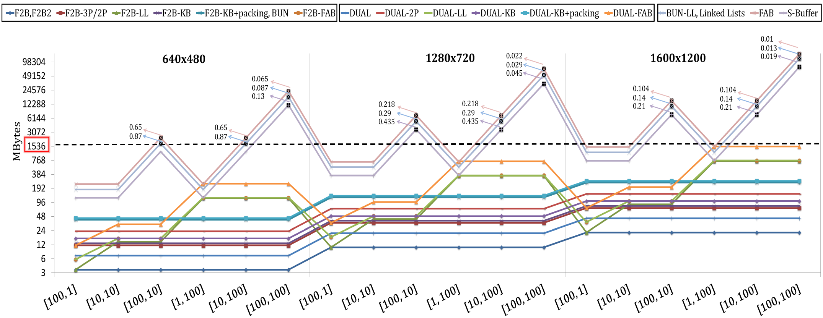
Results – Memory Allocation Analysis
Impact of Number of Generated Fragments
Robustness ratio ?
[depth complexity, fragment coplanarity]
Notes:
(1:10+) (17:20+)
This Figure illustrates evaluation in terms of memory consumption for a scene with varying number of generated fragments defined by the combination of screen resolution, depth complexity, and fragment coplanarity.
An interesting observation is the high GPU memory requirements of FAB due to its strategy to allocate the same memory per pixel.
The rest buffer-based methods require less storage resources by dynamically allocating storage only for fragments that are actually there. However, it will lead at a serious overflow as the number of the generated fragments to be stored increases rapidly.
Conversely, our variants does not consume more than the maximum storage of the testing graphics card (dashed line).
Robustness is closely related to memory allocation for these methods.
To avoid memory overflow, we have to allocate less storage than we actually need leading at a significant fragment information loss. Note the low robustness ratio of all buffer-based solutions, illustrated by black markers, due to the memory overflow.

Slide 21

And the Oscar goes to…
Performance (Modern Hardware)
  Low Memory: Winner(FAB)
  Medium Memory:
    Low depth complexity: Winner(SB)
    High depth complexity: Winner(BUN-LL)
  High Memory:
    Low coplanarity: Winner(F2B-FAB, DUAL-FAB)
    High coplanarity: Winner(F2B-LL, DUAL-LL)
Performance (Older Hardware)
    Low coplanarity: Winner(F2B-3P, DUAL-2P)
    High coplanarity: Winner(F2B-KB, DUAL-KB)
Performance (F2B VS DUAL)
Notes:
(1:10+) (18:20+)
FAB has the best performance in conjunction with robust peeling but comes with the burden of extremely large memory requirements.
SB alleviates most of the wasteful storage resources running at high speeds, but cannot avoid the unbounded space requirement drawback.
BUN-LL outperforms both methods when rendering uniformly distributed scenes that consist of high depth complexity
When accuracy and memory are of utmost importance, FAB extensions are shown to offer a significant speed up over LL variations with satisfactory approximate results.
When modern hardware is not available, multipass peeling with primitive identifiers is the best option.
KB variations might be used to approximate scenes with high coplanarity in the entire depth range.
Finally, it is preferred to use F2B extensions for handling scenes with low detail under high resolutions. On the other hand, dual extensions performs better when rendering highly tessellated scenes at low screen dimensions.

Slide 22
Conclusions
Approximate and exact approaches
GPU optimizations
Features – Limitations
Extensive comparative results
Future Work
  Tiled Rendering
  Hybrid Technique
Notes:
(60+) (19:20+)
Approximate and exact extensions to the conventional single and multi-pass rendering methods have been introduced accounting for coplanar fragments.
We described features and tradeoffs for each technique, pointing out GPU optimizations, portability, and limitations that can be used to guide the decision of which method to use in a given setting.
We have also included extensive comparative results with respect to algorithm complexity, memory usage, performance, and robustness.
Further directions may be explored for tackling the problem of coplanarity in rasterization architectures.
To reduce bandwidth demand of the rendering operations and increase locality of memory accesses, tiled rendering may be exploited.
Finally, a hybrid technique is an interesting option that should be investigated further. To this end, one may seek a modified form of peeling which efficiently captures a sequence of layers when coplanarity is not presented followed by on demand peeling of overlapping fragments.

Slide 23
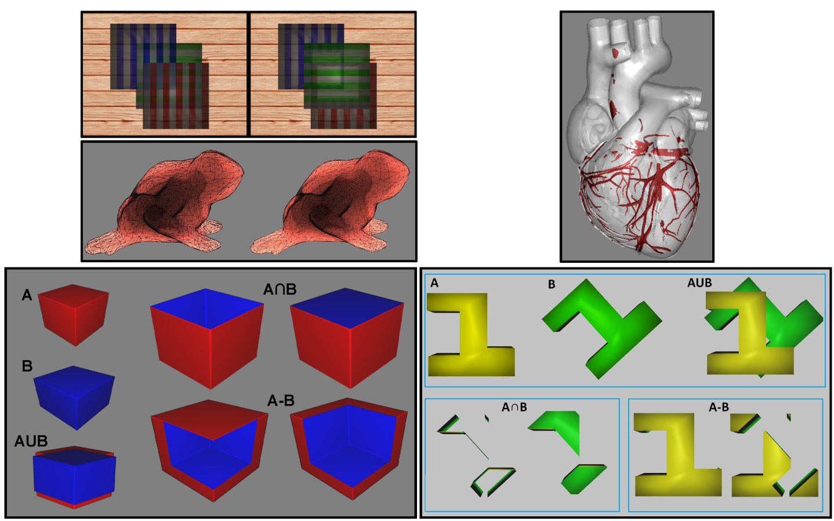
Thank you! - Questions ?
Self-collided coplanar areas are visualized with red color
Order independent transparency on three partially overlapping cubes
Correct
Incorrect
Wireframe rendering of a translucent frog
CSG
operations
CSG
operations
Incorrect
Correct
Incorrect
Correct
Incorrect
Correct
Source Code Available at: http://www.cs.uoi.gr/~fudos/coplanarity.html
Notes:
Illustrating the image superiority of our extensions over the base methods in several depth-sensitive applications.
(top) Order independent transparency on three partially overlapping cubes with and without Z-fighting - Self-collided coplanar areas are visualized with red color
(bottom) wireframe rendering of a translucent frog model with and without Z-fighting.
(bottom-2) CSG operations rendering without and with coplanarity corrections.

Slide 24
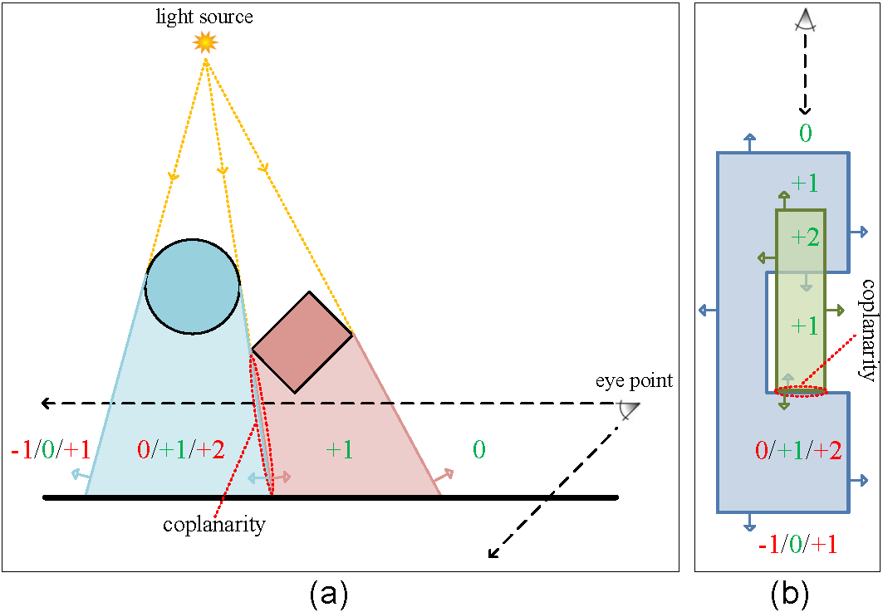
Extra Notes
Notes:
Illustrating the values of the popular winding number when ray casting for in/out classifications.
Red-painted values highlight erroneous computations (in cases where only one of the two coplanar fragments is successfully captured).

