Slide 1

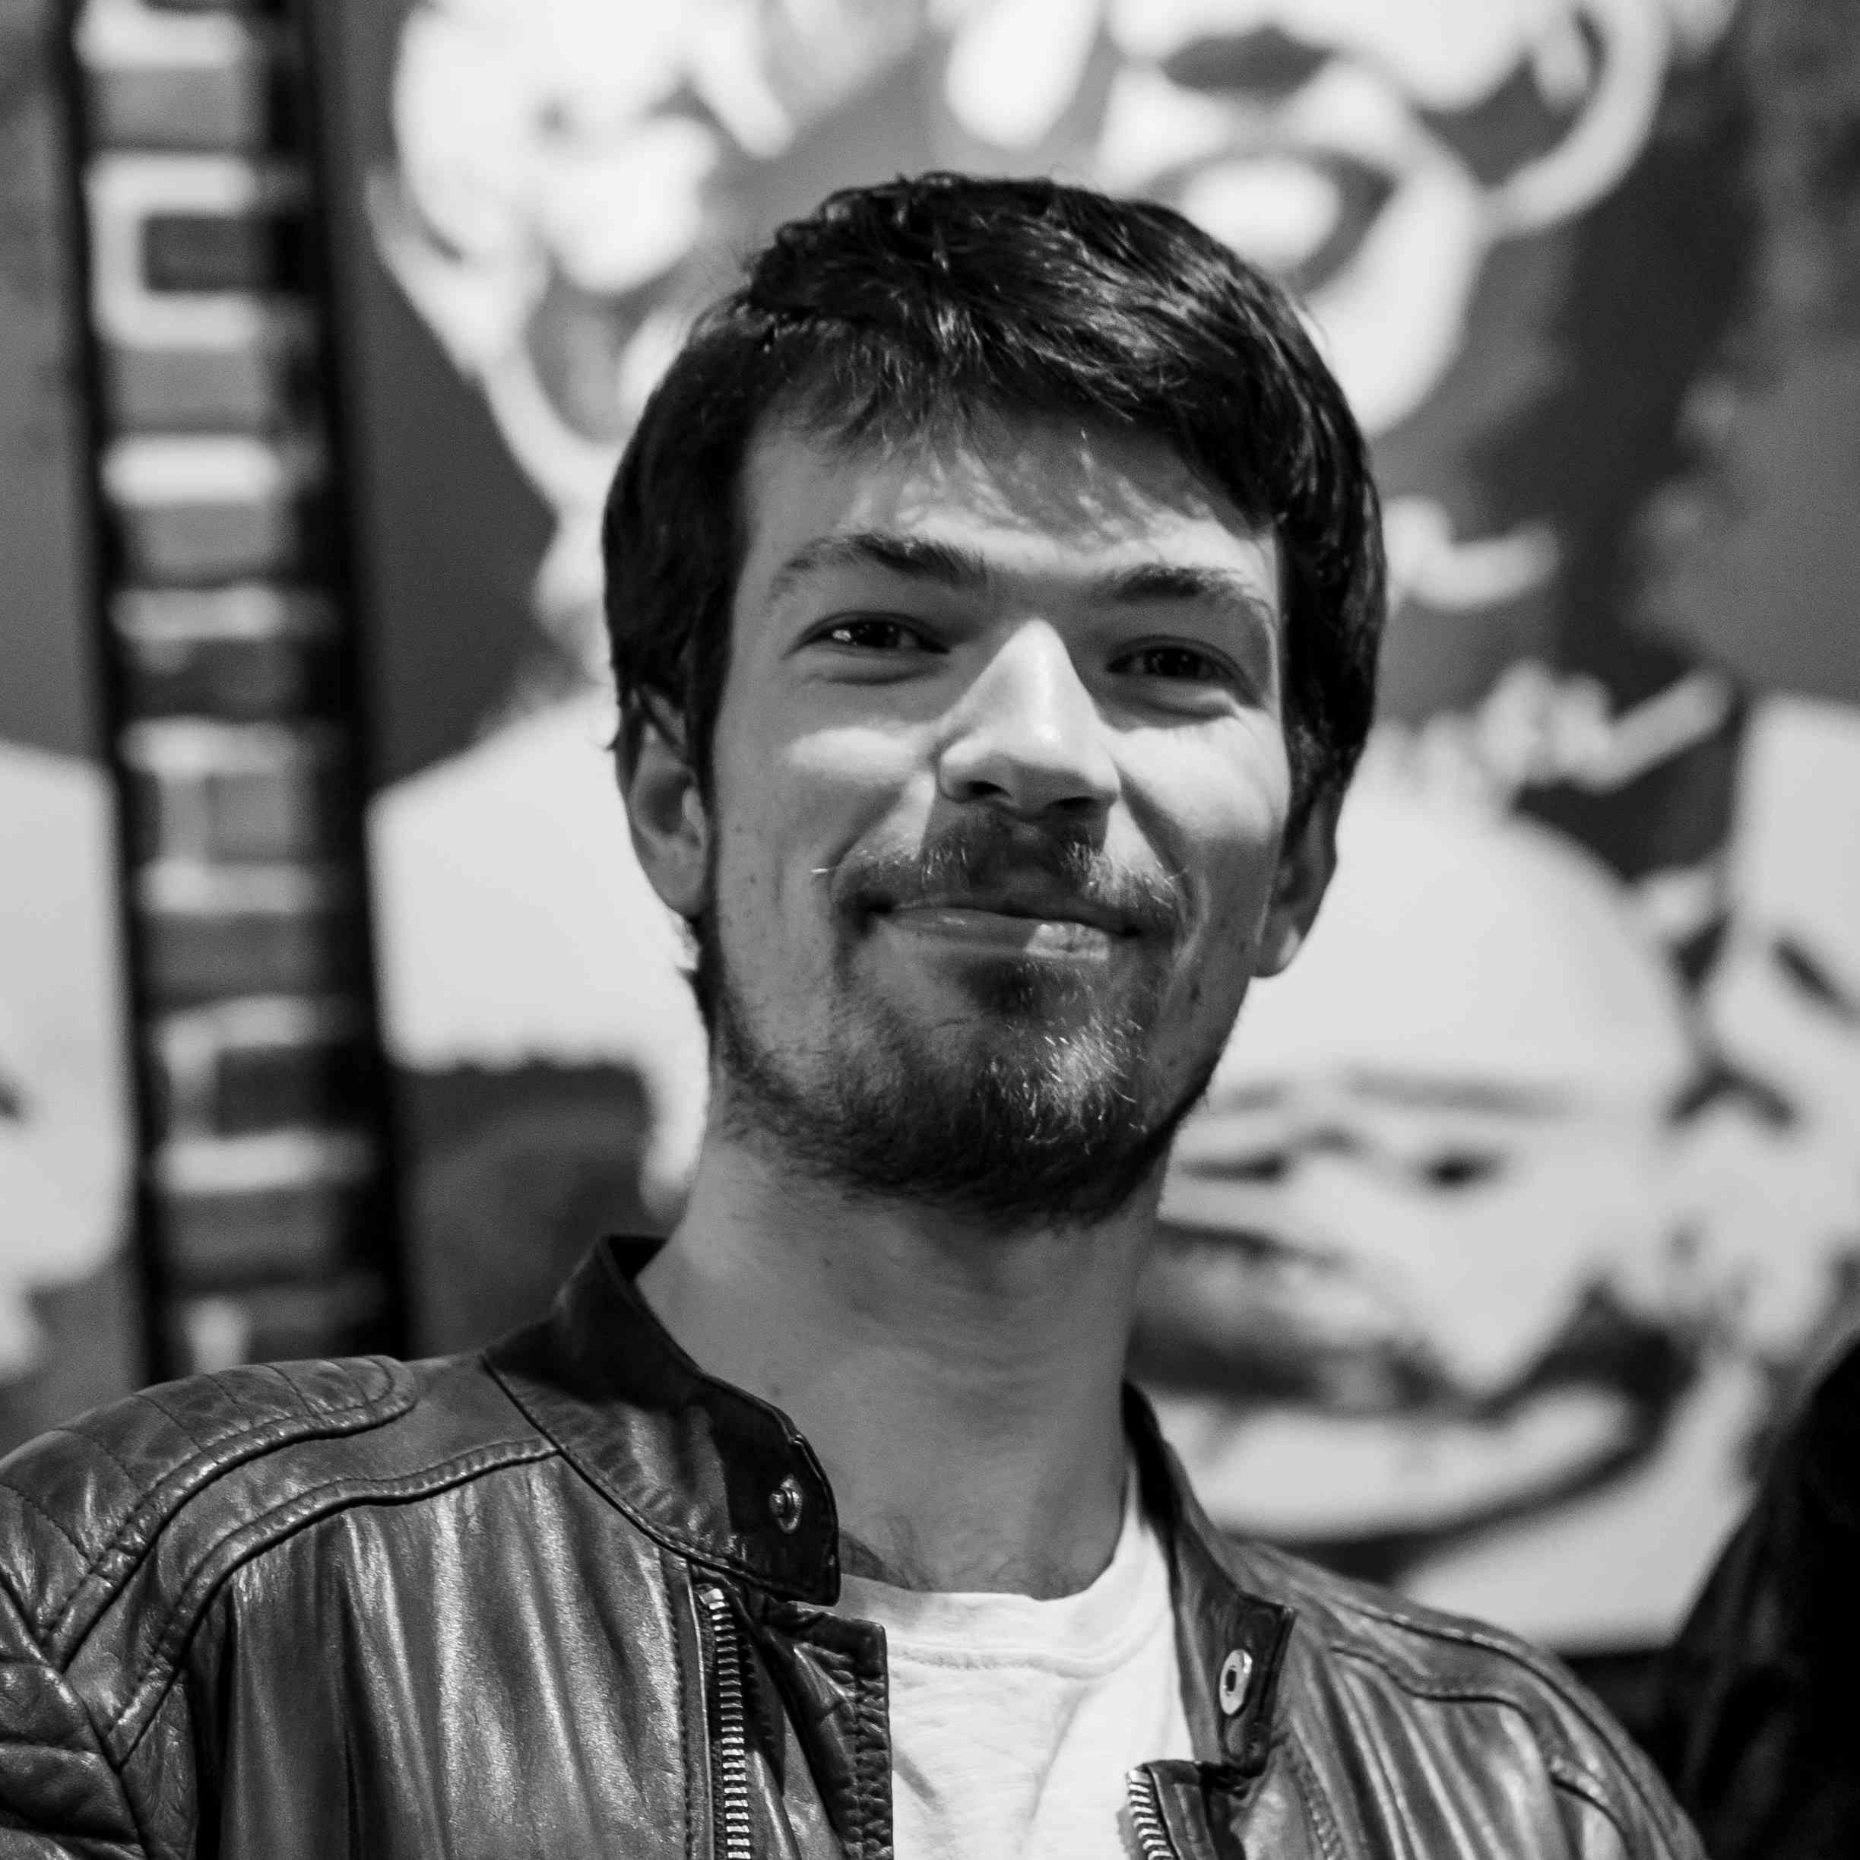



Antonin Bavoil

