Slide 1
Backoffice
PF and ESI Consultant
Developed & Design By
… ARVIND BAWANKAR

Slide 2
Introduction
Are you PF and ESI consultant ?
Are you struggling with manual calculation of number of company to calculate PF and ESI contribution of your client employee ?
Are you struggling billing in the GST ara ?
We are here to help you to introduce a very simple, user friendly web application
One spot to manage all your client.

Slide 3
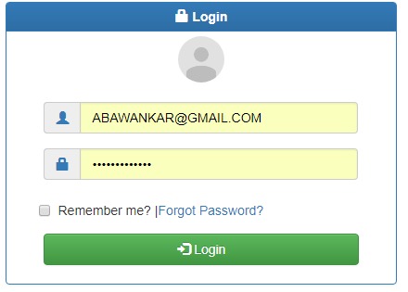
Login Screen

Slide 4
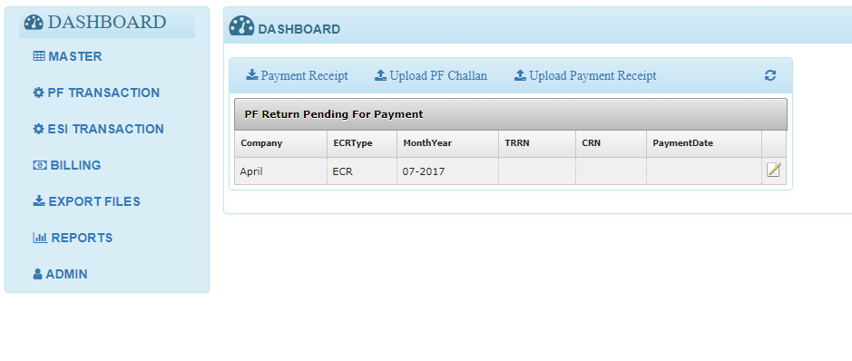
Dashboard

Slide 5
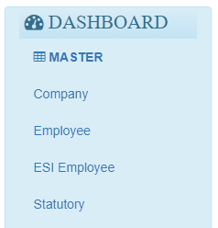
Master
Add you client company
View Company employee and Edit info
View ESI Employee
Set Statutory code for PF contribution

Slide 6
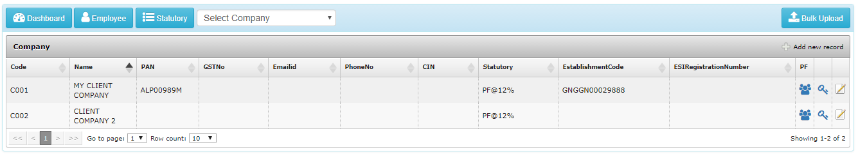
Company
Bulk upload Company
Dashboard
Employee List
Statutory Code
Company Filtration
View all Employee
Digital Signatory

Slide 7
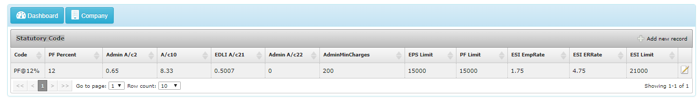
Statutory Code
Set the statutory code,

Slide 8
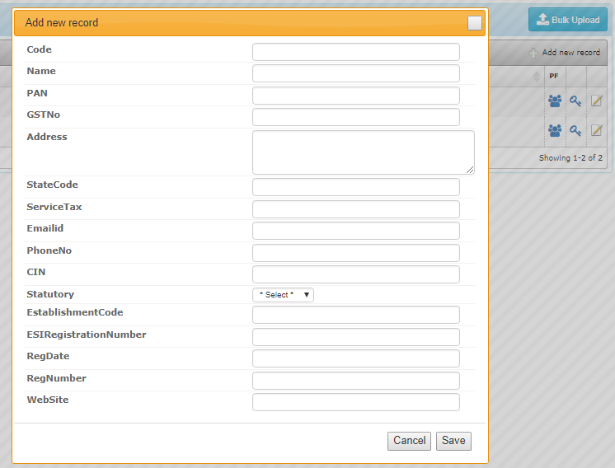
New Company
Add new company
Select statutory code eg. 12% or
10% contribution,

Slide 9
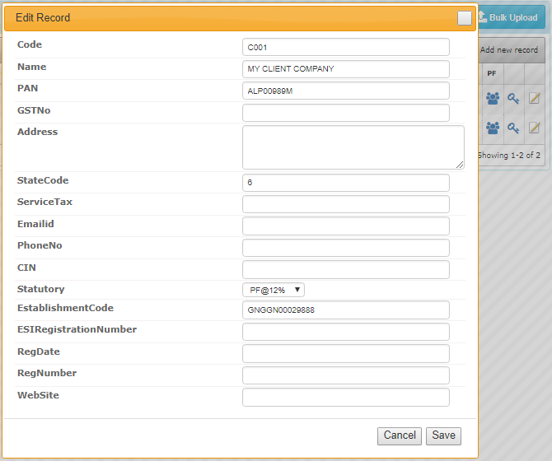
Update Company Info
Update existing company
Info, if you want any changes

Slide 10
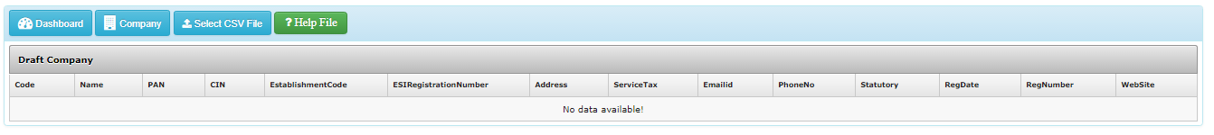
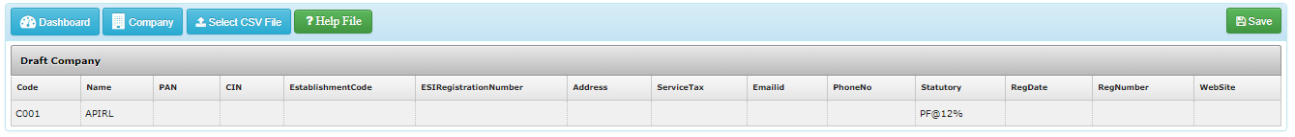
Bulk Upload Company
Select created CSV FIle
Download Help file in excel, fill the info, save in CSV format
After selecting CSV file record will display and Save Button Visible

Slide 11
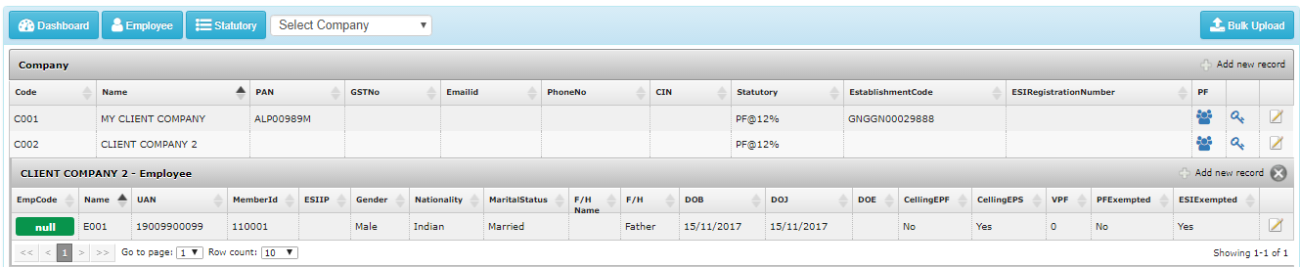
View Employee
See all employee by one click

Slide 12
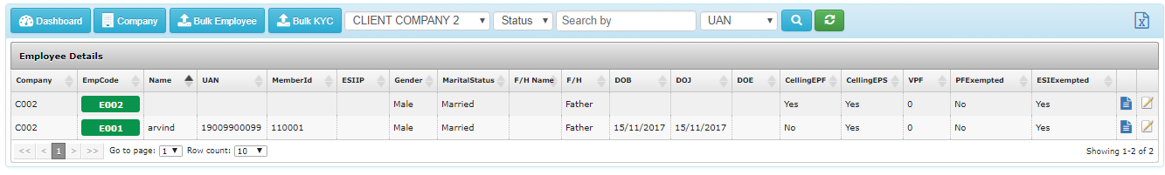
Employee Details
Select company to view
All employee details
Can search any employee
By selecting fields
Export To excel
Upload bulk employee
Upload Bulk
KYC
Update KYC details

Slide 13
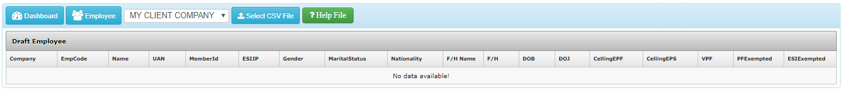
Upload Bulk Employee: Step 1
Select Company, where you want
to upload employee
Download format file
Fill the details,
Save as CSV format
Select CSV file

Slide 14
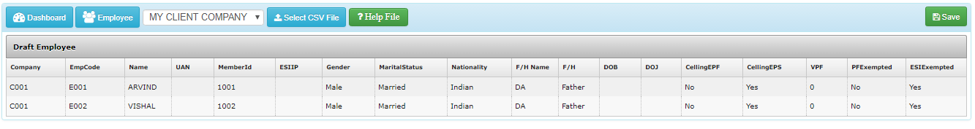
Upload Bulk Employee : Step 2
Save button Visible
Check the record and process
Details will be display as a Draft

Slide 15
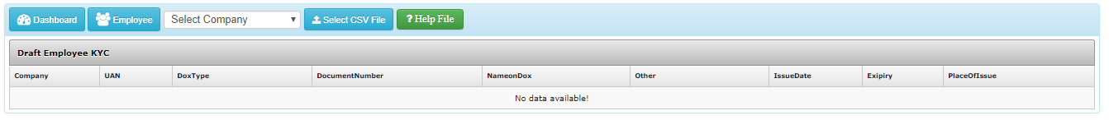
Update Bulk KYC of Employee

Slide 16
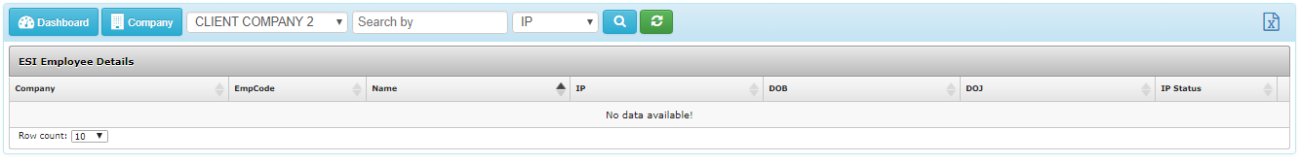
ESI Employee
Employee, which is under ESI, will be display here
When you upload employee, there is option for ESI exempted or not, mark all ESI employee as ESI employee

Slide 17
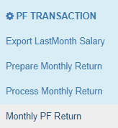
PF Transaction
Get Last month salary, details
Draft monthly pf details
Process the drafted details
View all processes challan

Slide 18

Export Last Month Salary
Export button will display
Click and details will be saved in
Excel file
By clicking here,
All option will display
So no need to go back to dashboard
For further process
Select company
Select month,
This facility will help you to reduce the file creation process, make the changes in updated data

Slide 19
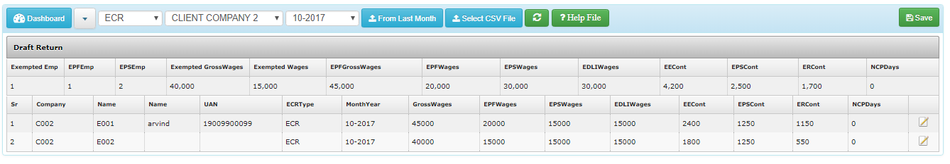
Prepare Monthly PF Return: Step 2
You have option to edit value,
If you want to update any data
Record will be display
You can see summary as well as
Full details
Click on Save Button
Return will be drafted

Slide 20
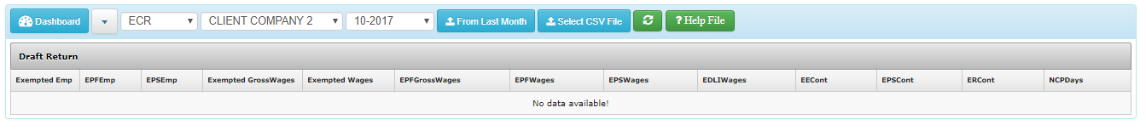
Prepare Monthly PF Return: Step 1
Select return month
Select Company
Download help file
And prepare data, save as in csv
Select ECR type
If salary details is save
As per previous month
Get data by clicking From Last Month
Select CSV file for upload

Slide 21
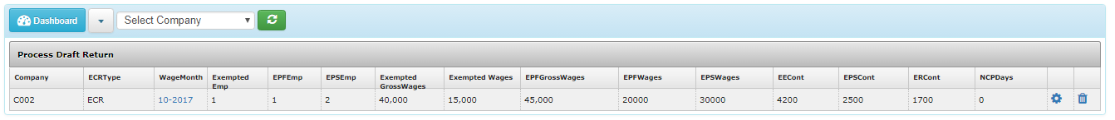
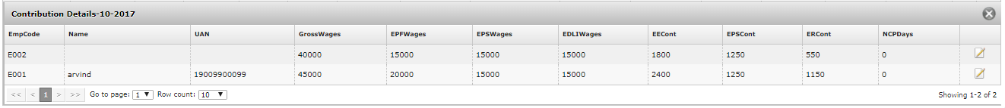
Process Draft Return
After checking all info
And sure you can process.
Otherwise you can delete.
Once process can not be edited
Or deleted
Once you prepare monthly return, record will be ready to process.
All drafted return will display in this optin
You can see the contribution details
By clicking here
You can edit, any info from here also

Slide 22
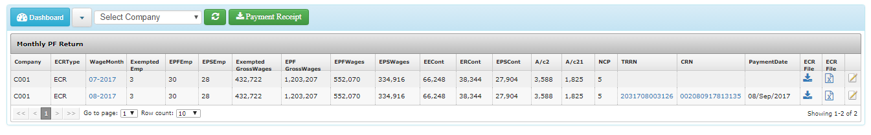
Monthly PF return
All process return will be display here
Excel file for member wise
Contribution details.
Download ECR file in txt format
To upload in EPF website
View contribution details
Update TRRN number and CRN number
And payment date

Slide 23
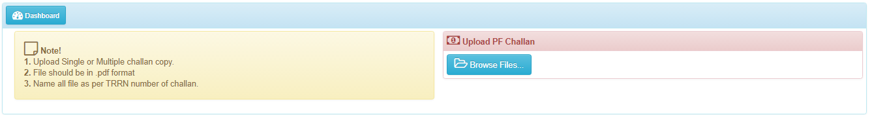
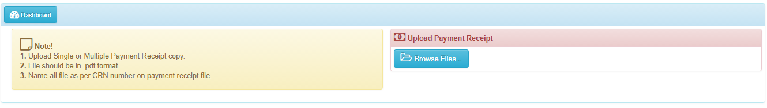
Upload PF challan & Payment Copy
Name the challan file and payment receipt file by TRRN number and CRN number
Here you can upload bulk file, Same can be view in monthly return

Slide 24
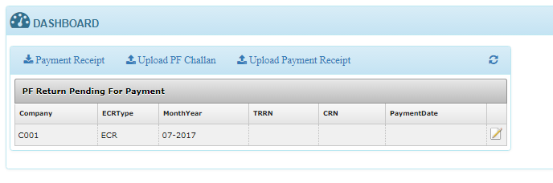
Update Payment Status
All processes return will be display in dashboard, once the payment date and TRRN and CRN details
Update, record will be removed from dashboard. Only pending payment will be display here

Slide 25

ESI Transaction
Process ESI return
View already process return

Slide 26
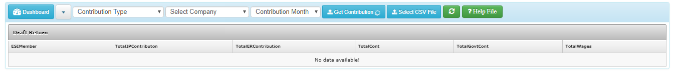
File Monthly ESI Contribution : Step1
If PF for the selected company already process, then click on
Get contribution, details will be fetched for all ESI member.
No need to prepare any file
Select necessary details
If you have company only has ESI employee
Download format file, fill the details, save as CSV
Select CSV file and process

Slide 27
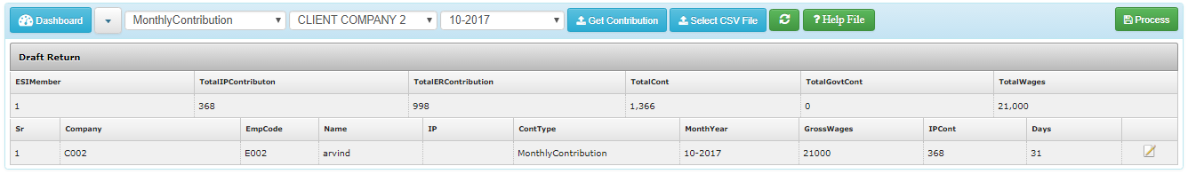
File Monthly ESI Contribution : Step2
Once data is uploaded or fetch from PF return, record will display, check the record, need any update
Update the record and process same

Slide 28
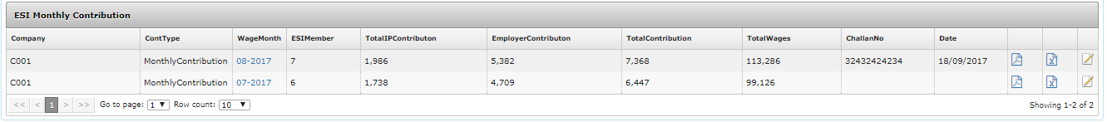
View ESI Monthly Contribution
Download Excel file to upload in ESI site
PDF file for monthly contribution details

Slide 29
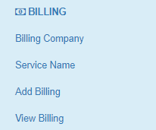
Billing
Set billing company
Set Service name offered to company
Create new billing
View all billing

Slide 30
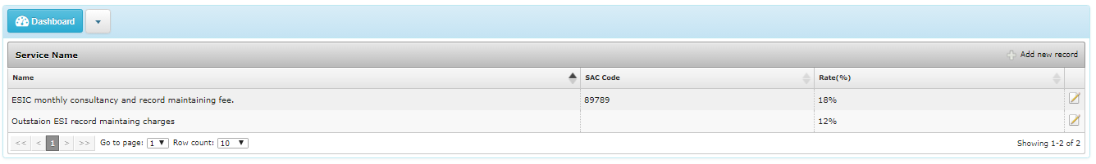
Service Name
Add services you offered to client, need to mentioned SAC code and applicable GST rate

Slide 31
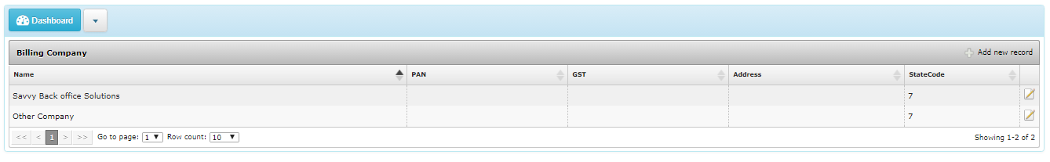
Billing Company
Have option to set multiple billing company, State code to set GST category like invoice
Will covered CGST / SGST or IGST

Slide 32
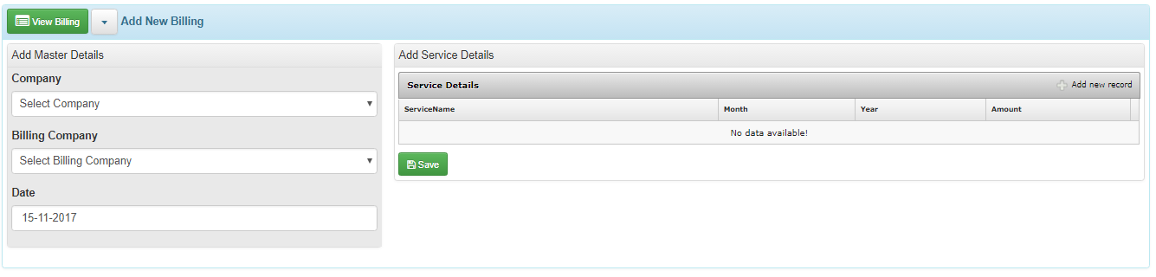
Add New Billing
Company from you want to bill
Company to Bill
Add services you offered to bill
Save

Slide 33
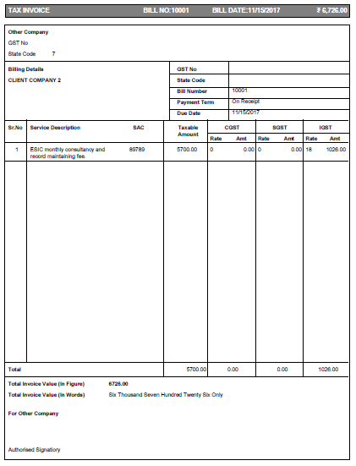
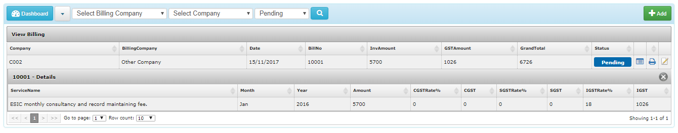
View / Print /Status

Slide 34
Billing Format

Slide 35
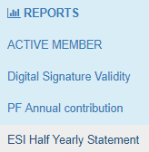
Report

Slide 36
Thank You
Developed & Design By
… ARVIND BAWANKAR

