Slide 1

AL-FARABI KAZAKH NATIONAL UNIVERSITY
Fudan University Science and Technology Innovation Competition — 2026
TITLE
Team leader:
Team members:
Instructing teacher:

Slide 2

Goal
Research Objectives and Challenges
The semantic aspects of the language have not been developed at the fundamental level
Kazakh language belongs to the low-resource languages
The interaction between the level of perception and analysis should be developed from scratch.
Data collection, storage and processing is a very time-consuming process

Slide 3
(Objectives)

Slide 4


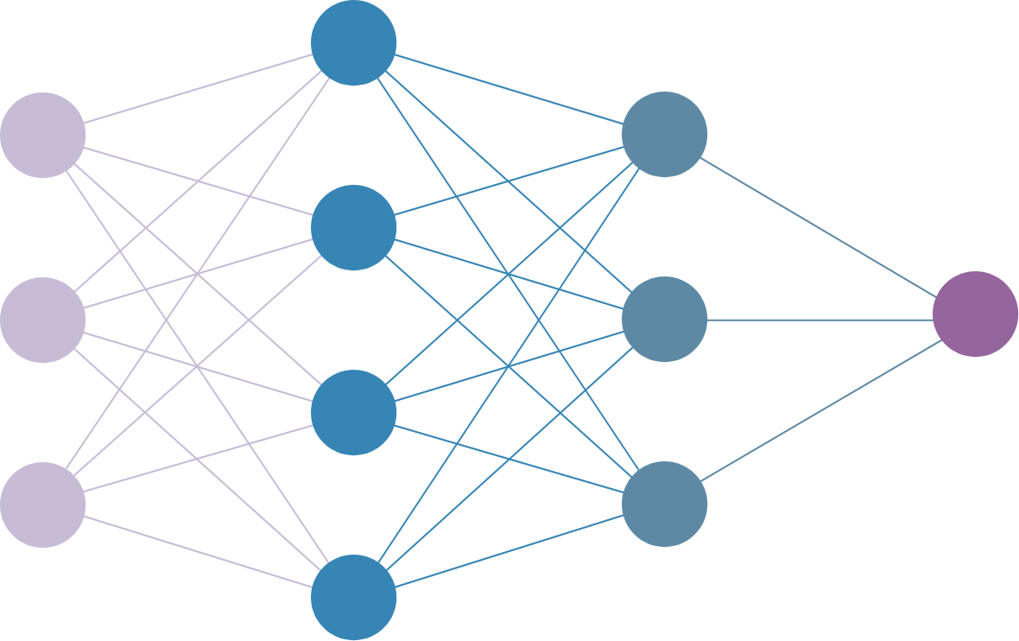



Functional architecture
International Joint Project "Building
of the Kazakh Speech Recognition System", 2019-2022
Beijing PERCENT Technology Group Co., Ltd.
Budget: 11,000 $ USD
audio
audio
response:
audio/text
transcription
text request
Speech2text
response
configuration
Updating / obtaining
knowledge
Knowlage
Developer
Notes:
And for clarity, I will demonstrate where this module will be integrated.

Slide 5
Today it is relevant:
Call analytics and operator assistance
Search for media content
Human-robot interface
Multimedia subtitles (with a ASR system)
Notes:
Using a tool like Transcribe Call Analytics allows you to quickly extract useful information from conversations with customers, which improves customer interaction and increases agent productivity.
Transcribe service also allows you to record meetings and conversations using the digital recording function, increasing productivity, availability and optimizing important notes.
speech recognition provides information about people's accents and vocabulary by interpreting age, location, and other important demographic data.
Speech is the most natural way to communicate with a person. If the interaction of people and machines is carried out through voice, then this becomes a modern trend.

Slide 6
Methodology
Language Model
Generating a knowledge base for an autonomous robot
Research and standardization of the semantic model from the point of view of linguistics.
chat robot based on semantics and ASR modules
Data Collection
Evaluation
A tool for automating data collection that provides pre-tagged data.
Precision
Recall
F-score
Loss

Slide 7
What have we done
OR
The current state of the Project

Slide 8
A semantic model of the Kazakh language (V-1.0).
<BLANK> O
Position
Agent
Object
Doer
Location
Target
Recipient
Experiencer
Condition
Cause|Reason
Means
Result
Time
Predicate
+
B - is the prefix to the first word.
I - is the prefix of the middle word.
E - is the prefix to the last word.
S - If the tag consists of only one word.
O - in the absence of meaning.

Slide 9
Патенты/сертификаты/акты внедрения / публикации (СПИСОК )

Slide 10
Conclusion
The resulting data is based on understanding the meaning of a sentence; accordingly, the model can be widely used in other areas as well. In particular, it can be widely used in linguistics, data sorting, creating artificial assistants, extracting the main idea from text and in business models.
The results show that our model is competitive. Moreover, evaluations show that this model is capable of identifying complex labels, such as words appearing within a named object and names of different objects with a small training dataset

