Slide 1

Create a resume website in the browser using github.dev and GitHub Pages
https://aka.ms/workshoplibrary-resume
Presented by:
Notes:
Want to make your application stand out to recruiters, and learn a few new skills in the process? This workshop will walk you through how to code a resume website, and the best part is that you don't have to download any coding tools or languages to get started.
Using the power of github.dev and GitHub Pages, we'll code a resume website together, completely in your browser window. By the end of the workshop, you'll be able to send anyone a link where they can view your resume online.

Slide 2

Abayomi Abiodun
A microbiology undergraduate, working as a Data Analysis/Science Tutor at Ijan africa, he’s a microsoft learn student ambassador at Microsoft, he’s also a Data Science/ML Team Lead at Google Developer Student Club OAU, he’s also a core member of DSN - Data Scientists Network/Data Science Nigeria where he has facilitated different ML/AI classes.

Slide 3
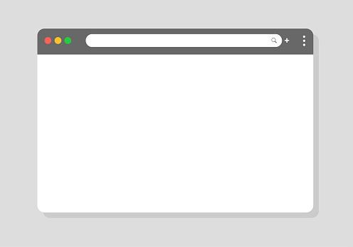
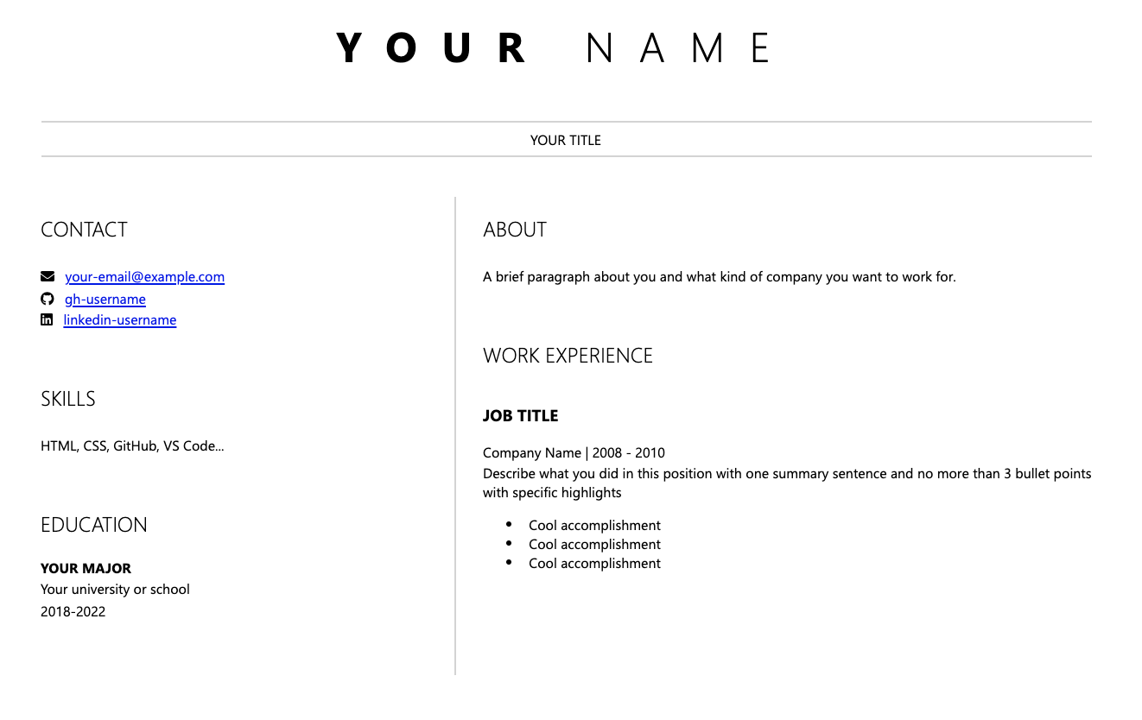
Notes:
Imagine you want to create a resume to post publicly. You decided to create a webpage, which can be widely shared. It's a great way to control how your information will be displayed.
Webpages are most commonly created with a combination of three languages - Hypertext Markup Language (HTML), Cascading Stylesheets (CSS), and JavaScript. These languages might exist all in one file, or be separated across multiple files. There are numerous frameworks which exist to aid in creation of webpages, but at their core they all generate HTML, CSS and JavaScript.
HTML is used to describe the information to be shared on the page by using markup. Markup marks certain portions of text as having a particular significance on a page, such as a header or a table.
CSS is used to add style to the page, including color, font selection, and page layout - where the information should be displayed on the page.
Finally, JavaScript is used to add interactivity on a page. You can add controls such as buttons or textboxes to a page; JavaScript can add functionality so the page updates when a user taps on a button.
In this workshop, we’ll focus on HTML and CSS as the building blocks for our resume webpage.

Slide 4
Setting up your coding environment
github.com
1. Create a new repository
2. Press “.”
3. Write code in the browser!
Notes:
As you might expect, the first step to getting started with any new technology is setting up a couple of tools. While it is possible to create HTML and CSS with any text editor, using a code editor will offer features to make your life easier. To create your resume website, you'll need to download a modern Browser, like Microsoft Edge or Google Chrome. You'll also need a GitHub account. We'll be using github.dev, a free, online code editor, for this workshop. If you've ever used Visual Studio Code, this code editor may look familar to you. One of the awesome things about using github.dev is that we'll be coding directly in the browser.
Let’s start by creating a new repository for this project on GitHub, and then opening it in github.dev. Create a new public repository named resume, making sure to select Public and initialize the repository with a README. Press the period key on your keyboard to open the repository in github.dev. This will set up a VS Code environment in your browser.

Slide 5
github.dev/your-username/resume
1. Install CodeSwing
Notes:
Once you have your repository open in github.dev, you can install CodeSwing. CodeSwing is an extension which helps you create HTML, CSS and JavaScript and see updates in real time.
Open the Extensions toolbar by selecting the Extensions icon from the Activity Bar on the left-hand side of your window.
In the Search Extensions text box in the upper-right corner, type CodeSwing
Select Install for CodeSwing
The extension will be installed.
Let’s start by creating a new repository for this project on GitHub, and then opening it in github.dev. Create a new public repository named resume, making sure to select Public and initialize the repository with a README. Press the period key on your keyboard to open the repository in github.dev. This will set up a VS Code environment in your browser.

Slide 6
github.dev/your-username/resume
1. Install CodeSwing
2. Turn on AutoSave
Notes:
One of the best productivity features in github.dev and Visual Studio Code is AutoSave. AutoSave automatically saves changes to your files, so you don't have to worry about losing any of your work. To turn on AutoSave, select the three parallel lines icon on the left-hand side of your github.dev window in the Activity Bar. Go to File > AutoSave. Your AutoSave is turned on if there is a check mark next to the AutoSave menu item.

Slide 7
Getting started with HTML
html
head
body
link
title
header
main
h1
article
article
Notes:
HTML stands for Hypertext Markup Language, and is used to "markup" the text to be displayed on a webpage. It describes the hierarchy and function of the text on a page. With HTML, you can indicate a header, create a link to another page, or indicate where an image should be placed.
HTML consists of "tags" or "elements". While there is a technical difference between the two, you will find many developers use the terms interchangeably and generally doesn't impact how you create your code. These tags are read by a browser and are used to determine how to display and interpret the information in a page.
Every HTML page includes three main tags - html which contains all the HTML, head which includes information about the page, and body which contains the contents to display on the page. Tags can also contain attributes, which allow us to change how a tag behaves. We're going to use these three tags (and a couple of others) to begin the creation of our resume. We'll explain the tags we're using after we create the page.
We’ll get started creating our resume by creating an HTML file and adding the code. You may notice the page looks pretty basic, but we will make it look better when we add our CSS.

Slide 8
Creating an HTML page
github.dev/your-username/resume
1. Open the Command Palette
2. Select CodeSwing: Initialize Workspace as Swing…
3. Choose Basic: HTML-Only
Notes:
Open the Command Palette by selecting the three parallel lines icon in the left-hand side Activity Bar, then navigating to View > Command Palette. You can also quickly open the Command Palette by using the keyboard shortcut Control+Shift+P on a PC, or Command+Shift+P on a Mac.
Type CodeSwing, select CodeSwing: Initialize Workspace as Swing...
Choose the option for Basic: HTML-Only and your new swing will appear, with your HTML file on the left, and a browser window on the right.
This will create an index.html file in your root directory.

Slide 9
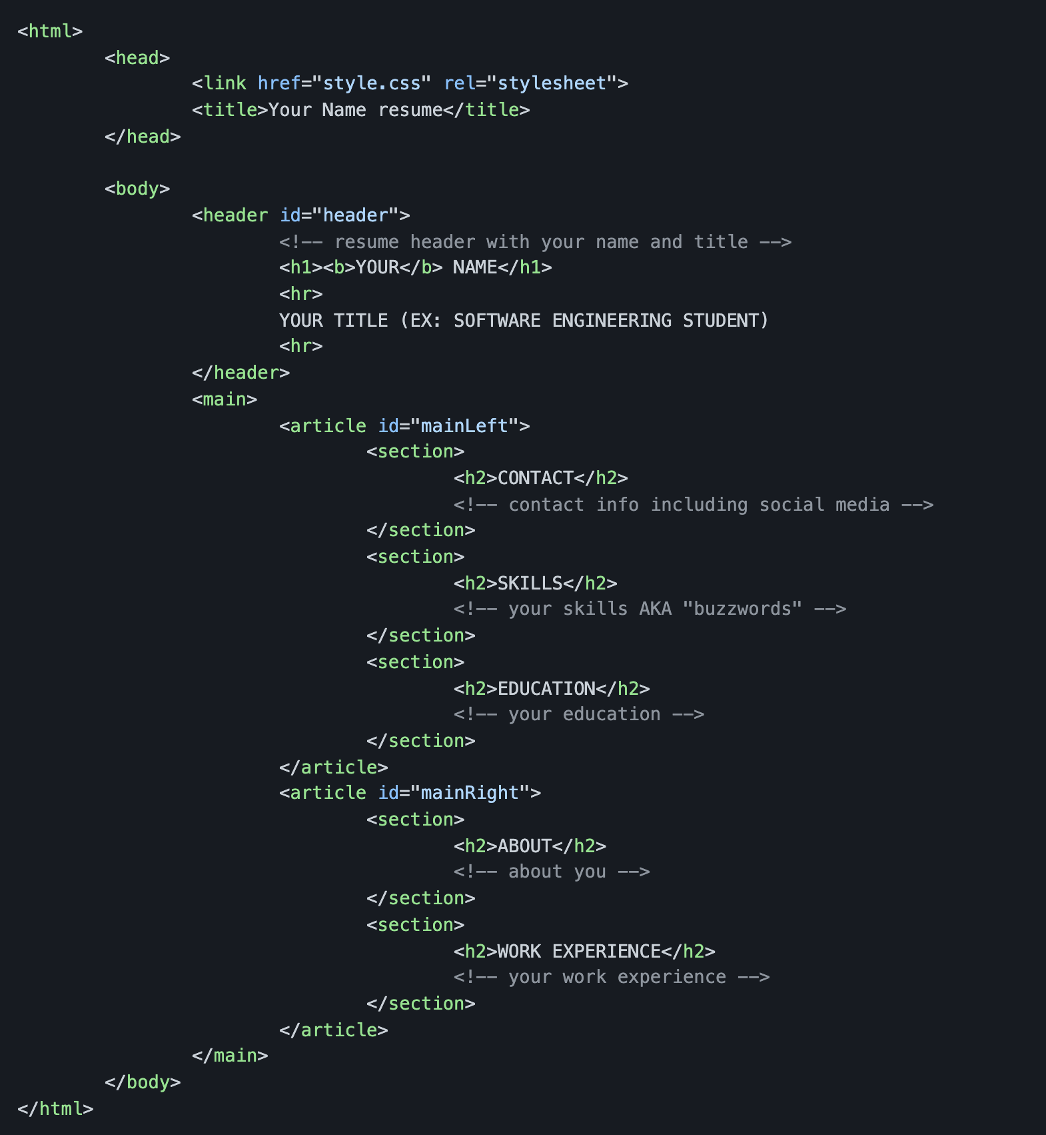
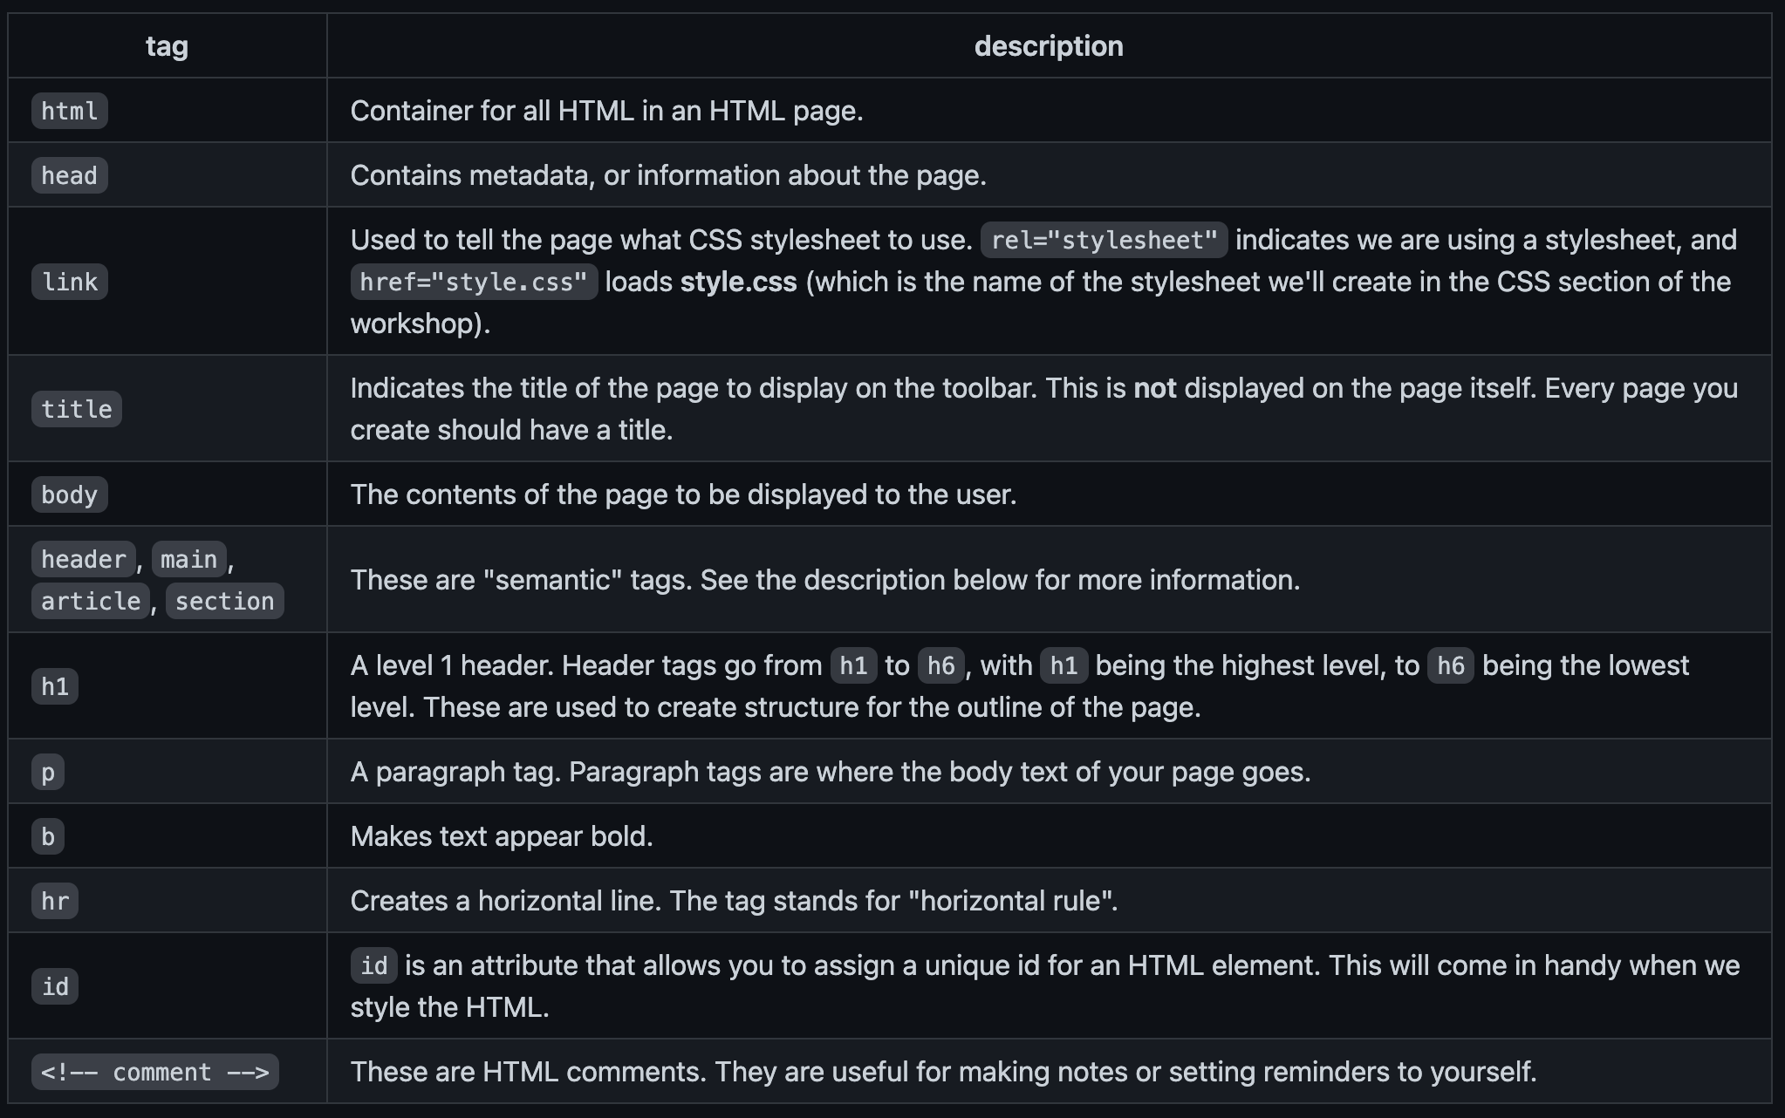
Notes:
Inside the index.html window, add the following code to create the initial structure of your page, replacing Your Name in the <title> tag with your name. Notice how as you type (or copy and paste) the browser window on the right automatically updates with the information you've added.
We used several tags to display our page. To learn more about each tag and what they mean, check out the table and compare it to the code. As you look at the code, notice the HTML is in all lower case letters, and the use of tabs to create an outline for the code. While this isn't required, it does make your HTML much more readable.
Semantic tags are a relatively new addition to HTML. You may notice on the page there is a difference in size between h1 and h2. This is because besides just indicating a level, header tags also modify how content is displayed. Semantic tags such as header, main, article and section are only used to group information together. The main advantage is the ability to structure a large HTML document, and later use CSS to control how the content will actually get displayed. We used the common hierarchy of header, main, article, and section on our page.

Slide 10



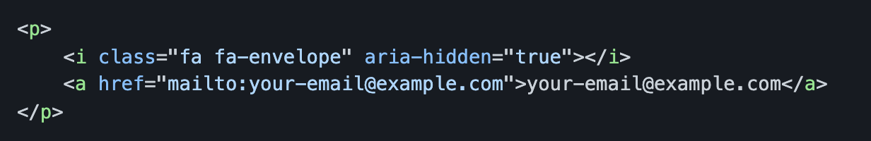
Adding content to an HTML page
Notes:
Now that you’ve seen how your HTML page is structured, you can add content to your resume. Specifically, you probably want to add an email address, social media links, your education and professional experience.
1. Most resumes feature the name of the person at the top as the "title" of the resume. This is a perfect place to use an h1 tag. You can also add a little separation between the header and the rest of the page by using two horizontal rules, or hr tags, with some text in between. Inside your index.html file, change "YOUR NAME" to be your name. Change "YOUR TITLE" to your general title - or the title you might like to have - for example, "SOFTWARE ENGINEER".
2. Create a link to your email address and any social media you wish to share on your resume. You'll use the a tag, which stands for "anchor". a has an attribute named href (short for hypertext reference). href will contain the address you want the link to point to. When a user selects the link, they will be taken to the page. If you want to create a link to an email address, you will use mailto: in front of the address; this will open the user's email client
3. You can repeat this for any social media you want to add – there are different icons that you can use for the various social media platforms. You’ll swap out the class of the i element for those icons, and the href of the a element for the links to that account.

Slide 11
HTML Lists
Unordered List
Work Experience
Cool accomplishment
Cool accomplishment
Cool accomplishment
Ordered List
In this role, I accomplished three main objectives:
Cool accomplishment
Cool accomplishment
Cool accomplishment
Notes:
Lists come in two varieties in HTML: ordered (with numbers or letters) and unordered (bullet points). ol is used to create an ordered list and ul is used to create an unordered list. li indicates each "list item" in a list. We’re going to use an unordered list to create a list of our work experience, since it fits better with the style of a resume. You can add as many (or as few) work experience entries as you like, modifying the text as appropriate.

Slide 12
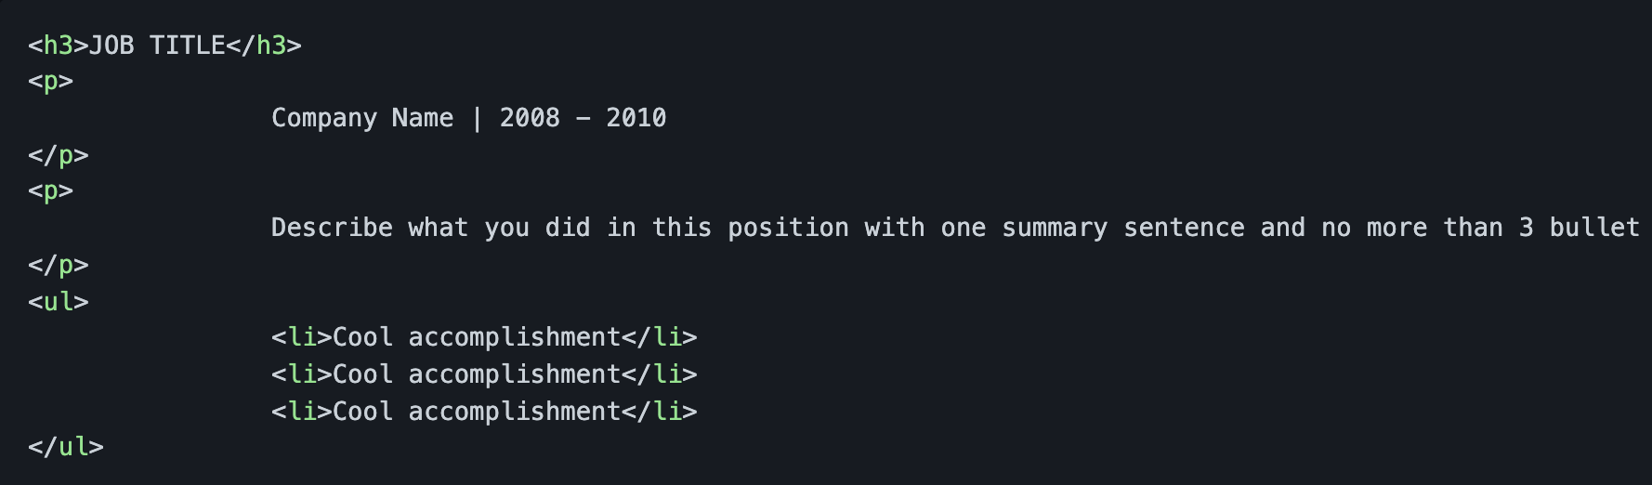
Add your work experience
Notes:
Inside index.html, below the comment which reads <!-- your work experience -->, add HTML to create the list
Swap out JOB TITLE for your previous job title (for example, SOFTWARE ENGINEER).
Change the "Company Name" and date as appropriate.
Add a short description that sums up your responsibilities.
Update the li items to add the accomplishments you want to highlight from that work experience.

Slide 13
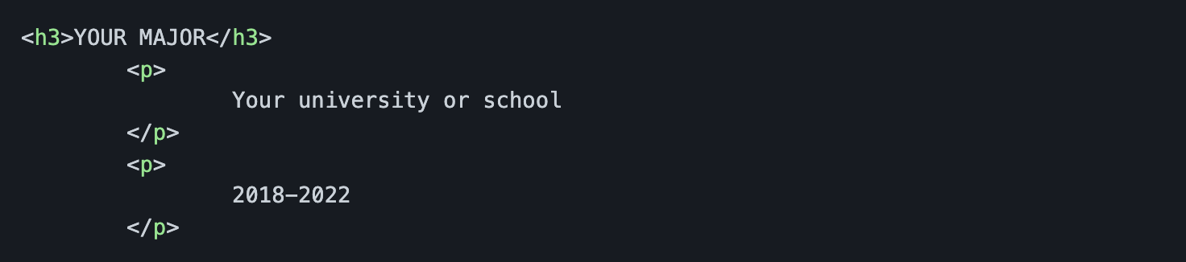
Add your skills, education, and about you
Notes:
Finish filling in the final sections of your resume by adding your skills, education, and about you. You’ll notice the window on the right will update with your new information. It does look a little plain though, so let’s learn how we can use CSS to style the page.

Slide 14
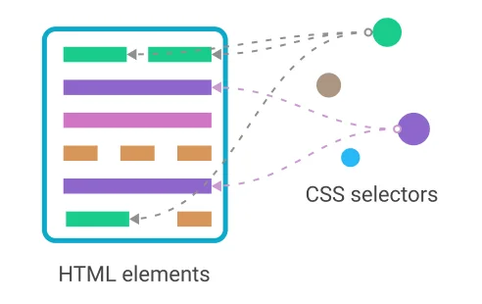
Adding style using CSS
Image Source
Notes:
As we explored in the beginning of the workshop, HTML is used to structure the content of a page. CSS, or Cascading Stylesheets, is used to provide style. CSS is used to set colors and fonts, where on a page information should be displayed, and other decorative items. By keeping HTML and CSS focused on these concerns (sometimes called separation of concerns), you create pages which are easier to modify and maintain, and become more accessible to all users.
CSS uses selectors to indicate what to modify. These selectors can be the name of a tag such as h1, an attribute such as class or id - useful for modifying a group of elements or a specific one, respectively - or get really fancy and look at the entire structure of a page to determine what to modify. We're first going to focus on using tag names as selectors.
When using a tag name for a selector, you use just the name of the tag. Keep in mind, when you indicate the name of a tag, the style applies to all tags.

Slide 15
Adding style to a page
github.dev/your-username/resume
1. Create a new file called style.css
2. Add your CSS to style your page
body {
font-family: ‘Segoe UI’, Tahoma, Geneva, Verdana, sans-serif;
font-size: 12px;
max-width: 960px;
margin: auto;
}
Notes:
Let's start by creating a CSS file to hold our code, so you can add style to the page. Then, you'll set a couple of properties for the body tag to change the font and size
Notice font-family, which is used to select the font. There are five fonts listed. Because users may not have a particular font installed, CSS offers the ability to fallback to the next font. In this case you're telling the browser to try Segoe UI first, then Tahoma if that's not installed, and so on.
There are also a few more rules that apply to everything in the body tag, which is the whole page:
font-size - sets the size of the font to 12 pixels
max-width - sets a maximum width for your resume so that it doesn't look strange on huge screens. 960 pixels is a common width for many websites.
margin - sets the margin to auto. When combined with the max-width property, this centers the content on the screen horizontally.

Slide 16
Sizing
github.dev/your-username/resume
h1 {
font-size: 3em;
letter-spacing: .6em;
padding-top: 1em;
padding-bottom: 1em;
}
h2 {
font-size: 1.5em;
padding-bottom: 1em;
}
h3 {
font-size: 1em;
padding-bottom: 1em;
}
Notes:
CSS offers different ways to indicate sizes. In the example above, you used 12px. px stands for pixels, and is an absolute sizing - it will always be 12 pixels regardless of the screen used. The problem with using absolute sizing is modifications to the size require updates to multiple styles. By using relative sizing, you use a single base; updates to the base then update the rest of the page.
For our example we'll use em. em indicates the size of the font at the root element - body in our example. em is a 1 based value, where 1em is the size of the root element, 1.5em is one and a half times the size, and .25em is one quarter the size.
Let's set the size for our three different header elements.
Notice that we can not only set the text size, but we can change the spacing in between letters with the letter-spacing property. We can add padding to an element with the padding property. All of these properties support the em relative sizing.

Slide 17
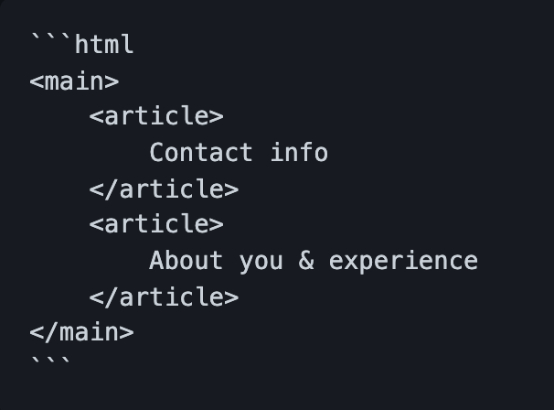
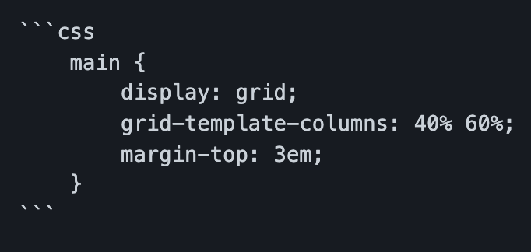
Using CSS grids
Notes:
CSS grids are a relatively new feature. Like the name implies, a grid allows you to place elements on a page much in the same way you might lay things out in a table. You can use grids to create columns and rows for your data.
On the left is the structure of your page. We want to create two columns, one for the first article with your contact info, skills, and education, and the second article with your work experience. Notice how both article elements are contained inside of a single main element. We will use the main element as the container for our grid. We will configure main to host the grid, and configure two column templates - one for each article.
This will split the main element into two columns. The first top-level element under main which is an article will be the first column and will take up 40% of the available space. The second top-level element under main (also an article) will take up the remaining 60%.

Slide 18

Controlling spacing with the box model
Notes:
CSS uses what's known as the box model. The box model controls how information is displayed inside an element, and how close to one another elements are placed. There are 3 key properties - margin, border, and padding. The diagram below indicates how these control content placement.
In this diagram the content is the text Hello, world. padding is the space between the text and the black border. And margin is the space between the border and the next element.
We’re going to add some more style rules to add some padding around the elements on your page – copy and paste the css from the workshop into your style.css file. What we’re doing with this code is
centering the text in the header element and adding a 2em margin to the left and the right so that the lines from the hr don't go all the way to the edge, but have a little padding.
The section element is given some margin so that each section (ABOUT, CONTACT, SKILLS) has spacing around it. The p element is also given some margin.
The i element is given some spacing on the right. These are the icons that we will be adding next.
The hr element is turned into a thinner gray line by removing its border and providing a background color and height.
We reduce the font-weight or "thickness" of the font of our header tags so that they aren't so blocky.

Slide 19
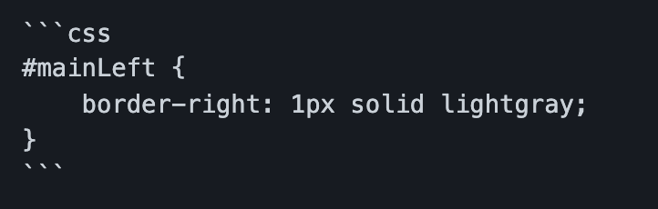
Selecting an element by ID
id property
Notes:
Sometimes, you want to style a specific element on a page. For instance, we want to add a thin gray line between our two columns. We can do that by adding a right border to the left column, but both columns are article elements. How do we correctly pick the left one?
Notice that each of the article elements has an id property - "mainLeft" and "mainRight". We can select these elements by their ID in the CSS and style them. So, to add a border to just the left column, add this final rule to your stylesheet.
Your resume should look much better now. However, you're still missing some icons in the CONTACT section. For that, we'll need to add an icon font. Refer to the workshop to finish this last step.

Slide 20
Notes:
You have successfully added style to your resume using CSS. You learned how to use selectors, sizing, grids, spacing, and icon fonts to make your resume stand out! Hopefully, your resume now matches the image at the very beginning of the workshop! Now, let’s walk through how to get it onto a webpage using GitHub Pages

Slide 21
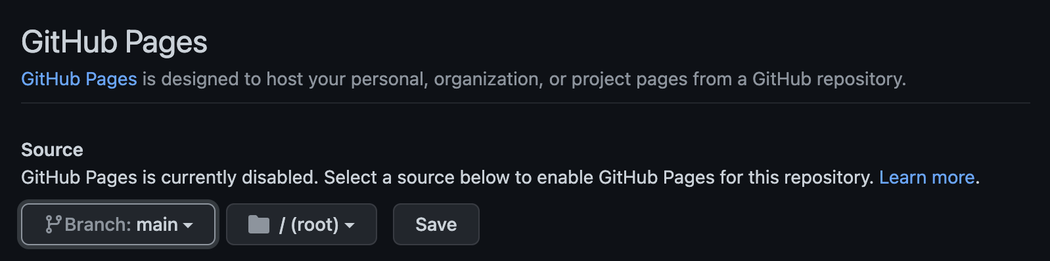
Creating your website
Notes:
Now that you have your basic resume crafted in HTML and CSS, let's work on putting your resume on a website. To do this, we'll use a feature called GitHub Pages, which allows you to create a website directly from a repository on GitHub.
The first thing we need to do is commit the changes we've made to our resume repository to GitHub. This will upload all of the resume content that we added to our repository, so we can use it for our website.
Then, let’s turn on GitHub Pages for our repository. Navigate to your repository on GitHub.com, and select Settings, next to the gear icon. Go to Pages, then make sure you have the main branch of your repository selected to be the source for your website. You’ll be able to see the address of your new website. Check it out and see what you think!

Slide 22
your-username.github.io/resume/
To continue growing your web development skills,
Modify this page! Experiment with more styles and content
Explore content on Microsoft Learn
You can reach out to me via
Twitter - @AbiodunAbayom19
LinkedIn - Abayomi Abiodun

