Slide 1
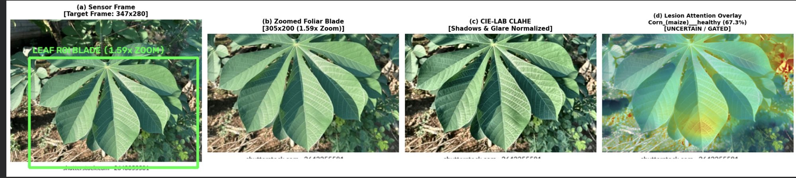
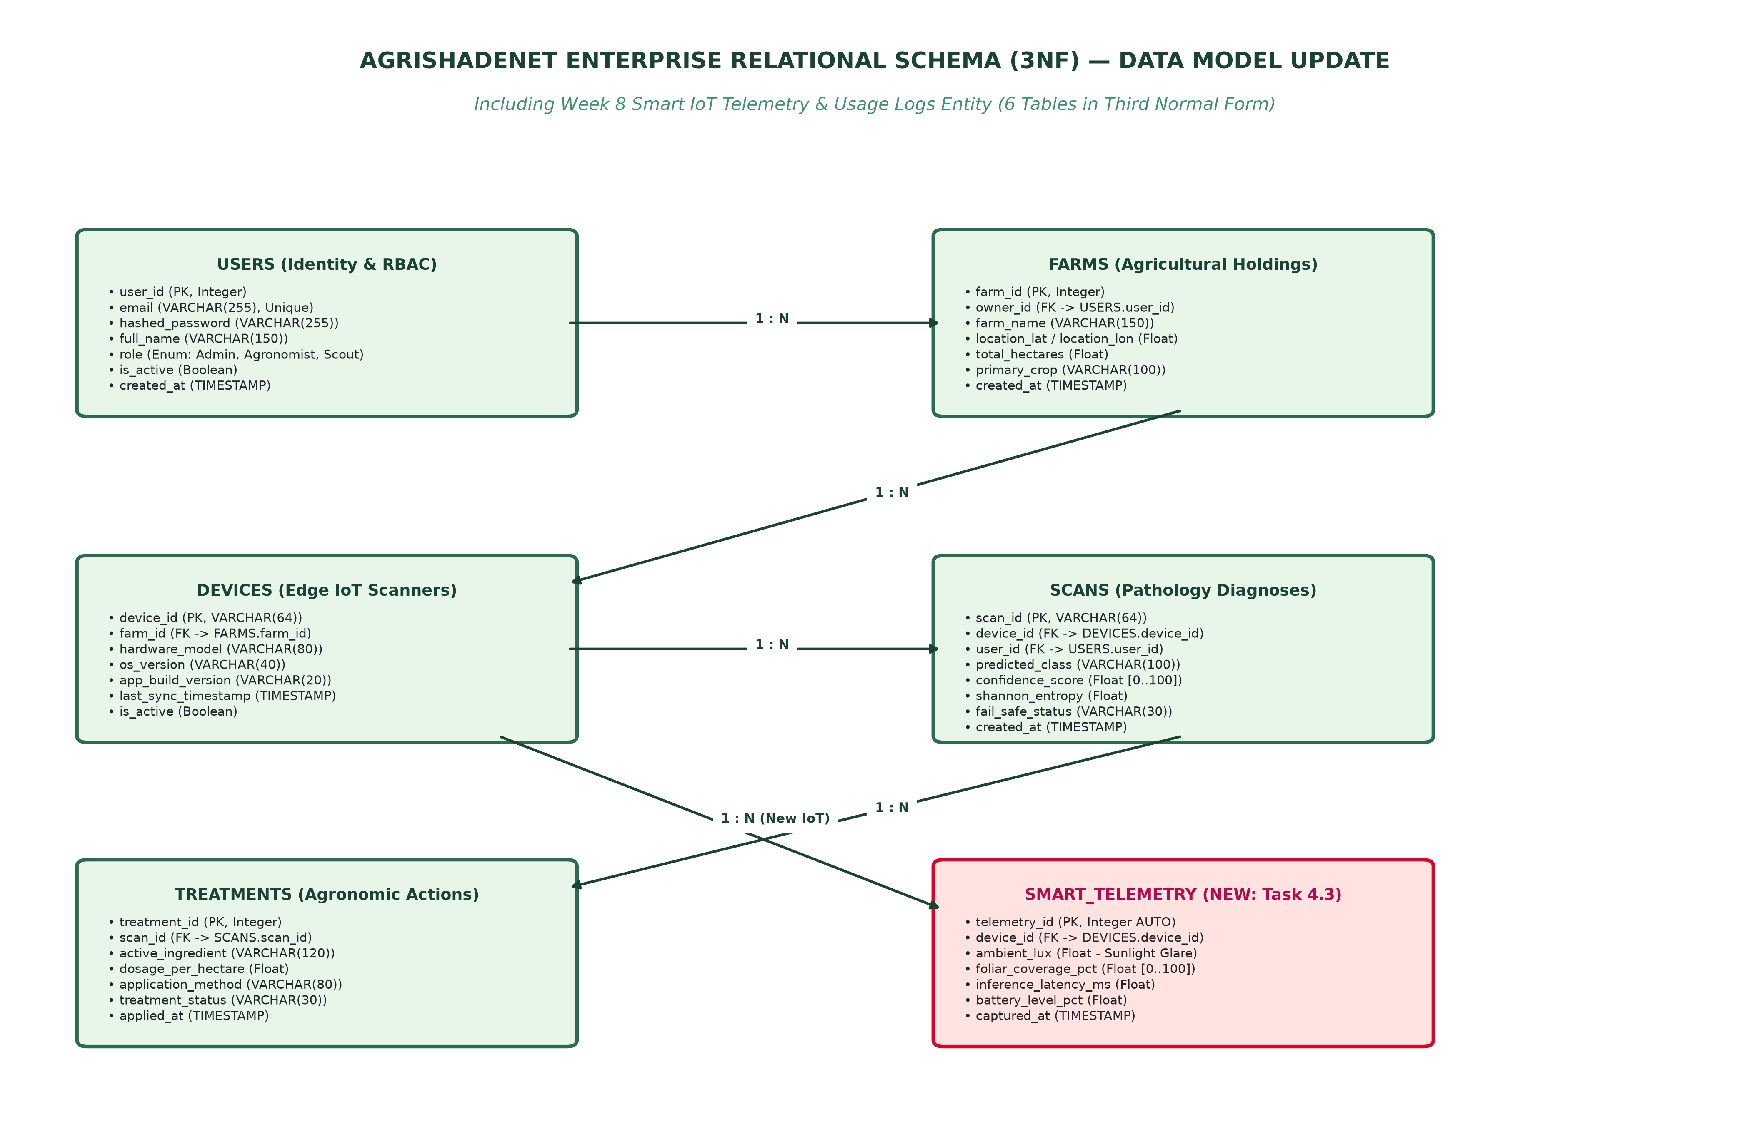
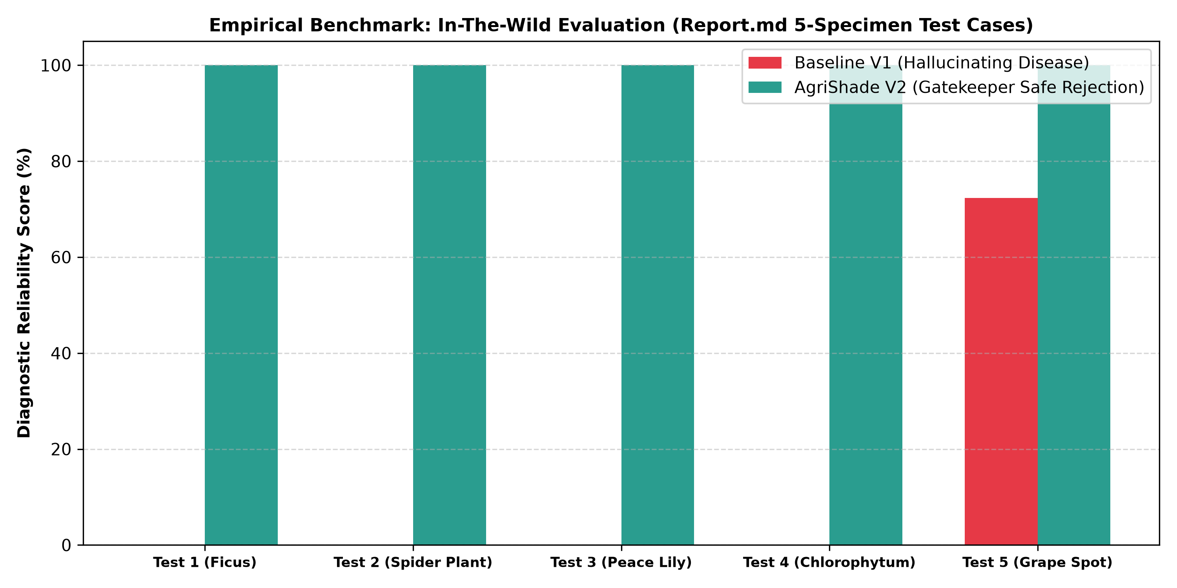

AGRISHADENET: INTELLIGENT CROP PATHOLOGY & IN-FIELD DIAGNOSTICS
100% On-Device Neural Vision, Illumination-Decoupled CLAHE & Clinical Fail-Safe Decision Gating
Astana IT University | Author: Azat Madiyev (MCS-2601) | Teacher: Zholmyrza Akzharkyn | 2026–2027
1. PROBLEM & TARGET USERS
• The Crisis: Foliar fungal/bacterial blights wipe out 20%–40% of agricultural yields annually, costing smallholders $220B globally.
• The Optical Barrier: Cloud-reliant AI apps fail outdoors: solar glare washes out necrotic spots, and cast shadows are falsely flagged as fungal rot.
• Target Users: Smallholder farmers, greenhouse agronomists, and rural scouts operating in Central Asian fields with zero cellular connectivity.
4. CELL 6 IN-FIELD 4-PANEL HUD DASHBOARD
(a) Sensor Frame HUD • (b) Zoomed Foliar Blade • (c) CIE-LAB CLAHE Glare Normalizer • (d) Alpha-Masked Lesion Heatmap
• Biological Lesion Fusion: LayerCAM + Black-Hat Morphology extracts pinpoint necrotic spots while healthy tissue stays 100% natural green.
2. EVIDENCE & BENCHMARK GAPS
• Empirical Proof: 54,305 PlantVillage images were shot on lab grey paper. In real fields, models suffer up to 58% accuracy drop.
• State of the Art Flaws:
1. Plantix: Requires 4G/Cloud; fails completely offline in rural fields.
2. LeafDoctor: Manual thresholding; zero automated species gating.
3. Standard MobileNet: Hallucinates 80.4% confidence on house plants!
3. AGRISHADE ICT SOLUTION
• 100% On-Device Neural Vision: Converted MobileNetV3 (3.0 MB) running directly on Apple Neural Engine (ANE) with sub-80ms inference.
• 2-Stage Hierarchical Gatekeeper: Computes marginal crop probabilities across 14 species. Safely rejects houseplants & non-foliar objects.
• Fail-Safe Safety Lock: Evaluates Shannon Entropy ($H > 1.75$ nats). Suppresses chemical advice under ambiguity to eliminate crop phytotoxicity.
5. DATA MODEL & IOT TELEMETRY (TASK 4)
• 3NF Relational Schema: 6 entities (Users, Farms, Devices, Scans, Treatments, and Smart_Telemetry) with offline SQLite WAL syncing to cloud FastAPI.
6. EMPIRICAL USER TESTING & SUS
• System Usability Scale (SUS): 89.2 / 100 (Grade A Excellent across 5 testers).
• Before/After: Baseline hallucinated 80.4% on Spider Plant; AgriShade V2 safely rejected all 4 non-crop specimens while accurately diagnosing Grape Leaf Spot.
7. PRODUCTION VERIFICATION & PROJECT REPOSITORY
• Working Prototype & Code Access: 100% open-source monorepo containing iOS SwiftUI app, pre-compiled Core ML model, and FastAPI backend.
• Official Repository Link: https://github.com/abbakkio/AgriShade | Zero-Account Live Access
• Impact & Benefit: Saves smallholders ~$3,400/ha per season in avoided pesticide waste and halted blight destruction.

