Slide 1



TRADECHAIN
Secure Blockchain Solutions for Global Trade
Syed Nazr-e-Abbas & Muhammad Fahad
Comsats University Islamabad Attock Campus
20 May 2026

Slide 2
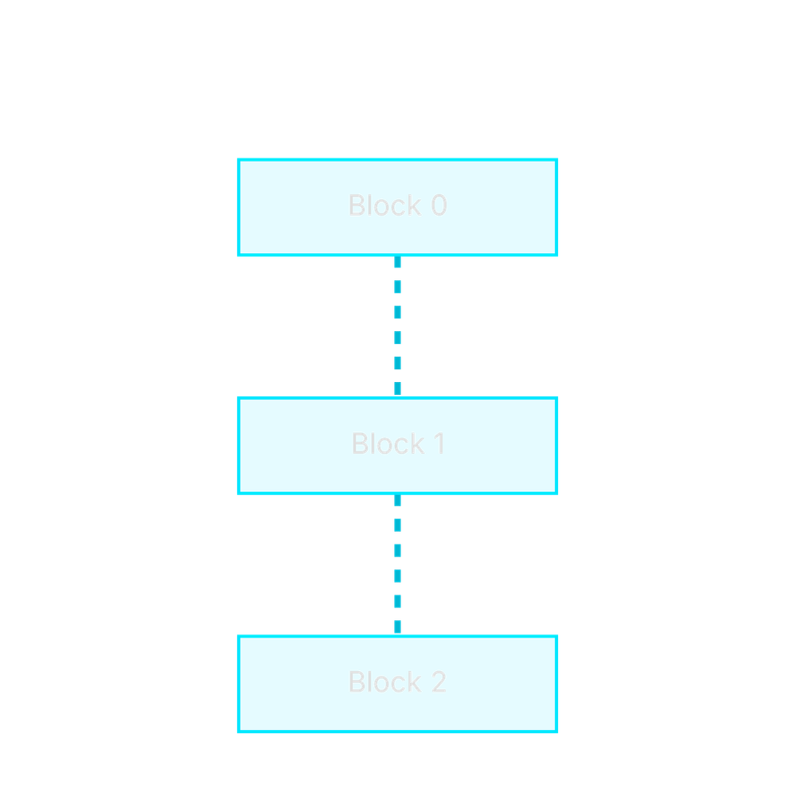




What is Blockchain?
Decentralized Ledger
A distributed database shared across a network of nodes.
Immutable Records
Data cannot be altered once it is recorded in a block.
Transparency
All participants have access to the same single source of truth.
Security
Advanced cryptography (SHA-256) secures every transaction.

Slide 3




Real-World Blockchain Examples
Finance
Supply Chain
Bitcoin and Ethereum for decentralized payments and smart contracts.
IBM Food Trust for tracking food products from farm to table.
Banking
Trade
Ripple for fast, low-cost international cross-border payments.
TradeLens (Maersk & IBM) for digitizing global supply chains.

Slide 4




The Problem: Traditional Systems
Centralization
Lack of Transparency
Single points of failure make systems vulnerable to cyber-attacks and data loss.
Opaque processes make it difficult to track data history and verify authenticity.
Inefficiency
Tampering Risks
Heavy reliance on manual paperwork and intermediaries leads to significant delays.
Data can be altered without a clear audit trail, increasing the risk of fraud.

Slide 5





Our Solution: TradeChain
Specialized Implementation
Immutable Storage
Designed specifically for secure and efficient trade data management.
Permanent, tamper-proof record of every trade transaction on the ledger.
User Wallets
Consensus Validation
Secure digital identities for all participants in the trade ecosystem.
Network agreement ensures the integrity and validity of the entire chain.

Slide 6





How TradeChain Works
Initiation
Verification
Block Formation
Hashing
Distribution
User creates a trade transaction via their secure digital wallet.
Network nodes validate the transaction using digital signatures.
Verified transactions are grouped into a new data block.
The block is hashed and linked to the previous block in the chain.
The new block is synchronized across all nodes in the network.

Slide 7





Core Implementation Logic
Block Structure
Each block encapsulates an index, a precise timestamp, the trade data, and the cryptographic hash of the preceding block.
Index: 1
SHA-256 Hashing
Timestamp: 1716201600
Data: \"Trade ID: TC-99\"
A one-way cryptographic function that generates a unique 256-bit signature. Any change in data results in a completely different hash.
Prev Hash: 0000a1b2...
SHA-256
f32b8c9a1e4d5f6b7a8c9d0e1f2a3b4c5d6e7f8a9b0c1d2e3f4a5b6c7d8e9f0
Chain Integrity
By storing the previous hash, blocks are cryptographically linked. Tampering with one block breaks all subsequent links.

Slide 8
Core Implementation Code
blockchain_logic.py
import hashlib import time def calculate_hash(index, prev_hash, timestamp, data): # Combine block data into a single string value = str(index) + str(prev_hash) + str(timestamp) + str(data) # Generate SHA-256 cryptographic fingerprint
return hashlib.sha256(value.encode()).hexdigest() def create_next_block(last_block, data): idx = last_block.index + 1 ts = time.time() h = calculate_hash(idx, last_block.hash, ts, data) return Block(idx, last_block.hash, ts, data, h)
The calculate_hash function ensures immutability, while create_next_block maintains the cryptographic link between transactions.

Slide 9





System Demonstration
Real-time Dashboard
Participant Roles
Audit Trail
Live blockchain metrics and node health.
Access control for Exporters, Importers and Banks.
Searchable, tamper-evident history of trades.

Slide 10
Advantages & Limitations
Key Advantages
Current Limitations
Enhanced Security
Scalability Challenges
Cryptographic hashing and decentralization eliminate single points of failure and prevent unauthorized data alteration.
As the blockchain grows, the computational resources and time required for network synchronization can increase.
Operational Efficiency
Regulatory Landscape
Automated verification and digital documentation reduce manual paperwork and speed up trade processing times.
The lack of global standardized legal frameworks for blockchain-based trade remains a significant hurdle for adoption.
Full Transparency
Integration Complexity
A shared, immutable ledger provides all participants with a real-time, verifiable audit trail of every transaction.
Migrating from legacy centralized systems to a decentralized architecture requires substantial initial investment and training.

Slide 11






Conclusion & Future Scope
PROJECT SUMMARY
FUTURE ROADMAP
Robust Security
Smart Contracts
Implemented SHA-256 hashing to guarantee data immutability.
Automate payments and document releases via rules-based contracts.
Enhanced Transparency
Built a shared ledger as a single source of truth for participants.
IoT Integration
Use real-time sensor data for automated supply chain checks.
Process Efficiency
Reduced manual overhead and intermediary delays across workflows.
Global Interoperability
Expand connections with international trade blockchain networks.
THANK YOU

