Slide 1
Proof Of Concept For Opportunistic Security in MPLS Network
Dissertation
CS7CS5
Student:
Salil Ajgaonkar
Supervisor:
Prof. Stephen Farrell
Date 20/08/2018

Slide 2
Multi Protocol Label Switching (MPLS)
• It’s a transport protocol, meaning that it can be used to transport different types of network protocols (both packet switching - IP, Ethernet- and older circuit switching - SONET)
• Uses “Labels” appended to packets for transport of data
• MPLS packets can run on other layer2 technologies such as ATM, FR, PPP, POS, Ethernet
• Other layer2 technologies can be run over an MPLS network
Notes:
P529 of Stalling for details of TTL
RFC 3032

Slide 3
MPLS Header Format
Label: 20-bit label value
Exp: experimental use
Can indicate class of service
S: bottom of stack indicator
1 for the bottom label, 0 otherwise
TTL: time to live
20
3
1
8
Label
Exp
S
TTL
Notes:
P529 of Stalling for details of TTL
RFC 3032

Slide 4
Forwarding Equivalence Class
An MPLS capable router is called a label switching router (LSR)
Forwarding Equivalence Class (FEC): A subset of packets that are all treated the same way by an LSR
A packet is assigned to an FEC at the ingress of an MPLS domain

Slide 5
Forwarding Equivalence Class
A packet’s FEC can be determined by one or more of the following:
Source and/or destination IP address
Source and/or destination port number
Protocol ID
Differentiated services code point
Incoming interface
A particular PHB (scheduling and discard policy) can be defined for a given FEC
Notes:
In IP, FEC is destination network

Slide 6
MPLS Operation
At ingress LSR of an MPLS domain, an MPLS header is inserted to a packet before the packet is forwarded
Label in the MPLS header encodes the packet’s FEC
At subsequent LSRs
The label is used as an index into a forwarding table that specifies the next hop and a new label.
The old label is replaced with the new label, and the packet is forwarded to the next hop.
Egress LSR strips the label and forwards the packet to final destination based on the IP packet header
Notes:
Once a packet is assigned to a FEC, no further header analysis is done by subsequent routers; all forwarding is driven by the labels.

Slide 7
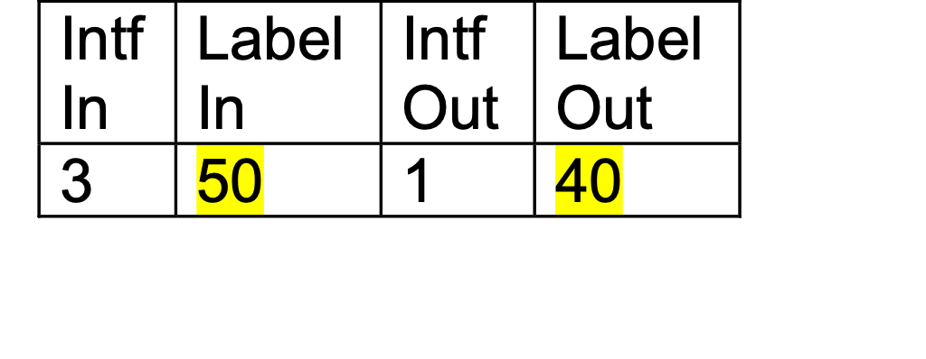
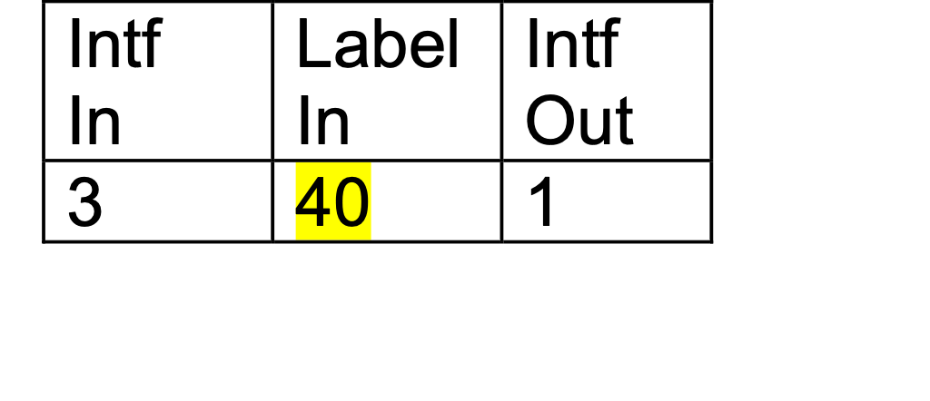
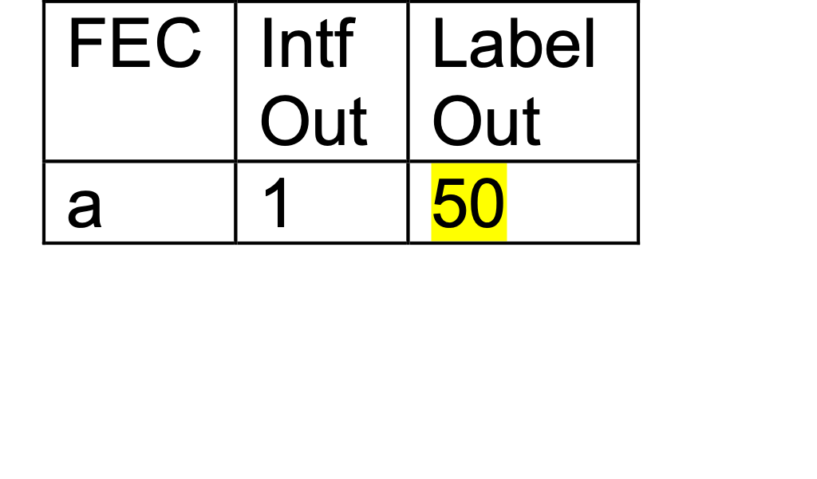
MPLS Operation
1
3
3
1
40
2
1
2
3
50
2

Slide 8
Security issues/threats in MPLS
MPLS is vulnerable for Variety of attacks
Attacks on Signalling protocols can lead to path switching or path shutdown
Data modification attacks
Data Sniffing
Denial Of Service (DOS)
Notes:
Once a packet is assigned to a FEC, no further header analysis is done by subsequent routers; all forwarding is driven by the labels.

Slide 9
Available Tools to protect MPLS Networks
Physical isolation of the network
IP Security (IPSec)
MAC Security (MACSec)
Secure Socket Layer (SSL)
Transport Layer Security (SSL)
Notes:
Once a packet is assigned to a FEC, no further header analysis is done by subsequent routers; all forwarding is driven by the labels.

Slide 10
Issues with available Security Tools
There are tools available to tap interfaces which does brute force attack even though the network is isolated
SSL and TLS leaves metadata like IP destination
MACSec is a layer2 security protocol which works with ethernet and its a hop-by-hop solution and not advised for end to end coverage.
IPSec works only with IP in Layer3 and not with other protocols.
Notes:
Once a packet is assigned to a FEC, no further header analysis is done by subsequent routers; all forwarding is driven by the labels.

Slide 11
Opportunistic Security in MPLS (MPLSOS)
Its an end to end Security protocol design proposal for MPLS
LSRs can send packets between as Cipher text
Payloads can be authenticated using Auth Tags
Encryption and Decryption Keys are generated out of Diffie-Hellman Key Exchange
Encryption/Decryption is performed by a minimum AES-128-GCM Algorithm
Notes:
Once a packet is assigned to a FEC, no further header analysis is done by subsequent routers; all forwarding is driven by the labels.

Slide 12
Initial Works
An Extensive research is already conducted by Professor Stephen Farrell from TCD and Adrian Farrell from Juniper Networks
A detailed functional specification is published in ietf with title “Opportunistic Security in MPLS Networks draft-ietf-mpls-opportunistic-encrypt-03”
Notes:
Once a packet is assigned to a FEC, no further header analysis is done by subsequent routers; all forwarding is driven by the labels.

Slide 13
Goals of the Dissertation
Implement the functional specification of draft published in IETF with title “Opportunistic Security in MPLS Networks draft-ietf-mpls-opportunistic-encrypt-03”
Test the functionality and measure the Network performance such as scalability, latency, throughput etc
Document the finding in the form of proof of concept with detailed analysis of feature, performance overhead, gains etc.
Notes:
Once a packet is assigned to a FEC, no further header analysis is done by subsequent routers; all forwarding is driven by the labels.

Slide 14
Implementation
Install OpenVSwitch in a Ubuntu Machine
Install multiple dockers or install mininet to create Virtual Network Topology
Initialise the Dockers or Mininet nodes with Installed OpenVswitch kernel
Configure the ARP and MPLS OpenFlows for each Switches
Modify the data path package in the OpenVswitch to support MPLS OS
Send Traffic Through the Switches with MPLS OS and measure performance
Send Traffic Through the Switches without MPLS OS and measure performance
Document the test results and compare it in the form of Proof Of Concept
Notes:
Once a packet is assigned to a FEC, no further header analysis is done by subsequent routers; all forwarding is driven by the labels.

Slide 15
Tools used in the experiment
Ubuntu 18.04 with Kernel 4.13
Mininet
OpenVswitch
Wireshark
TCPDUMP
Notes:
Once a packet is assigned to a FEC, no further header analysis is done by subsequent routers; all forwarding is driven by the labels.

Slide 16
Mininet
Creates a realistic network, running real kernel, switch and application code on a single machine
Interact with the network using Mininet Command Line Interface (CLI)
Support OpenFlow switches (OpenVSwitch)
Support custom topologies
Notes:
Once a packet is assigned to a FEC, no further header analysis is done by subsequent routers; all forwarding is driven by the labels.

Slide 17
OpenVswitch
Open vSwitch is a production quality, multilayer virtual switch licensed under the open source Apache 2.0 license
Mostly used for network automation
supports standard management interfaces and protocols (e.g. NetFlow, sFlow, SPAN, RSPAN, CLI, LACP, 802.1ag)
Broad support:
–Linux, FreeBSD, NetBSD, Windows, ESX–KVM, Xen,
Docker, VirtualBox, Hyper-V,
OpenStack,CloudStack,OpenNebula,
Notes:
Once a packet is assigned to a FEC, no further header analysis is done by subsequent routers; all forwarding is driven by the labels.

Slide 18
Diffie-Hellman Key Exchange
Exponential key agreement
Allows two users to exchange a secret key
Requires no prior secrets
Real-time over an untrusted network
No known successful attack strategies
Requires two large numbers, one prime (P), and (G), a
primitive root of P
Notes:
Once a packet is assigned to a FEC, no further header analysis is done by subsequent routers; all forwarding is driven by the labels.

Slide 19
DH Key Exchange Implementation
P and G are both publicly available numbers
Users pick private values a and b
Compute public values
x = ga mod p
y = gb mod p
Public values x and y are exchanged
Notes:
Once a packet is assigned to a FEC, no further header analysis is done by subsequent routers; all forwarding is driven by the labels.

Slide 20
DH Key Exchange Implementation
Compute shared, private key
ka = ya mod p
kb = xb mod p
Mathematically it can be shown that ka = kb
ka and kb are the generated symmetric secret key for encryption/decryption
Notes:
Once a packet is assigned to a FEC, no further header analysis is done by subsequent routers; all forwarding is driven by the labels.

Slide 21
AES-128-GCM Encryption Algorithm
Performs Encryption and data authentication
Key Size is 128 bits in 16 Hexadecimal number format
Initialisation Vector is of 12 bytes
Input is plain text data
Output is Cipher text
16 bytes authentication tag is used for authentication after decryption
Notes:
Once a packet is assigned to a FEC, no further header analysis is done by subsequent routers; all forwarding is driven by the labels.

Slide 22
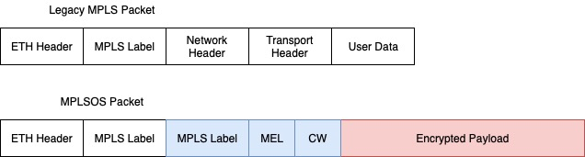
MPLS OS Packet Format
Notes:
Once a packet is assigned to a FEC, no further header analysis is done by subsequent routers; all forwarding is driven by the labels.

Slide 23
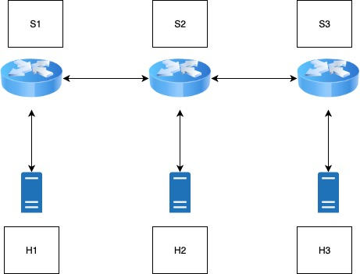
Network Topology
Notes:
Once a packet is assigned to a FEC, no further header analysis is done by subsequent routers; all forwarding is driven by the labels.

Slide 24
Performance Metrics
Throughput
Scalability
Latency
CPU and Memory Utilization
Robustness

Slide 25
Completion Status
Emulated the Topology
Installed OpenVswitch
Implemented DH Key Exchange in OVS Datapath
Created the shared key after DH Exchange
Implemented Encryption/Decryption
Collected RTT Figures for Comparison

Slide 26
Demo

