Slide 1


Selection of Intrusion Detection System (IDS) Security Policies
Syed Ghazanfar Abbas

Slide 2
Presentation highlights
Fundamental Concepts - Relevant to this project
Implementation 1 - Enhance IDS by adding an IoT protocol implementation
Implementation 2 - Creating IoT security policies
Testing - Testing the security of IoT use-case with and without policies.

Slide 3
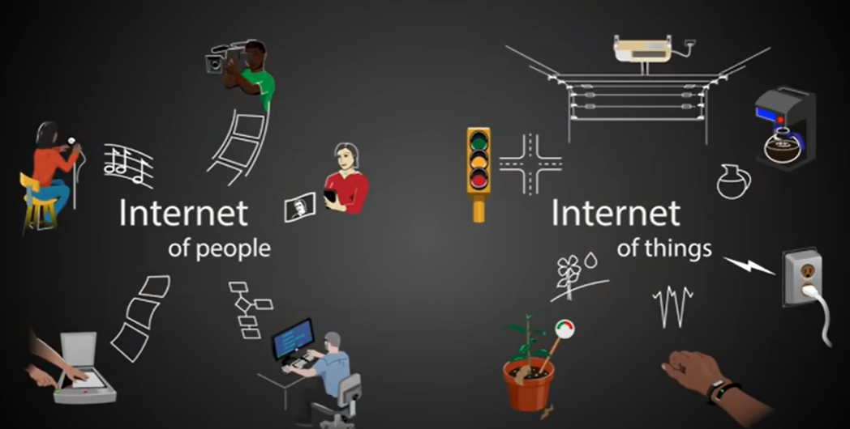
Internet of Things (IoT)
What is it, and should you care?
With Internet of Things, “Things” begin to share their experiences with one another.
This is how it works. We take the things and add the ability to sense and communicate.
Credit: https://www.youtube.com/watch?v=_AlcRoqS65E

Slide 4
IoT Protocols
The Internet of Things protocols have influenced the security debate and thereby opening up new avenues for discussion.
Considering the well-known and extensively used protocols that are not adequate for the significant advancement of IoT, new protocols that match the light devices used for communication have been introduced. As a result of their recent existence, security is a crucial research topic.

Slide 5
CoAP
What is it, and should you care?
The CoAP is an application layer IoT protocol .
Many vendors use CoAP for their IoT devices since it is lightweight and consumes little energy.
CoAP's primary function is to behave similarly to HTTP whenever constrained devices are involved in communication. It bridges the HTTP gap, allowing devices like as actuators and sensors to communicate over the internet.
CoAP is by default connected to UDP and, optionally, DTLS, offering a high level of communication security.

Slide 6
Intrusion Detection System (IDS)
What is it, and should you care?
A hardware or software program that monitors a network for malicious activity or policy breaches is known as an intrusion detection system (IDS).
Firewall vs IDS: A firewall is a device or software that examines packet headers and applies policy depending on protocol type, source address, destination address, source port, and/or destination port. An intrusion detection system (IDS) is a device or application that examines whole packets, both header and content, for known occurrences.
Some of the most widely adopted open source IDS are: Suricata, Snort etc.
Suricata IDS will be our key emphasis in this project. However, our technique will be applicable to other IDS.

Slide 7
Implementation 1 - Enhance IDS by adding an IoT protocol implementation
Technical document with screenshots is uploaded on link:
https://github.com/abbas4Security/CoAPIDS
Video demonstrating how to compile and run the CoAP enabled Suricata:
https://www.youtube.com/watch?v=OpIpsjiSwwI

Slide 8
Lack of CoAP implementation in IDS
To date (21 May 2023), top publicly available open source IDS (Suricata, Snort, Bro) are not supported with CoAP protocol.
Suricata recently implemented MQTT support, which is one of the IoT protocol. As a result, there are a variety of commercial and open security policies for MQTT.
This leads to the conclusion that IDS solutions must be rapidly updated to handle IoT Protocols.

Slide 9
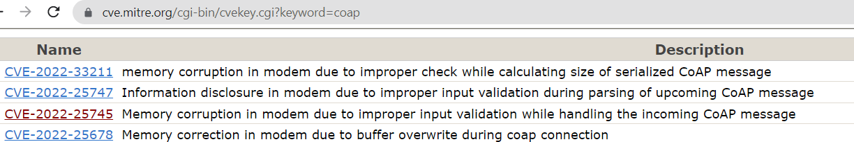
Million Dollar Question!!
Why should we be concerned about CoAP protocol support?
Reason 1: IoT applications that are using CoAP are vulnerable to attacks.
Reason 2: Security policy providers (e.g., Emerging Threats https://rules.emergingthreats.net/) lack CoAP-related security policies.

Slide 10
Key Challenges
There is no formal explicit documentation guidance for adding new protocols.
Suricata was one of the earliest multithreaded intrusion detection systems, making it more difficult to debug and understand.

Slide 11
Our Approach
Suricata existing protocol implementations (HTTP and DNS) are well understood.
Based on our understanding, we devise a high-level architecture that is also relevant to the majority of other open source intrusion detection systems.

Slide 12
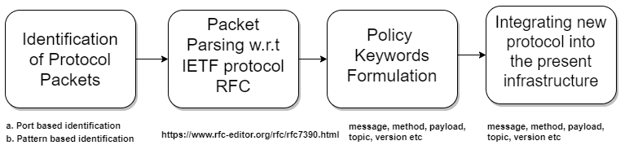
Generic IDS Protocol Implementation Architecture

Slide 13
Implementation 2 - Creating IoT security policies
Code for creating IoT security policies:
https://github.com/abbas4Security/CoAPIDS/tree/main/Implementation2-RuleCreation

Slide 14
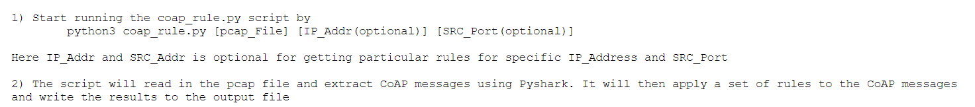
CoAP Rules: Application Logic
IoT use case network traffic is recorded and stored in pcap (Packet Capture).
Application generates device profiles from pcap file to detect anomalies. A network anomaly is a divergence from its predicted behavior, which is described by a profile based on network activity.
For instance, when application run with pcap file, rules below will be generated.
Rules output

Slide 15
Testing - Testing the security of IoT use-case with and without policies.
Video demonstrating whole testing process:
https://www.youtube.com/watch?v=WsEPYdXz1Ww
Testing VMs Uploaded:
CoAP Server VM with inline CoAPIDS: https://mega.nz/file/OJ4w3ZyI#Ez7k4fbaLCdwTVcNxF8CV6qNf00oIyR_NKorM0CPkgQ
CoAP Client VM: https://mega.nz/file/yJg1AAIS#GT_Ph6tG2aKF9M3aaJMOhWl500RTzXC5RD704LY8kws
Attacker VM: https://mega.nz/file/CZowwR7D#-K-SRultkzbWJZQAUu9NQa0tOdo9h2zq2fKsdU6H_30

Slide 16
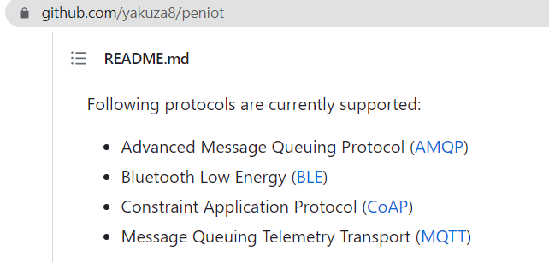
Testing: Penetration Testing Tool
We have used tool PENIOT: Penetration Testing Tool for IoT for testing CoAPSuricata and our security policies.
Following protocols supported in the PENIOT for penetration.

Slide 17
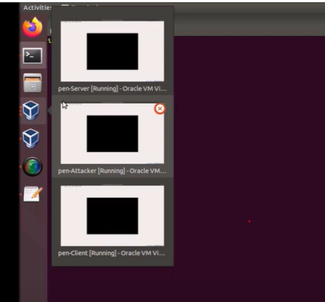

Testing: Testing Environment
3 separate VMs are setup, one for CoAP server, one for benign CoAP client and one for the attacker.
All network traffic to or from CoAP server pass through the CoAPSuricata.
VM1: CoAP Server
Video Screen shot for 3 VMs
CoAPSuricata
VM2: CoAP Client
VM3: Attacker

Slide 18
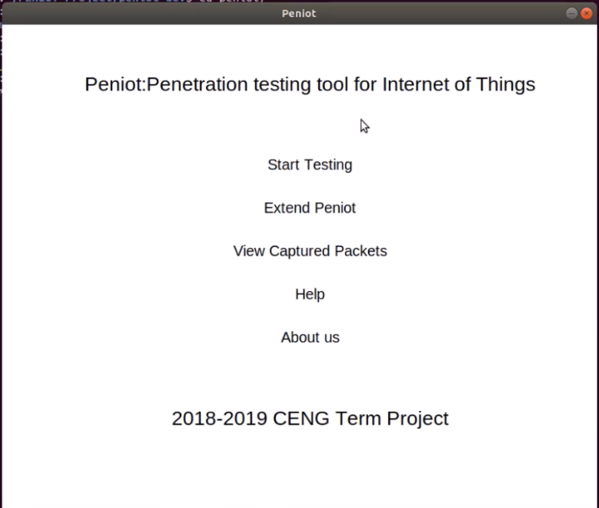
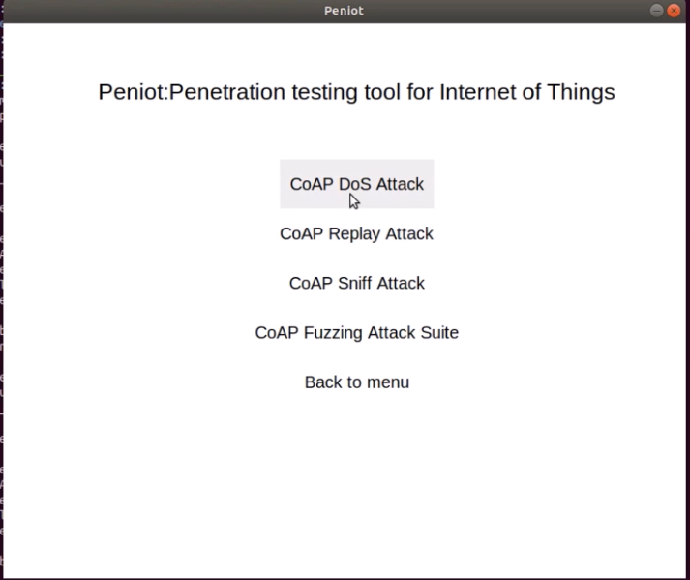
Step 3: Start Attack Tool

Slide 19
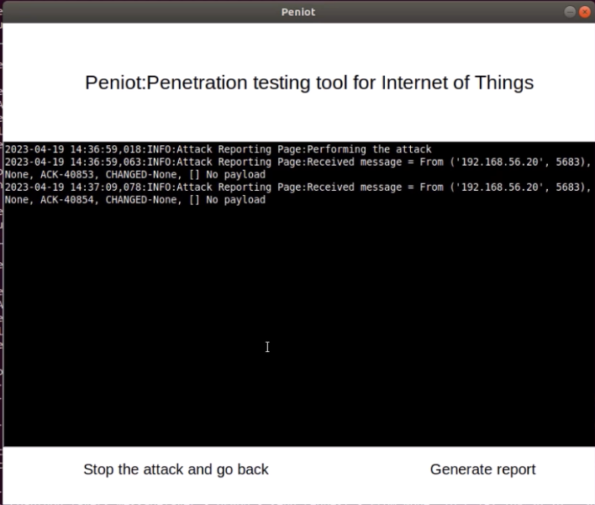
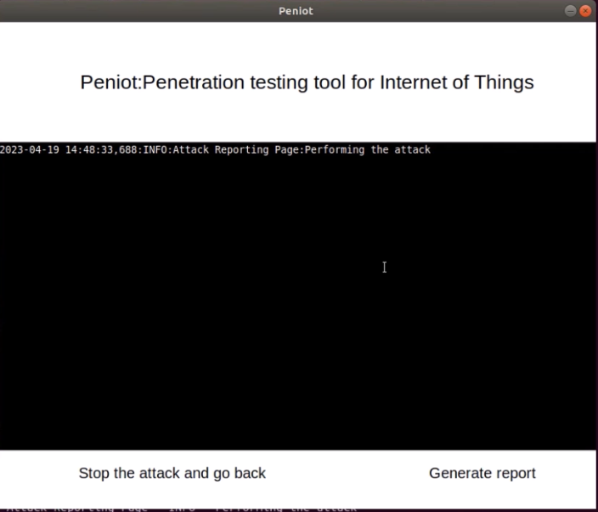
Testing Result
Successful Attack
Attack Stopped

Slide 20
Conclusion
In this project, we enhanced Suricata IDS for the detection and prevention of assaults in CoAP networks, and within this framework, we evaluated the value of anomaly-based intrusion detection in preventing DoS attacks against such communication environments. In CoAP applications, it is crucial from a practical point of view to prevent as many intrusions as feasible when implementing an IDS system.

Slide 21
Videos
Compiling & Executing CoAPSuricata | https://www.youtube.com/watch?v=OpIpsjiSwwI
Testing IoT Use-Case with and without CoAP security policies. | https://www.youtube.com/watch?v=WsEPYdXz1Ww
Codes & Documents
CoAP Suricata Code | https://github.com/abbas4Security/CoAPIDS/tree/main/Implementation1-CoAPSuricata
Code for creating CoAP security policies | https://github.com/abbas4Security/CoAPIDS/tree/main/Implementation2-RuleCreation
Technical Documentation | https://github.com/abbas4Security/CoAPIDS/blob/main/Technical%20Report%20-%20CoAPImplementation.pdf
3 Testing VMS
CoAP Server VM: https://mega.nz/file/OJ4w3ZyI#Ez7k4fbaLCdwTVcNxF8CV6qNf00oIyR_NKorM0CPkgQ CoAP Client VM: https://mega.nz/file/yJg1AAIS#GT_Ph6tG2aKF9M3aaJMOhWl500RTzXC5RD704LY8kws Attacker VM: https://mega.nz/file/CZowwR7D#-K-SRultkzbWJZQAUu9NQa0tOdo9h2zq2fKsdU6H_30

