Slide 1







Data Analysis
Tassawar Abbas
25-11-2024

Slide 2



OUTLINE
Executive Summary
Introduction
Methodology
Results
Visualization – Charts
Dashboard
Discussion
Findings & Implications
Conclusion
Appendix

Slide 3

EXECUTIVE SUMMARY
The analysis investigates current and future trends in programming languages and databases to understand shifts in demand and usage.
Data was gathered from multiple sources, including job postings, dashboards, and surveys, ensuring comprehensive coverage.
Programming language popularity trends are highlighted with insights into emerging technologies.
Database trends showcase shifts in preferences driven by scalability and performance needs.
Salary trends are analyzed to correlate with demand and industry relevance.
Findings reveal actionable insights for developers, educators, and businesses to align skills and strategies.
Implications suggest adapting to industry trends for career growth and technological advancement.
The study provides a forward-looking perspective, aiding informed decision-making for stakeholders

Slide 4

INTRODUCTION
The study aims to explore trends in programming languages and database technologies, focusing on their relevance to the evolving tech landscape.
The scope includes analyzing current usage patterns, future projections, and their implications for developers, businesses, and educators.
Data sources include job postings, Cognos dashboards, and web scraping, providing a comprehensive and accurate dataset.
The insights generated aim to guide stakeholders in decision-making and adapting to changing industry demands.
Emphasis is placed on identifying high-demand technologies for skill development and strategic planning.
Key findings highlight opportunities in emerging tools and techniques for long-term growth.

Slide 5

METHODOLOGY
Data Acquisition – Data was sourced from diverse platforms, including APIs, web scraping, and Cognos dashboards, to ensure comprehensive coverage.
Preprocessing – The raw data was cleaned by removing inconsistencies, duplicates, and missing values to improve data quality and reliability.
Analysis Tools – Analytical methods involved the use of Python for programming, Excel for preliminary data handling, and Power BI for creating interactive visualizations.
Modeling and Insights – Statistical models and trend analysis were employed to identify key insights and predict future developments.
Exploratory data analysis (EDA) was conducted to understand data distribution, correlations, and anomalies.
Visualization techniques like bar charts and trend lines were used to effectively communicate findings.

Slide 6
RESULTS

Slide 7
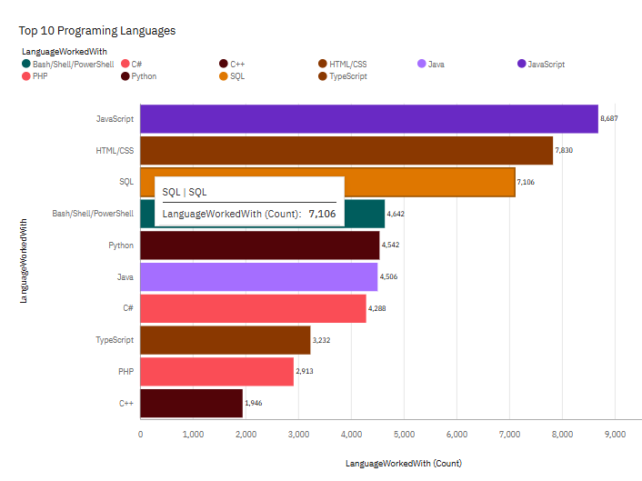
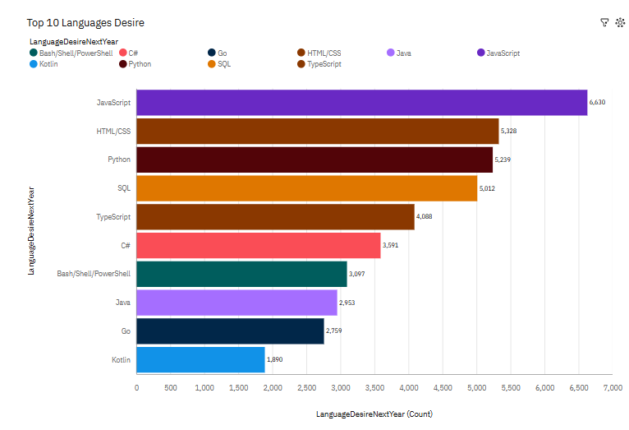
PROGRAMMING LANGUAGE TRENDS
Current Year
Next Year

Slide 8
PROGRAMMING LANGUAGE TRENDS - FINDINGS & IMPLICATIONS
Findings
Python remains the most popular programming language due to its extensive applications in data science, AI, and web development.
Emerging languages like Rust and Go are gaining traction, especially in system programming and scalable applications.
Traditional languages such as PHP and Ruby show a decline in demand, reflecting a shift towards modern frameworks and tools.
Implications
Developers should focus on upskilling in high-demand languages like Python, Go, and Rust to remain competitive in the job market.
Educational institutions and training programs should prioritize these languages in their curricula to align with industry needs.
Businesses need to adapt their tech stacks to include modern programming languages to stay relevant and scalable.

Slide 9
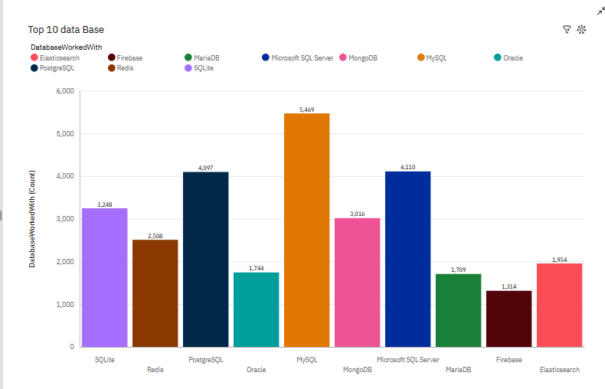
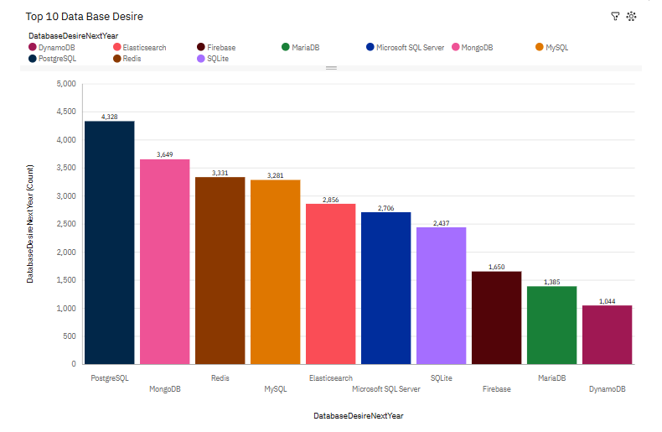
DATABASE TRENDS
Current Year
Next Year

Slide 10
DATABASE TRENDS - FINDINGS & IMPLICATIONS
Findings
Relational databases like MySQL and PostgreSQL continue to dominate due to their robust features and wide adoption in traditional applications.
NoSQL databases such as MongoDB and Cassandra are growing rapidly, driven by the need for scalability and flexibility in handling unstructured data.
Cloud-based database solutions like AWS RDS and Google BigQuery are becoming more prevalent, reflecting the shift towards cloud infrastructure.
Implications
Developers and database administrators must adapt by gaining expertise in both relational and NoSQL databases to meet diverse project requirements.
Organizations should consider integrating NoSQL databases for handling big data and real-time analytics to improve performance.
Businesses migrating to the cloud need to invest in cloud-based database solutions to reduce infrastructure costs and enhance scalability.

Slide 11

DASHBOARD
https://github.com/abbas829/cognos_work

Slide 12
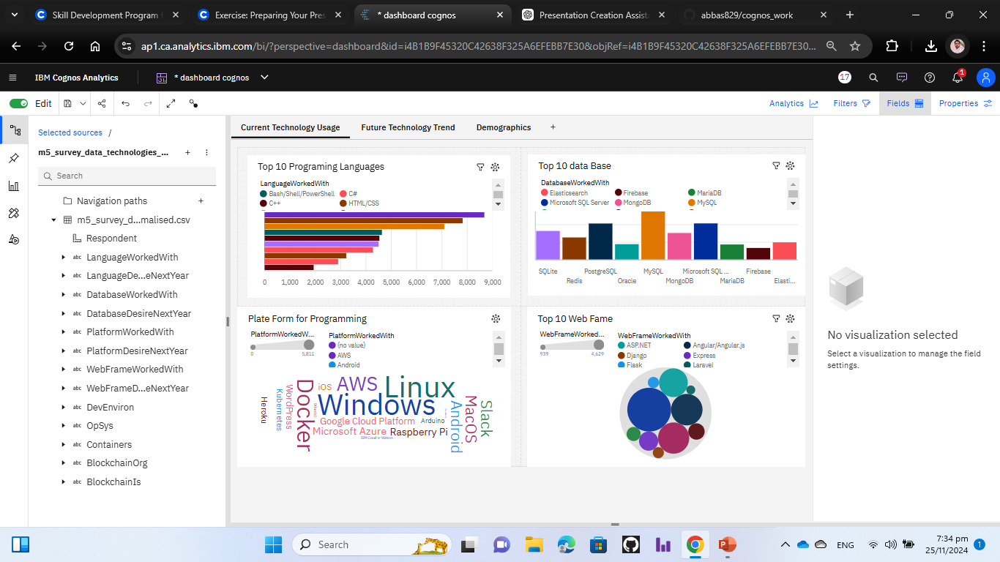
DASHBOARD TAB 1

Slide 13
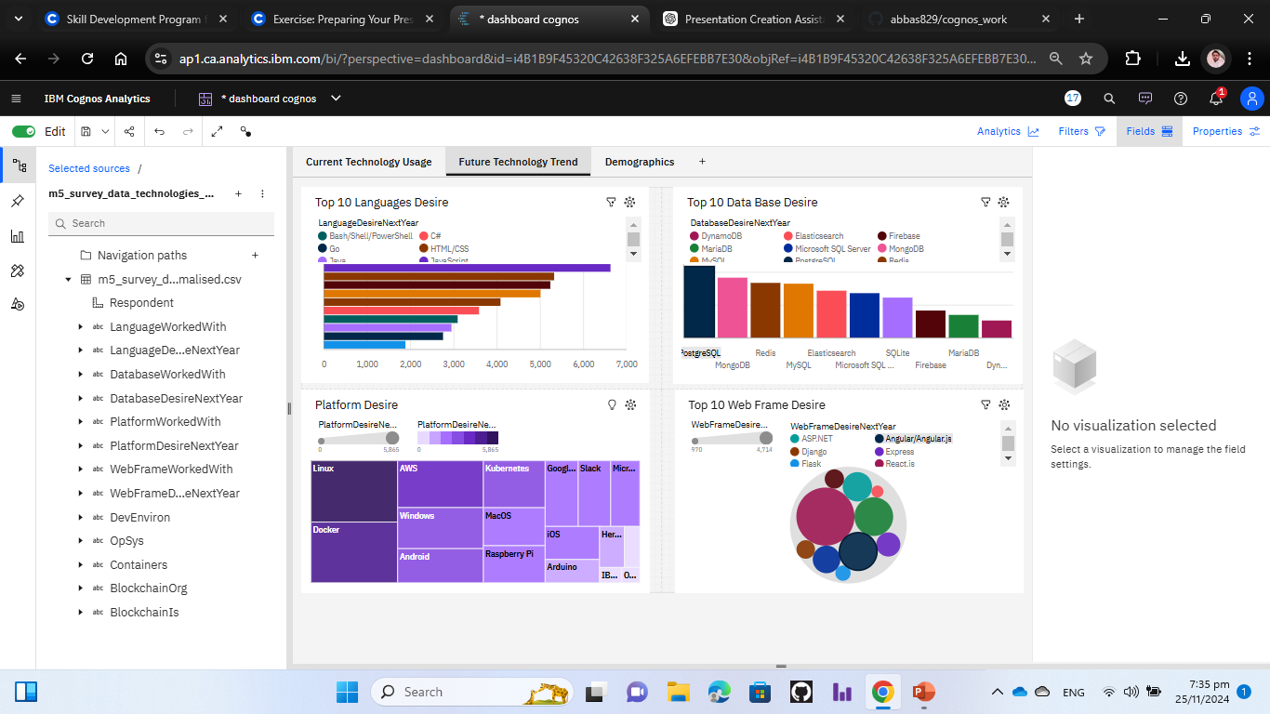
DASHBOARD TAB 2

Slide 14
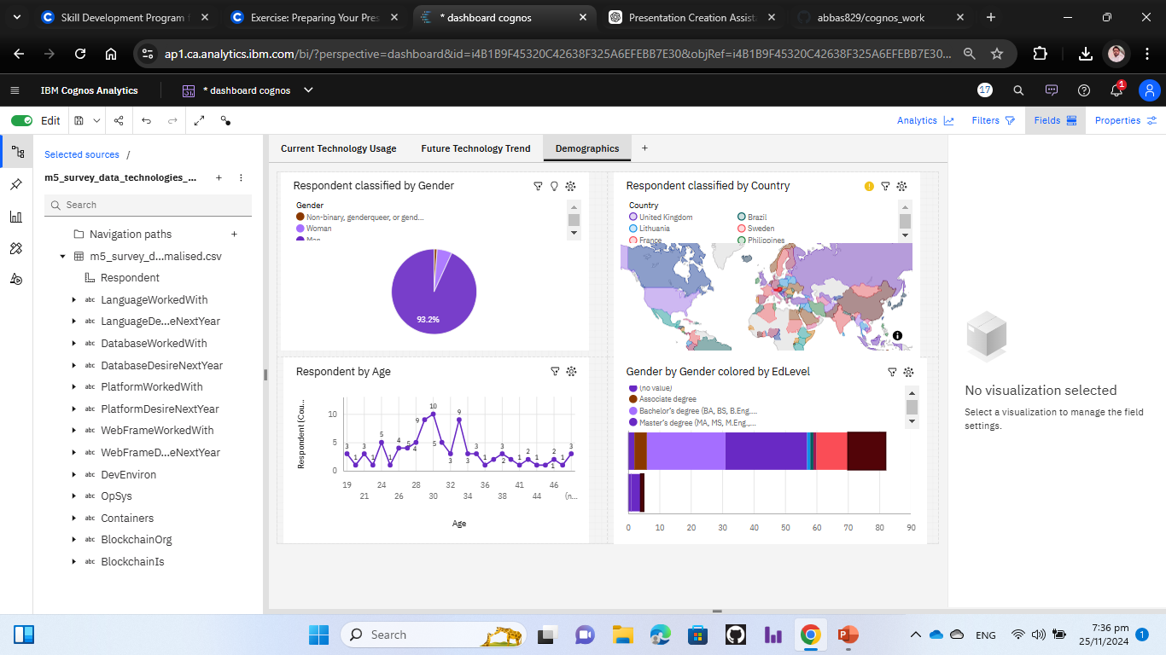
DASHBOARD TAB 3

Slide 15
DISCUSSION
This presentation highlights evolving trends in programming languages and databases, showcasing Python's dominance and the rise of NoSQL and cloud-based solutions. Insights emphasize adapting to industry demands, upskilling for emerging technologies, and balancing legacy systems with innovation. These findings guide businesses and professionals toward informed decisions and competitive strategies.

Slide 16
OVERALL FINDINGS & IMPLICATIONS
Findings
Python remains the most in-demand programming language due to its versatility in AI, data science, and web development.
NoSQL and cloud-based databases are rapidly growing, driven by the need for scalability and real-time analytics.
Emerging technologies like Rust and Go are gaining traction, while traditional tools like PHP are declining.
Implications
Developers should prioritize learning Python, Rust, and Go to align with market demands and future opportunities.
Businesses should adopt NoSQL and cloud-based databases to enhance performance and scalability.
Educational institutions need to update their curricula to focus on modern languages and database technologies.

Slide 17

CONCLUSION
The dominance of Python and the rise of modern languages like Rust and Go emphasize the need for adaptability in technology skills.
NoSQL and cloud-based databases are transforming data management, offering scalability and flexibility for modern applications.
The evolving tech landscape underscores the importance of continuous learning and upskilling for professionals and organizations.
Strategic adoption of emerging tools and technologies ensures long-term growth, competitiveness, and operational efficiency.

