Slide 1
Web services
Service Oriented Architecture
(SOA)

Slide 2
Agenda
What is Service
What is Web Service
Web Service Vs Web Application
What is Service Oriented Architecture(SOA)
SOA Architecture
Features of Web Services
Types of Web services
Technology Stack
JSON Vs XML
SOAP VS Rest

Slide 3
What is Service
A service is a software component that is well-defined, self-contained, and does not depend on the context or state of other services
Ex: In ShoppingCart project
DO
DAO

Slide 4
What is Web Service?
A web service is a network accessible interface to application programs, built using standard Internet technologies.
Clients of web services do NOT need to know how it is implemented.
Network
Web
Service
Application
client
Application
program

Slide 5
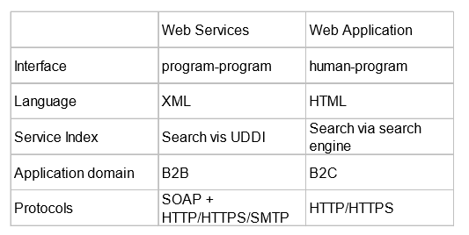
Web Services Vs Web Application

Slide 6
SAO
A service-oriented architecture (SOA) is an architectural pattern in computer software design in which application components provide services to other components via a communications protocol, typically over a network.
It is a concept, not a technology

Slide 7
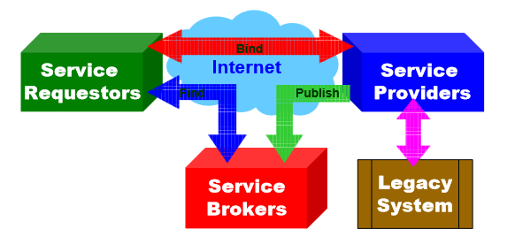
SAO - Architecture

Slide 8
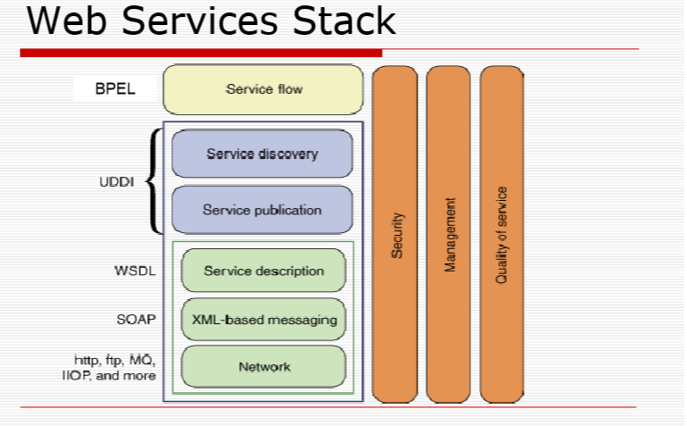

Slide 9
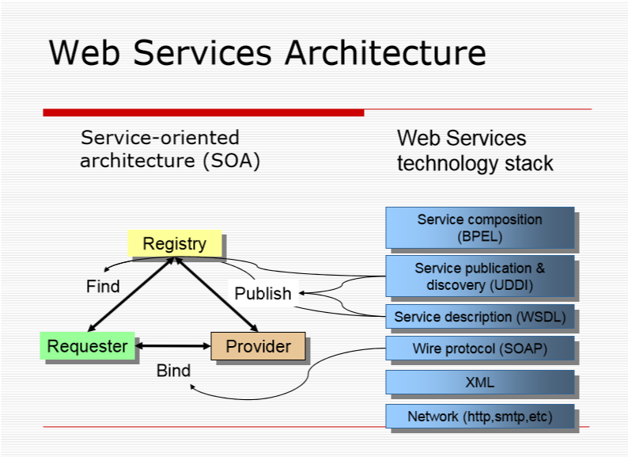

Slide 10
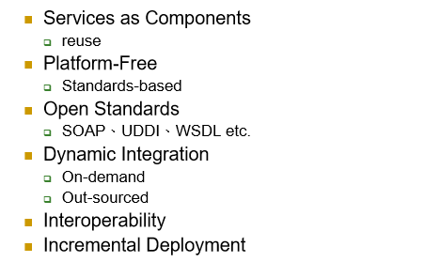
Features of Web Services

Slide 11
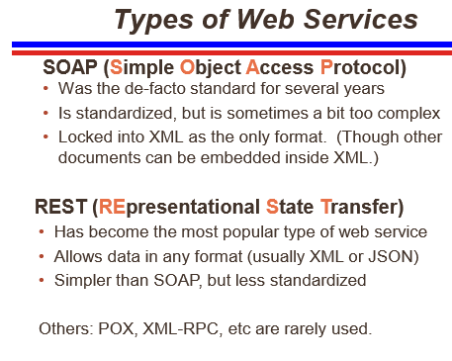

Slide 12
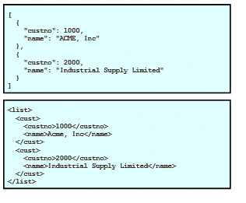
Data Representation JSON Vs XML

Slide 13
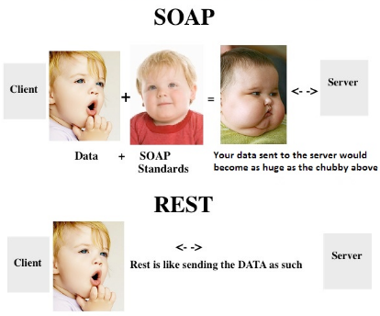
SOAP Vs REST

Slide 14
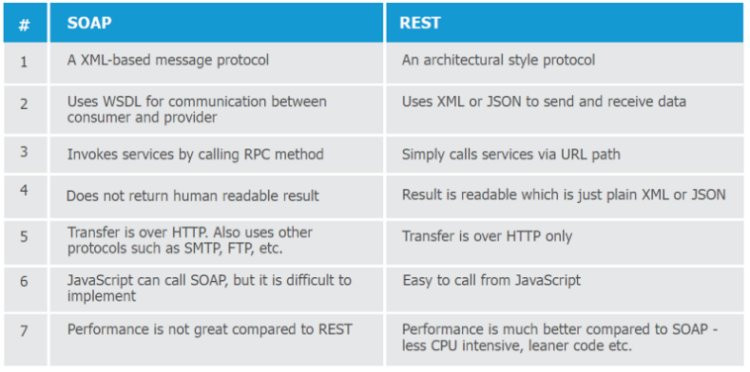

Slide 15
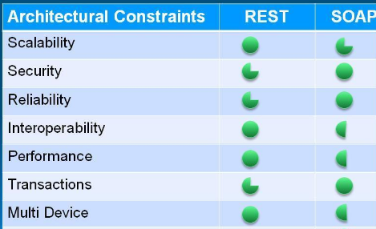
SOAP Vs REST

Slide 16
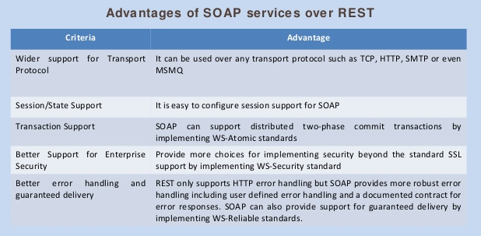

Slide 17
