Slide 1
Angular JS

Slide 2
Agenda
What is Angular JS
Request/Response Mechanism
Traditional Vs Angular approach
Data Binding
One way Vs Two way
Angular JS Architecture
Angular Directives
Examples / Demo

Slide 3
What is Angular JS
AngularJS is a JavaScript framework.
Front end side MVC Framework
MVVM, MVW
ModelView and ViewModel
Model View and Whatever
SPA
Single Page Application
Supported by Google and a great development community.
Supports Template support

Slide 4
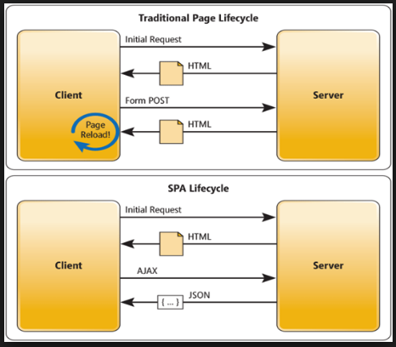
Request/Response – Mechanism

Slide 5
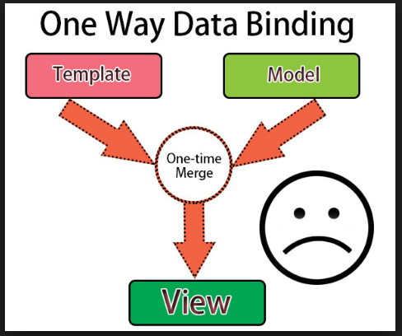
One Way Binding

Slide 6
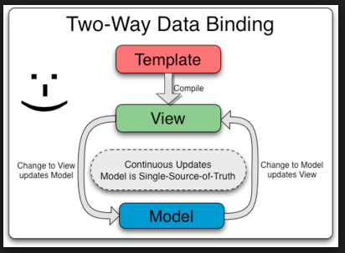
Two way Binding

Slide 7
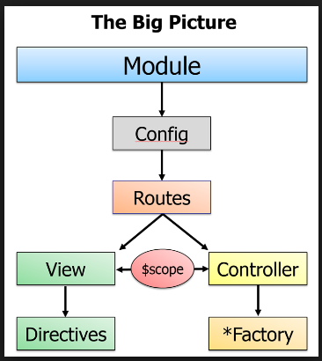
Angular JS Architecture

Slide 8
Topics
Directives
Controllers
Routers
Services

Slide 9
Angular JS Directives
Attach a specified behaviour to that DOM element (HTML)
DOM – Document Object Model
Tree Structure

Slide 10
Basic ng directives
The ng-app directive defines an AngularJS application.
The ng-model directive binds the value of HTML controls (input, select, textarea) to application data.
The ng-bind directive binds application data to the HTML view.
{{}} --Using expression

Slide 11
Environment Setup???
<script src="http://ajax.googleapis.com/ajax/libs/angularjs/1.4.8/angular.js"></script>
OR
You can download this js and keep in a folder and can refer (let us say “lib”
<script src = lib/angular.js></script>

Slide 12
Demo

