Slide 1

Java Programming
Java Input Output
Prof. Shailesh Gahane
Assistant Professor
Dr. D. Y. Patil School of MCA
Charholi (Bk), Lohegaon, Pune – 412105
Mail ID: shaileshmca2007@gmail.com
Prof. Shailesh T. Gahane, Dr. D Y Patil School of MCA, Pune

Slide 2
JAVA Input Output
The Stream is a sequence of Bytes.
Output Stream: Writing Data to a Stream.
Input Stream: Reading Data from a Stream.
If a stream has a buffer in memory then it is Buffered Stream.
Character stream have character data and are used for storing and retrieving the text.
Prof. Shailesh T. Gahane, Dr. D Y Patil School of MCA, Pune

Slide 3
There are four types of abstract Streams class
Reader: Read Character
Writer: Write Character
InputStream: A stream to read binary data.
OutputStream: A Stream to write binary data.
Generally we are using BufferedInputStream, BufferedOutputStream, BufferedReader and BufferedWriter for better performance of Buffered I/O Classes.
Prof. Shailesh T. Gahane, Dr. D Y Patil School of MCA, Pune

Slide 4
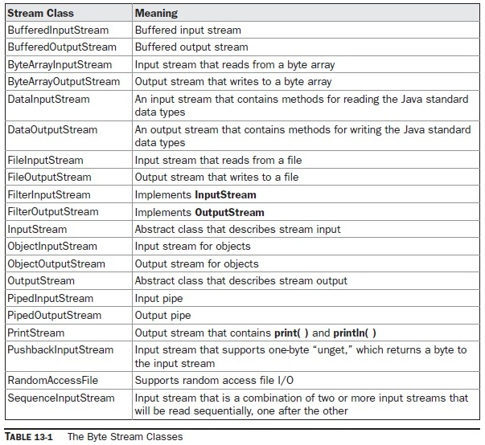
Byte Stream Classes
Prof. Shailesh T. Gahane, Dr. D Y Patil School of MCA, Pune

Slide 5
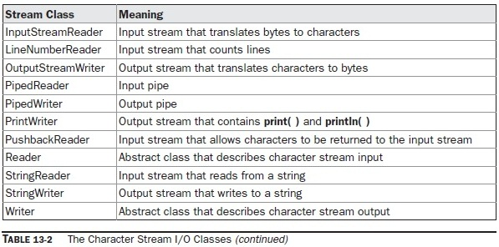
Character Stream I/O Classes
Prof. Shailesh T. Gahane, Dr. D Y Patil School of MCA, Pune

Slide 6
InputStream:
Used to read binary data.
FileInputStream enables easy reading from a file.
BufferInputStream provides data buffering .
InputStream class has three read method overloads.
public abstract int read(int b1)
public int read(byte[] data)
public int read(byte[] data, int offset, int length)
Where the offset stands for the first bytes should be placed.
Prof. Shailesh T. Gahane, Dr. D Y Patil School of MCA, Pune

Slide 7
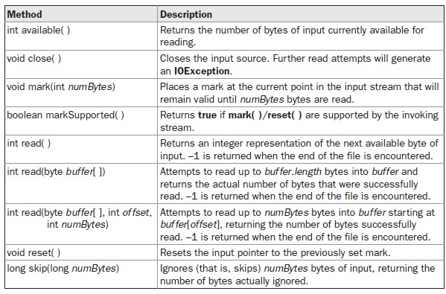
Methods Defined by InputStream
Prof. Shailesh T. Gahane, Dr. D Y Patil School of MCA, Pune

Slide 8
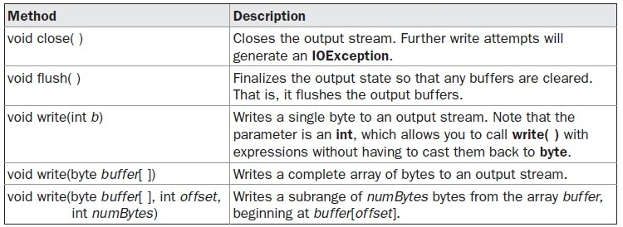
Methods Defined by OutputStream
Prof. Shailesh T. Gahane, Dr. D Y Patil School of MCA, Pune

Slide 9
The Predefined Streams
Java programs automatically import the java.lang package. This package defines a class called System, which encapsulates several aspects of the run-time environment.
System also contains three predefined stream variables: in, out, and err. These fields are declared as public, static, and final within System. This means that they can be used by any other part of your program and without reference to a specific System object.
System.in is an object of type InputStream; System.out and System.err are objects of type PrintStream. These are byte streams, even though they typically are used to read and write characters from and to the console.
Prof. Shailesh T. Gahane, Dr. D Y Patil School of MCA, Pune

Slide 10
File:
File object is used to obtain or manipulate the information associated with a disk file such as permission, time, date and directory path.
File object can refer to either file or directory.
File f1 = new File(“mcaii.txt”);
File f1 = new File(“c:\mcaii.txt”);
Files are stored in binary form.
The following constructors can be used to create File objects:
File(String directoryPath)
File(String directoryPath, String filename)
File(File dirObj, String filename)
File(URI uriObj)
Prof. Shailesh T. Gahane, Dr. D Y Patil School of MCA, Pune

Slide 11
FileInputStream
The FileInputStream class creates an InputStream that you can use to read bytes from a file.
Its two most common constructors are shown here:
FileInputStream(String filepath)
FileInputStream(File fileObj)
FileOutputStream
FileOutputStream creates an OutputStream that you can use to write bytes to a file. Its most commonly used constructors are shown here:
FileOutputStream(String filePath)
FileOutputStream(File fileObj)
FileOutputStream(String filePath, boolean append)
FileOutputStream(File fileObj, boolean append)
Prof. Shailesh T. Gahane, Dr. D Y Patil School of MCA, Pune

Slide 12
The PrintWriter Class
PrintWriter is one of the character-based classes.
Using a character-based class for console output makes it easier to internationalize your program.
PrintWriter defines several constructors. The one we will use is shown here:
PrintWriter(OutputStream outputStream, boolean flushOnNewline)
Here, outputStream is an object of type OutputStream, and flushOnNewline controls whether Java flushes the output stream every time a println( ) method is called.
PrintWriter supports the print( ) and println( ) methods for all types including Object.
Prof. Shailesh T. Gahane, Dr. D Y Patil School of MCA, Pune

Slide 13
The following application illustrates using a PrintWriter to handle console output
// Demonstrate PrintWriter
import java.io.*;
public class PrintWriterDemo
{
public static void main(String args[])
{
PrintWriter pw = new PrintWriter(System.out, true);
pw.println("This is a string");
int i = -7;
pw.println(i);
double d = 4.5e-7;
pw.println(d);
}
}
Prof. Shailesh T. Gahane, Dr. D Y Patil School of MCA, Pune

Slide 14
Reading and Writing Files
Two of the most often-used stream classes are FileInputStream and FileOutputStream, which create byte streams linked to files. To open a file, you simply create an object of one of these classes, specifying the name of the file as an argument to the constructor.
the following are the forms that we will be using:
FileInputStream(String fileName) throws FileNotFoundException
FileOutputStream(String fileName) throws FileNotFoundException
Prof. Shailesh T. Gahane, Dr. D Y Patil School of MCA, Pune

Slide 15
DataOutputStream and DataInputStream
DataOutputStream and DataInputStream enable you to write or read primitive data to or
from a stream. They implement the DataOutput and DataInput interfaces, respectively
Prof. Shailesh T. Gahane, Dr. D Y Patil School of MCA, Pune

Slide 16

Thank you !!!
Prof. Shailesh Gahane
Assistant Professor
Dr. D. Y. Patil School of MCA
Charholi (Bk), Lohegaon, Pune – 412105
Mail ID: shaileshmca2007@gmail.com
Prof. Shailesh T. Gahane, Dr. D Y Patil School of MCA, Pune

