Slide 1
Operators in JAVA

Slide 2
Operator
An operator is a symbol that operates on one or more arguments to produce a result.
Java provides a rich set of operators to manipulate variables.

Slide 3
Operands
An operands are the values on which the operators act upon.
An operand can be:
A numeric variable - integer, floating point or character
Any primitive type variable - numeric and boolean
Reference variable to an object
A literal - numeric value, boolean value, or string.
An array element, "a[2]“
char primitive, which in numeric operations is treated as an unsigned two byte integer

Slide 4
Types of Operators
Assignment Operators
Increment Decrement Operators
Arithmetic Operators
Bitwise Operators
Relational Operators
Logical Operators
Ternary Operators
Comma Operators
Instanceof Operators

Slide 5
Assignment Operators
The assignment statements has the following syntax:
<variable> = <expression>

Slide 6
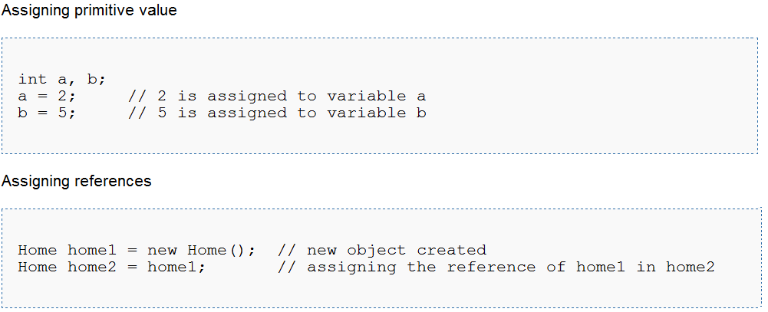
Assigning values Example

Slide 7
Increment and Decrement operators ++ and --
The increment and decrement operators add an integer variable by one.
increment operator:
two successive plus signs, ++
decrement operator: --

Slide 8
Increment and Decrement operators ++ and --
Common Shorthand
a = a + 1; a++; or ++a;
a = a - 1; a--; or --a;

Slide 9
Example of ++ and -- operators
public class Example
{
public static void main(String[] args)
{
}
}
int j, p, q, r, s;
j = 5;
p = ++j; // j = j + 1; p = j;
System.out.println("p = " + p);
q = j++; // q = j; j = j + 1;
System.out.println("q = " + q);
System.out.println("j = " + j);
r = --j; // j = j -1; r = j;
System.out.println("r = " + r);
s = j--; // s = j; j = j - 1;
System.out.println("s = " + s);
> java example
p = 6
q = 6
j = 7
r = 6
s = 6
>

Slide 10
Arithmetic Operators
The arithmetic operators are used to construct mathematical expressions as in algebra.
Their operands are of numeric type.

Slide 11
Arithmetic Operators
Operator | Result
+ | Addition
- | Subtraction (also unary minus)
* | Multiplication
/ | Division
% | Modulus
++ | Increment
+= | Addition assignment
-= | Subtraction assignment
*= | Multiplication assignment
/= | Division assignment
%= | Modulus assignment
-- | Decrement

Slide 12
Simple Arithmetic
public class Example {
public static void main(String[] args) {
int j, k, p, q, r, s, t;
j = 5;
k = 2;
p = j + k;
q = j - k;
r = j * k;
s = j / k;
t = j % k;
System.out.println("p = " + p);
System.out.println("q = " + q);
System.out.println("r = " + r);
System.out.println("s = " + s);
System.out.println("t = " + t);
}
}
> java Example
p = 7
q = 3
r = 10
s = 2
t = 1
>

Slide 13
Bitwise Operators
Java's bitwise operators operate on individual bits of integer (int and long) values.
If an operand is shorter than an int, it is promoted to int before doing the operations.

Slide 14
Bitwise Operators
Operator | Name | Description
a & b | and | 1 if both bits are 1.
a | b | or | 1 if either bit is 1.
a ^ b | xor | 1 if both bits are different.
~a | not | Inverts the bits.
n << p | left shift | Shifts the bits of n left p positions. Zero bits are shifted into the low-order positions.
n >> p | right shift | Shifts the bits of n right p positions. If n is a 2's complement signed number, the sign bit is shifted into the high-order positions.
n >>> p | right shift | Shifts the bits of n right p positions. Zeros are shifted into the high-order positions.

Slide 15
Example of Bitwise Operators
class Test {
public static void main(String args[]) {
int a = 60; /* 60 = 0011 1100 */
int b = 13; /* 13 = 0000 1101 */
int c = 0;
c = a & b; /* 12 = 0000 1100 */
System.out.println("a & b = " + c );
c = a | b; /* 61 = 0011 1101 */
System.out.println("a | b = " + c );

Slide 16
Example Cont.,
c = a ^ b; /* 49 = 0011 0001 */
System.out.println("a ^ b = " + c );
c = ~a; /*-61 = 1100 0011 */
System.out.println("~a = " + c );
c = a << 2; /* 240 = 1111 0000 */
System.out.println("a << 2 = " + c );
c = a >> 2; /* 215 = 1111 */
System.out.println("a >> 2 = " + c );
c = a >>> 2; /* 215 = 0000 1111 */
System.out.println("a >>> 2 = " + c );
} }
Output: a & b = 12 a | b = 61 a ^ b = 49 ~a = -61 a << 2 = 240 a >> 15 a >>> 15

Slide 17
Relational Operators
A relational operator compares two values and determines the relationship between them.
For example, != returns true if its two operands are unequal.
Relational operators are used to test whether two values are equal, whether one value is greater than another, and so forth.

Slide 18
Relational Operators
Operator | Description
== | Checks if the value of two operands are equal or not, if yes then condition becomes true.
!= | Checks if the value of two operands are equal or not, if values are not equal then condition becomes true.
> | Checks if the value of left operand is greater than the value of right operand, if yes then condition becomes true.

Slide 19
Relational Operators
Operator | Description
< | Checks if the value of left operand is less than the value of right operand, if yes then condition becomes true.
>= | Checks if the value of left operand is greater than or equal to the value of right operand, if yes then condition becomes true.
<= | Checks if the value of left operand is less than or equal to the value of right operand, if yes then condition becomes true.

Slide 20
Example of Relational Operators
public LessThanExample
{
public static void main(String args[])
{
int a = 5; int b = 10;
if(a < b)
{
System.out.println("a is less than b");
}
}
}

Slide 21
Logical Operators
These logical operators work only on boolean operands. Their return values are always boolean.

Slide 22
Logical Operators
Operator | Description
&& | Called Logical AND operator. If both the operands are non zero then then condition becomes true.
|| | Called Logical OR Operator. If any of the two operands are non zero then then condition becomes true.
! | Called Logical NOT Operator. Use to reverses the logical state of its operand. If a condition is true then Logical NOT operator will make false.

Slide 23
Example of Logical Operators
public class ANDOperatorExample{
public static void main(String[] args){
char ans = 'y';
int count = 1;
if(ans == 'y' & count == 0){
System.out.println("Count is Zero.");}
if(ans == 'y' & count == 1) { System.out.println("Count is One."); }
if(ans == 'y' & count == 2) { System.out.println("Count is Two.");
} } }

Slide 24
Ternary Operators
Java has a short hand way by using ?: the ternary aka conditional operator for doing ifs that compute a value.
Unlike the if statement, the conditional operator is an expression which can be used for

Slide 25
Example of Ternary Operator
// longhand with if:
int answer;
if ( a > b )
{
answer = 1;
}
else
{
answer = -1;
}
// can be written more tersely with the ternary operator as: int answer = a > b ? 1 : -1;

Slide 26
Comma Operators
Java has an often look past feature within it’s for loop and this is the comma operator.
Usually when people think about commas in the java language they think of a way to split up arguments within a functions parameters

Slide 27
Example of Comma Operator
//: c03:CommaOperator.java // From 'Thinking in Java, 3rd ed.' (c) Bruce Eckel 2002 // www.BruceEckel.com. See copyright notice in CopyRight.txt. public class CommaOperator { public static void main(String[] args) { for(int i = 1, j = i + 10; i < 5; i++, j = i * 2) { System.out.println("i= " + i + " j= " + j); } } } ///:~

Slide 28
Instanceof Operators
This operator is used only for object reference variables. The operator checks whether the object is of a particular type(class type or interface type).
InstanceOf operator is wriiten as:
( Object reference variable ) instanceOf (class/interface type)

Slide 29
Example of instanceof Operator
class Vehicle {} public class Car extends Vehicle { public static void main(String args[]) { Vehicle a = new Car(); boolean result = a instanceof Car; System.out.println( result); } }

Slide 30
The End
….. Thank You …..

