Slide 1
Hibernate
Spring with Hibernate

Slide 2
Agenda
Why ORM ( Object Relational Mapping)
JDBC Steps ( Java Data Base Connectivity)
Hibernate architecture
Configuration with Spring
Configuration
Model / Bean / Entity/DO
DAO

Slide 3
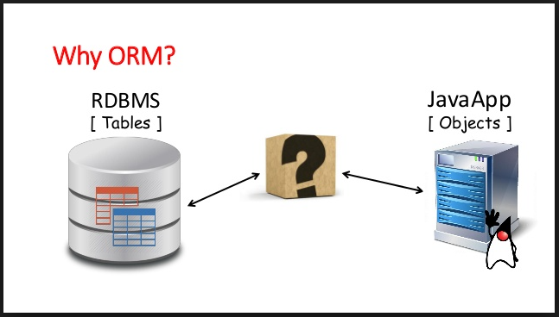
Why ORM

Slide 4
OO Vs RDBMS
Different data types
Identity
Association
Object Navigation

Slide 5
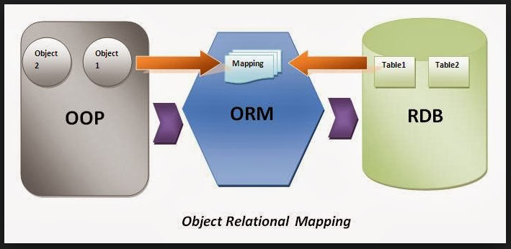
ORM

Slide 6
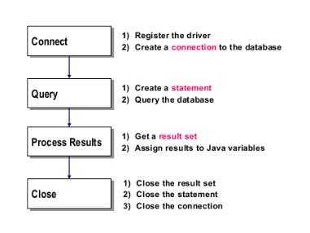
JDBC Steps

Slide 7
Hibernate
DB Connection
Mapping from table to Object
Transaction management
Session Management

Slide 8
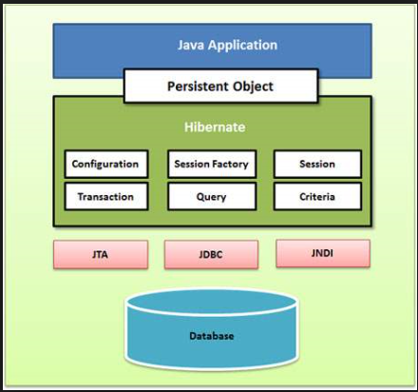
Hibernate Architecture

Slide 9
Hibernate Configuration (Data Source Configuration)
Java Based configuration
Xml based configuration

Slide 10
What to configure??
Data source Properties
Driver Name
URL
User Name
Password
Hibernate Properties
Dialect
Session Factory
With datasource
With hibernate properties
With annotated classes (for each domain object)

Slide 11
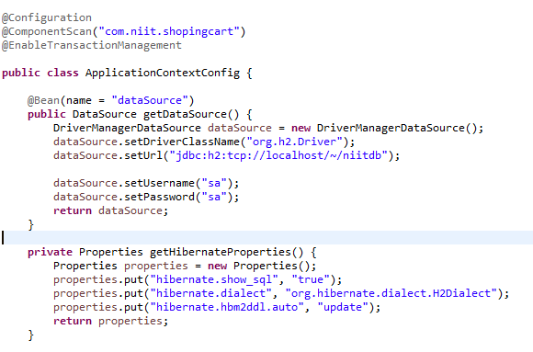
Java Based configuration

Slide 12
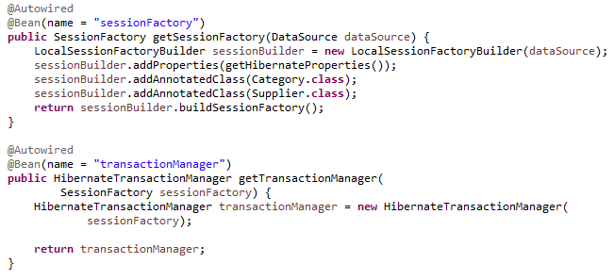
Java Based configuration

Slide 13
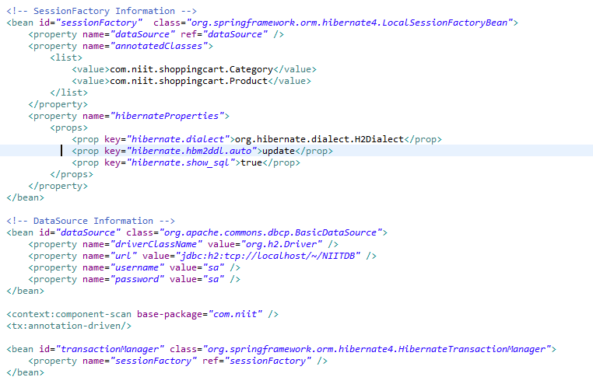
XML Based Configuration

