Slide 1
Spring Security

Slide 2
Configuration
Maven Dependencies
Web.xml (Can use Java based)
Spring Security xml (Can use Java based)
Data Source reference
Get the user and role from user table
Intercept url
Controller

Slide 3
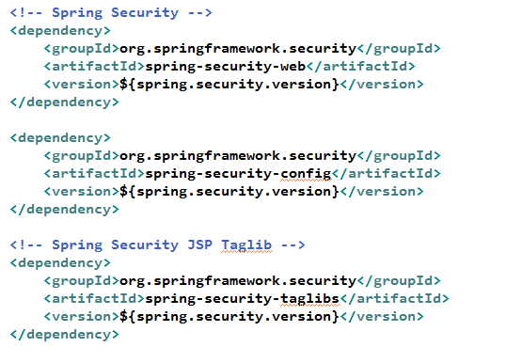
Maven Dependencies

Slide 4
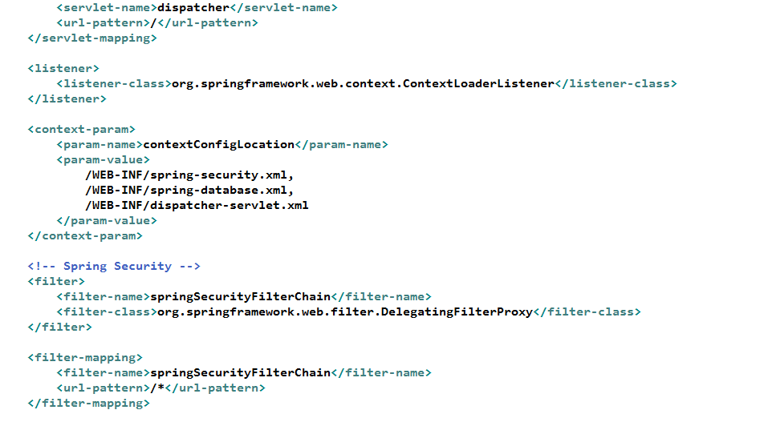
Web.xml

Slide 5
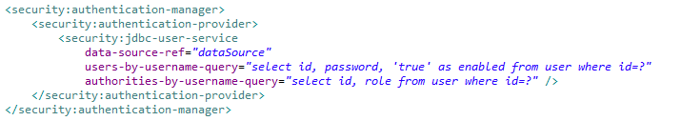
Data source reference

Slide 6
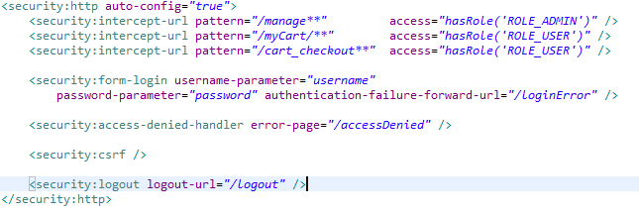

Intercept urls
Admin Controller
Product Controller

Slide 7
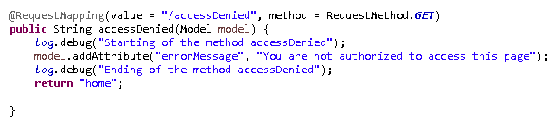
Security Controller

Slide 8
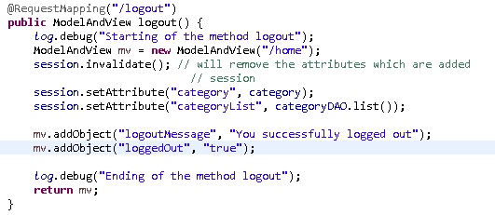
Security Controller

Slide 9
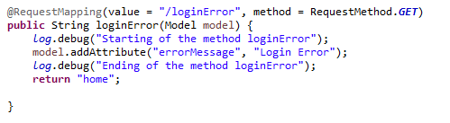
Security Controller

Slide 10
Java Based configuration

Slide 11
Security Configuration
@Override
protected void configure(HttpSecurity http) throws Exception {
http.authorizeRequests()
.antMatchers("/product/cart/add", "/mycart**").access("hasRole(‘C')")
.antMatchers(“/manage**”, “/supplier/save/”,”category/save/, “product/save/”).access("hasRole(‘A')")
.antMatchers(“/**").access("hasRole('SUPER_ADMIN')")
.and().formLogin().loginPage("/login").defaultSuccessUrl("/home")
.usernameParameter("id").passwordParameter("password")
.and().exceptionHandling().accessDeniedPage("/accessdenied");
}

Slide 12
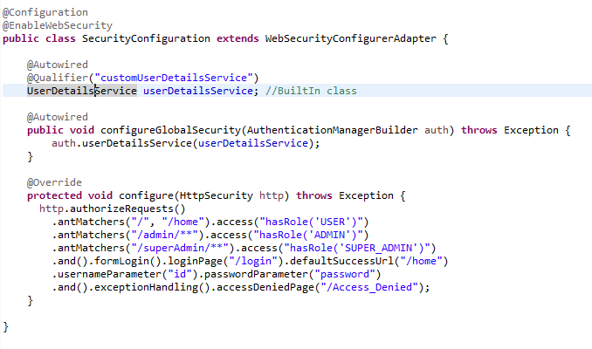
Security Configuration

Slide 13
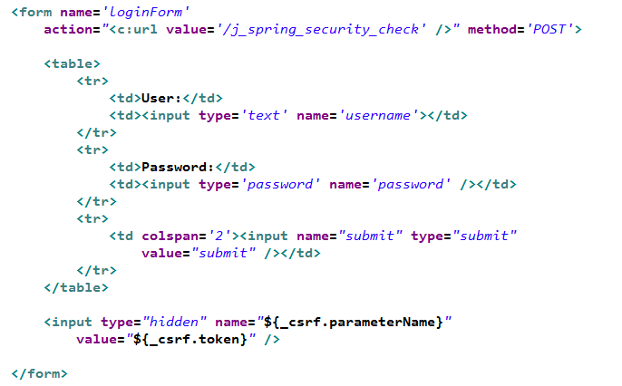
Login Page

Slide 14
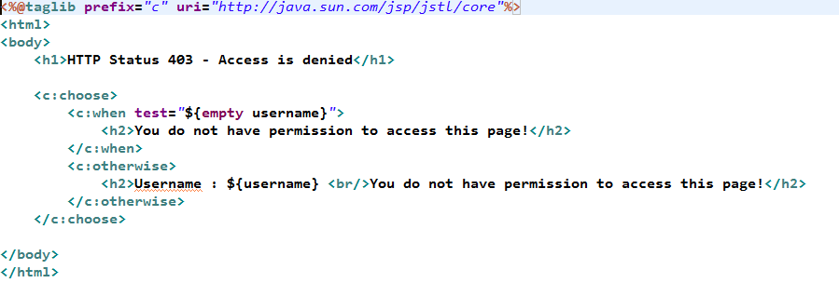
Access Denied Page

Slide 15
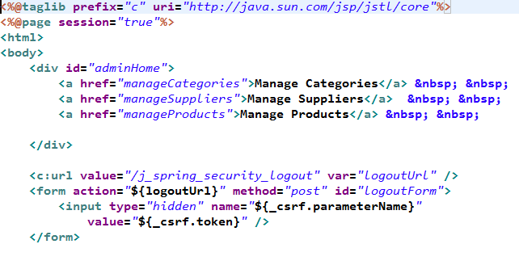
Admin Home page

Slide 16
References
https://dzone.com/articles/spring-security-4-authenticate-and-authorize-users
http://websystique.com/spring-security/spring-security-4-hello-world-annotation-xml-example/

