Slide 1
Machine Learning Quick Tour
By phonchi 2016/06/21

Slide 2
Why machine learning?
Exists some ‘underlying pattern’ to be learned, and exists data about the pattern : so performance can be improved
But no programmable (easy) way, so machine learning(ML) is needed!
Key idea:
Give a computer a fish, you feed it for a day; teach it how to fish, you feed it for a lifetime
We want to obtain a model (a set of formula or rules) that we can make prediction or inference

Slide 3
How is it related to other Fields
Machine Learning and Artificial Intelligence
Compute something that shows intelligent behavior
ML is something that shows intelligent behavior —ML can realize AI! ex: Game tree -> learn from board data
Machine Learning and Statistics
Use data to make inference about an unknown process
Traditional statistics also focus on provable results with math assumptions
Many useful tools for ML

Slide 4
Lab0: Data Analysis with Python/Matlab/R
There are versatile of data analysis libraries built-in
It is a big advantage to have both interactive and visualization capability when we analysis data
The syntax is very similar, refer to Syntax Difference, or this
Log into SagemathCloud and open Lab0-0, Lab0-1, Lab0-2 to play around with it.
Notes:
Lua – torch
Julia
Scala

Slide 5
How does machine learning work?
Supervise
The data comes with additional attributes that we want to predict which is called label or ground truth. The goal is to predicted future unseen data.
Unsupervise
The training data consists of a set of input vectors without any corresponding target values. The goal in such problems are to reveal the underlying pattern within the data.
C.f. Semi-supervised learning, reinforcement learning.
Notes:
combines both labeled and unlabeled data to generate an approriate function or classifier learns how to act or behave when given occasional reward or punishment signals
Reinforcement learning differs from standard supervised learning in that correct input/output pairs are never presented, nor sub-optimal actions explicitly corrected. Further, there is a focus on on-line performance, which involves finding a balance between exploration (of uncharted territory) and exploitation (of current knowledge). The exploration vs. exploitation trade-off in reinforcement learning has been most thoroughly studied through the multi-armed bandit problem and in finite MDPs.

Slide 6
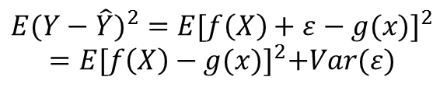
General Architecture
$${E(Y−\hat{Y})}^{2}={E[f\left(X\right)+ε−g(x)]}^{2}$$
$$=E{[f\left(X\right)−g(x)]}^{2}+Var(ε)$$
Reducible
Irreducible
Notes:
Noise comes from
Unmeasured variables that are useful for predicting Y
Unmeasurable variation (equipment, human)

Slide 7
Data Set
Awesome-dataset
A collection of public datasets
Kaggle
Competitions on which researchers post their data and statisticians to produce the best models
KDDCup
Notes:
ACM

Slide 8



Lab1: Sklearn Library
Built on NumPy, SciPy, and matplotlib
Simple and efficient tools for data mining and data analysis
Well-documented
Go to Lab1-Overview to learn about data sets
Who use sklearn?
Notes:
Scikit-learn 是一個機器學習領域的開源套件。整個專案起始於 2007年由David Cournapeau所執行的Google Summer of Code 計畫。而2010年之後，則由法國國家資訊暨自動化研究院（INRIA, http://www.inria.fr） 繼續主導及後續的支援及開發。近幾年(2013-2015)則由 INRIA 支持 Olivier Grisel (http://ogrisel.com) 全職負責該套件的維護工作。以開發者的角度來觀察，會發現Scikit-learn的整套使用邏輯設計的極其簡單。往往能將繁雜的機器學習理論簡化到一個步驟完成。
Python的機器學習相關套件相當多，為何Scikit-learn會是首選之一呢？其實一個開源套件的選擇，最簡易的指標就是其contributor: 貢獻者 、 commits:版本數量 以及最新的更新日期。下圖是2016/1/3 經過了美好的跨年夜後，筆者於官方開源程式碼網站(https://github.com/scikit-learn/scikit-learn) 所擷取的畫面。我們可以發現最新commit是四小時前，且contributor及commit數量分別為531人及 20,331個。由此可知，至少在2016年，這個專案乃然非常積極的在運作。在眾多機器學習套件中，不論是貢獻者及版本數量皆是最龐大的。
http://machine-learning-python.kspax.io/

Slide 9
When can we use machine learning?(1/2)
Classification:
It is as a discrete form of supervised learning where one has a limited number of categories and for each of the n samples provided, one is to try to label them with the correct category or class.
Regression:
If the desired output consists of one or more continuous variables, then the task is called regression
Ex1: Given features humidity, wind speed, wind direction, season, barometric pressure…etc. We want to predict whether it will rain or not (T/F test or Multiple Choice)
Ex2: Given features humidity, wind speed, wind direction, season, barometric pressure…etc. We want to predict the temperature (Calculation problem)

Slide 10
When can we use machine learning?(2/2)
Clustering
The goal in such problems is to discover groups of similar examples within the data
Density estimation
Determine the distribution of data within the input space
Dimension Reduction
To project the data from a high-dimensional space down to two or three dimensions for the purpose of visualization or reduce complexity

Slide 11
Training vs Testing
A common practice in machine learning to evaluate an algorithm is to split the data at hand into two sets (Training set and testing set)

Slide 12
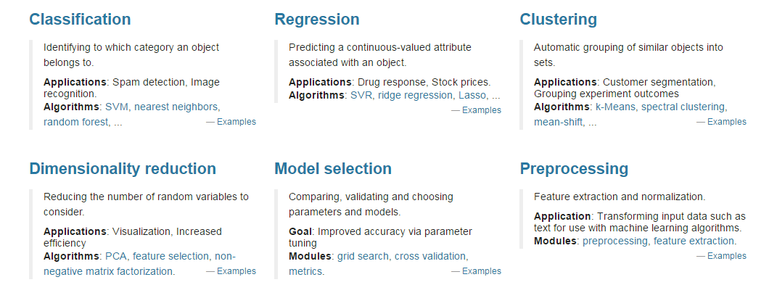
Lab2: Classification and Regression
Watch an amazing illustration about decision tree classifier
Go to Lab2 to see how classification and regression works
You can find more examples in Sklearn website

Slide 13
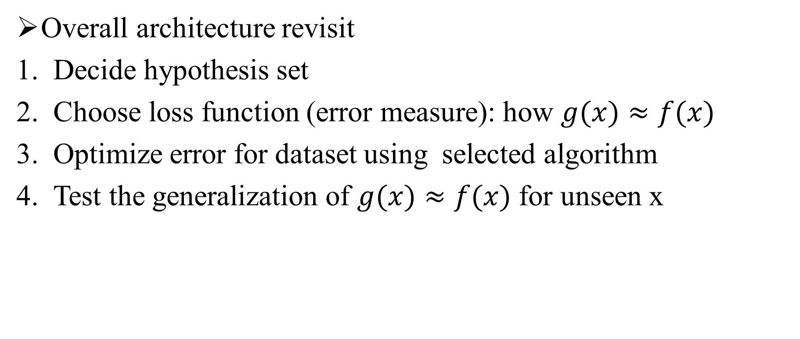
Loss function
Overall architecture revisit
Decide hypothesis set
Choose loss function (error measure): how $g(x)≈f(x)$
Optimize error for dataset using selected algorithm
Test the generalization of $g(x)≈f(x)$ for unseen x

Slide 14
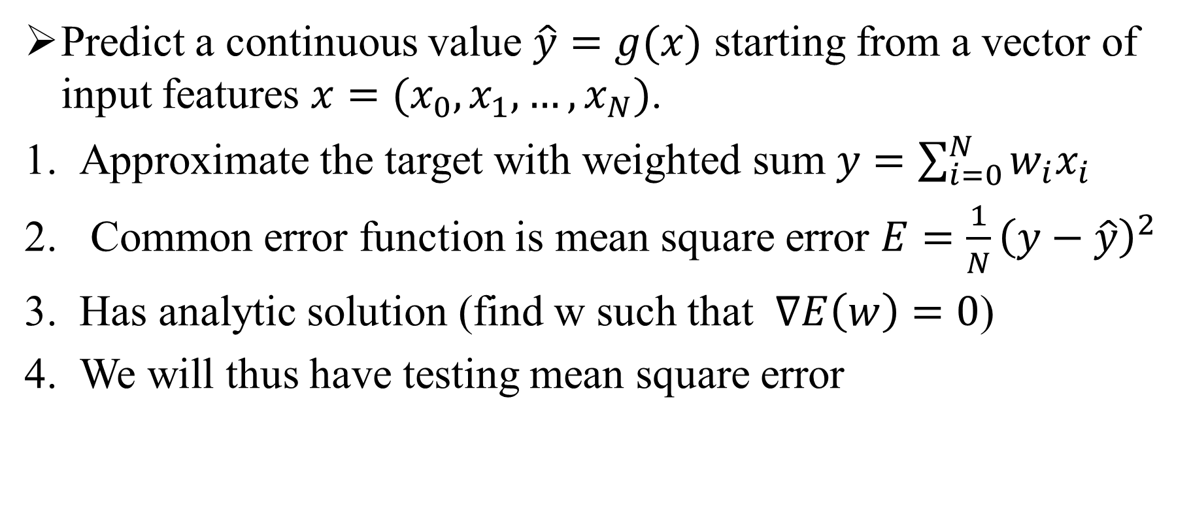
Supervise Learning: Linear Regression
Predict a continuous value $\hat{y}=g(x)$ starting from a vector of input features $x=(x_{0}, x_{1},…,x_{N})$.
Approximate the target with weighted sum $y=\sum_{i=0}^{N}{w_{i}x_{i}}$
Common error function is mean square error $E={\frac{1}{N}\left(y−\hat{y}\right)}^{2}$
Has analytic solution (find w such that $∇E\left(w\right)=0$)
We will thus have testing mean square error
Notes:
Regression Y on X
Assume they are independent

Slide 15
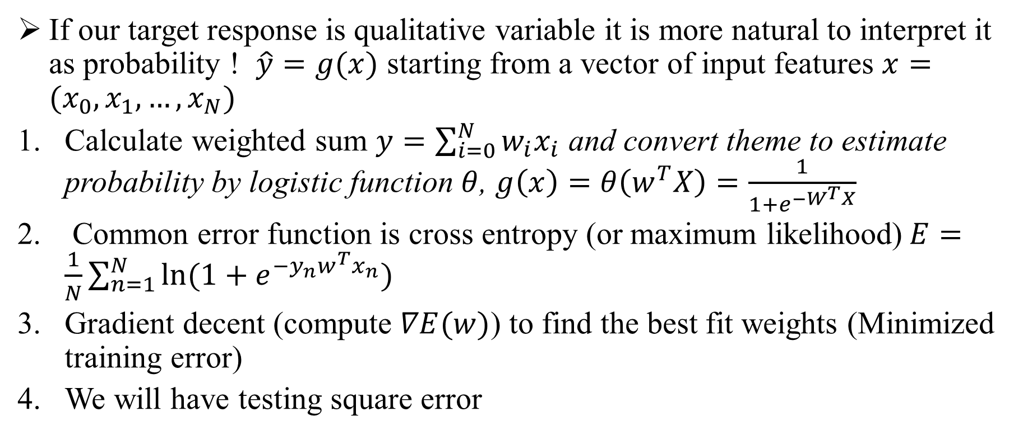
Supervise Learning: Logistic Regression
If our target response is qualitative variable it is more natural to interpret it as probability ! $\hat{y}=g(x)$ starting from a vector of input features $x=(x_{0}, x_{1},…,x_{N})$
Calculate weighted sum $y=\sum_{i=0}^{N}{w_{i}x_{i}}$ and convert theme to estimate probability by logistic function $θ$, $g\left(x\right)=θ\left(w^{T}X\right)=\frac{1}{1+e^{−W^{T}X}}$
Common error function is cross entropy (or maximum likelihood)$E=\frac{1}{N}\sum_{n=1}^{N}{\ln{(1+e^{−y_{n}w^{T}x_{n}})}}$
Gradient decent (compute $∇E(w)$) to find the best fit weights (Minimized training error)
We will have testing square error
Notes:
When to stop

Slide 16
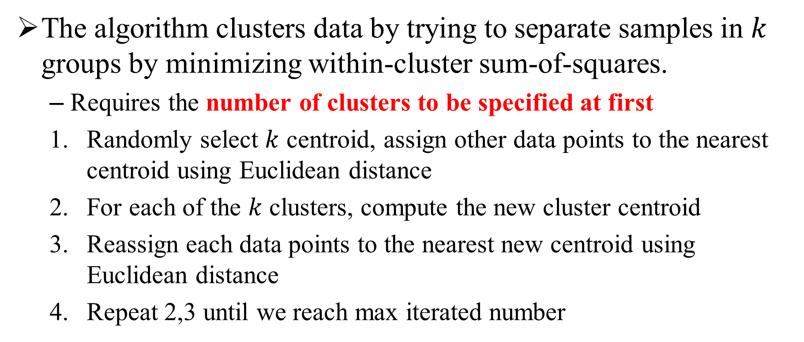
Unsupervise Learning: K-means
The algorithm clusters data by trying to separate samples in $k$ groups by minimizing within-cluster sum-of-squares.
Requires the number of clusters to be specified at first
Randomly select $k$ centroid, assign other data points to the nearest centroid using Euclidean distance
For each of the $k$ clusters, compute the new cluster centroid
Reassign each data points to the nearest new centroid using Euclidean distance
Repeat 2,3 until we reach max iterated number
Notes:
When to stop

Slide 17
Lab3~ Lab4
There are two sets of ipython notebooks worth reading
https://github.com/amueller/scipy-2016-sklearn
https://github.com/jakevdp/sklearn_tutorial/tree/master/notebooks
Go to Lab3 to see regression examples
Go to Lab4 to find how clustering works

Slide 18
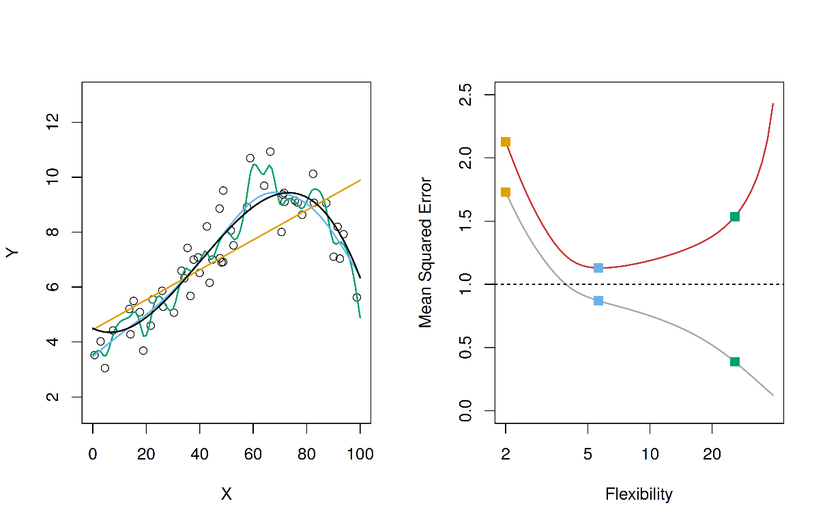
Overfitting
Overfitting is that a model describes noise instead of the underlying relationship
Overfitting occurs when a model is excessively complex, such as having too many parameters relative to the number of observations.

Slide 19
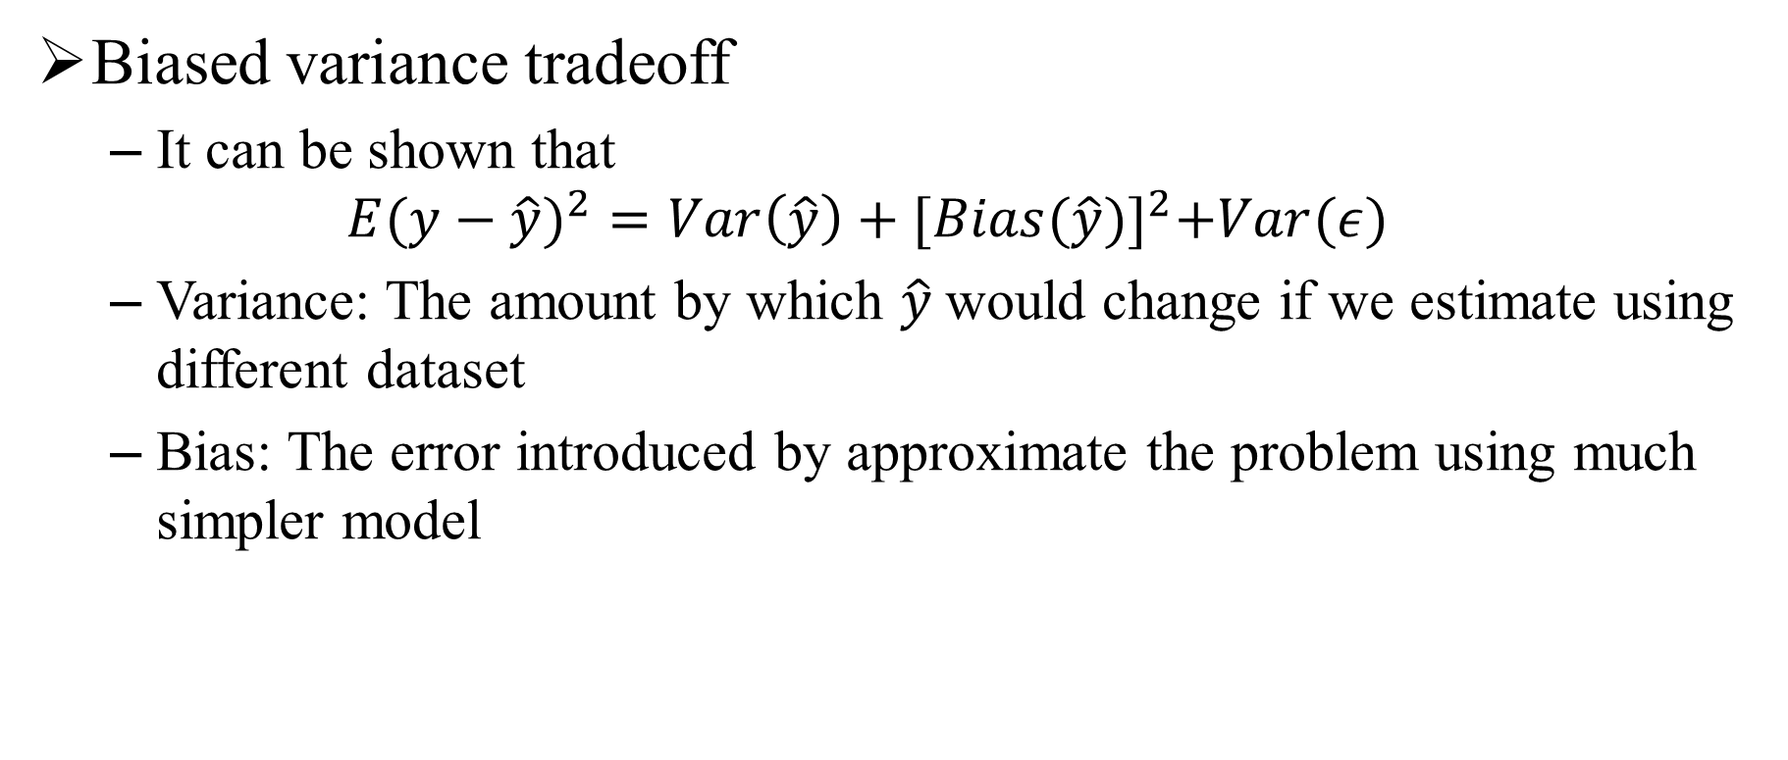
Related Issue (1/2)
Biased variance tradeoff
It can be shown that
$${E(y−\hat{y})}^{2}=Var\left(\hat{y}\right)+{[Bias(\hat{y})]}^{2}+Var(ε)$$
Variance: The amount by which $\hat{y}$would change if we estimate using different dataset
Bias: The error introduced by approximate the problem using much simpler model
Notes:
Other than prediction accuracy

Slide 20
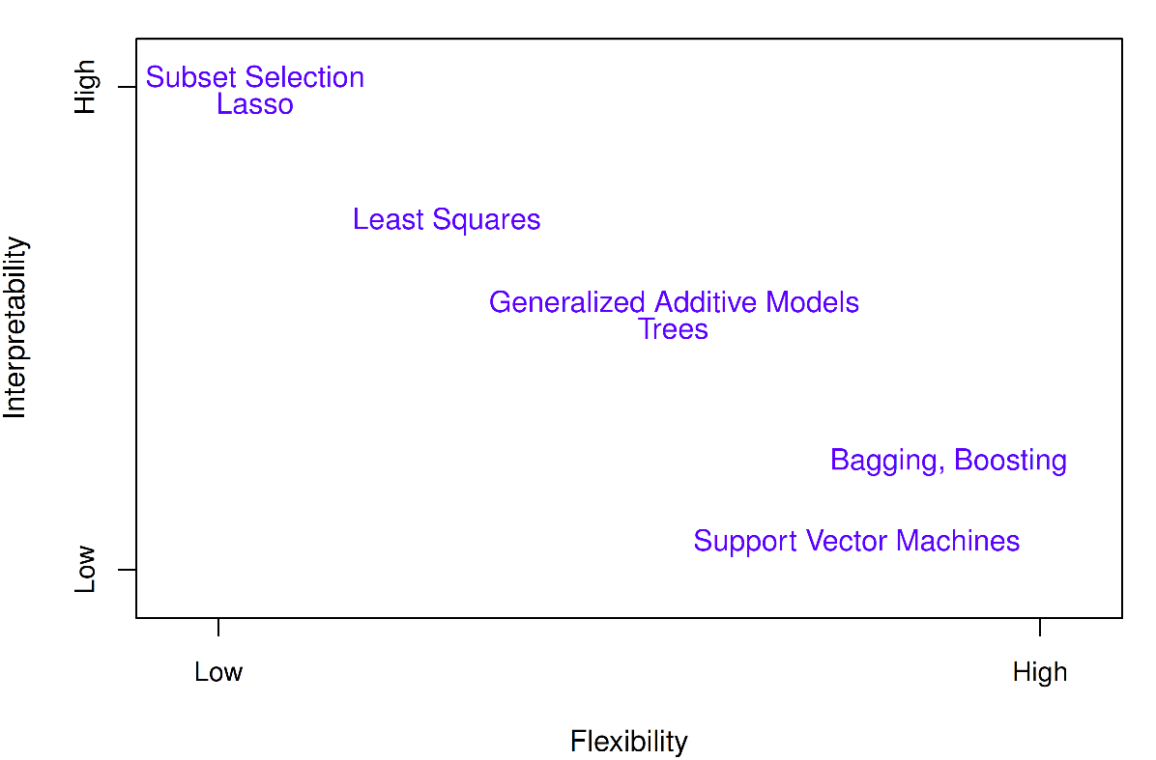
Related Issue (2/2)
Flexibility and Interpretability tradeoff
Why would we ever choose to use a more restrictive method instead of a flexible one?
If we are mainly interested in inference, then interpretability counts!

Slide 21
Solution to Overfitting
Analog to driving from lectures by Lin
Driving | Machine Learning
Car accident | overfit
Driving too fast | use too complex model
Limited observations about road condition | limited data size
Drive slowly | Start from simple model
Put the brakes | Regularization
Monitor the dashboard | Validation
Notes:
Data cleaning/pruning, data hinting

Slide 22
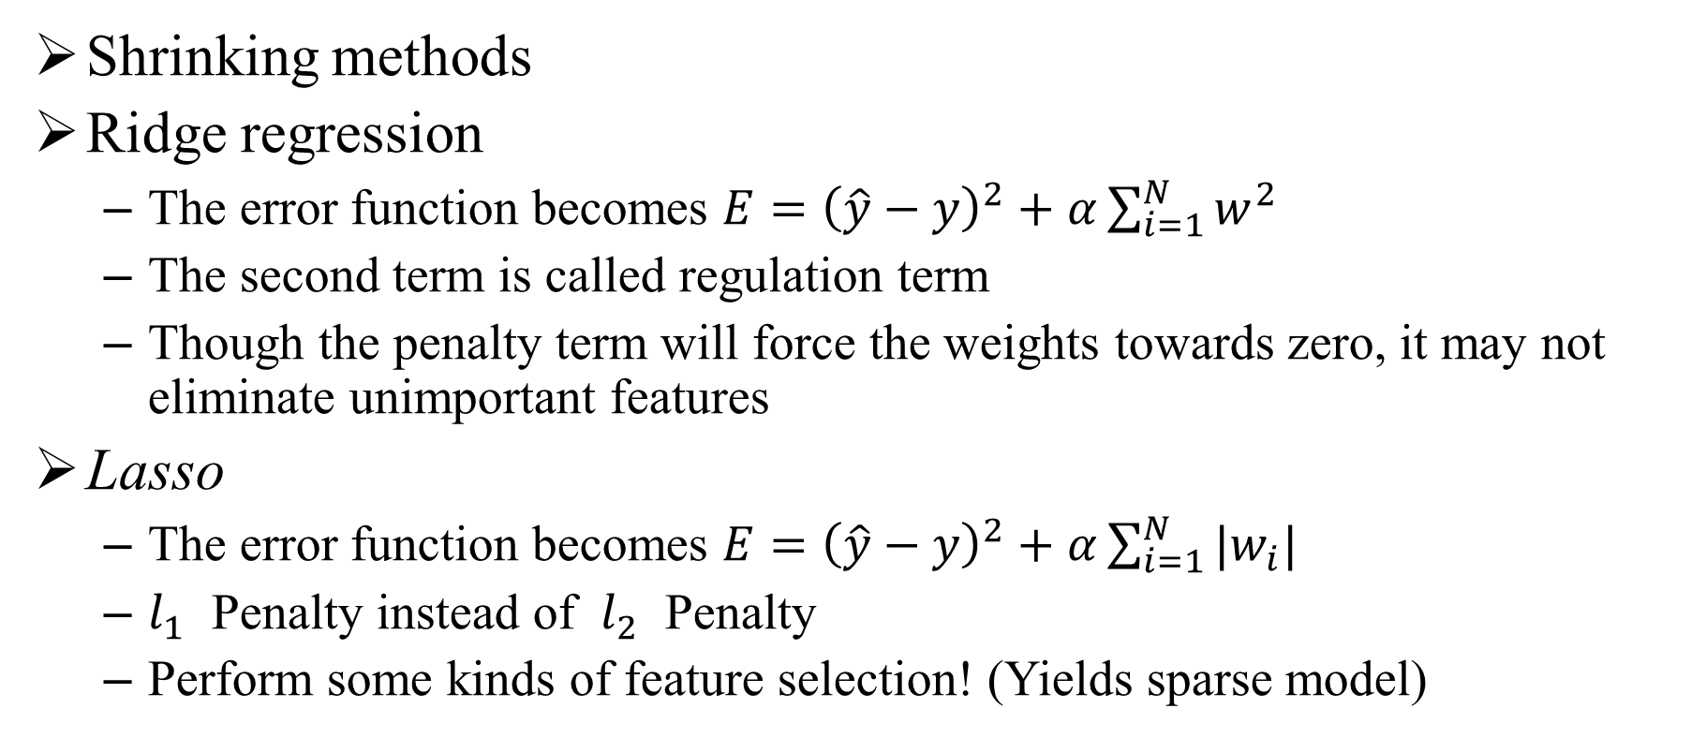
Regularization
Shrinking methods
Ridge regression
The error function becomes $E={\left(\hat{y}−y\right)}^{2}+α\sum_{i=1}^{N}{w^{2}}$
The second term is called regulation term
Though the penalty term will force the weights towards zero, it may not eliminate unimportant features
Lasso
The error function becomes $E={\left(\hat{y}−y\right)}^{2}+α\sum_{i=1}^{N}{|w_{i}|}$
$l_{1}$ Penalty instead of $l_{2}$ Penalty
Perform some kinds of feature selection! (Yields sparse model)

Slide 23
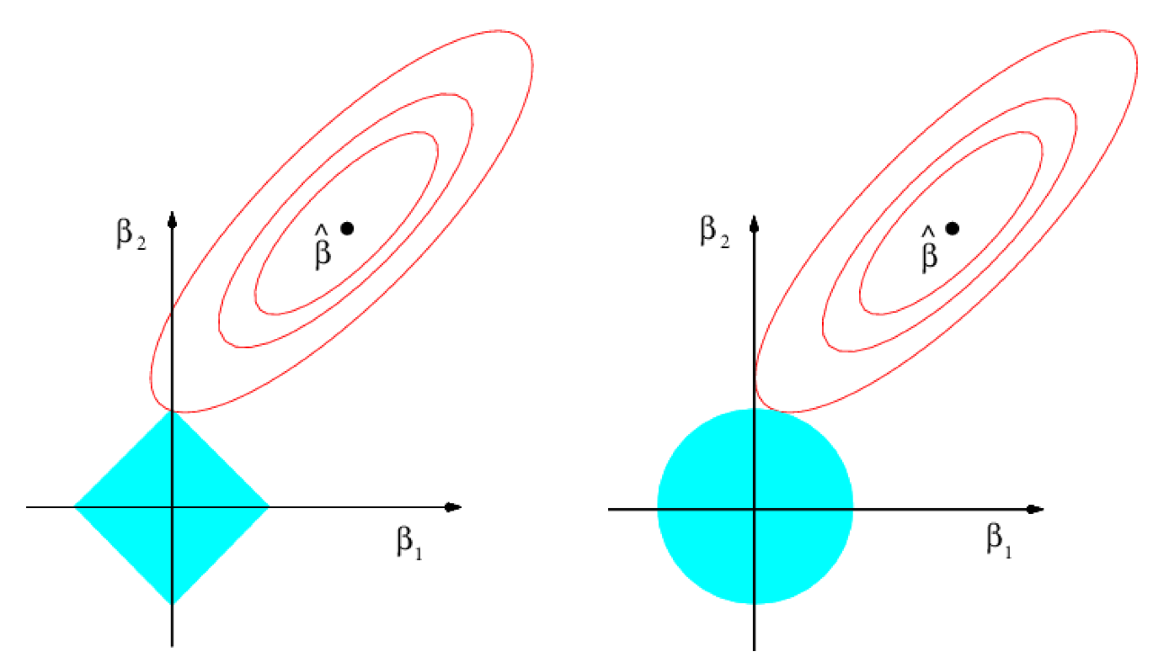

Regularization
Ridge regression
Minimized $E={\left(\hat{y}−y\right)}^{2}$ subject to $\sum_{i=1}^{N}{w^{2}}<s$
Lasso
Minimized $E={\left(\hat{y}−y\right)}^{2}$ subject to$\sum_{i=1}^{N}{|w_{i}|}<s$
Notes:
二維

Slide 24
Cross validation
Cross-validation
The test data set is not always available, it is necessary to have a way to estimate the test error rate from training error rate.
It can also help us to do model selection and prevent overfitting
Review of validation set approach
Highly variable depending on split
Do not utilized full data sets to train
Notes:
Some method make a mathematical adjustment to the training error rate in order to estimate the test error rate

Slide 25

Cross validation
Leave-One-Out-Cross-Validation
${CV}_{(n)}=\frac{1}{n}\sum_{i=1}^{n}{{MSE}_{i}}$
General, but computation time
is long
K-fold Cross Validation
${CV}_{(k)}=\frac{1}{k}\sum_{i=1}^{k}{{MSE}_{i}}$
Notes:
The original datasets is randomly partitioned into k equal sized subsamples. Of the k subsamples, a single subsample is retained as the validation data for testing the model, and the remaining k − 1 subsamples are used as training data.
The cross-validation process is then repeated k times (the folds), with each of the k subsamples used exactly once as the validation data. The k results from the folds can then be averaged (or otherwise combined) to produce a single estimation.

Slide 26
Lab5: Overfitting and Model selection
There is one gitbook written in Chinese which may help
https://www.gitbook.com/book/htygithub/machine-learning-python/details
Go to lab5 to find how validation works
Many functions in a library will have a CV version which can automatically choose parameters by applying CV

Slide 27
Curse of Dimensionality
Our geometrical intuition can fail badly in a space of higher dimensionality
When the dimension is high, the data should be exponentially growth!

Slide 28
Feature extraction/Selection
Feature extraction
From an initial feature set and builds derived features intended to facilitate the subsequent learning and generalization steps
The best results are achieved when an expert constructs a set of application-dependent features
Nevertheless, if no such expert knowledge is available, general dimensionality reduction techniques may help
There also exists lots of feature selection methods
Notes:
and in some cases leading to better human interpretations. Feature extraction is related to dimensionality reduction.

Slide 29
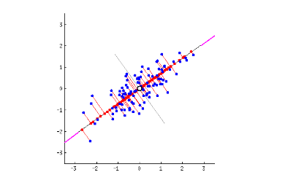
Dimensional Reduction
Reducing the number of features to consider
Principal component analysis (PCA)
PCA is used to summarized original dataset using successive orthogonal components that explain a maximum amount of the variance
Data are projected to the principal axes
It can also be view as a basis transform
Notes:
http://deeplearning4j.org/eigenvector.html
The principal components are orthogonal because they are the eigenvectors of the covariance matrix, which is symmetric. PCA is sensitive to the relative scaling of the original variables.

Slide 30
Lab6: Dimensional reduction
There is a great visualization of PCA, try to play with it
Go to Lab6 to see how PCA works in practice
Almost the end, hope you enjoy this quick tour, and enjoy your follow-up projects with seniors
If you want a book for reference, I recommend the following:
An Introduction to Statistical Learning
Understanding Machine Learning: From Theory to Algorithms

Slide 31
Road Map
Nonlinear transform
Interaction term, SVM…
Nonparametric supervise learning
Deep learning, Neuro Network, CNN…
Ensemble learning
Bagging, boosting (Ex: Random forest…
Pre-processing
Nomarlization, outlier, missing data, imbalance data…

Slide 32
Resource and Reference
For online course
機器學習基石
機器學習技法
For deep learning or CNN
http://cs231n.github.io/classification/
http://deeplearning.stanford.edu/tutorial/
For article collection
http://hangtwenty.github.io/dive-into-machine-learning/
https://buzzorange.com/techorange/2016/02/02/plan-to-be-a-data-scientist-in-new-year/

Slide 33
Resource and Reference
For interesting project
https://github.com/josephmisiti/awesome-machine-learning#python-misc
For Libraries
Caffe: https://github.com/BVLC/caffe/ (C++, Python)
Tensorflow: https://www.tensorflow.org/ (Python, C++)
MLPack: http://www.mlpack.org/ (C++)
Panda: http://pandas.pydata.org/ (Python)

