Slide 1
🎓 AI Learning Platform
Personalized Learning Assessment with AI-Powered Feedback
Students:
Abbas Yaghi 6484
Hussein Darwish 6297
Course: mini-project

Slide 2
Project Overview
What is the AI Learning Platform?
Purpose: A web application that provides personalized learning feedback using AI and rule-based engines
Core Features:
Self-assessment with 0-100 scoring system
AI-powered vs Rule-based feedback modes
Progress tracking and data visualization
User authentication and data persistence
Export functionality (PDF/CSV)
Target Users: Students, educators, and self-learners

Slide 3
Technical Architecture
Modern Full-Stack Solution
Frontend (React):
Component-based architecture
Tailwind CSS for responsive design
Chart.js for data visualization
Dark mode support
Backend (Flask):
RESTful API design
Session-based authentication
SQLite database integration
AI integration (Cohere)
Deployment (Docker):
Multi-container orchestration
Production-ready configuration
Data persistence with volumes

Slide 4
Authentication System
Secure User Management
Security Features:
User Registration & Login
Password hashing (SHA-256)
Session token authentication
User data isolation
Input validation
Implementation:
SQLite database for user storage
Secure session management
Protected API endpoints
Automatic logout on session expiry

Slide 5
Assessment Interface
Intelligent Assessment System
Features:
0-100 scoring system with validation
Visual progress indicators
Dual feedback modes (AI vs Rule-based)
Dynamic topic addition
Color-coded score feedback
Custom topic creation
User Experience:
Intuitive numeric input fields
Real-time score validation
Visual feedback with progress bars
Easy topic management

Slide 6

AI-Powered Feedback
Dual Feedback System
AI Agent (Cohere):
Natural language processing
Personalized recommendations
Context-aware responses
Resource suggestions
Rule-Based Engine:
Score-based categorization
Template-driven responses
Consistent feedback structure
Fallback system
Smart Features:
Performance analysis
Improvement suggestions
Learning resource recommendations

Slide 7
Progress Analytics
Comprehensive Progress Tracking
Visualization Features:
Interactive charts and visualizations
Historical trend analysis
Performance metrics tracking
Export capabilities (PDF/CSV)
Real-time data updates
Analytics Capabilities:
Individual topic progress
Overall improvement trends
Performance comparisons
Statistical summaries
Export Options:
PDF reports with charts
CSV data for external analysis
Print-friendly formats

Slide 8


Technology Stack
Modern Technology Stack
Frontend Technologies:
React 18 - Component-based UI
Tailwind CSS - Responsive design
Chart.js - Data visualization
Backend Technologies:
Python Flask - REST API framework
SQLite Database - Data persistence
Cohere AI - Intelligent feedback
Session Authentication - Security
DevOps & Deployment:
Docker & Docker Compose - Containerization
Nginx Reverse Proxy - Load balancing

Slide 9

Docker Deployment
Modern DevOps Practices
Container Architecture:
Multi-container architecture
Automatic service orchestration
Data persistence with volumes
Production-ready configuration
Deployment Commands:
docker-compose up --build
# Access: http://localhost
Container Management:
docker ps
docker-compose logs
docker-compose down
Production Benefits:
Consistent deployment across environments
Simplified scaling and maintenance
Environment isolation
Easy rollback capabilities

Slide 10
Live Demo Walkthrough
Complete Feature Demonstration
Authentication Flow:
User registration process
Secure login functionality
Session management
Assessment Process:
Topic input and scoring (0-100)
Feedback mode selection (AI vs Rule-based)
Results visualization with charts
Analytics & Export:
Progress tracking charts
Historical data analysis
PDF/CSV export functionality
User Experience:
Dark mode toggle
Responsive design
Intuitive navigation

Slide 11
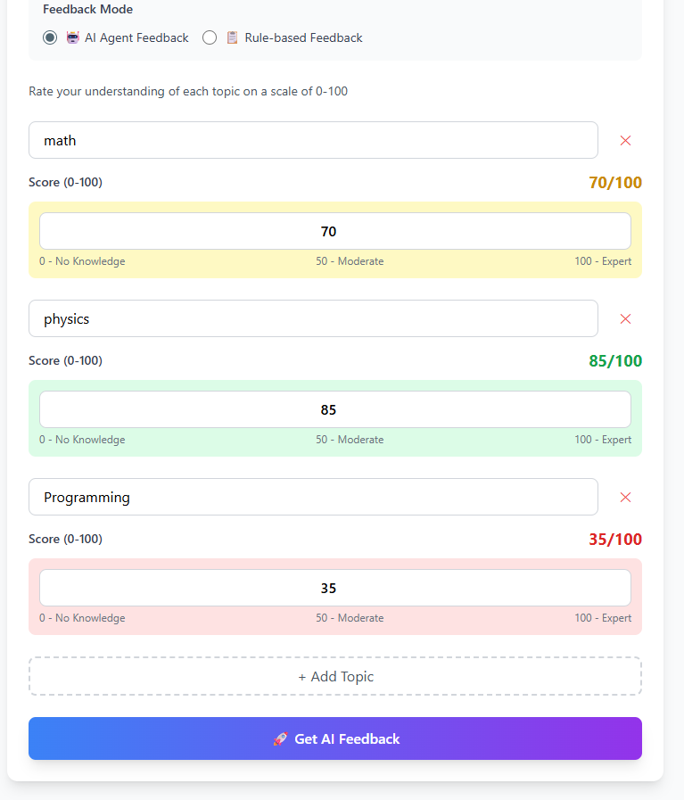
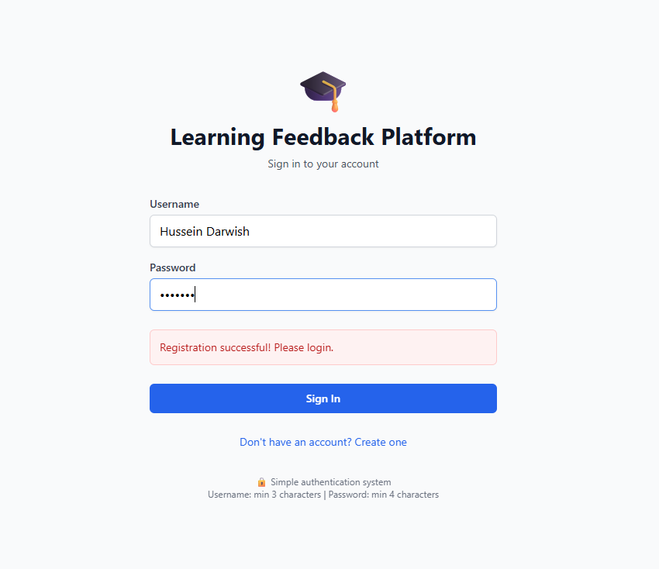

Slide 12
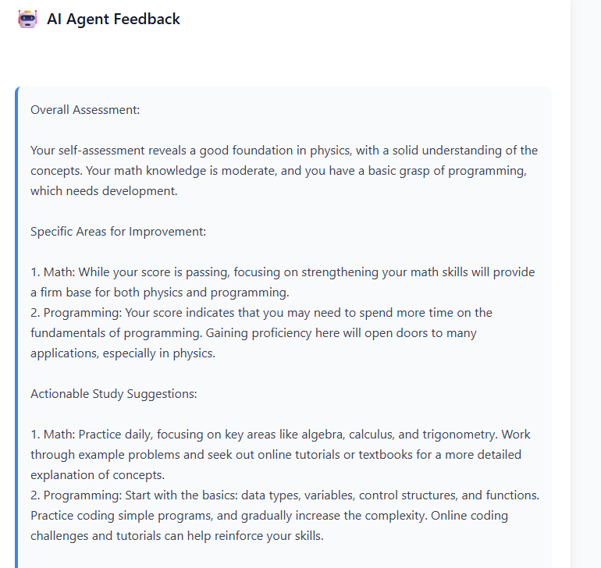
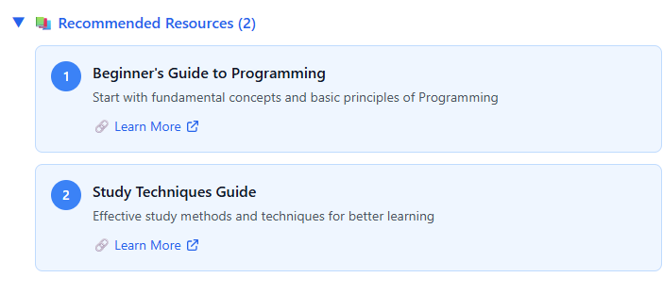

Slide 13
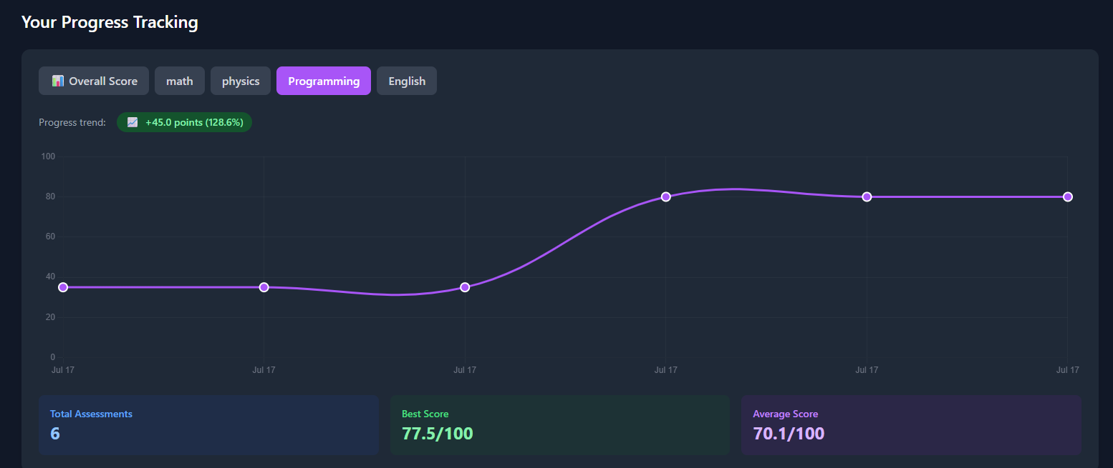

Slide 14
Database Architecture
Efficient Data Management
Database Tables:
Users Table - User credentials, password hashing
Sessions Table - Active session tracking, token management
Submissions Table - Assessment data, user-specific isolation
Security Features:
User data isolation per session
Encrypted password storage (SHA-256)
Automatic session expiration
SQL injection prevention
Input validation and sanitization
Data Relationships:
One-to-many: Users → Sessions
One-to-many: Users → Submissions
Foreign key constraints for data integrity
Efficient indexing for query optimization

Slide 15
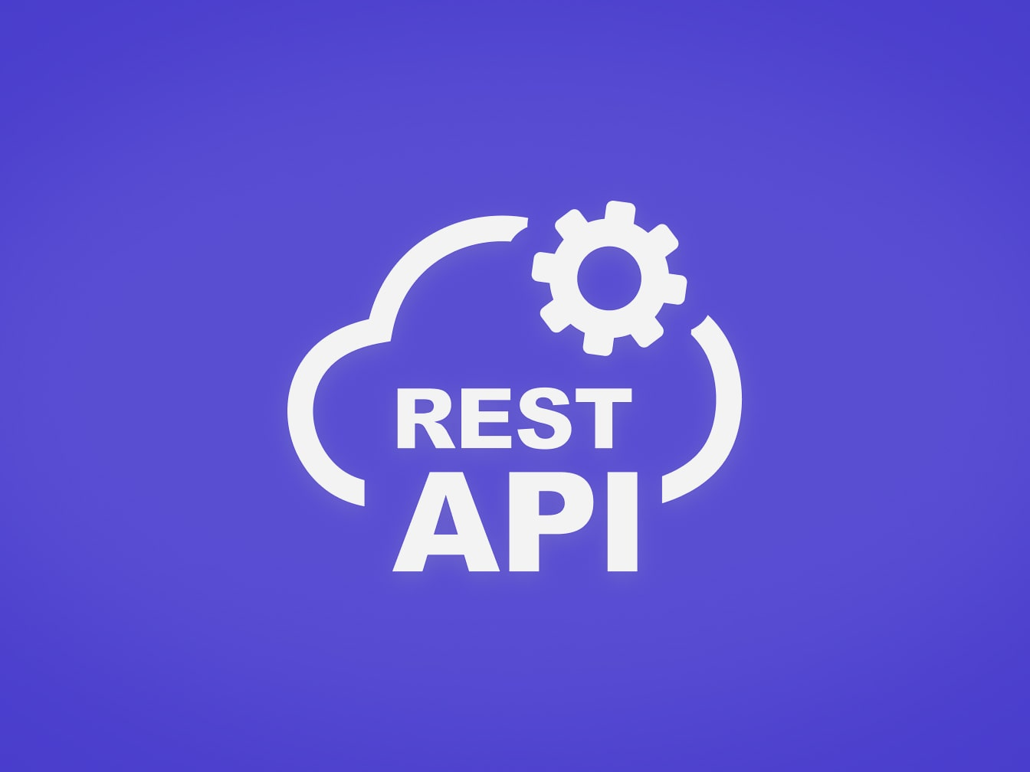
RESTful API Design
API Endpoints
Authentication Endpoints:
POST /register - User registration
POST /login - User authentication
POST /logout - Session termination
GET /profile - User information
Application Endpoints:
POST /feedback - Submit assessment & get feedback
GET /history - Retrieve user's assessment history
GET /progress - Get progress analytics data
GET /export/csv - Export data as CSV
API Features:
Token-based authentication middleware
Input validation and sanitization
Comprehensive error handling
JSON response standardization
CORS configuration for web clients

Slide 16
Future Enhancements
Roadmap for Development
Short-term Enhancements:
Mobile application (React Native)
Advanced analytics dashboard
Long-term Vision:
Machine learning personalization
Multi-language support
Advanced reporting system
Scalability Considerations:
Cloud deployment (AWS/Azure)

Slide 17
Project Impact & Value
Real-World Applications & Skills
Educational Value:
Self-assessment tool for students
Progress tracking for educators
Personalized learning paths
Data-driven insights
Professional Skills Demonstrated:
Full-stack web development
API design and integration
Database management
Container deployment
UI/UX design principles
Industry Relevance:
Modern development practices
Industry-standard technologies
Scalable architecture design
Production-ready deployment
Security best practices

Slide 18
Project Success & Conclusion
Key Achievements
Complete full-stack application
AI integration with fallback system
Professional user interface
Secure authentication system
Docker-based deployment
Comprehensive testing
Real-world applicability
Industry-standard practices
Key Takeaways:
Demonstrated proficiency in modern web development
Implemented industry-standard practices
Created a practical, production-ready application
Showcased technical expertise across multiple domains

