Slide 1
BatteryGPT
Project Progress
GPT trajectory
Last 2 Months - 1 day/week
SOH model
End-to-end workflow: GPT-generated trajectories -> CNN-LSTM SOH estimation -> knee/EOL analysis
Knee / EOL
Prepared for employer update

Slide 2
Project overview
Goal: develop a battery degradation prediction and SOH estimation pipeline.
1
GPT trajectory generation
2
Preprocessing pipeline
3
SOH estimation
4
Knee / EOL analysis
High-level outcome
Current status
Built an end-to-end workflow from generated cycles to SOH predictions.
Validated key interfaces: token decoding, tensor shapes, checkpoint loading.
Long generation is resumable and chunked.
Ready to improve physical scaling and degradation realism.
BatteryGPT progress review
02

Slide 3
Weekly breakdown
2 months of progress at roughly 1 day per week.
Week
Task
Outcome
1
Repo + MIT dataset
Understood data format and preprocessing
2
GPT sample.py outputs
Mapped token structure and cycle representation
3
CNN-LSTM SOH estimator
Confirmed checkpoint and preprocessing needs
4
Initial evaluation script
Generated SOH predictions from sample cycles
5
Pipeline debugging
Explore why end of cycle / knee point was not being detected
6
GPT + SOH integration
Tested generated trajectories for 10-400 cycles
7
Resume + chunk generation
Long trajectories robust with checkpointing
8
Final validation
Analyzed SOH, knee and EOL predictions
BatteryGPT progress review
03

Slide 4
Key achievements
Major technical progress made during the 2-month period.
✓
End-to-end pipeline
✓
Long generation
GPT trajectory -> decoded series -> CNN-LSTM -> SOH predictions
Resumable generation up to ~400 cycles with checkpointing
✓
Checkpoint fixes
✓
Dataset validation
Resolved n_class mismatch, tensor shape, and output averaging issues
Verified workflow against MIT battery dataset assumptions
BatteryGPT progress review
04

Slide 5
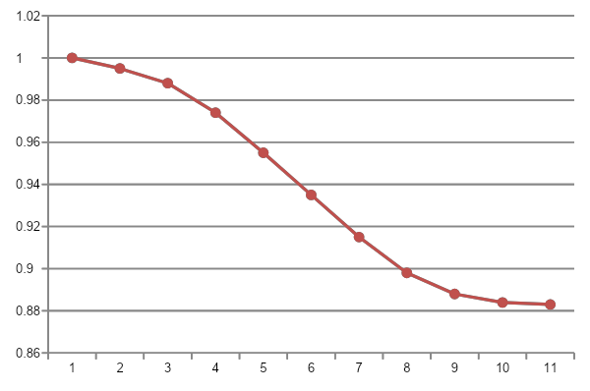
Demo visuals
Representative analysis outputs for reporting.
SOH prediction curve
Example token sequence
[743, 128, 392, ...] -> decoded voltage/current/temp series
CNN-LSTM input
cycle window -> 3 channels -> 60 x 60 matrix representation
Knee / EOL markers
Knee detected; EOL not reached in latest test trajectories
BatteryGPT progress review
06

Slide 6
Next steps
Recommended technical direction after the current milestone.
1
2
3
4
Improve degradation realism
Add physical scaling
Reporting visuals
Stronger Model
Make GPT-generated trajectories reflect EOL behavior more clearly
Map tokens back to volts, amps and temperature values
Plot SOH curves with knee/EOL markers for employer-ready reports
Use TimeGPT to generate samples and then feed that to CNN - LSTM
BatteryGPT progress review
07

Slide 7
Summary
✓
Pipeline works end-to-end
Generated trajectories can now flow through SOH estimation.
✓
Long runs are robust
Current
Milestone
Chunking and resume logic reduce failure risk.
Debugging blockers removed
End-to-end validation complete
✓
Checkpoint, tensor and conversion issues are understood.
✓
Ready for model improvements
Next focus: physical scaling and stronger degradation signals.

