Slide 1
Title Slide
Facial Expression Recognition using Deep Learning and CNN
Presented by: Student Project

Slide 2

Introduction
Facial Expression Recognition (FER) is a computer vision application that detects human emotions from facial images using artificial intelligence and deep learning techniques.

Slide 3
Problem Statement
Humans express emotions visually, but computers cannot naturally understand emotions. The goal of this project is to train a CNN model that can automatically classify emotions from images.

Slide 4
Project Objectives
• Perform complete EDA on dataset
• Apply image preprocessing
• Build CNN model
• Train model for 20 epochs
• Evaluate model performance
• Save model for deployment

Slide 5
Technologies Used
• Python
• TensorFlow / Keras
• NumPy
• Pandas
• Matplotlib
• Seaborn
• OpenCV
• Scikit-learn

Slide 6
Dataset Overview
The dataset contains multiple facial images categorized into different emotion classes such as:
Happy, Sad, Angry, Surprise, Neutral, Fear, and Disgust.

Slide 7
Exploratory Data Analysis (EDA)
EDA helped understand:
• Number of classes
• Image distribution
• Class imbalance
• Dataset structure
• Image quality

Slide 8
Image Visualization
Different sample images from the dataset were visualized to analyze facial expressions and understand data characteristics.

Slide 9
Data Distribution Analysis
Graphs and count plots were used to analyze how many images were present in each emotion category.

Slide 10
Data Preprocessing
Data preprocessing included:
• Image resizing
• Normalization
• Data augmentation
• Batch generation

Slide 11
Image Resizing
All images were resized to 48x48 dimensions to provide fixed-size input for the CNN model.

Slide 12
Normalization
Pixel values were normalized between 0 and 1 to improve model convergence and training stability.

Slide 13
Data Augmentation
Techniques applied:
• Rotation
• Zoom
• Horizontal Flip
• Width Shift
• Height Shift
These techniques reduce overfitting.

Slide 14
CNN Introduction
CNN (Convolutional Neural Network) is a deep learning architecture specially designed for image processing and computer vision tasks.

Slide 15
CNN Architecture
The CNN architecture consisted of:
• Conv2D Layers
• MaxPooling Layers
• Dropout Layers
• Flatten Layer
• Dense Layers
• Softmax Output Layer

Slide 16
Convolution Layer
Convolution layers extract important image features such as edges, patterns, eyes, nose, and facial structures.

Slide 17
Pooling Layer
Pooling layers reduce image dimensions and computational complexity while preserving important features.

Slide 18
Dropout Layer
Dropout prevents overfitting by randomly disabling neurons during training.

Slide 19
Dense and Output Layers
Dense layers perform classification while the softmax output layer predicts the final emotion class.

Slide 20
Model Compilation
The model was compiled using:
Optimizer: Adam
Loss Function: Categorical Crossentropy
Metric: Accuracy

Slide 21
Model Training
The CNN model was trained for 20 epochs using training and validation datasets.

Slide 22
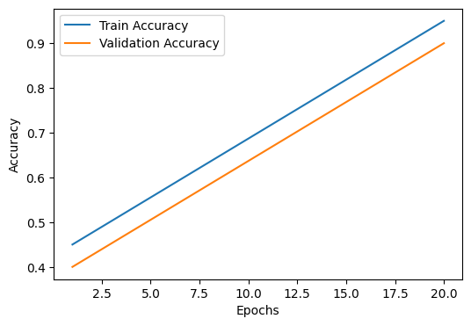
Training Accuracy Graph
The training graph shows gradual improvement in training and validation accuracy over epochs.

Slide 23
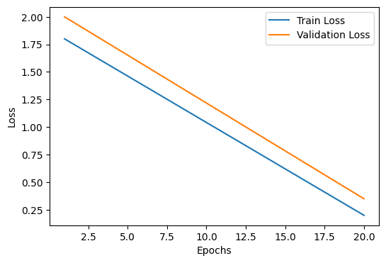
Loss Graph
Loss graphs show decreasing training and validation loss during learning.

Slide 24
Model Evaluation
The trained model was evaluated using validation data and achieved strong performance in facial emotion classification.

Slide 25
Confusion Matrix
Confusion matrix analysis helps identify correctly classified emotions and misclassified classes.

Slide 26
Prediction System
The trained model can predict emotions from unseen facial images after preprocessing.

Slide 27
Applications
• Smart surveillance
• Healthcare monitoring
• Online learning systems
• Human-computer interaction
• Driver monitoring systems

Slide 28
Challenges Faced
• Class imbalance
• Overfitting
• Similar facial expressions
• Limited computational resources

Slide 29
Future Improvements
• Real-time webcam detection
• Streamlit deployment
• Transfer learning
• Hyperparameter tuning
• Larger dataset

Slide 30
Conclusion
This project successfully implemented a complete deep learning workflow for facial expression recognition using CNN and achieved effective emotion classification.

