Slide 1

About me – Dr Temitope Sam-Odusina
BEng Engineering, University of Liverpool, UK
PhD Engineering, Liverpool John Moores University (LJMU), UK
Computer vision /AI Engineer LJMU, UK

Slide 2




Why Face Detection ?

Slide 3
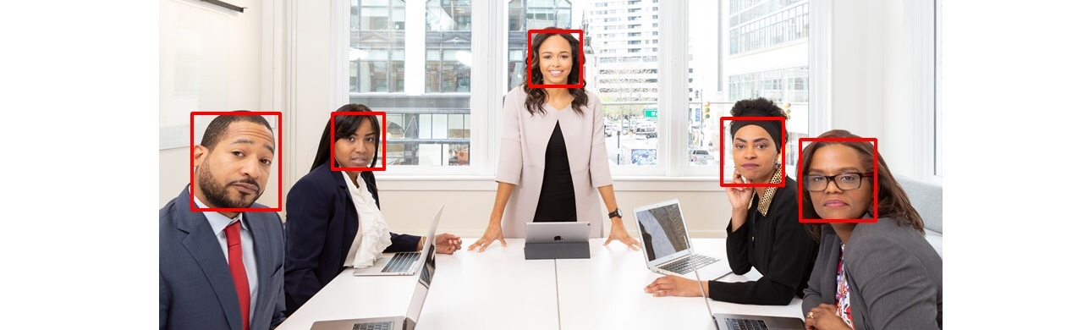
Face Detection vs Face Recognition
Face Detection - Identifying where a face is located in an image
Face Recognition – Given a located face can we identify who the face belongs to ?

Slide 4
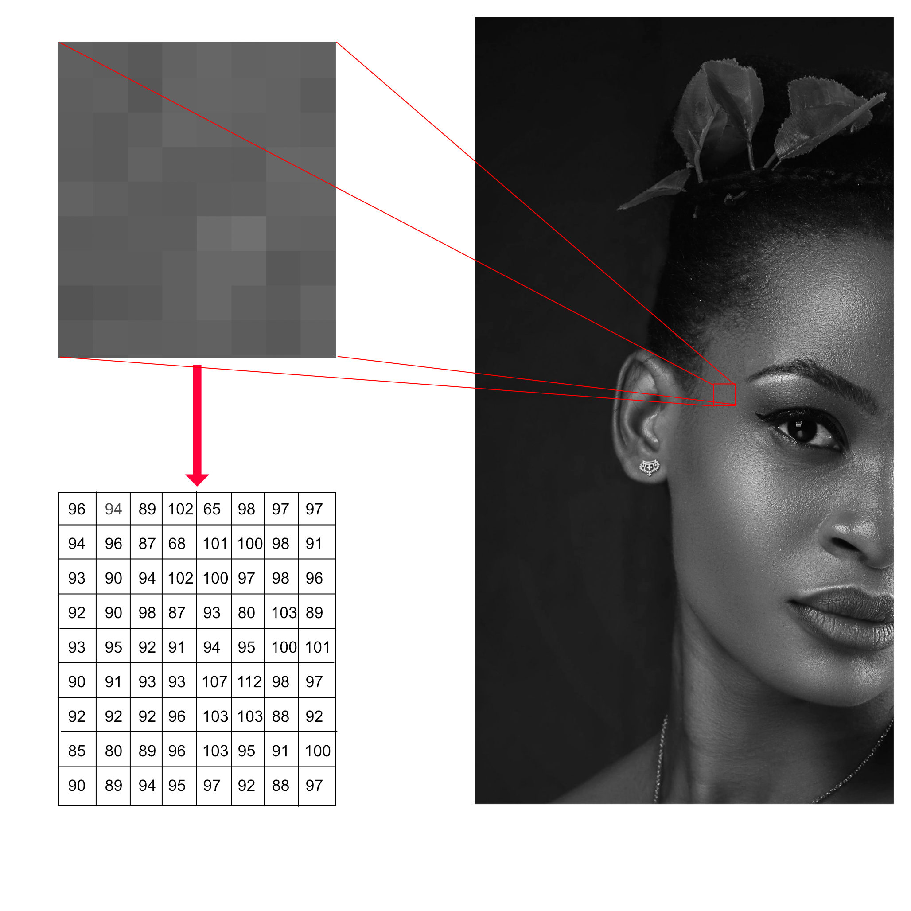
What is an Image?
Machines see and process everything using numbers, including images and text.
Conversion from images to numbers can be done using pixel values.
Every number represents the pixel intensity at that location.

Slide 5

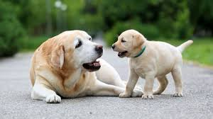
Differentiating between image content
Feature descriptors encode interesting information into a series of numbers and act as a sort of numerical “fingerprint” that can be used to differentiate one image from another.
Various techniques exist such as
Histogram of Oriented gradients
Convolution Neural Networks (CNN)
Scale Invariant Feature Transform (SIFT) and many more

Slide 6
Face recognition library
Face recognition library provides useful helper functions for face detection
Image can be loaded using the load_image_file function call
Based upon dlib’s state-of-the art face recognition built with deep learning
Useful links
https://github.com/ageitgey/face_recognition
http://dlib.net/

Slide 7

Helpful utility functions
1 . face_locations= face_recognition.face_locations(image)
Extracting face location
Conversion to 128D vector
[x0, x1, …………..x127]
2. face_encodings= face_recognition.face_encodings(image, face_locations)

Slide 8
Face Recognition
128-D Feature descriptors (f)
128-D Feature descriptors (g)
compare_faces(f, g)
Euclidean distance > threshold
No, face is not a match
Euclidean distance < threshold
Yes, face is a match

Slide 9
Face recognition pipeline
Query Image
Face detection and Feature extraction
Comparison between feature vectors
Output
Database Image
Face detection and Feature extraction

Slide 10

Jumping into some code!

