Slide 1
About me – Dr Temitope Sam-Odusina
BEng Engineering, University of Liverpool, UK
PhD Engineering, Liverpool John Moores University, UK
Computer vision /AI Researcher LJMU, UK

Slide 2
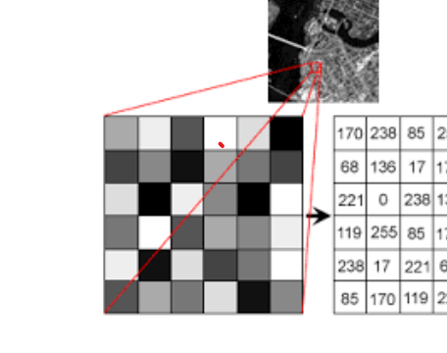
Image Interpretation
Machines see and process everything using numbers, including images and text.
Conversion from images to numbers can be done using pixel values.
Every number represents the pixel intensity at that location.

Slide 3




Why Face Detection ?

Slide 4
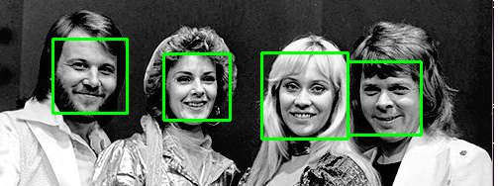
Face Detection vs Face Recognition
Face Detection - Locating and localizing one or more faces in an image
Face Recognition – Given a Region of Interest belonging to a face can we identify who the face belong to ?

Slide 5
Face recognition pipeline
Query Image
Feature extraction
Feature matching
Retrieved Images
Image Database
Feature extraction

Slide 6
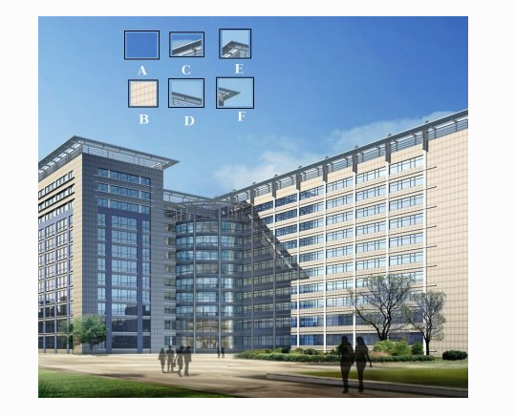
Finding Features in an Image

Slide 7
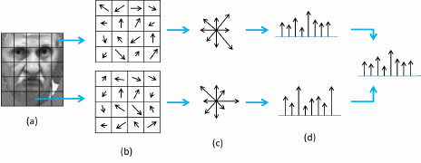
Feature extraction – Histogram of Oriented Gradients

Slide 8
Feature Matching
Query Image
F1
F2
F3
: :
FM
Test Image
F1
F2
F3
: :
FM
Compute Euclidean distance between vectors

Slide 9

Jumping into some code!

