Slide 1
LAB 1. LOGIC GATES
Objective
To get acquainted with different standard integrated circuits.
To study the basic logic gates: AND, OR, INVERT, NAND, NOR, and XOR.
To understand formulation of Boolean function and truth table for logic circuits
Design a sample function on bread board.

Slide 2
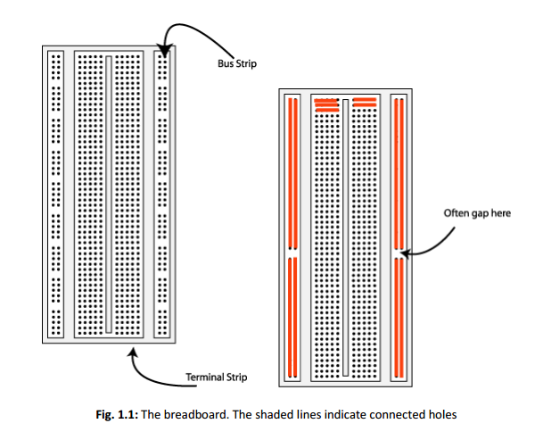
The Breadboard

Slide 3
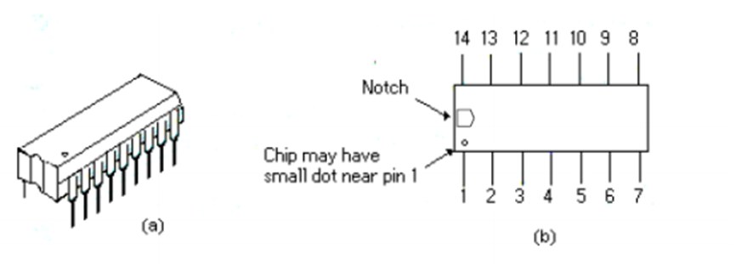
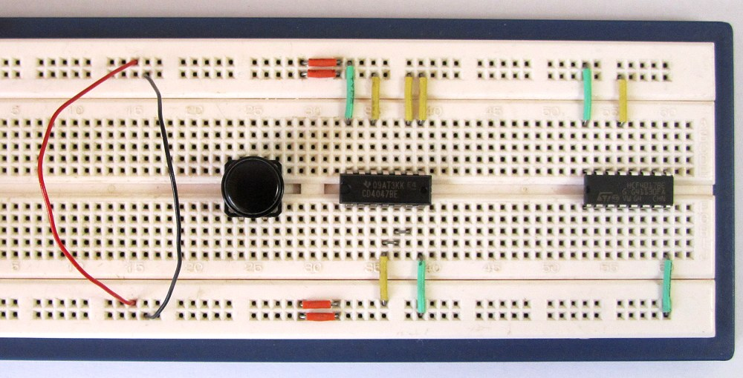
(a) Dual-In-Line Package (b) Top view showing Pin numbers

Slide 4
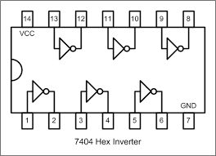
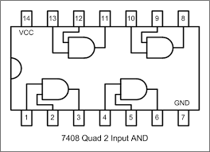

Example Implementation of a Logic Circuit
Build a circuit to implement the Boolean function F = $\overline{A}$ $\overline{B }$using 74LS08 (AND gate) and 7404 (INVERTER)

Slide 5
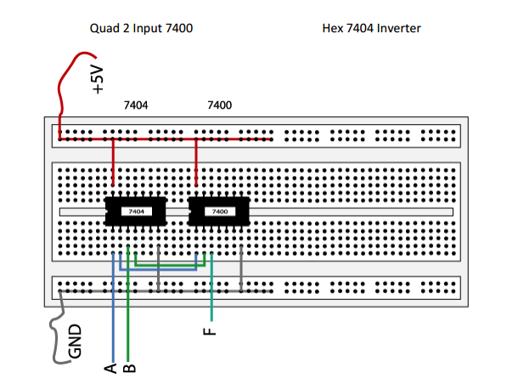

Slide 6
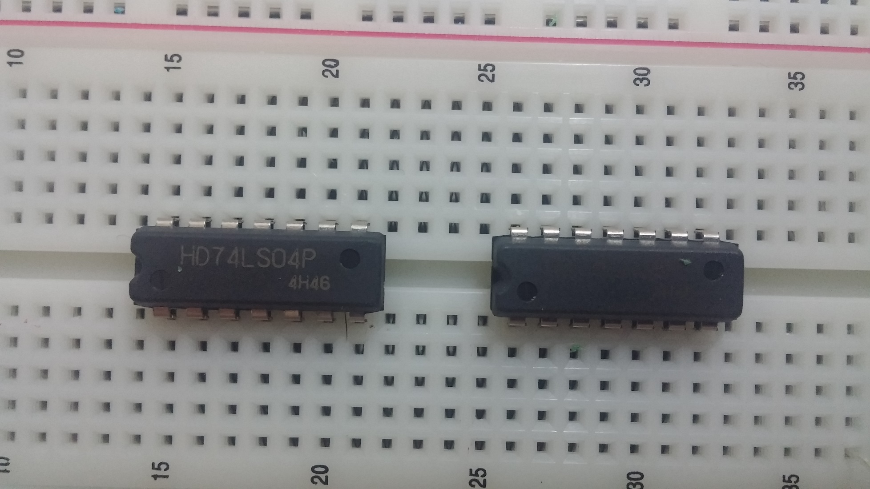

Slide 7
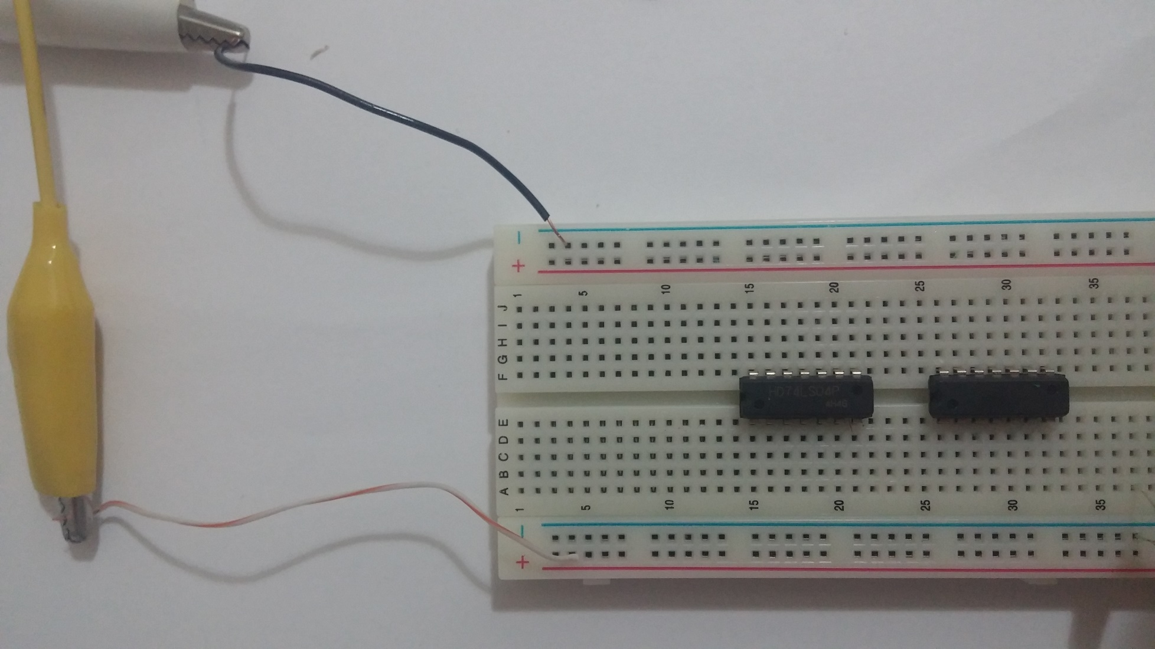

Slide 8
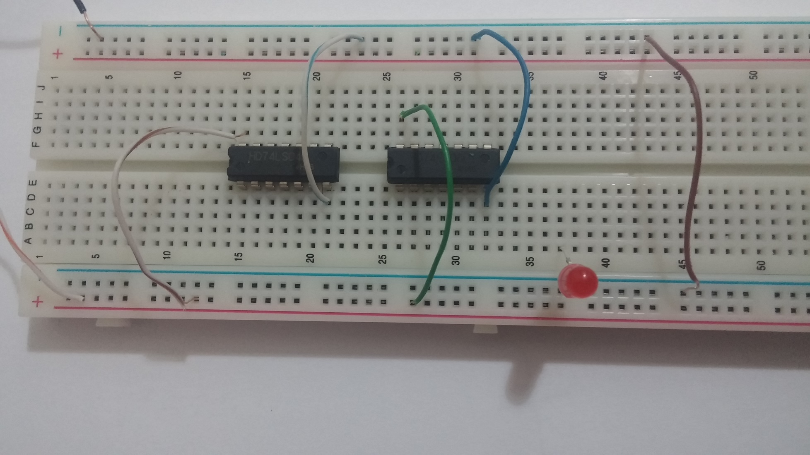

Slide 9
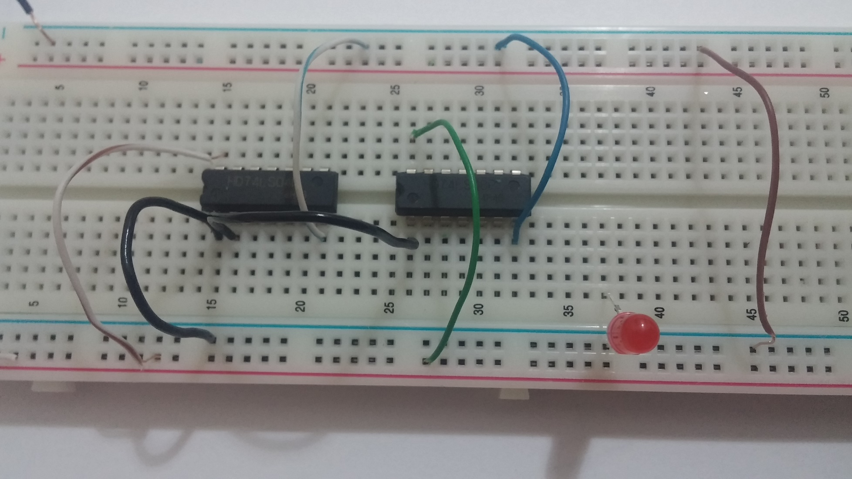

Slide 10
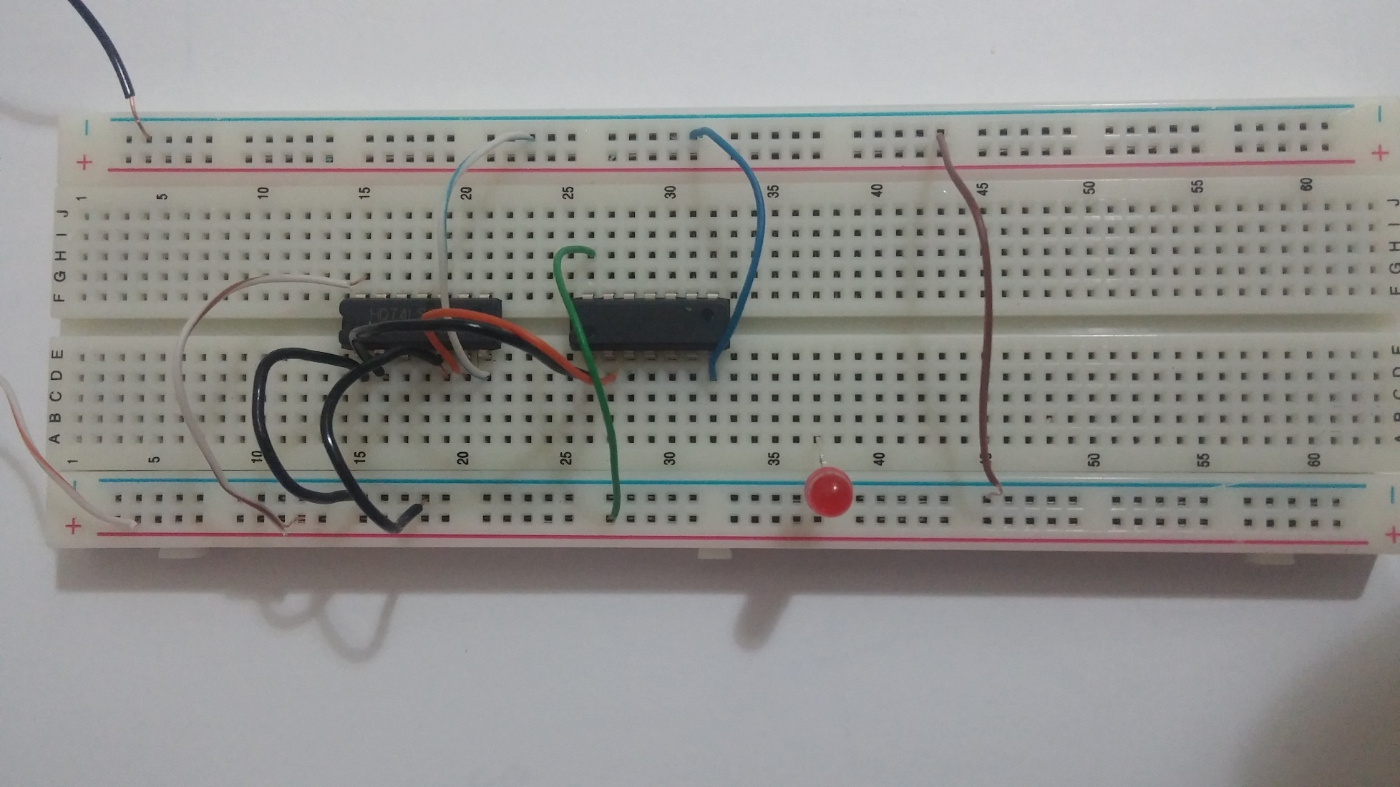

Slide 11
