Slide 1

👨‍💻 Abbas Ghori – The AI Multitool
📧 abbasghori0229@gmail.com | 📞+92 3032008961 🔗 linkedin.com/in/abbasghori | github.com/abbasghori29
🎯 AI Engineer | Full-Stack Web Developer | GenAI Problem Solver
From neural nets to REST APIs—building intelligent systems that work and wow. I mix machine learning with modern web stacks to create tech with impact.
🏆 Dean’s List ×4 | AI Intern @ AorySoft | 10+ Projects | CGPA: 3.6 📌 Mission: Build smarter, scalable, AI-powered web solutions.
🚀 Projects That Speak
🧾 Legal Docs Analyzer – GenAI-based clause reviewer
🧑‍🏫 CourseCompass Chatbot – Academic query resolver
🌿 LeafCheck – Deep learning model for plant disease detection
🤖 Sales Assistant Slack Bot – GPT-4o + LangChain + FastAPI
🎬 IMDb Recommender – Built with Flask, pandas & scikit-learn
🧠 My Tech Stack
AI/ML: LangChain, LlamaIndex, OpenAI, Hugging Face
Web Dev: Django, Flask, MERN Stack, FastAPI
Languages: Python, Java, JavaScript, C++, SQL, MongoDB

Slide 2
Bazaar Inventory Tracking System
Overview: A scalable backend service designed to manage inventory for retail kiryana stores, evolving from a single-store solution to a multi-store, enterprise-scale platform.
What I Built:
* Stage 1: Simple inventory tracking for one store with local storage (SQLite) and a CLI/API for stock-in, sales, and removals.
* Stage 2: Expanded to 500+ stores with REST APIs, PostgreSQL database, basic authentication, and store-specific reporting.
* Stage 3: Scaled to thousands of stores with horizontal scalability, asynchronous updates (Celery/Redis), caching, and audit logging.
Key Features: Real-time stock visibility to prevent stockouts/overstocking.Efficient data modeling and secure, high-performance APIs.Scalable architecture supporting high concurrency and transactional integrity.
Tech Stack: Django, PostgreSQL, Redis, RESTful APIs.
Outcome: A robust system ready for Bazaar’s dynamic retail-tech ecosystem, ensuring profitability and seamless operations.
Note: A video demonstration is available in the root folder for a detailed walkthrough.

Slide 3
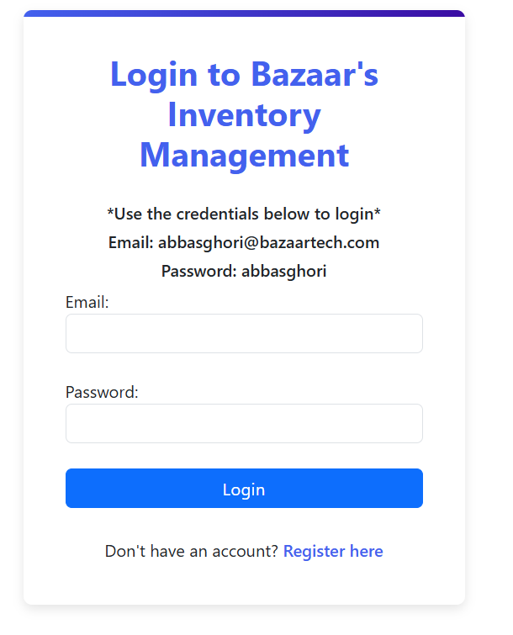
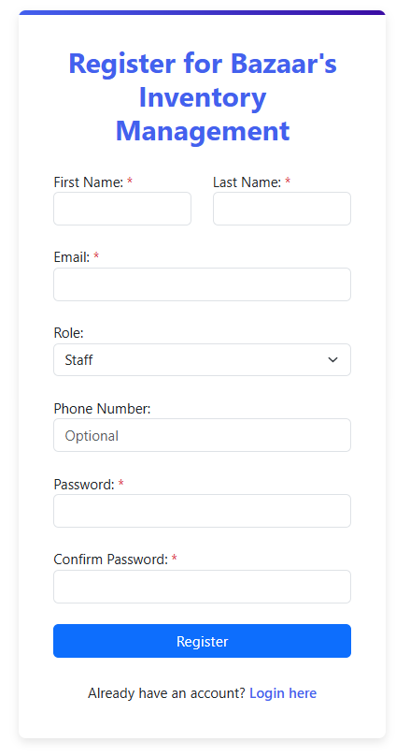
Basic Authentication

Slide 4
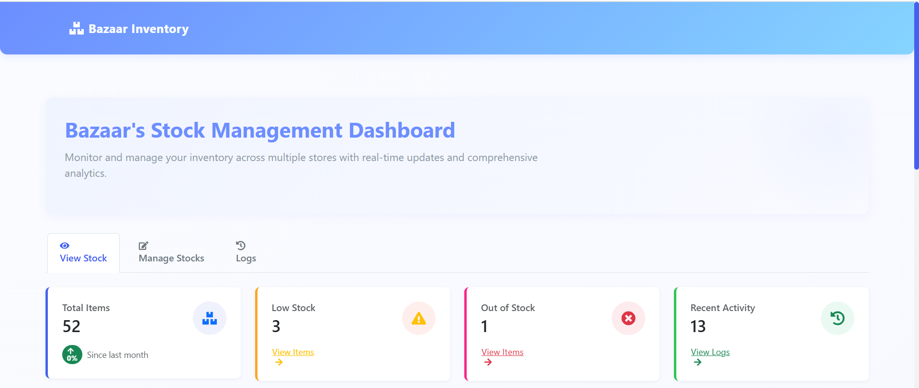
Bazaar Stock Management Dashboard

Slide 5
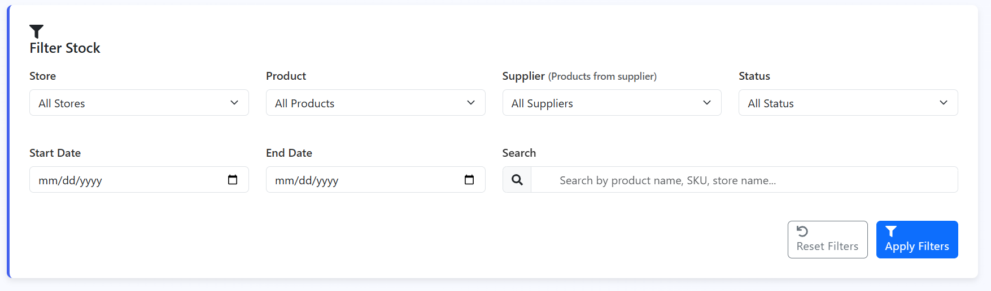
Filters for stocks and search functionality
filtering options for stock management, allowing users to sort by store, product, date, supplier, and status.

Slide 6
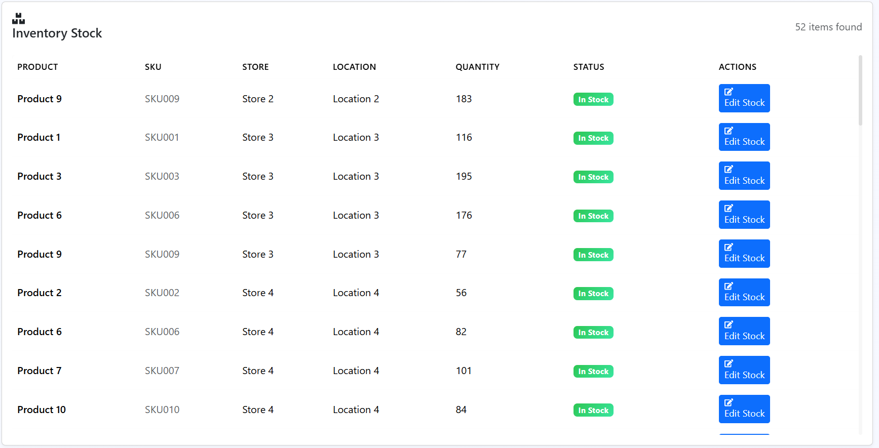
Inventory Stock Summary
This is the table of inventory stock details, including product names, SKUs, stores, locations, quantities, and statuses.

Slide 7
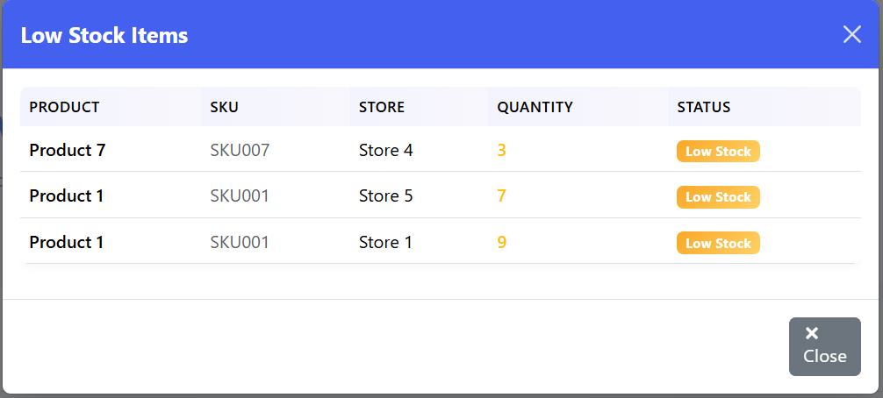
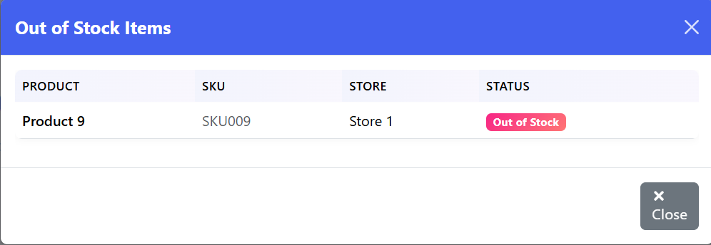
Low Stock & Out of Stock Items
Modals to display low stock and out-of-stock items, intended to alert users to inventory shortages

Slide 8
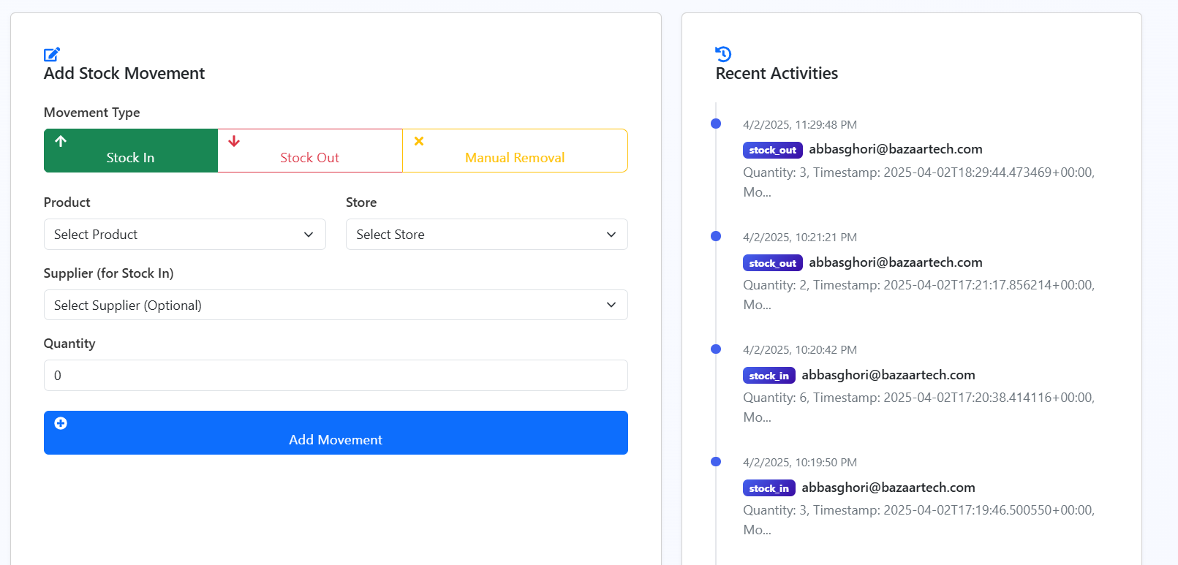
Add Stock Movement & Recent Activities
This page allows users to add stock movements (type, product, store, supplier, quantity) and displays recent activity logs with timestamps.

Slide 9
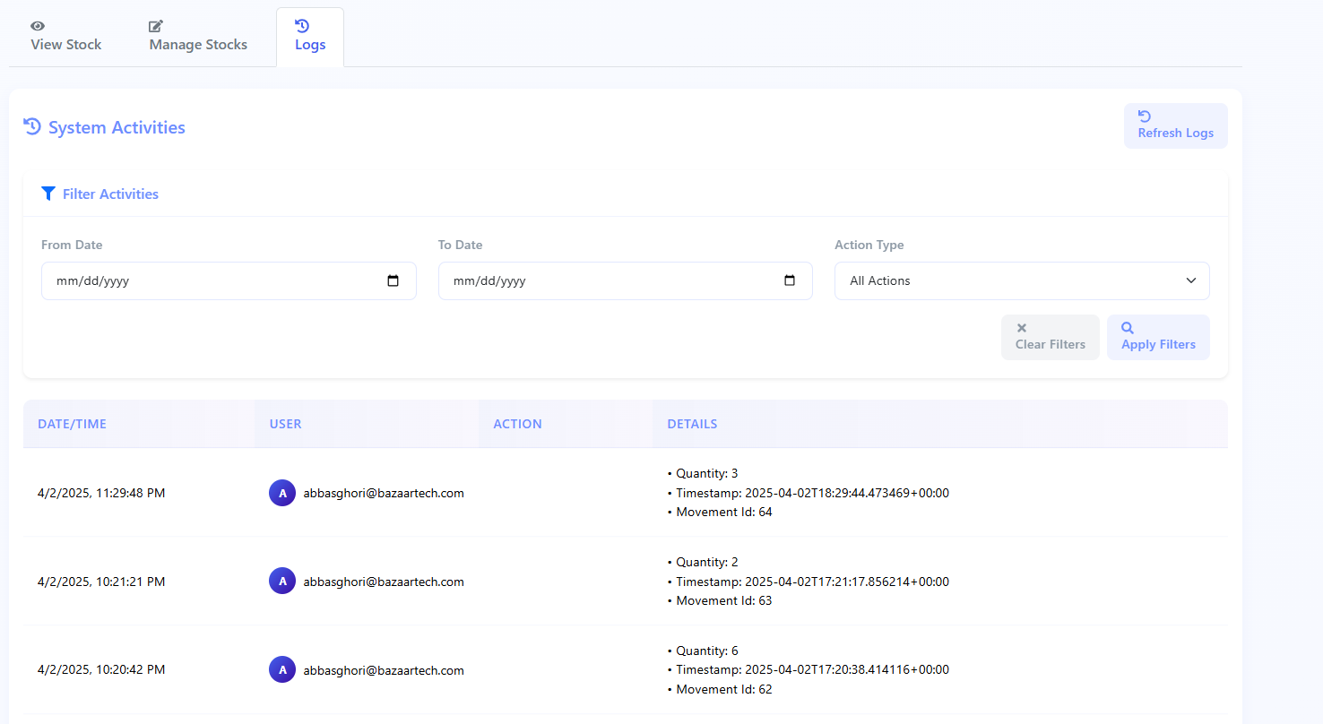
System Activity Logs

