Slide 1
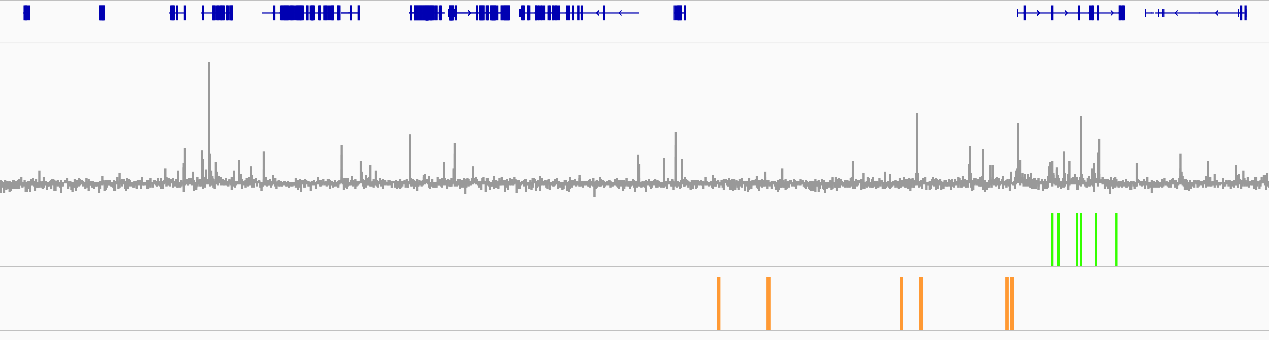
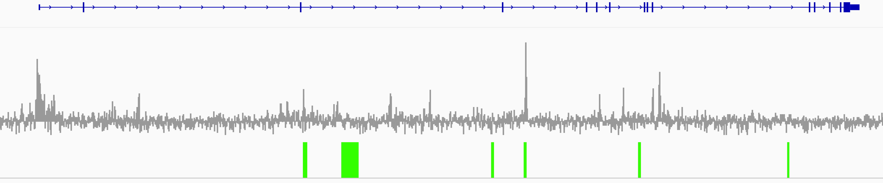
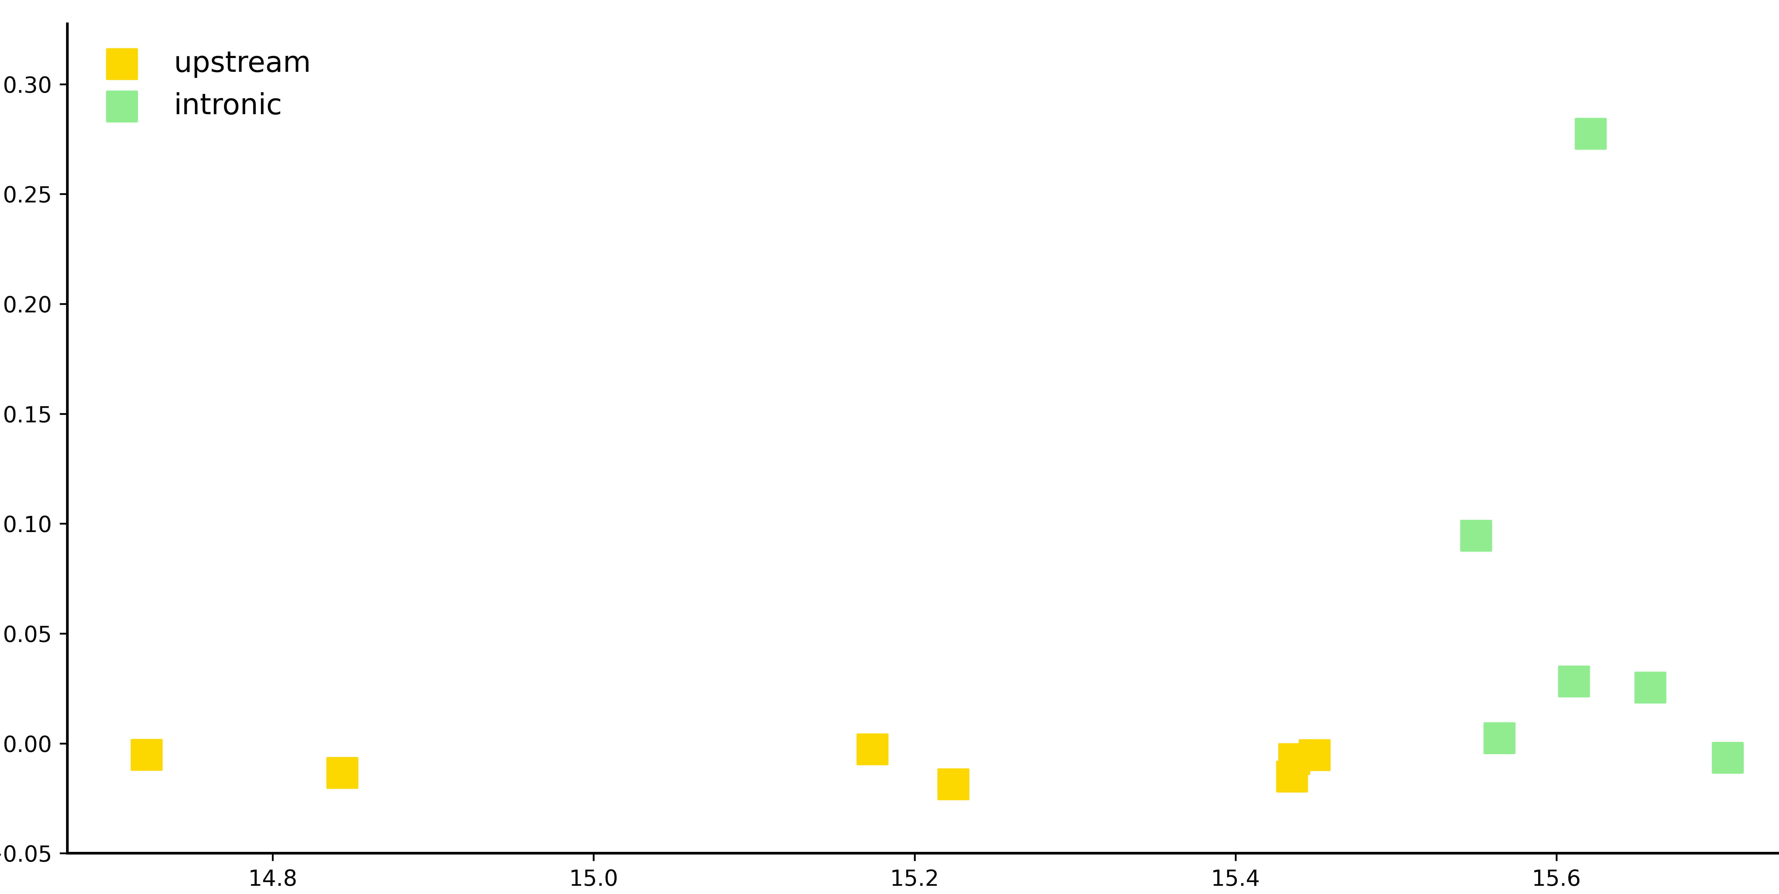
Supplementary Figure S1
A
Chr13 [(mm10, E11.5 limb) :12,683,013-16,244,221]
Gli3
Refseq Genes
prl2c2
Gpr137b
Hecw1
mrpl32
inhba
E11.5 limb GLI3 log2(ChIP/Input)
Gli3 limb enhancers (intronic)
Gli3 limb enhancers (upstream)
B
Chr13 [(mm10: zoomed view) :15,440,165-15,755,642]
Gli3
E11.5 limb GLI3 log2(ChIP/Input)
Gli3 limb enhancers (intronic)
C
CNE19
GLI3 enrichment (mean log2[Chip/input])
CNE14/hs1586
mm2080
CNE18
CNE21
mm2176
mm1859
mm1889
mm2018
mm2164
mm1179
CNE13
Chr 13 position (Mb, mm10)

Slide 2
Supplementary Figure S1. GLI3 ChIP-seq signal across the curated Gli3 limb-enhancer set (mm10, WT E11.5 limb).
(A) Genome-browser view of the broader Gli3 locus (mm10) showing GLI3 ChIP-seq enrichment in WT E11.5 limb as a log2(ChIP/Input) bigWig track. Reads from three GLI3 ChIP-seq runs (SRR11907926, SRR11907927, SRR11907928) were aligned to mm10 using Bowtie2, merged, and normalized to CPM prior to log2(ChIP/Input) calculation. Track display ranges were set with minimum = -0.15 and maximum = 1.0. The curated Gli3 limb enhancer set is displayed as color-coded intervals (upstream in gold; intronic in green). Gene models are shown for positional reference. Display range was fixed across views to allow consistent visual comparison.
(B) Zoomed-in genome-browser view highlighting representative enhancer intervals at higher local resolution using the same GLI3 log2(ChIP/Input) track and scale conventions as in panel A. This view enables direct visual assessment of GLI3 ChIP-seq signal across individual enhancer elements and shows higher signal at a subset of intronic enhancers, whereas several other elements exhibit comparatively weak or near-background signal.
(C) Quantification of GLI3 ChIP-seq signal across individual Gli3 enhancers (mm10). For each BED-defined enhancer interval, mean GLI3 enrichment was calculated as the average log2(ChIP/Input) signal across the full enhancer length. Enhancers are plotted by genomic position (x-axis) against mean GLI3 enrichment (y-axis) and color-coded as upstream or intronic. GLI3 signal varies substantially among the 13 enhancers, with the strongest mean enrichment observed at CNE19 (~0.28), followed by CNE14/hs1586 (~0.095), CNE18 (~0.028), and CNE21 (~0.025), whereas several other enhancers show weak or near-background mean signal. The numerical values underlying panel C are provided in Supplementary Table S3.

Slide 3
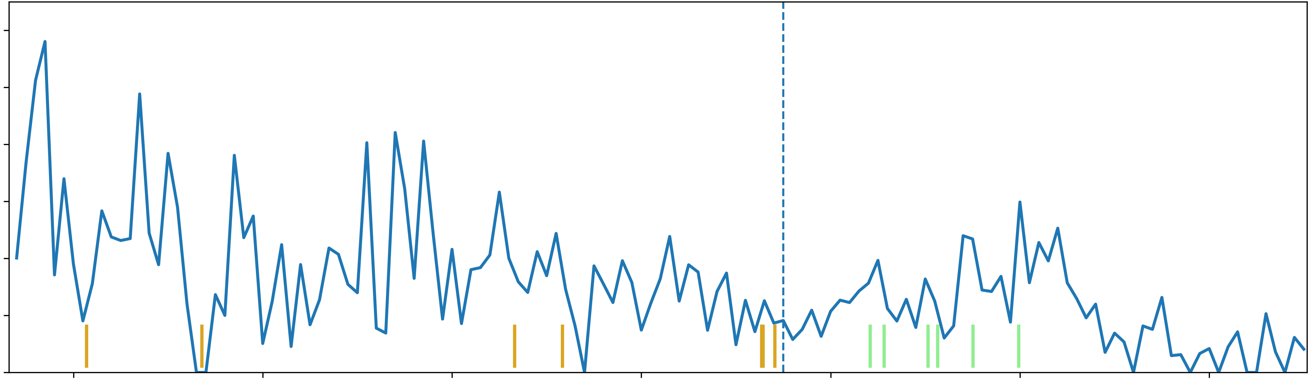
Supplementary Figure S2
6
5
4
Gli3-Promoter region
Virtual 4C signal (O/E, KR)
3
2
CNE19
CNE18
1
mm2080
mm2176
mm1859
mm2164
mm1179
mm2018
CNE21
mm1889
CNE14
CNE13
0
14.8
15.0
15.2
15.4
15.6
15.8
16.0
Genomic position (Mb, mm9)
Supplementary Figure S2. Virtual 4C from the Gli3 promoter in E11.5 hindlimb Hi-C (mm9).
Virtual 4C was computed from KR-balanced Hi-C matrices from mouse E11.5 hindlimb buds (GEO GSE116791; NCBI37/mm9). The viewpoint was the 10-kb bin containing the Gli3 promoter/TSS (chr13:15,550,000–15,560,000; dashed line). The profile shows observed/expected (O/E), KR-normalized contact enrichment between the promoter-containing bin and successive 10-kb bins across chr13:14,732,034–16,103,316 (mm9). Vertical ticks mark the 13 curated Gli3 limb enhancers analyzed in this study (light green, intronic; gold, upstream). The profile provides a promoter-centered view of contact enrichment across the Gli3 region; these population-averaged Hi-C contacts are descriptive and do not by themselves establish direct enhancer–promoter looping or functional interaction. Underlying signal values and enhancer coordinates are provided in Supplementary Tables S4a and S4b. TSS, transcription start site; O/E, observed/expected; KR, Knight–Ruiz matrix balancing; GEO, Gene Expression Omnibus

