Slide 1
Ali Abbasinasab
Practical Data
Notes:
It is a pleasure meeting with you.
Thank you for for scheduling this time to meet

Slide 2
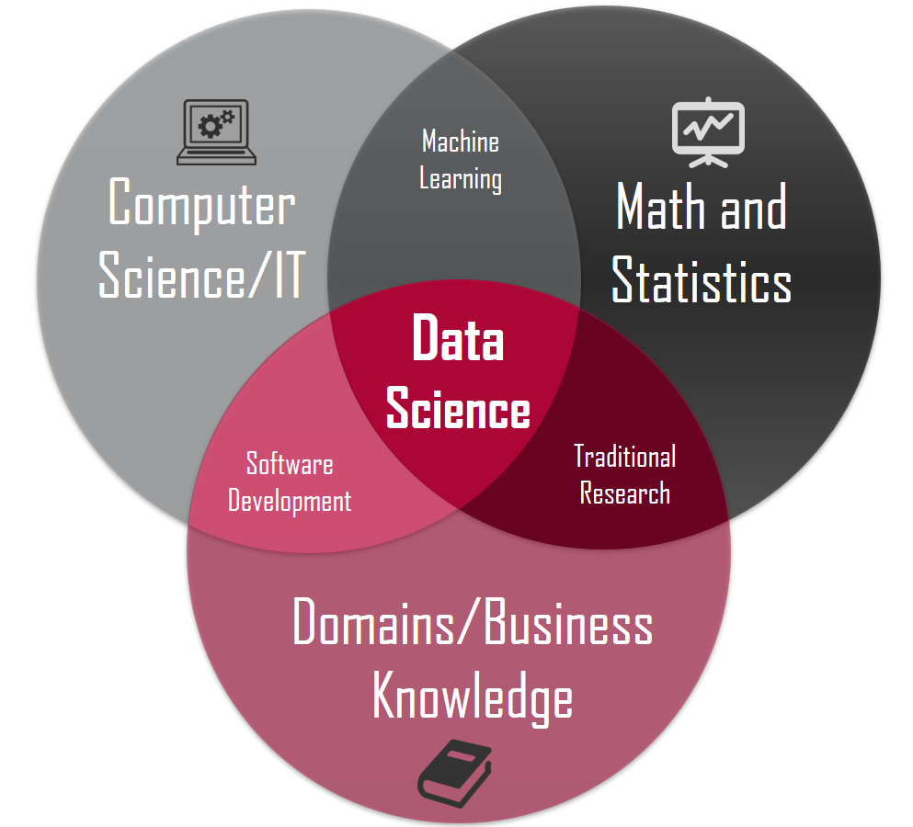
Overview
Data Science
Statistics:
Machine Learning: Sci-kit / MLLIB
Software: Pandas (Python) / Spark (Scala)
Porotype your ML (sci-kit) on small data (panda DF in ram)
Perform your ML (mllib) on big data (spark DF in clusters)

Slide 3
Statistics

Slide 4


Statistics
Linear predictor: y=mx+b → m, b?
Error function: least squares: $e={\sum_{t=1}^{n}{\left(y_{t}−\hat{y_{t}}\right)}}^{2}$
e
b
m
Notes:
Hi Martin,
Thanks for your email and sorry for my tardiness in response. It's been chaotic last two weeks -- have been traveling multiple times to the bay area for interviews.
To update you regarding my job status, I have not accepted any of my offers yet. I have three upcoming interviews tomorrow, Friday and next Monday. So, coming to LA on Thursday doesn't seem to be practical. Can we meet sometime next week?
By the way, I really enjoyed our first online meeting. While we discussed in details what your team currently need, I would like to take some time and go through the skills you listed in the postings. I think juxtaposing these skills with those of mine will give us, better mutual expectations before our meeting.
§ College degree
§ Independently scoping problems, understanding dependencies, and connecting task breakdowns to overall strategy.
§ Working collaboratively with the team to improve internal development practices and procedures.
- I bundle these skills to shorten my email. I believe that throughout my Ph.D. and internships I must have naturally built all those skills.
§ Python: 2+ years on larger projects
I have experience working with python on several projects for more than 2 years. However, I should let you know that the most recent experience of mine with Python (that I can consider as a large project) will go back to 2014 when I was with Apple. Not to mention, that I used python and many of its libraries constantly for developing my own utility tools during my Ph.D. (from implementing algorithms, computational methods, data representations to data analysis). While these projects were parts of a big software that I ultimately offered in my thesis, I don't think they are qualified for being extremely large projects.
§ Programming the frontend and backend (full stack) of our web service and analytics platform, using Python, Django, Python-RQ, MongoDB, Angular and other related languages and tools.
§ JavaScript; Angular or react: 2+ years on larger projects
I love web applications. I have built two large web/mobile cross-platform apps where I was in charge of backend, frontend, diagnose, build and deployment. One of them gratefully led me to form my own small startup in 2015. Throughout developing those apps, I gained experience working with different stacks (MEAN, MERN, and Ruby on Rails). But, I do not myself consider an expert in any of those technologies. Regarding JavaScript, I know JS and have used angular 1 (in Naregni app) and react (in Boomernag app). I, however, do not consider myself a frontend guru either. I have used node to serve a million chat requests at once, provide real-time metrics to a dashboard and etc. I have also picked Ruby on Rail as a backend when node was not a good idea, for example when I would have to crunch a lot of numbers (e.g. you may google PayPal problem with nodejs). I also have picked Php many times for some hit-and-run projects where I wanted to practice my bad programming habits! I think I gave up on PHP a few years ago as its maintenance usually cause serious brain damage on me :) Regarding Django, I would like to be extremely clear that I never had a professional experience working with it. But I have created some great REST API's and built some simple apps for some courses and small gigs. While I've been always a big fan and constant user of Python, I think I never picked Django because maybe it was too monolithic especially for small apps, or because of its tricky routing or its ORM limitations. Nevertheless, curiously, I just gave Django a fresh try today before sending you this email. I brought up a simple web app using basic Django Admin to make sure that I can still get something quickly done using Django. I created some simple models and views, wrote some simple routers and controllers and performed some basic database migrations. While it's been a while since the last time I touched Django, it did not take long to launch a complete app. (I absolutely used google to recall the commands). In very short, it was not a monster at all and I can definitely educate myself more before our meeting, but due to the interviews I most likely will show up with my current level of expertise.
§ Relevant experience deploying features of the backend and frontend into production on Linux based systems.
§ Experience with using AWS.
Linux is my default OS unless I want to play video-games. I have experience working with multiple deployment tools including Jenkin, Firebase, Heroku and AWS. Regarding AWS, in particular, I have deployed two large web apps (not Django) using EC2 where I used the AWS console to create an Elastic Beanstalk environment, used S3 bucket and finally deployed with EB CLI. I am also confident about my knowledge in making web apps highly scalable via AWS load balancer, vertical and horizontal scaling techniques. I am also familiar with other fancy-yet-useful AWS services such as CloudWatch alarms. I'm not sure if they have any use case in your current projects though.
§ Growing to a position of architecting and owning major components in the system.
§ Basic data processing and analysis experience.
Building my own startup may, to some extent, endorse my skills in this regard where I was in full charge of technical strategic planning, translating requirements into specifications, R&D on technologies and architecting application. Data analysis and machine learning is a completely different universe and I invite you to discuss it further in another conversation if you're interested. In short, I have dealt with a massive amount of data every day during my last three years of my Ph.D. and also during my internships. This made me to build a solid background in using data pattern recognition and learning methods to extract insights from data whenever needed.
§ Experience working with nonprofit organizations.
I have none, but that is one of the main reason that I'm interested in Nexleaf.
OMG, what a long email! I hope you do not hate me for my verbose email. Nexleaf is very different from my other possible job opportunities (currents offers from Amazon, Apple, Twitter, and Oracle) in terms of size as well as the type of responsibilities. So, I felt I need to write to you in very details. My interest in joining Nexleaf comes from two sources. First, I like Nextleaf's mission and I like having visible impacts. Second, since joining Nexleaf requires me to be in charge of many things, I assume that this role may give me an opportunity to extend my skills beyond what I have right now and utilize them desirably in developing your web apps. So, I think if you are looking for an absolute pro web developer whose background is extremely laser-focused on Django or expecting him to be in full charge of the entire full-stack development urgently and immediately (which I guess it might be a little bit unrealistic), I would not be the right candidate. However, if you are looking for a long-term investment in a new person on your team with a solid background in computer science which allows him to comfortably pick up new technologies and integrate into a team with a gentle learning curve, I'm a right candidate!

Slide 5
Machine Learning

Slide 6
Statistics vs Machine learning
StAT draws population inferences from a sample [inference]
ML finds generalizable predictive patterns from a sample [prediction]
Two major goals in the study of biological systems are inference and prediction.
Inference creates a mathematical model of the data-generation process to formalize understanding or test a hypothesis about how the system behaves.
Prediction aims at forecasting unobserved outcomes or future behavior, such as whether a mouse with a given gene expression pattern has a disease. Prediction makes it possible to identify best courses of action (e.g., treatment choice) without requiring understanding of the underlying mechanisms.
In a typical research project, both inference and prediction can be of value—we want to know how processes work and what will happen next.
For example, we might want to infer which biological processes are associated with the dysregulation of a gene in a disease, as well as detect whether a subject has the disease and predict the best therapy.
Notes:
Hi Martin,
Thanks for your email and sorry for my tardiness in response. It's been chaotic last two weeks -- have been traveling multiple times to the bay area for interviews.
To update you regarding my job status, I have not accepted any of my offers yet. I have three upcoming interviews tomorrow, Friday and next Monday. So, coming to LA on Thursday doesn't seem to be practical. Can we meet sometime next week?
By the way, I really enjoyed our first online meeting. While we discussed in details what your team currently need, I would like to take some time and go through the skills you listed in the postings. I think juxtaposing these skills with those of mine will give us, better mutual expectations before our meeting.
§ College degree
§ Independently scoping problems, understanding dependencies, and connecting task breakdowns to overall strategy.
§ Working collaboratively with the team to improve internal development practices and procedures.
- I bundle these skills to shorten my email. I believe that throughout my Ph.D. and internships I must have naturally built all those skills.
§ Python: 2+ years on larger projects
I have experience working with python on several projects for more than 2 years. However, I should let you know that the most recent experience of mine with Python (that I can consider as a large project) will go back to 2014 when I was with Apple. Not to mention, that I used python and many of its libraries constantly for developing my own utility tools during my Ph.D. (from implementing algorithms, computational methods, data representations to data analysis). While these projects were parts of a big software that I ultimately offered in my thesis, I don't think they are qualified for being extremely large projects.
§ Programming the frontend and backend (full stack) of our web service and analytics platform, using Python, Django, Python-RQ, MongoDB, Angular and other related languages and tools.
§ JavaScript; Angular or react: 2+ years on larger projects
I love web applications. I have built two large web/mobile cross-platform apps where I was in charge of backend, frontend, diagnose, build and deployment. One of them gratefully led me to form my own small startup in 2015. Throughout developing those apps, I gained experience working with different stacks (MEAN, MERN, and Ruby on Rails). But, I do not myself consider an expert in any of those technologies. Regarding JavaScript, I know JS and have used angular 1 (in Naregni app) and react (in Boomernag app). I, however, do not consider myself a frontend guru either. I have used node to serve a million chat requests at once, provide real-time metrics to a dashboard and etc. I have also picked Ruby on Rail as a backend when node was not a good idea, for example when I would have to crunch a lot of numbers (e.g. you may google PayPal problem with nodejs). I also have picked Php many times for some hit-and-run projects where I wanted to practice my bad programming habits! I think I gave up on PHP a few years ago as its maintenance usually cause serious brain damage on me :) Regarding Django, I would like to be extremely clear that I never had a professional experience working with it. But I have created some great REST API's and built some simple apps for some courses and small gigs. While I've been always a big fan and constant user of Python, I think I never picked Django because maybe it was too monolithic especially for small apps, or because of its tricky routing or its ORM limitations. Nevertheless, curiously, I just gave Django a fresh try today before sending you this email. I brought up a simple web app using basic Django Admin to make sure that I can still get something quickly done using Django. I created some simple models and views, wrote some simple routers and controllers and performed some basic database migrations. While it's been a while since the last time I touched Django, it did not take long to launch a complete app. (I absolutely used google to recall the commands). In very short, it was not a monster at all and I can definitely educate myself more before our meeting, but due to the interviews I most likely will show up with my current level of expertise.
§ Relevant experience deploying features of the backend and frontend into production on Linux based systems.
§ Experience with using AWS.
Linux is my default OS unless I want to play video-games. I have experience working with multiple deployment tools including Jenkin, Firebase, Heroku and AWS. Regarding AWS, in particular, I have deployed two large web apps (not Django) using EC2 where I used the AWS console to create an Elastic Beanstalk environment, used S3 bucket and finally deployed with EB CLI. I am also confident about my knowledge in making web apps highly scalable via AWS load balancer, vertical and horizontal scaling techniques. I am also familiar with other fancy-yet-useful AWS services such as CloudWatch alarms. I'm not sure if they have any use case in your current projects though.
§ Growing to a position of architecting and owning major components in the system.
§ Basic data processing and analysis experience.
Building my own startup may, to some extent, endorse my skills in this regard where I was in full charge of technical strategic planning, translating requirements into specifications, R&D on technologies and architecting application. Data analysis and machine learning is a completely different universe and I invite you to discuss it further in another conversation if you're interested. In short, I have dealt with a massive amount of data every day during my last three years of my Ph.D. and also during my internships. This made me to build a solid background in using data pattern recognition and learning methods to extract insights from data whenever needed.
§ Experience working with nonprofit organizations.
I have none, but that is one of the main reason that I'm interested in Nexleaf.
OMG, what a long email! I hope you do not hate me for my verbose email. Nexleaf is very different from my other possible job opportunities (currents offers from Amazon, Apple, Twitter, and Oracle) in terms of size as well as the type of responsibilities. So, I felt I need to write to you in very details. My interest in joining Nexleaf comes from two sources. First, I like Nextleaf's mission and I like having visible impacts. Second, since joining Nexleaf requires me to be in charge of many things, I assume that this role may give me an opportunity to extend my skills beyond what I have right now and utilize them desirably in developing your web apps. So, I think if you are looking for an absolute pro web developer whose background is extremely laser-focused on Django or expecting him to be in full charge of the entire full-stack development urgently and immediately (which I guess it might be a little bit unrealistic), I would not be the right candidate. However, if you are looking for a long-term investment in a new person on your team with a solid background in computer science which allows him to comfortably pick up new technologies and integrate into a team with a gentle learning curve, I'm a right candidate!

Slide 7
Statistics vs Machine learning
STAT | ML
Parsimony (simple and formal model) | User Friendly (I don’t learn, I use them)
Interpretability (easy to understand behave, parameters) | Good prediction (often using multiple stat models)
Knowledge creation (Newtonian physics models) | Automated
Worry about interference | Black box (not too why? don’t care much formalization if works, works)
Population (connecting data to population) | Worry about overfitting not model complexity
Generativity (with little data, we model answer to many cases, distributions) | Generatability (data-driven)
Little data | Lots of data
Often: few variables, row (num of data point) >> columns (num of features) | High dimension data (long,
Concern over Assumptinon (data process generation, what distro,…) and robustness | concern over performance and robustness
Fit probabilistic model, significance (p-value), confidence interval | Fit , best algorithm (crossvalidation), accuracy (recall, f score, kappa)

Slide 8
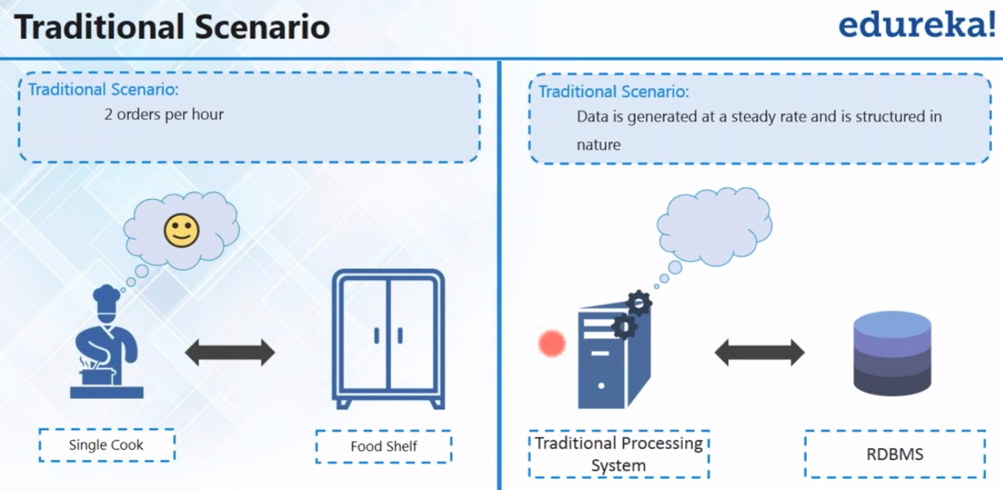
Big DATA: OLD

Slide 9
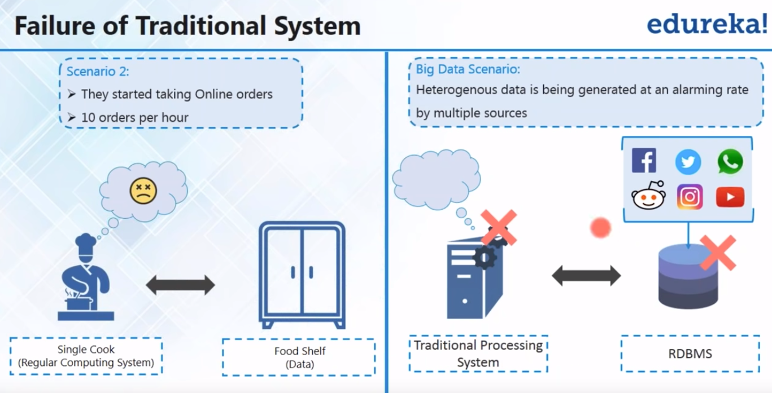
BIG DATA: OLD is bad
Notes:
Hi Martin,
Thanks for your email and sorry for my tardiness in response. It's been chaotic last two weeks -- have been traveling multiple times to the bay area for interviews.
To update you regarding my job status, I have not accepted any of my offers yet. I have three upcoming interviews tomorrow, Friday and next Monday. So, coming to LA on Thursday doesn't seem to be practical. Can we meet sometime next week?
By the way, I really enjoyed our first online meeting. While we discussed in details what your team currently need, I would like to take some time and go through the skills you listed in the postings. I think juxtaposing these skills with those of mine will give us, better mutual expectations before our meeting.
§ College degree
§ Independently scoping problems, understanding dependencies, and connecting task breakdowns to overall strategy.
§ Working collaboratively with the team to improve internal development practices and procedures.
- I bundle these skills to shorten my email. I believe that throughout my Ph.D. and internships I must have naturally built all those skills.
§ Python: 2+ years on larger projects
I have experience working with python on several projects for more than 2 years. However, I should let you know that the most recent experience of mine with Python (that I can consider as a large project) will go back to 2014 when I was with Apple. Not to mention, that I used python and many of its libraries constantly for developing my own utility tools during my Ph.D. (from implementing algorithms, computational methods, data representations to data analysis). While these projects were parts of a big software that I ultimately offered in my thesis, I don't think they are qualified for being extremely large projects.
§ Programming the frontend and backend (full stack) of our web service and analytics platform, using Python, Django, Python-RQ, MongoDB, Angular and other related languages and tools.
§ JavaScript; Angular or react: 2+ years on larger projects
I love web applications. I have built two large web/mobile cross-platform apps where I was in charge of backend, frontend, diagnose, build and deployment. One of them gratefully led me to form my own small startup in 2015. Throughout developing those apps, I gained experience working with different stacks (MEAN, MERN, and Ruby on Rails). But, I do not myself consider an expert in any of those technologies. Regarding JavaScript, I know JS and have used angular 1 (in Naregni app) and react (in Boomernag app). I, however, do not consider myself a frontend guru either. I have used node to serve a million chat requests at once, provide real-time metrics to a dashboard and etc. I have also picked Ruby on Rail as a backend when node was not a good idea, for example when I would have to crunch a lot of numbers (e.g. you may google PayPal problem with nodejs). I also have picked Php many times for some hit-and-run projects where I wanted to practice my bad programming habits! I think I gave up on PHP a few years ago as its maintenance usually cause serious brain damage on me :) Regarding Django, I would like to be extremely clear that I never had a professional experience working with it. But I have created some great REST API's and built some simple apps for some courses and small gigs. While I've been always a big fan and constant user of Python, I think I never picked Django because maybe it was too monolithic especially for small apps, or because of its tricky routing or its ORM limitations. Nevertheless, curiously, I just gave Django a fresh try today before sending you this email. I brought up a simple web app using basic Django Admin to make sure that I can still get something quickly done using Django. I created some simple models and views, wrote some simple routers and controllers and performed some basic database migrations. While it's been a while since the last time I touched Django, it did not take long to launch a complete app. (I absolutely used google to recall the commands). In very short, it was not a monster at all and I can definitely educate myself more before our meeting, but due to the interviews I most likely will show up with my current level of expertise.
§ Relevant experience deploying features of the backend and frontend into production on Linux based systems.
§ Experience with using AWS.
Linux is my default OS unless I want to play video-games. I have experience working with multiple deployment tools including Jenkin, Firebase, Heroku and AWS. Regarding AWS, in particular, I have deployed two large web apps (not Django) using EC2 where I used the AWS console to create an Elastic Beanstalk environment, used S3 bucket and finally deployed with EB CLI. I am also confident about my knowledge in making web apps highly scalable via AWS load balancer, vertical and horizontal scaling techniques. I am also familiar with other fancy-yet-useful AWS services such as CloudWatch alarms. I'm not sure if they have any use case in your current projects though.
§ Growing to a position of architecting and owning major components in the system.
§ Basic data processing and analysis experience.
Building my own startup may, to some extent, endorse my skills in this regard where I was in full charge of technical strategic planning, translating requirements into specifications, R&D on technologies and architecting application. Data analysis and machine learning is a completely different universe and I invite you to discuss it further in another conversation if you're interested. In short, I have dealt with a massive amount of data every day during my last three years of my Ph.D. and also during my internships. This made me to build a solid background in using data pattern recognition and learning methods to extract insights from data whenever needed.
§ Experience working with nonprofit organizations.
I have none, but that is one of the main reason that I'm interested in Nexleaf.
OMG, what a long email! I hope you do not hate me for my verbose email. Nexleaf is very different from my other possible job opportunities (currents offers from Amazon, Apple, Twitter, and Oracle) in terms of size as well as the type of responsibilities. So, I felt I need to write to you in very details. My interest in joining Nexleaf comes from two sources. First, I like Nextleaf's mission and I like having visible impacts. Second, since joining Nexleaf requires me to be in charge of many things, I assume that this role may give me an opportunity to extend my skills beyond what I have right now and utilize them desirably in developing your web apps. So, I think if you are looking for an absolute pro web developer whose background is extremely laser-focused on Django or expecting him to be in full charge of the entire full-stack development urgently and immediately (which I guess it might be a little bit unrealistic), I would not be the right candidate. However, if you are looking for a long-term investment in a new person on your team with a solid background in computer science which allows him to comfortably pick up new technologies and integrate into a team with a gentle learning curve, I'm a right candidate!

Slide 10
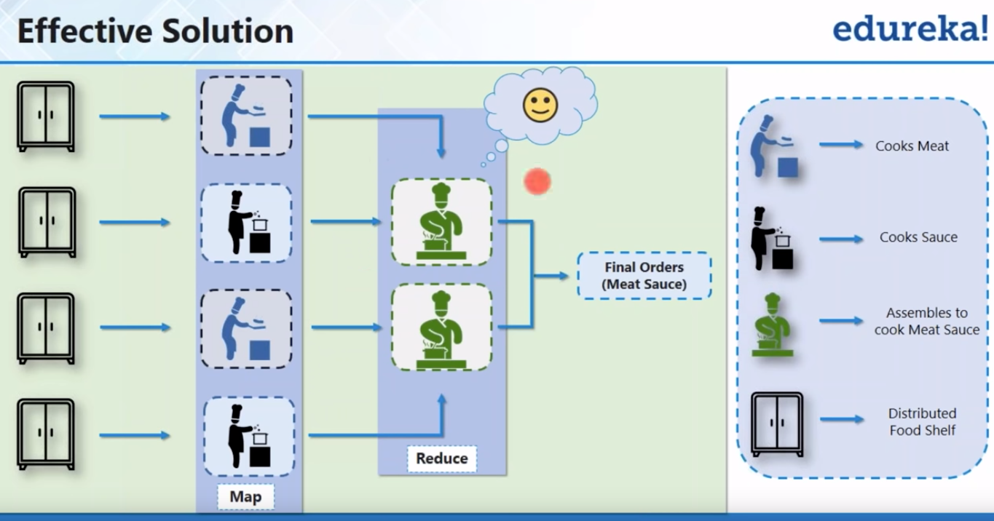
Big DATA: NEW
General Idea: Distributed Data and Process:
Multiple food shelves(HDF), Multiple chefs with diff tasks (Map) + Multiple Head Chefs (Reduce)
Two main data analytics: Batch and Real-Time

Slide 11
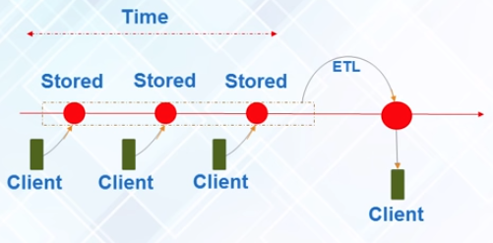
BIG DATA: BATCH
Alanlytics based on the data collected over a period of time.
Ex: Laundry: you collect dirty clothes and wash all ( you don’t wash evertime a clothe is dirty)

Slide 12
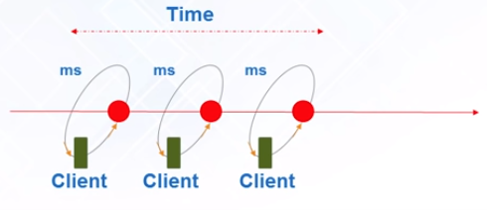
BIT DATA: REAL-TIME
Analytics based on immediate data (stream) for instant result
Ex: Credit Card: living in SB, and if your card is used in NY, as soon as bank process and check (they don’t let all happen and then process 10 transactions, no!),
Ex: ML + Realtime: Stock market: Prediction Algo (ML) if an unusual events: down: they limit, up: buy more

Slide 13
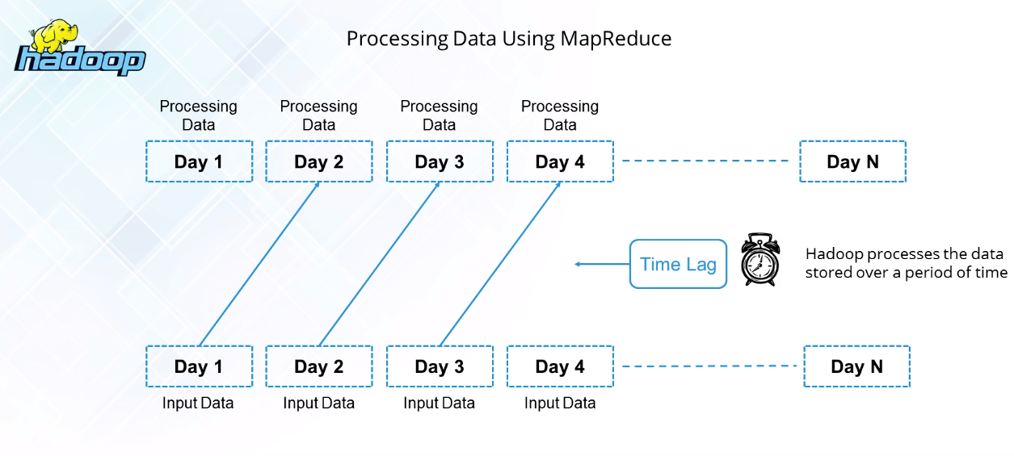
BIG DATA: REAL-TIME: HADOOP
MapReduce can suffer from many I/O operations in each steps (mapping, sort&shuffle and reduce) when reads input and store/write output

Slide 14
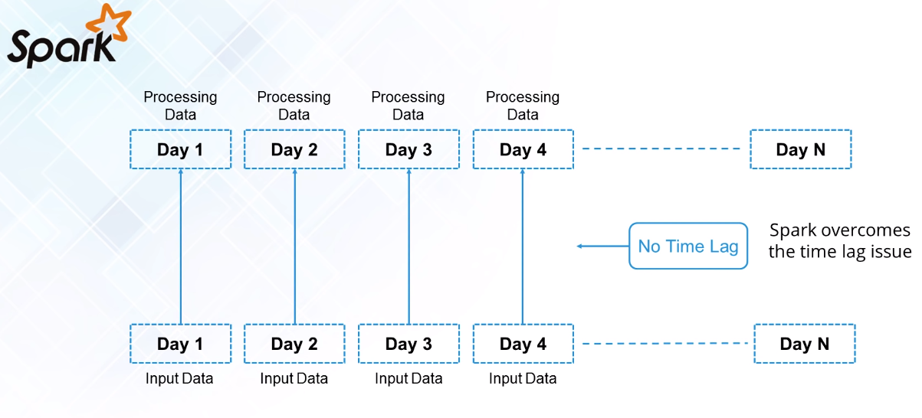
BIG DATA: REAL-TIME: Spark

Slide 15
Data Science & Machine learning
Supervised: if need to train models to make a prediction
Classification: discrete (0,1,2): spam emails, med img, cancerous tumors, speech rec, credit score: Logistics Regression, KNN, SVM, NN
Regression: range (real nums): Temperature, Equipment TTF, Stock: [non]Linear (GD)
Unsupervised: if need to train models to explore data and extract insights
Clustering: Gene sequence, market research, object rec: k-mean, Hidden Markov Model
Other Analysis:
Finding Extrema: Lagrange Multiplier (Optimization, Cost Func, Classifiers e.g. SVM)
Outlier test: P-value (Regression)
Dimension Reduction: PCA
Param Tuning: CrossValidation (K-fold KNN), Bias-Variance Trade-off (Linear vs Squiggle)

