Slide 1
Data Incubator Auto Theft in Boston
Nima Abbasi
11/15/2016

Slide 2
Auto theft incidents in Boston 2012-2015
Interactive map:
https://abbasinima.shinyapps.io/back/
Links to the data:
https://data.cityofboston.gov/Public-Safety/Crime-Incident-Reports-July-2012-August-2015-Sourc/7cdf-6fgx/data
https://data.cityofboston.gov/Public-Safety/Crime-Incident-Reports-August-2015-To-Date-Source-/fqn4-4qap
Click here

Slide 3
Car theft incident in different years 2012-2016
Car theft incidents
Year

Slide 4
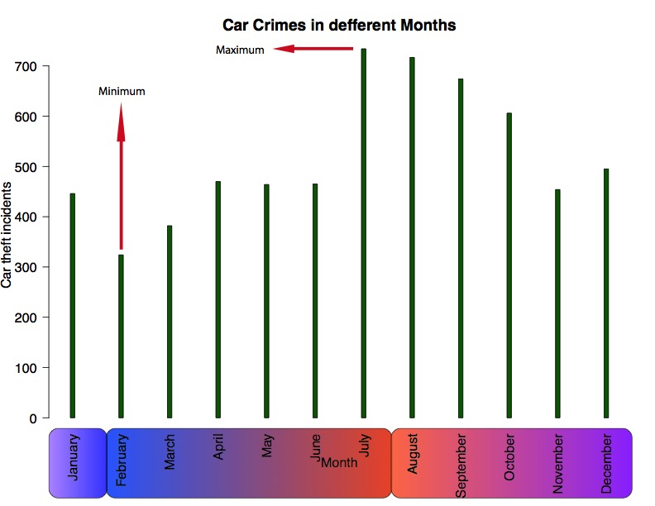
Car theft incident in different Months 2012-2016
Maximum
Minimum
Car theft incidents
Temperature

Slide 5
Car theft incident in different Day of a week 2012-2016
Car theft incidents

Slide 6
Car theft incident in different shifts of a day 2012-2016
Car theft incidents
16 - 24
8 - 16
0 - 8

Slide 7
Car theft incident in different hours of a day 2012-2016
Car theft incidents

Slide 8
Conclusion
Car theft crime rate in Boston is decreasing!
Data analysis shows this is a seasonal crime!
The pick hours of this type of crime is from 20-22

