Slide 1
Probabilistic Modelling and performance analysis of packet delay in a single router network
Milestone 2

Slide 2
Random Variables
We define the following random variables:
• A = Inter-arrival time
• S = Service time
• D = Total delay
• L = Queue Length

Slide 3
Modeling Arrivals: Poisson Process
We assume packet arrivals follow a Poisson process.
• λ (lambda) = Arrival Rate (packets/sec)
Poisson Distribution
N(t) ~ Poisson(λt)
N(t) = number of arrivals in time t
Example (λ = 2):
In 5 seconds, expected arrivals = λ × t
Expected = 2 × 5 = 10 packets.

Slide 4
Inter-Arrival Time Distribution
If arrivals are Poisson, the time between packets (A) is Exponential.
Exponential Distribution
A ~ Exponential(λ) | E[A] = 1 / λ
A = Time between consecutive arrivals
Example (λ = 2):
E[A] = 1 / 2 = 0.5 seconds
Meaning: Packets arrive every 0.5s on average.

Slide 5
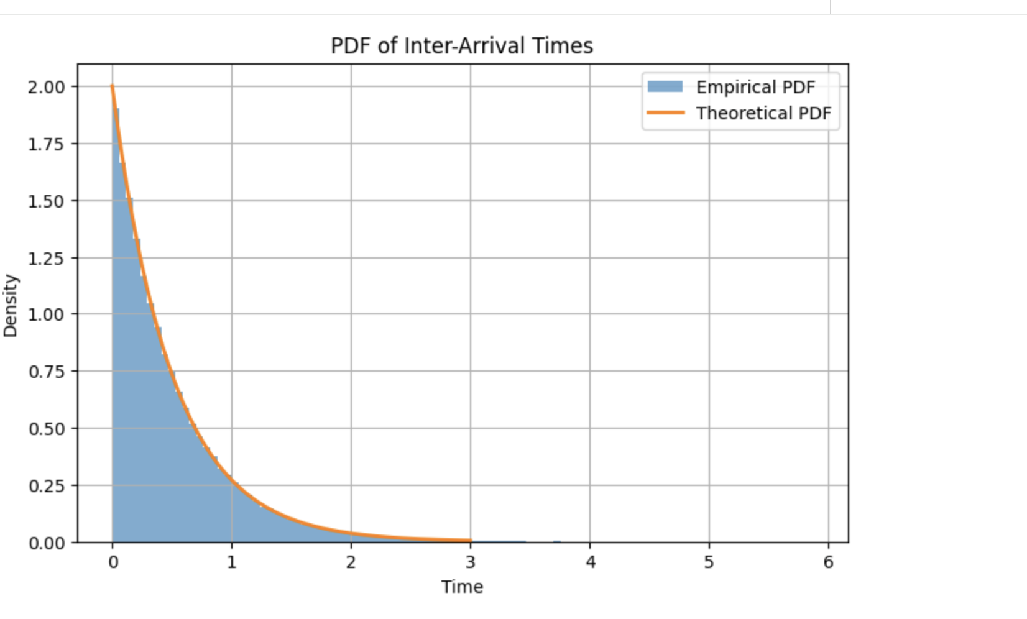

Slide 6
Modeling Service Time
Service time (S) is also random.
• μ (mu) = Service Rate (packets/sec)
Service Time Distribution
S ~ Exponential(μ) | E[S] = 1 / μ
S = Time to process one packet
Example (μ = 3):
E[S] = 1 / 3 ≈ 0.33 seconds
Meaning: Router processes 3 packets per second.

Slide 7
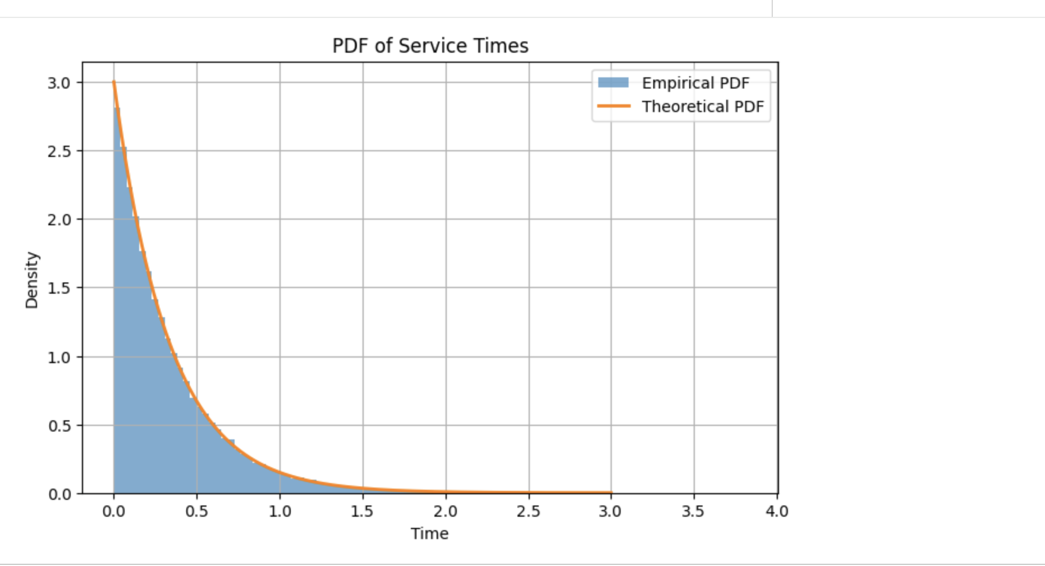

Slide 8
Traffic Intensity (ρ)
Traffic Intensity
ρ = λ / μ
Fraction of time the server is busy
Stability Condition:
• Stable if λ < μ
• If λ ≥ μ, queue grows indefinitely.
Example (λ = 2, μ = 3):
ρ = 2 / 3 = 0.67
Meaning: Router is busy 67% of the time.

Slide 9
Queue Length as a Random Variable
Define:
• N = number of packets in the system (waiting + service)
• Nq = number of packets waiting in the queue only
• λ = arrival rate, μ = service rate, ρ = λ / μ
Mean Number in System
E[N] = ρ / (1 - ρ)
Average total packets inside the router
Mean Number Waiting in Queue
E[Nq] = ρ² / (1 - ρ)
Average packets waiting before service

Slide 10
Little's Theorem
Connects Arrival Rate (λ), Delay (W), and Queue Size (L).
Little's Law
L = λ × E[D]
Average number of packets in the system
Example (λ = 2, E[D] = 1):
L = 2 × 1 = 2 packets
Meaning: On average, 2 packets are inside the system.

Slide 11
Connecting Queue Length to Delay
Using Little's Law to connect variables:
Little's Law Relation
E[N] = λ E[D]
Relates Size, Arrival Rate, and Delay
This connects:
• Arrival rate (λ)
• Average delay (E[D])
• Average system size (E[N])
Example:
If λ = 2 and E[D] = 1:
Then E[N] = 2
Meaning: On average, 2 packets are inside.

Slide 12
Packet Delay Definition
Total Delay
D = W + S
Wait Time (Queue) + Service Time (Router)
Definitions:
• W = Waiting time in queue
• S = Service time
• D = Total delay
Insight: This captures both congestion (W) and processing (S).

Slide 13
Average Delay Formula
M/M/1 Average Delay
E[D] = 1 / (μ - λ)
(μ - λ) represents 'Spare Capacity'
Interpretation:
• If spare capacity is small, delay becomes huge.
• Delay grows non-linearly.
Example (μ = 3, λ = 2):
E[D] = 1 / (3 - 2) = 1 second
Note: Service is only 0.33s, but total delay is 1s.

Slide 14
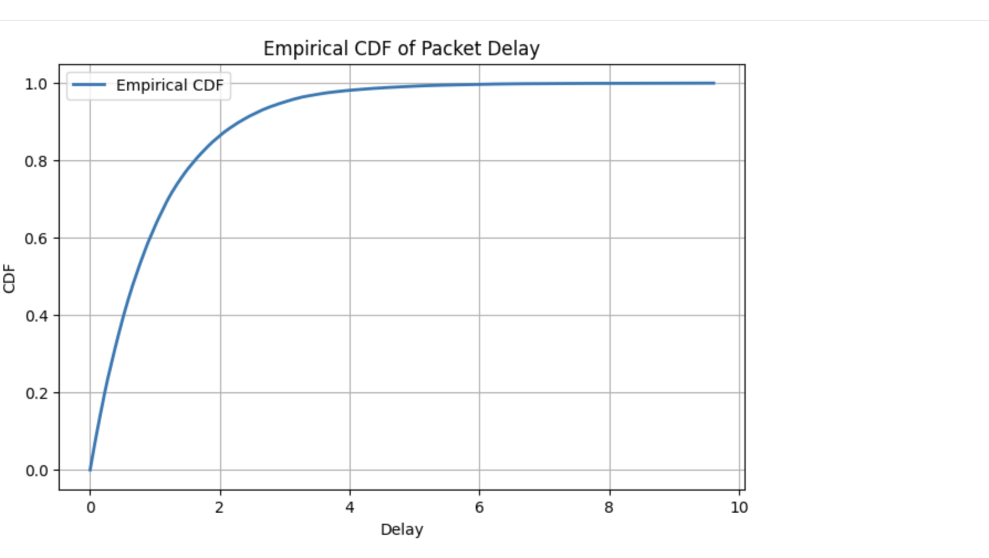

Slide 15
Exact Tail Probability
Probability of Delay > t
P(D > t) = e^{-(μ - λ)t}
Delay probability decreases exponentially
This measures the 'Tail Risk' or chance of extreme lag.
Example (μ - λ = 1, t = 3):
P(D > 3) = e^-3 ≈ 0.05
Result: Only 5% of packets exceed 3 seconds delay.

Slide 16
Markov Inequality
Worst-Case Bound
P(D ≥ t) ≤ E[D] / t
Useful when exact distribution is unknown
Comparison (E[D] = 1, t = 3):
Markov Bound: ≤ 1/3 ≈ 0.33 (Loose Estimate)
Exact Value: ≈ 0.05 (Precise)
Conclusion: Markov is safe but pessimistic.

Slide 17
Numerical Example (Very Important)
Given Parameters:
λ = 2
μ = 3
ρ = 2 / 3
Calculated Expectations
E[N] = 2 | E[Nq] ≈ 1.33
Results derived from formulas
Interpretation:
• About 1.33 packets are waiting in the queue.
• About 0.67 packet is in service.
• Total = 1.33 + 0.67 = 2 packets.
Conclusion: Matches Little’s Law.

Slide 18
Chernoff Bound (General Inequality)
For any non-negative random variable X:
P(X ≥ t) ≤ inf [ E[e^(sX)] / e^(st) ]
Minimizing over s > 0
Where:
• X = random variable
• t = threshold
• s = positive parameter
• E[e^(sX)] = moment generating function (MGF)
• Chernoff bound uses exponential moments.
• It gives exponentially decaying bounds.
• It is tighter than Markov inequality.
• Useful for bounding rare events.

Slide 19
Applying Chernoff to Packet Delay
In our model, Delay (D) is Exponential:
D ~ Exponential(μ - λ)
Its moment generating function (MGF):
MD(s) = (μ - λ) / (μ - λ - s)
for s < μ - λ
Using Chernoff inequality, we derive:
Final Bound
P(D ≥ t) ≤ e^(-(μ - λ)t)
Interpretation:
• Delay tail decays exponentially.
• Larger (μ - λ) → faster decay.
• This connects arrival/service rates directly to reliability.

Slide 20
Comparison of Bounds
Markov vs Chernoff vs Exact Tail
1. Exact Tail
P(D > t) = e^(-(μ - λ)t)
Matches exponential behavior perfectly
2. Markov Bound
P(D ≥ t) ≤ E[D] / t
Very loose (decays linearly as 1/t)
3. Chernoff Bound
P(D ≥ t) ≤ e^(-(μ - λ)t)
Much tighter (Matches the exact exponential decay)
Conclusion: Chernoff is significantly tighter than Markov for Queueing Delay.

Slide 21
