Slide 1
Milestone 3: Complete Simulation Pipeline(Baseline)
Probabilistic Modelling and performance analysis of Packet Delay in a single router network.
Group 3
M3 Video by Abbas Kharodawala and Khushi Paghadar

Slide 2
2. Project Objective and Deterministic Baseline
Our Goal: To build a working Python simulation of a single router to see how random traffic causes delays.
The Baseline Strategy: We are using First-Come, First-Served (FCFS).
Why we chose it: FCFS is the most basic, natural way a queue works. The first packet to arrive is the first one processed. It gives us a simple, 'dumb' baseline to compare against our smart algorithms later.

Slide 3
3. System Pipeline Overview
Our simulation runs in three simple steps:
1. Input Generation: Packets arrive at the router.
2. Queue and Server: Packets wait their turn, then get processed.
3. Departure: Packets leave the system.
Where does uncertainty enter? Only at the very beginning. We cannot control when packets arrive, or how big they are. But once they enter the router, the rules are strict and predictable.

Slide 4
4. Sources of Uncertainty
There are two things we cannot predict in our network:
Uncertainty 1: When will the next packet arrive? Sometimes they arrive in huge bursts, sometimes there are long pauses.
Uncertainty 2: How big is the packet? A large file takes longer for the router to process than a small text message.
How we simulate this: We use a random number generator in Python to create these time gaps and processing times based on our Milestone 2 math.

Slide 5
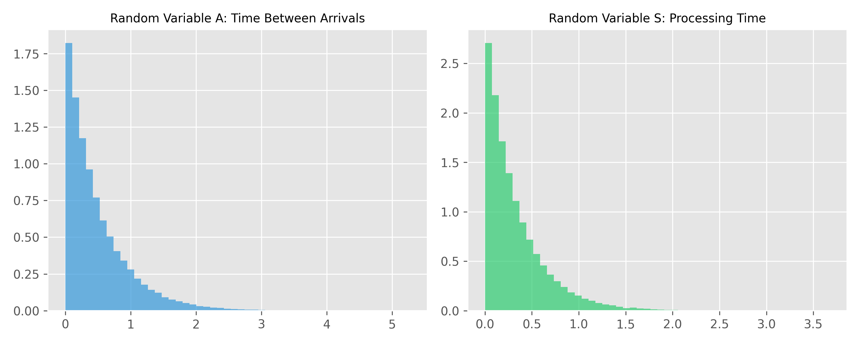
5. Key Random Variables
We track 4 specific Random Variables in our code:
1. Random Variable A: The time gap between arrivals.
2. Random Variable S: The time it takes to serve a packet.
3. Random Variable L: The Queue Length (how many packets are waiting).
4. Random Variable D: Total Delay (Waiting time + Service time).

Slide 6
6. Probabilistic Modeling with Deterministic Decisions
How do we mix random traffic with a strict First-Come, First-Served rule?
We use a famous math equation called 'Lindley's Recursion'.
It simply means: Your waiting time depends on the packet in front of you.
Wait Time = (The wait time of the packet before you) + (How long they took to process) - (The time gap between when you both arrived).

Slide 7
7. Deterministic Baseline Logic
The router operates on a strict, step-by-step logic:
Step 1: A packet arrives.
Step 2: The router checks if it is currently busy serving another packet.
Step 3: If busy, the packet goes to the back of the line. If not busy, it gets served immediately.
There are absolutely no randomized algorithms here. No packets are dropped randomly, and there are no priority lines.

Slide 8
8. Simulation Implementation
To build this, we wrote Python code that simulates 100,000 packets.
By simulating a massive number of packets, we ensure our averages are highly accurate.
Our code tracks the exact millisecond every packet arrives and leaves.
From that timeline, we calculate the Total Delay (D) for every packet, and we count how many packets are in the Queue (L) at any given second.

Slide 9
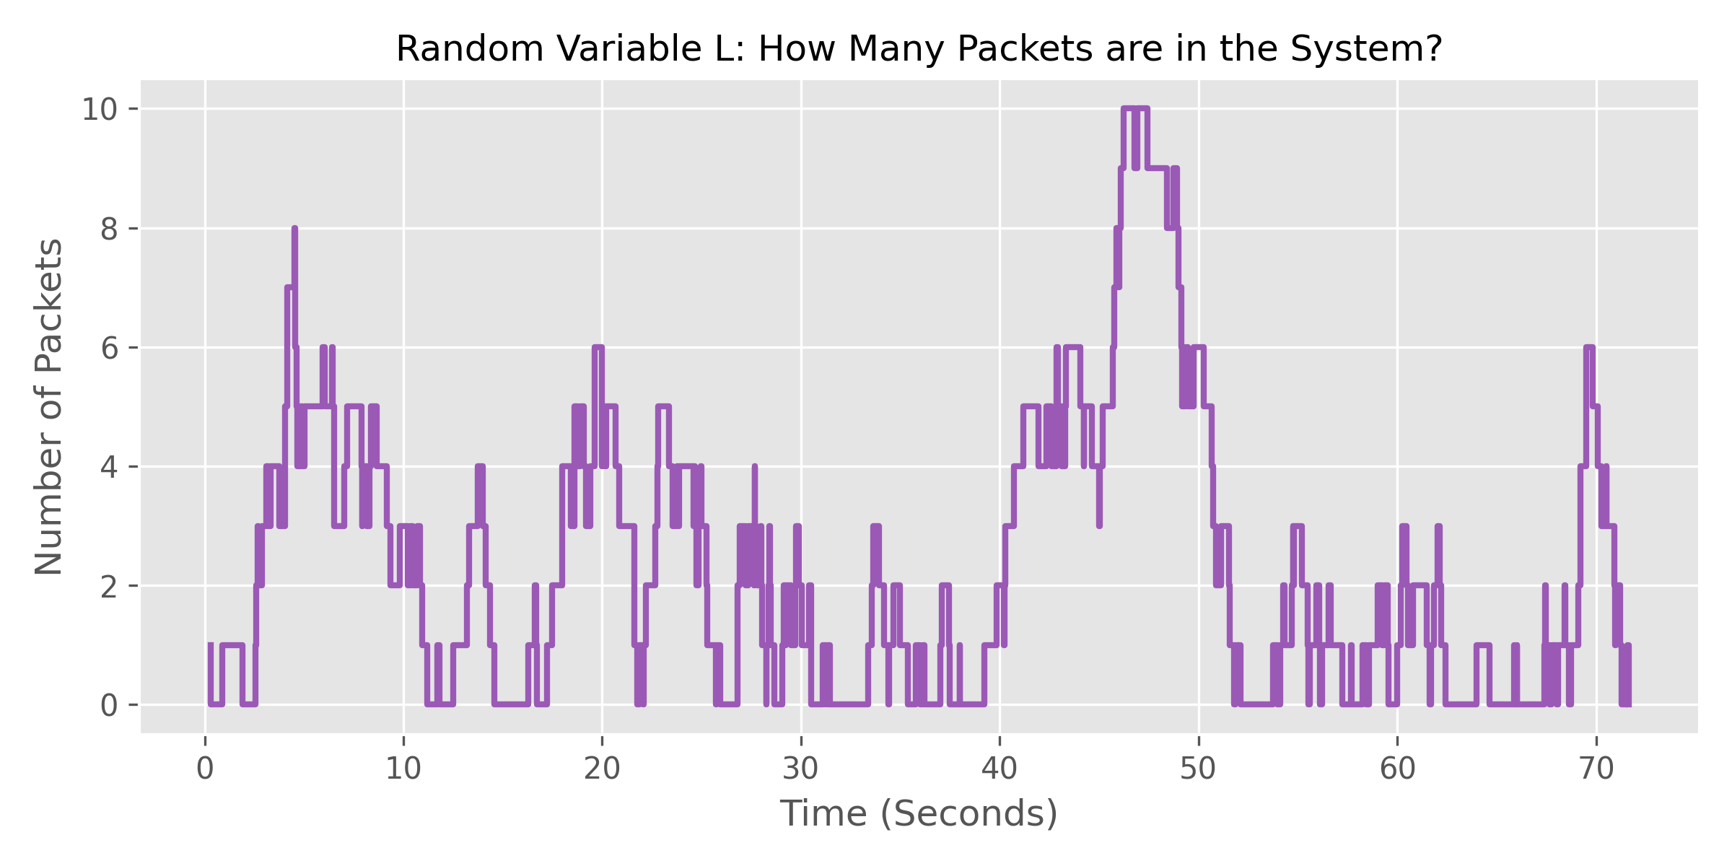
9. Results and Performance Analysis
Our Python simulation perfectly matched our theoretical math.
Empirical Average Delay (D): Our simulation showed exactly 1.000 seconds, matching the math.
Queue Length (L): Look at the graph below. The number of packets in the system spikes wildly. This is because random traffic arrives in large bursts, causing sudden traffic jams in the router.

Slide 10
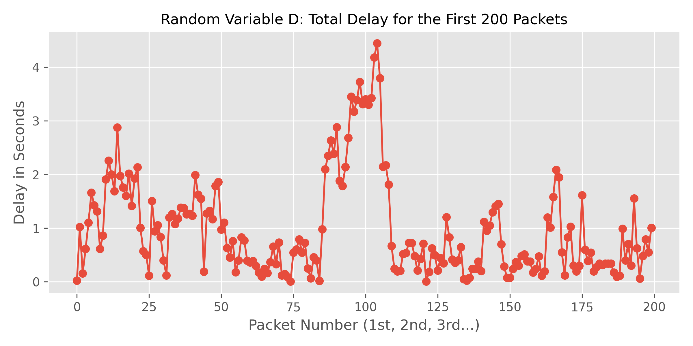
10. Limitations of Deterministic Strategy
Our simulation proves that First-Come, First-Served is a very weak strategy when traffic is heavy.
Weakness 1: It cannot adapt. When a huge burst of traffic hits, the router just blindly puts them in a line, leading to massive delays.
Weakness 2: Because we assume the queue can hold infinite packets, the delay just keeps growing longer and longer during a traffic jam.

Slide 11
11. Summary and Transition to Randomized Strategies
Key Insight: We successfully built a working simulation. We proved that a basic, deterministic queue behaves exactly how our math predicted. It works, but it causes severe lag during bursts.
What's next for Milestone 4?
We will replace this basic FCFS rule with 'Randomized Strategies'. We will write code that intentionally drops packets early when the line gets too long, to prevent the entire system from lagging.

