Slide 1
Milestone 4: Randomized Algorithmic Strategies
Active Queue Management via Random Early Detection (RED)
Group 3

Slide 2
1. Project Context and Motivation
Project Domain:
Probabilistic Modelling of Packet Delay in Router Networks.
Why Uncertainty is Critical:
Network traffic is inherently stochastic. We cannot control when users request data (Arrivals) or the payload size of that data (Service).
If we do not actively manage this uncertainty, the network will experience severe congestion, leading to high latency and dropped connections.

Slide 3
2. Deterministic Baseline Overview
Milestone 3 Recap:
We implemented First-Come, First-Served (FCFS) routing. This is a purely deterministic, zero-entropy admission rule.
Key Limitations of FCFS:
Buffer Bloat: Because FCFS accepts all packets, the queue grows infinitely during traffic bursts.
Global Synchronization: If a deterministic router drops packets (e.g., buffer is 100% full), it forces all users to throttle data simultaneously, crashing network throughput.

Slide 4
3. System Pipeline Overview
The End-to-End Architecture:
1. Input Generation (NumPy Exponential Distributions)
2. Queue Management Engine (The Router Logic)
3. Output Metrics & Evaluation
Where the Modification Operates:
We are strictly modifying Stage 2. We replace the rigid FCFS gatekeeper with a randomized Active Queue Management (AQM) algorithm.

Slide 5
4. Sources of System Uncertainty
The Problem with Determinism:
A fixed, deterministic rule cannot adapt to sudden, extreme fluctuations in stochastic traffic load.
The Mathematical Solution:
To combat the uncontrollable, external randomness of internet traffic, we must introduce controlled, internal randomness into the router's logic.

Slide 6
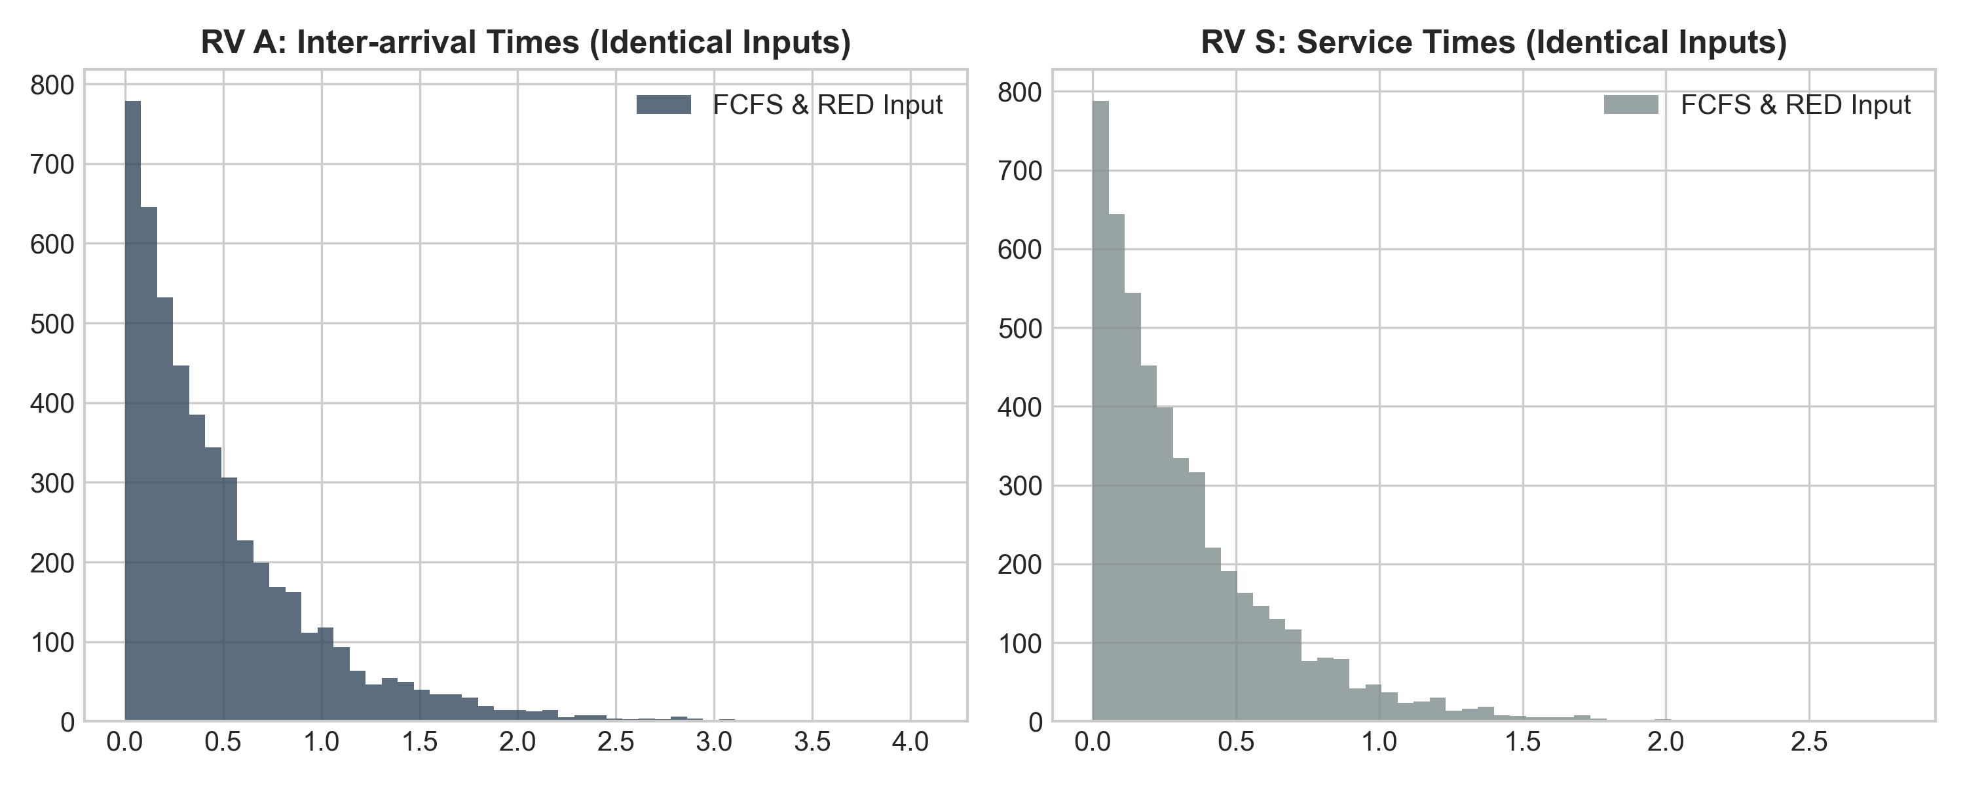
5. Controlling the Inputs (RVs A & S)
• To ensure a fair experiment, the input Random Variables must be 100% identical for both FCFS and RED simulations.
• RV A (Inter-Arrival Time) and RV S (Service Time) perfectly match across both algorithms.

Slide 7
6. Randomized Algorithm Design (RED)
Random Early Detection (RED):
The router tracks the Exponentially Weighted Moving Average (EWMA) of the queue length.
The Randomized Rule:
If the queue is growing between our min and max thresholds, RED calculates a linearly scaling Drop Probability (p).
The algorithm uses a Uniform(0,1) random number generator. If the random float is less than p, the packet is intentionally dropped.

Slide 8
7. Probabilistic Reasoning
Why Intentionally Drop Packets?
By probabilistically dropping a small fraction of packets early, RED disperses congestion signals randomly across independent traffic streams.
This mathematically desynchronizes the traffic, preventing global crashes.
We sacrifice a highly controlled ~1.5% of packets to prevent the Expected Delay of the remaining 98.5% from scaling to infinity.

Slide 9
8. Implementation in the Pipeline
Python Code Structure:
We replaced the static Lindley recursion loop with a dynamic, state-aware event loop.
We programmed the EWMA equation to update system state on every packet arrival.
We utilized the `numpy.random.rand()` function to generate the continuous Uniform sampling required for the randomized admission decision.

Slide 10
9. Evaluation Metrics
We evaluate the algorithm using three core metrics:
1. Queue Length (L) Dynamics: To verify internal router stability.
2. Total Delay (D) and Tail Probabilities P(D>t): To verify end-user Quality of Service and elimination of lag.
3. Packet Drop Rate: The communication 'cost' required to achieve the optimization.

Slide 11
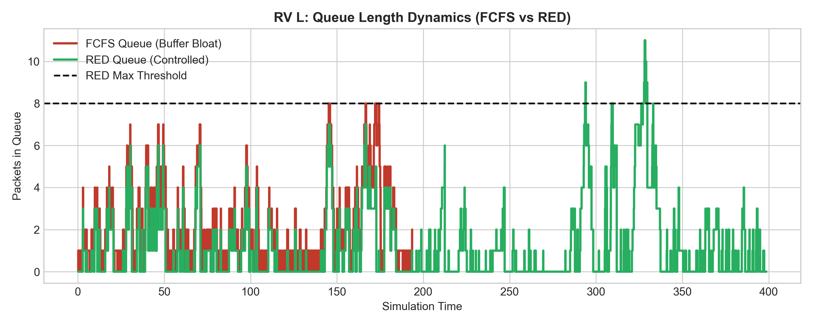
10. Results: Stabilizing Variables L and D
• FCFS (Red) suffers from severe Buffer Bloat and Delay Spikes. RED (Green) uses randomization to strictly bound the queue and flatten the delay.

Slide 12
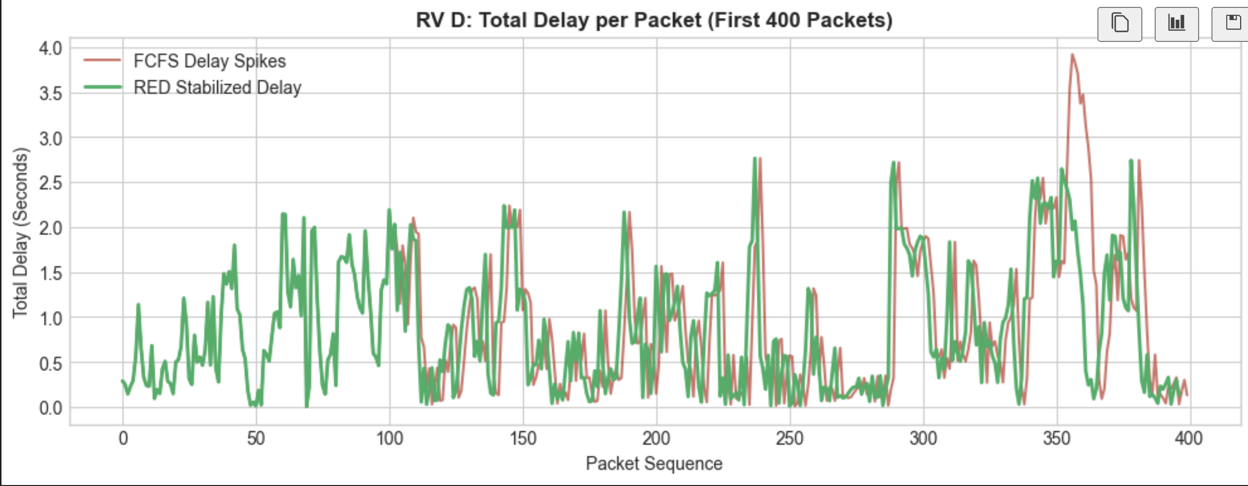

Slide 13
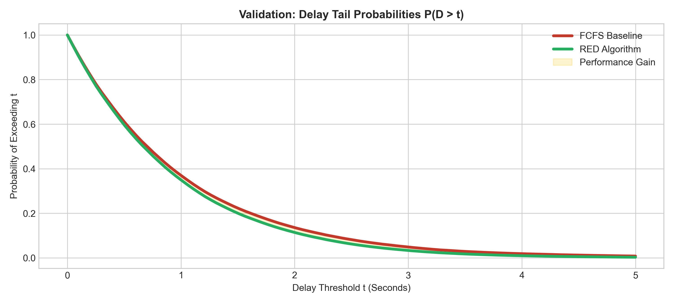
11. Results: Delay Tail Probabilities
• RED completely eliminates the extreme latency tail, guaranteeing excellent Quality of Service.
• Cost of optimization: We achieved this massive gain by sacrificing a negligible 1.32% Packet Drop Rate.

Slide 14
12. Key Insights and Conclusions
1. Randomness is a Computational Resource:
Introducing controlled algorithmic randomness stabilizes highly volatile systems.
2. Deterministic Rules Lack Adaptability:
FCFS fails in stochastic environments because it cannot proactively manage state.
3. The Optimization Trade-Off:
Exchanging a marginal fraction of throughput (Drop Rate) yields exponential improvements in latency and system stability.

