Slide 1
Probabilistic Modelling and Performance Analysis of Packet Delay in a single router Network
Group 3
Abbas Kharodawala
Khushi Paghadar
Tirth Pathar
Ansh Chaudhari
Namyaa Parmar

Slide 2
Problem Formulation
Network traffic is inherently stochastic and unpredictable.
We cannot control when users request data (Arrivals) or the payload size (Service).
High congestion leads to packet delay, experienced as lag, buffering, or dropped connections.
Objective: Analyze how random traffic patterns affect wait times and use Active Queue Management (AQM) to optimize routing logic.

Slide 3
Base Paper overview
Title: Base Research Paper: Delay Models in Data Networks
Source: Bertsekas & Gallager (MIT Analysis).
Main Idea: Provides a mathematical framework to predict packet delay using Queueing Theory.
Key Concept: Identifies that "Queueing Delay" is the most volatile and critical component of total network latency.
Objective: Moving from static, predictable models to Stochastic models that account for random traffic bursts.

Slide 4
Base Paper overview -1
Understanding Delay : Total network delay is a combination of processing, queueing, transmission, and propagation times. Statistical multiplexing is often used to efficiently manage traffic and minimize this delay.
The Golden Rule - Little's Theorem : The fundamental formula $N = \lambda T$ connects the average number of packets in the system ($N$) to the arrival rate ($\lambda$) and average delay ($T$), holding true across almost all stable probabilistic queueing models.
The Baseline Model - M/M/1 : The foundational queueing system featuring Poisson arrivals and exponential service times for a single server, serving as the starting point for understanding occupancy distribution and steady-state behavior.

Slide 5
Base Paper overview - 2
Complex Markov Systems : Extending the M/M/1 model to handle real-world variations, including multi-server setups (M/M/m), idealized infinite-server scenarios (M/M/∞), and loss systems where packets are dropped if no servers are available (M/M/m/m).
The M/G/1 System : Moving beyond exponential service to allow for General service time distributions. This section introduces the critical role of service time variance (via the Pollaczek-Khinchin formula).
System Variations : Applying M/G/1 principles to specialized network behaviors like server vacations, reservation/polling protocols, and priority-based queueing for different traffic classes.

Slide 6
Base Paper overview -3
Simplifying Complex Networks : Real networks consist of multiple interconnected queues. Tools like the Kleinrock Independence Approximation simplify transmission line analysis, while Jackson's Theorem allows complex networks to be solved as a product of independent queues.
System Properties : Burke’s Theorem and the concept of time reversibility prove that the departure process of a stable M/M/1 queue is also a Poisson process, a crucial property for analyzing cascading queues.
Mathematical Foundations (Appendices): All these models rely heavily on continuous and discrete-time Markov Chain Theory and algorithms like Mean Value Analysis to compute average system performance.

Slide 7
Random Variables
We assume packet arrivals follow a Poisson process.
N(t) ~ Poisson(λt)
N(t) = number of arrivals in time t
λ = Arrival Rate (packets/sec)
μ = Service Rate (packets/sec)
We define the following random variables:
• A = Inter-arrival time- Exponential distribution A ~ Exponential(λ) | E[A] = 1 / λ
• S = Service time S ~ Exponential(μ) | E[S] = 1 / μ
Total delay D = W + S Wait Time (Queue) + Service Time (Router)
• L = Queue Length

Slide 8
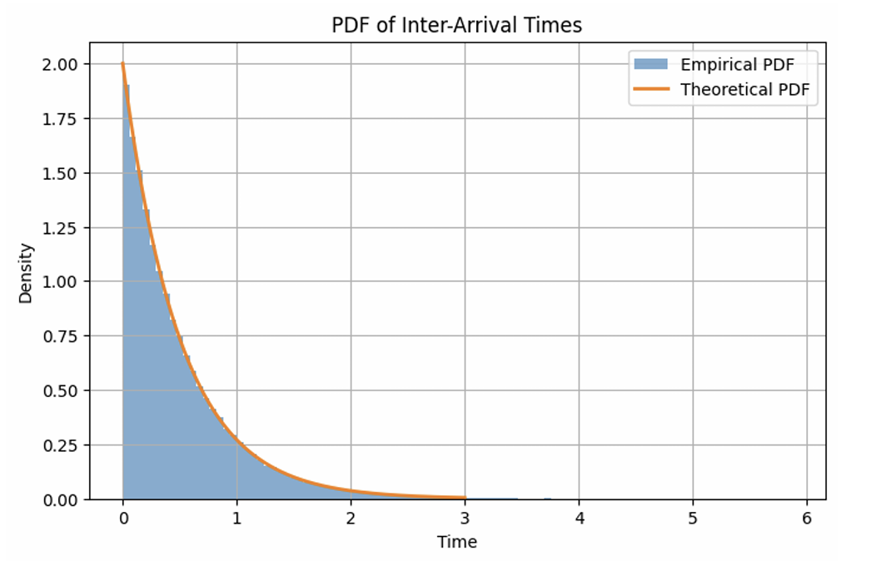
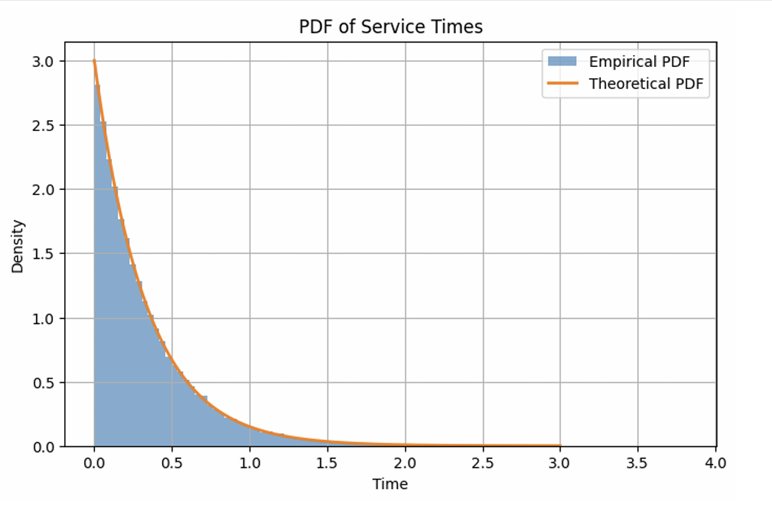
Plots :

Slide 9
Traffic Intensity (ρ)
Traffic Intensity
ρ = λ / μ
Fraction of time the server is busy
Stability Condition:
• Stable if λ < μ
• If λ ≥ μ, queue grows indefinitely.
Example (λ = 2, μ = 3):
ρ = 2 / 3 = 0.67
Meaning: Router is busy 67% of the time.

Slide 10
Queue Length as a Random Variable
Define:
• N = number of packets in the system (waiting + service)
• Nq = number of packets waiting in the queue only
• λ = arrival rate, μ = service rate, ρ = λ / μ
Mean Number in System
E[N] = ρ / (1 - ρ)
Average total packets inside the router
Mean Number Waiting in Queue
E[Nq] = ρ² / (1 - ρ)
Average packets waiting before service

Slide 11
Mathematical Model
• Modeled as an M/M/1 Queue: Markovian arrivals (λ), Markovian service (μ), single server.
• Little's Theorem: E[N] = λ * E[D] (Queue length is directly proportional to expected delay).
• Average Delay: E[D] = 1 / (μ - λ). Demonstrates non-linear growth as traffic intensity (ρ = λ/μ) approaches 1.
• Chernoff Bound: P(D ≥ t) ≤ e^(-(μ - λ)t), providing tight, exponentially decaying bounds on tail risk.

Slide 12
Comparison of Bounds
Markov vs Chernoff vs Exact Tail
1. Exact Tail
P(D > t) = e^(-(μ - λ)t)
Matches exponential behavior perfectly
2. Markov Bound
P(D ≥ t) ≤ E[D] / t
Very loose (decays linearly as 1/t)
3. Chernoff Bound
P(D ≥ t) ≤ e^(-(μ - λ)t)
Much tighter (Matches the exact exponential decay)
Conclusion: Chernoff is significantly tighter than Markov for Queueing Delay.

Slide 13
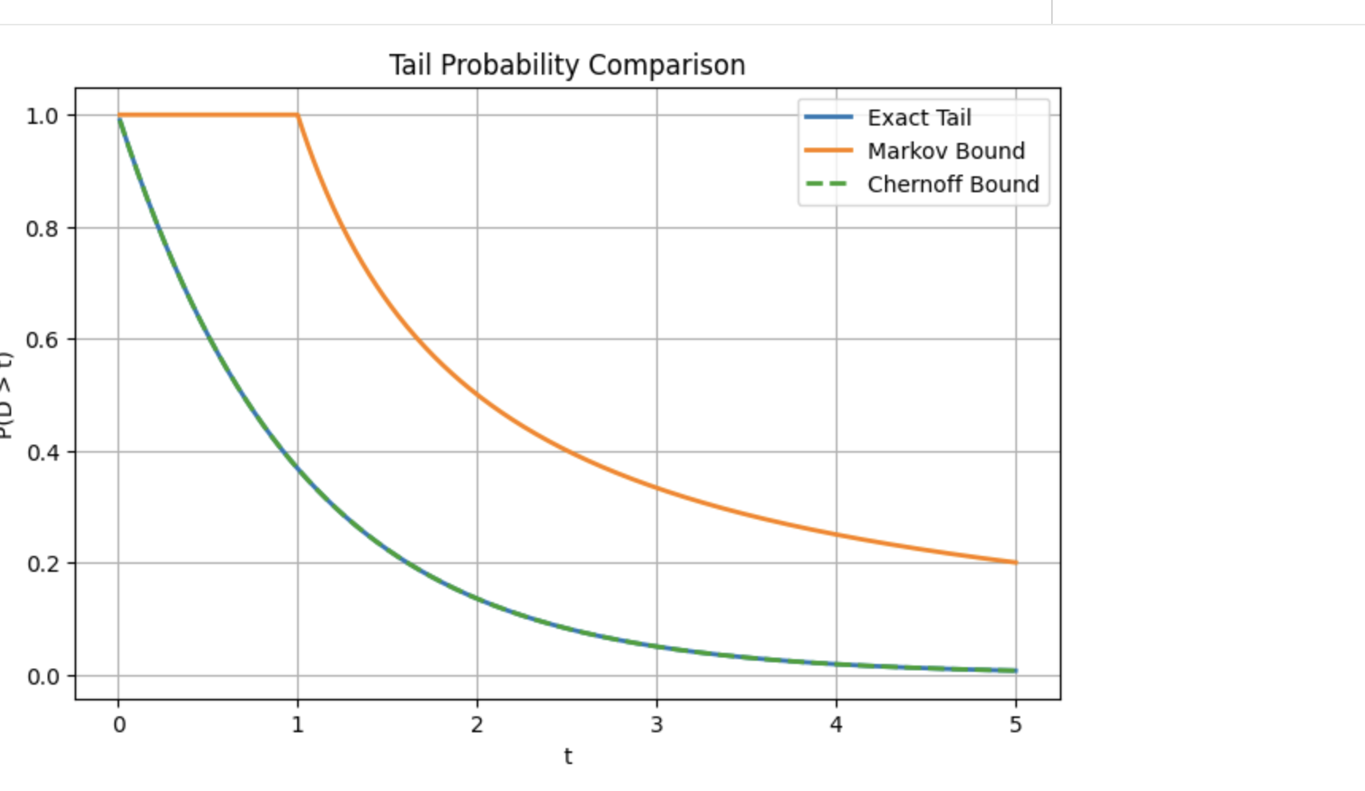

Slide 14
Deterministic Approach (FCFS)
• Baseline Strategy: First-Come, First-Served (FCFS).
• Mathematical Engine: Lindley's Recursion -> W_n = max(0, W_{n-1} + S_{n-1} - A_n).
• Passive rule: The router accepts all packets infinitely.
• Critical Failure - Buffer Bloat: Stochastic traffic bursts lead to infinite queue growth and severe latency spikes.
• Global Synchronization: Dropping packets deterministically when a buffer is full crashes network throughput.
Code:
# Lindley's Recursion:
W_n = max(0, W_{n-1} + S_{n-1} - A_n)
start_service = np.zeros(N)
finish_service = np.zeros(N)
for i in range(N):
if i == 0:
start_service[i] = arrival_times[i]
else:
# Packet waits if router is busy
start_service[i] = max(arrival_times[i], finish_service[i-1])
finish_service[i] = start_service[i] + service_times[i]
delay_fcfs = finish_service - arrival_times

Slide 15
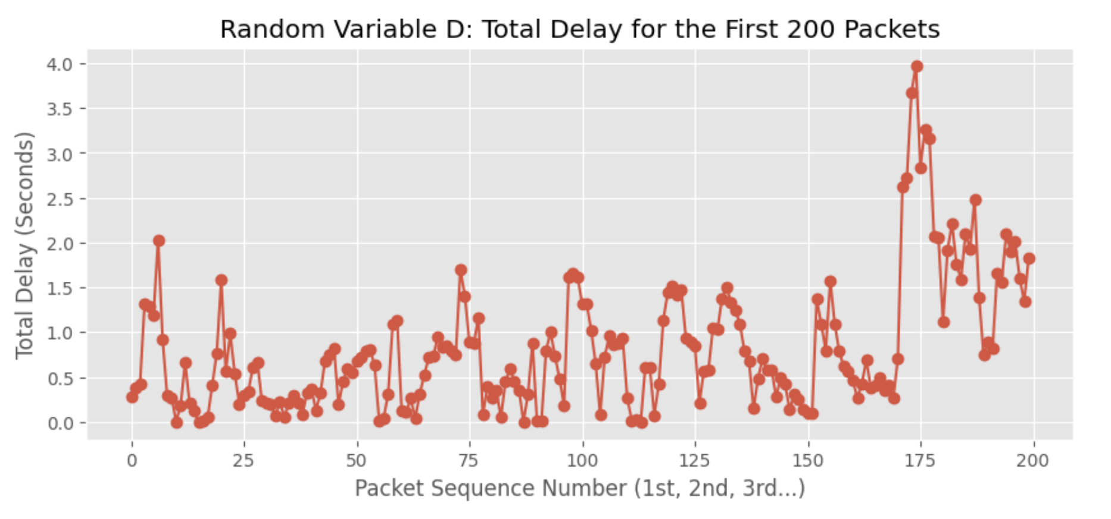
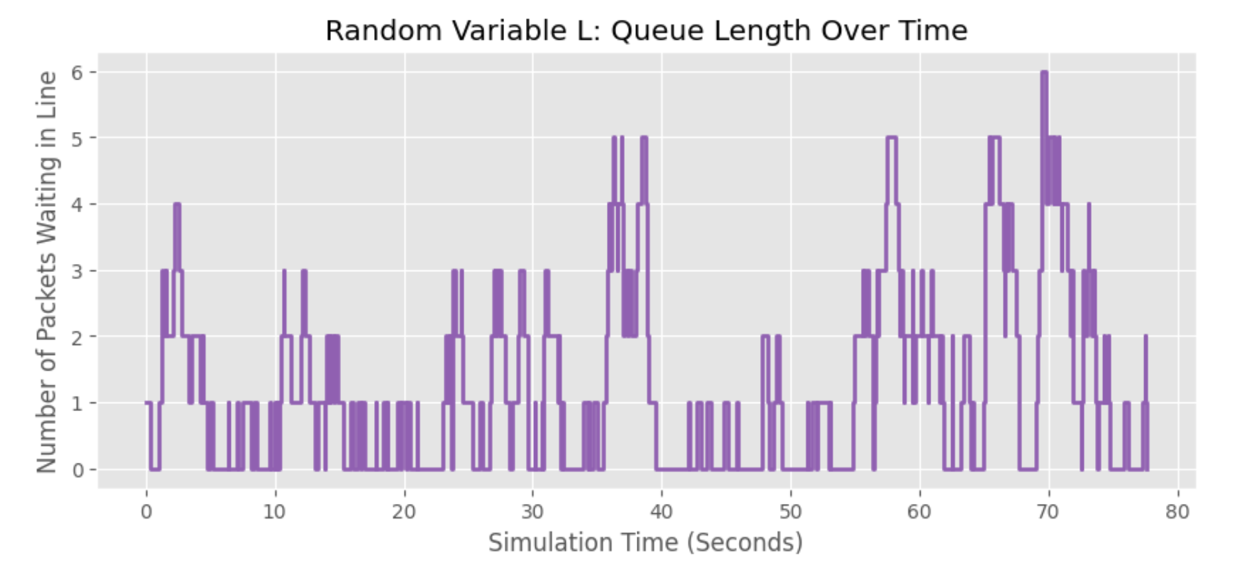
Simulation results(Plots)

Slide 16
Coding and Simulation Pipeline
For the baseline FCFS:
The number of packets in the system spikes wildly. This is because random traffic arrives in large bursts, causing sudden traffic jams in the router.
Our simulation proves that First-Come, First-Served is a very weak strategy when traffic is heavy.
Weakness 1: It cannot adapt. When a huge burst of traffic hits, the router just blindly puts them in a line, leading to massive delays.
Weakness 2: Because we assume the queue can hold infinite packets, the delay just keeps growing longer and longer during a traffic jam.

Slide 17
Randomized Approach (RED)
• Random Early Detection (RED) introduces internal algorithmic randomness to combat external traffic randomness.
• Tracks the Exponentially Weighted Moving Average (EWMA) of the queue length.
• If EWMA falls between min_th and max_th, RED calculates a linearly scaling drop probability (p).
• Uses a Uniform(0,1) random sample to execute probabilistic packet drops.
• Prevents network-wide synchronization by randomly dispersing congestion signals.
Code:
# RED Parameters
min_th, max_th = 2.0, 10.0
max_p = 0.1
avg_L = 0.0 # Exponentially Weighted Moving Average
w_q = 0.002
# Randomized Drop Logic
if avg_L > max_th:
p_drop = 1.0 # Forced drop
elif avg_L > min_th:
p_drop = max_p * (avg_L - min_th) / (max_th - min_th)
# Use Uniform(0,1) to decide drop
if np.random.rand() < p_drop:
packet_dropped = True

Slide 18
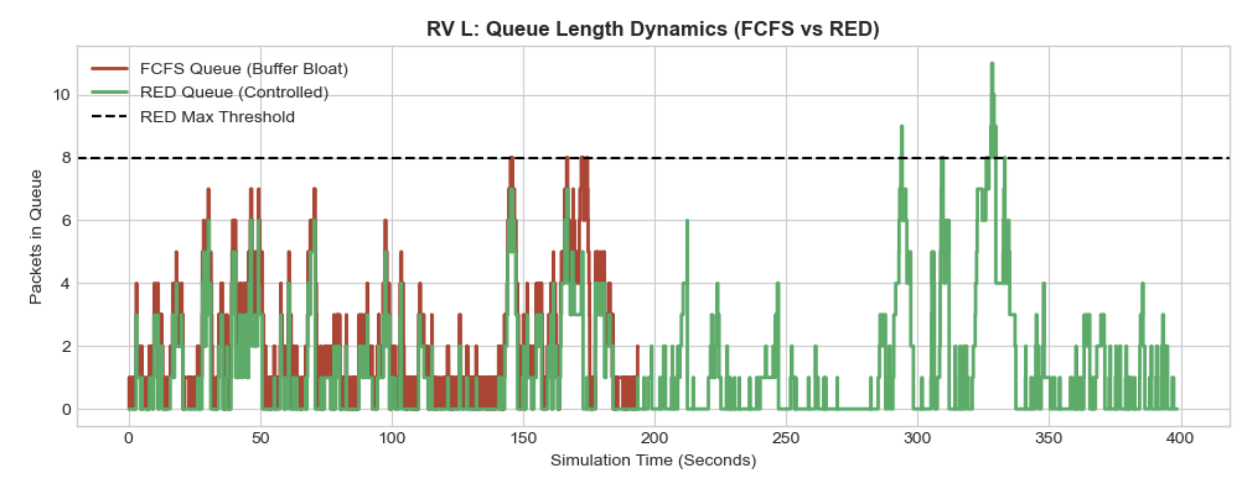
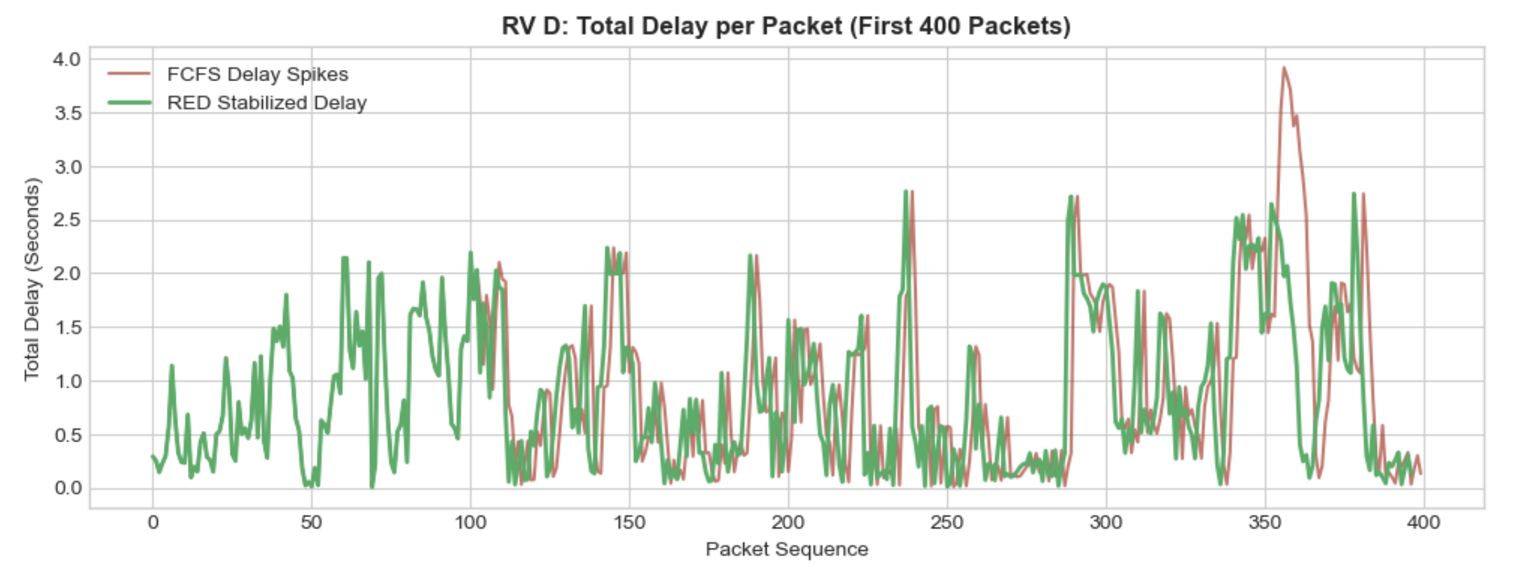
Results: Stabilizing System Variables
• Empirical vs. Theoretical: Simulated FCFS exactly matched theoretical expected delay.
• FCFS suffered from massive Buffer Bloat during stochastic bursts.
• RED stabilized internal dynamics, capping queue growth safely.

Slide 19
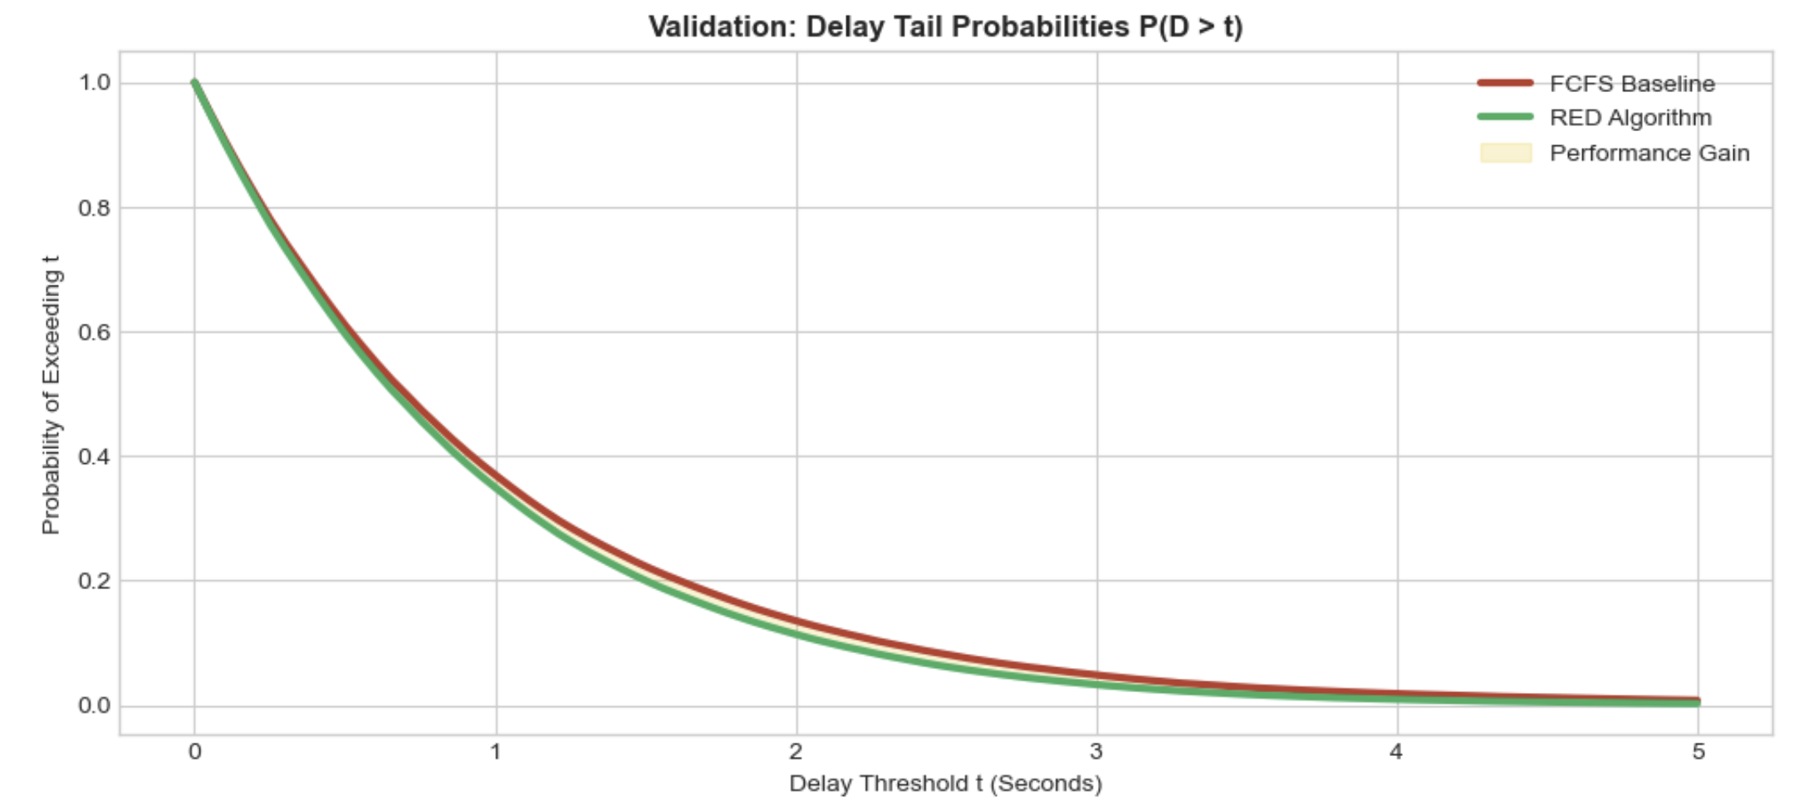
Results: Elimination of Latency Tails
• The extreme latency tail probabilities P(D>t) were completely flattened by the algorithm.
• Optimization Cost: Negligible 1.32% packet drop rate for massive latency improvements.

Slide 20
Inference – Domain Perspective
• Quality of Service (QoS): A 1.32% drop in throughput yields exponential improvements in latency stability.
• Deterministic rules fail in stochastic environments because they lack proactive state management.
• Controlled probabilistic dropping acts as a proactive shock absorber, preserving overall network integrity.

Slide 21
Inference – Computer Science Perspective
The Power of Randomized Algorithms: A strict, predictable rule (like FCFS) breaks when the real world acts unpredictably. Adding a little bit of controlled randomness to an algorithm actually makes it stronger and more adaptable.
Smart Data Structures: A basic Queue (FIFO) is not enough for real-world systems. If we don't put an intelligent "gatekeeper" in front of our queues, sudden data bursts will cause memory overflow and system crashes.
The Ultimate CS Trade-off: In computing, we often trade one resource for another. By sacrificing a tiny fraction of data (dropping ~1.32% of packets), we bought a massive improvement in system speed and reliability.

Slide 22
References
https://web.mit.edu/dimitrib/www/Queueing_Data_Nets.pdf
First Course in Probability, Sheldon Ross, A. Pearson Higher Ed, Year: 2019

