Slide 1

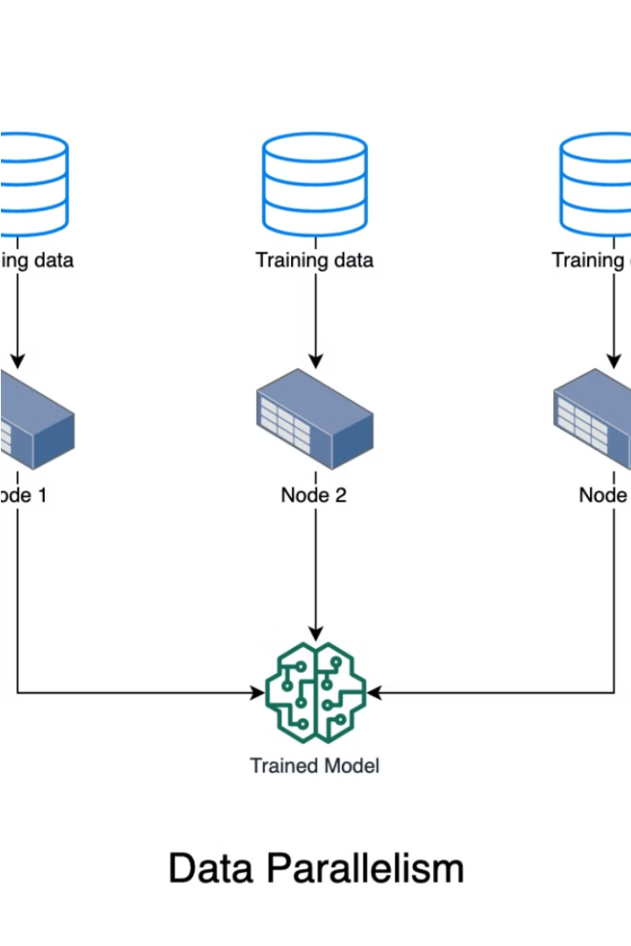
Introduction to Distributed Machine Learning in Secure Environments
Distributed machine learning is transforming the way we train complex models, enabling collaborative learning while preserving data privacy.

Slide 2
Related Work on Federated Learning and Its Relevance
Federated Learning
Relevant Applications
Recent Advancements
Federated learning allows multiple parties to collaboratively train a shared model without sharing their raw data, preserving privacy and security.
This approach is particularly relevant for healthcare, finance, and other domains where data privacy is of utmost importance.
Researchers have made significant progress in developing efficient federated learning algorithms and overcoming challenges like data heterogeneity and communication costs.

Slide 3
Data Set
Chest CT Scan Data
Classes
Data Splits
Chest cancer detection using machine learning and deep leaning (CNN) . we classify and diagnose if the patient have cancer or not
Adenocarcinoma
Large cell carcinoma
Squamous cell carcinoma
Normal Cells
training set is 70% testing set is 20% validation set is 10%

Slide 4
Security Algorithm for Data Transmission
1
Secure Data Encryption
2
Differential Privacy
Ensuring end-to-end encryption of data during transmission to prevent unauthorized access.
Applying differential privacy techniques to further protect individual data contributions.
3
Secure Aggregation
4
Verifiable Computing
Developing secure aggregation protocols to combine model updates while preserving privacy.
Incorporating verifiable computing methods to ensure the integrity of the learning process.

Slide 5




Machine Learning Frameworks and Weight Aggregation
Pysyft
PyTorch
Weight Aggregation
Client-Server Architecture
Leveraging Pysyft's distributed training capabilities for secure federated learning.
Exploring PyTorch's federated learning extensions and their impact on model performance.
Investigating advanced weight aggregation techniques to improve model convergence and accuracy.
Comparing the strengths and limitations of different machine learning frameworks for secure distributed learning.

Slide 6
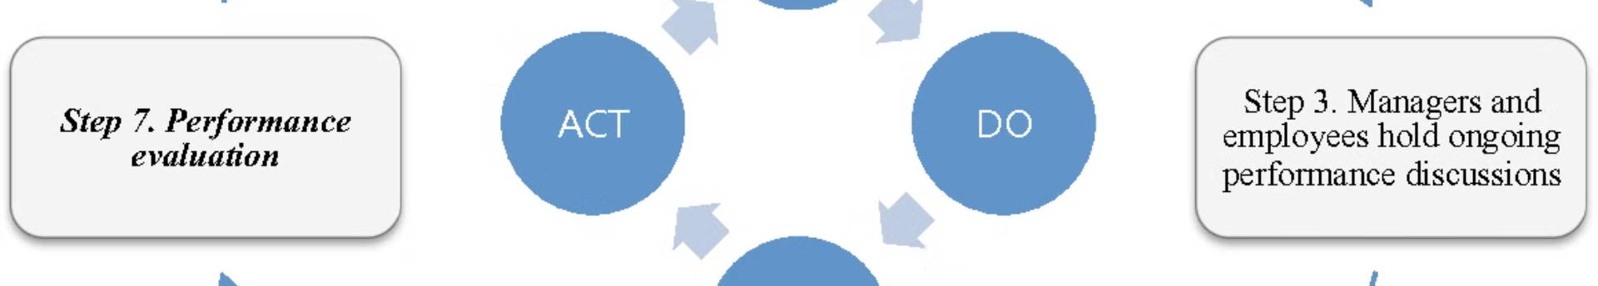



Evaluating the Enhanced Model Performance
Accuracy
Convergence
Privacy Preservation
Assessing the model's predictive accuracy on diverse datasets.
Analyzing the model's convergence rate and stability during training.
Evaluating the effectiveness of the security algorithms in preserving data privacy.

