Slide 1
🌍
COE 543 / 743
Wikipedia Infobox
Intelligence
Tree Edit Distance · Comparison · Clustering
Abbas Abdallah-Hasan Bazzi
Lebanese American University · Instructor: Dr. Joe Tekli · Spring 2026

Slide 2
OVERVIEW
What We Will Cover Today
01
Project 1 Improvements
04
Clustering Algorithms
Smarter preprocessing, better TED realism, bug fixes
AHC, K-Medoids, DBSCAN — methods and challenges
02
The Big Decision
05
Results & Observations
Raw trees vs preprocessed trees — cost vs accuracy
What the clusters tell us about the world
03
Distance Matrix at Scale
06
Live Demo
193 × 193 countries, ~18,500 pairs
Interactive exploration of the system

Slide 3
PROJECT 1
What We Improved
Smarter preprocessing · Better TED · Correct patching · Cleaner pipeline

Slide 4
PROJECT 1
Smarter Semantic Preprocessing
BEFORE
AFTER
✗ "10,452 km2" → raw string
✓ "10,452 km2" → number: 10452 unit: km²
✗ "1 December 1843" → raw string
✓ "1 December 1843" → year/month/day nodes
✗ "2021 estimate" ≈ "2023 estimate" (WRONG)
→
✓ "2021 estimate" ≠ "2023 estimate" (FIXED)
✗ "$21.78 billion" → raw string
✓ "$21.78 billion" → currency + number + unit
✗ Trees inflated with redundant nodes
✓ Cleaner trees, better TED accuracy

Slide 5
PROJECT 1
Pipeline, Patching & Quality
🔧 TED / Patch Alignment
🧩 5 Patch Bugs Fixed
🏗️ Cleaner Pipeline
Fixed a critical mismatch: values close numerically were treated as identical by TED but different by the patch validator. Now both agree — 12/12 test pairs pass.
Node ordering collisions, path resolution conflicts, semantic container mismatches, and depth-restricted promotion — all found and corrected.
Comparison logic, reporting, output generation and UI integration now share a unified backend. Easier to maintain and extend.
🧪 Stronger Testing
🖥️ Improved UI
✅ Result
Unit tests added for preprocessing, semantic value comparison, and TED consistency — verifying realistic country-data edge cases.
Easier comparison runs, clearer tree inspection, better edit-script display, and cleaner XML/JSON/report output panels.
Patch success rate went from partial to 12/12. TED distances are now semantically honest and consistent end-to-end.

Slide 6
THE BIG DECISION
Raw Trees vs Preprocessed Trees
Every clustering decision starts with this trade-off
VS

Slide 7
PROJECT 2
Two Paths, Two Costs
⚡ Raw Trees (~70 nodes)
🧠 Preprocessed Trees (~500 nodes)
Advantages
Advantages
✓ Fast — 48 min for full 193x193 matrix
✓ Wide distance range: 226–953
✓ Simple to compute
✓ Understands dates, numbers, units
✓ Good relative structure preserved
✓ Better cluster discrimination
Drawbacks
✓ Geographically coherent groups
✗ Narrow distance range: 45–119
Drawbacks
✗ No semantic understanding
✗ Slow — 4 hours for full matrix
✗ All countries look very similar
✗ Trees 7x larger per country
✗ Poor cluster separation
✗ Requires parallel computation
✓ OUR CHOICE

Slide 8
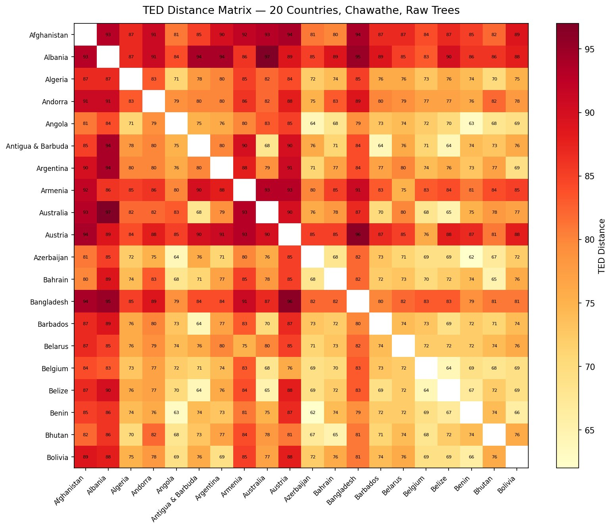
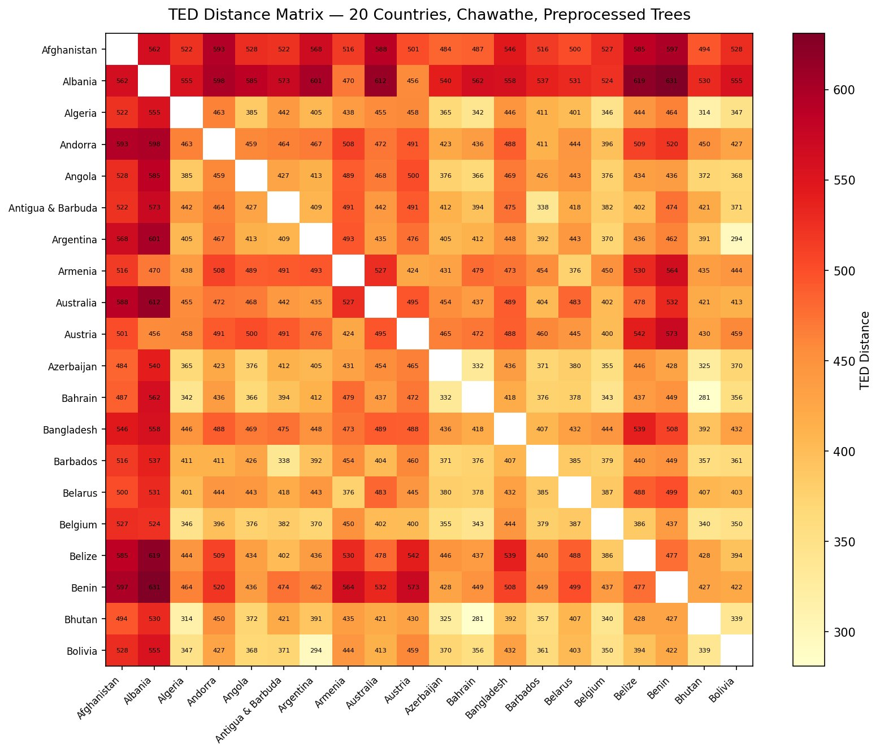
EVIDENCE
Same 20 Countries — Two Very Different Pictures
Raw Trees | Range: 45–119 | 30 seconds to compute
Preprocessed Trees | Range: 300–640 | 13 minutes to compute

Slide 9
PROJECT 2
The Full Distance Matrix
193
18,528
226–953
4 hrs
Countries
Unique Pairs
Distance Range
Build Time
Key Insight: The tight bell curve
The 193-country distance distribution forms a single symmetric bell curve — mean 469, std 89 — with no bimodal structure and no natural gaps. This is the first clue that no sharp natural clusters exist in this data.
How we built it: Parse all 193 XML files → Preprocess trees once (Phase 1) → Compute 18,528 TED pairs in parallel using multiprocessing.Pool → Cache to JSON → Never recompute

Slide 10
PROJECT 2
Four Clustering Algorithms
🌳 Agglomerative Hierarchical (AHC)
🎯 K-Medoids (PAM)
Start with N singleton clusters. Repeatedly merge the closest pair until k clusters remain.
Select k actual countries as cluster centers (medoids). Assign all others to nearest medoid. Swap medoids to reduce total cost.
Single · Complete · Average linkage
Works directly on distance matrix — no centroid needed
Output: Full dendrogram showing merge hierarchy
Output: k balanced clusters with real country centers
📐 K-Means (via MDS)
🔍 DBSCAN
Compress the distance matrix to 2-D using MDS, then run standard K-Means. Uses imaginary centroids, not real countries.
Find dense neighborhoods: a country is a core point if it has enough neighbors within epsilon distance. No k required.
Used for comparison and scatter-plot visualization
Explores: epsilon = 30, 65, 280, 320
Output: k clusters — loses info from 2-D compression
Output: Tight coherent micro-groups + noise points

Slide 11
CHALLENGES
What Each Algorithm Struggled With
⛓️ AHC — The Chaining Problem
Unsuitable for this dataset
All three linkage strategies collapsed 94–96% of countries into one giant cluster with k−1 singletons. The bell-curve distance distribution has no natural gap, so AHC just absorbs one country at a time instead of forming balanced groups.
🎯 K-Medoids — Near-Zero Silhouette
Best global partitioner despite low scores
Silhouette scores hover near 0 across all k values (range: −0.006 to +0.022). This sounds bad but is expected: with no sharp cluster boundaries in the data, every country sits roughly equidistant from multiple clusters.
📐 K-Means — Information Loss via MDS
Useful for visualization only
Compressing 193-dimensional distances to 2-D before clustering loses structural nuance. On the 9-country demo, K-Means scored silhouette 0.11 vs K-Medoids 0.29 — Switzerland was misplaced into the European cluster instead of being correctly isolated.
🔇 DBSCAN — 92% Noise
Best for finding most-similar pairs
At tight epsilon values only 16 of 193 countries form clusters; the rest are labeled noise. No single epsilon cleanly separates the data. Most countries are structurally unique enough to be their own neighborhood.

Slide 12
EVALUATION
When Numbers Lie — Understanding Our Metrics
Hopkins
Statistic
Why silhouette is near zero
The distance distribution is a uniform bell curve. Every country is roughly equidistant from multiple clusters, so a(i) and b(i) are always close. A score of ~0 is mathematically inevitable — not a sign the algorithm is wrong.
H = 0.505
± 0.002 (5 independent trials)
Why AHC silhouette looks high
H ≈ 0.5 = random data
H > 0.75 needed for real clusters
Singleton clusters trivially score S(i) = 1.0 — they have no intra-cluster neighbors. One giant cluster + singletons inflates the average. The score of 0.25 is an artifact, not quality.
What to trust instead
Geographic coherence: do the clusters match real-world regions? Average intra-cluster distance: lower = tighter group. The 9-country demo (K-Medoids silhouette 0.29, Dunn 0.90) shows the algorithm works correctly when clusters are real.

Slide 13
RESULTS
The Clusters Make Sense — Geographically
C0
Medoid: Uruguay
Latin America + Caribbean + East Africa
C3
Medoid: Uzbekistan
49
countries
Share presidential democracy structures and similar economic indicator fields
Middle East + Central Asia
52
countries
Former Soviet + Islamic governance fields + basic economic blocks
C1
Medoid: Malta
Western & Southern Europe
C4
Medoid: Tuvalu
47
countries
Parliamentary democracy, EU-related fields, complex multilingual infoboxes
Pacific Microstates (tightest cluster)
16
countries
Virtually identical sparse infoboxes — tiny population, area, GDP, Commonwealth fields
C2
Medoid: Senegal
Francophone Africa + Southeast Asia
29
countries
Surprising! Reflects shared post-colonial administrative structures — same Wikipedia editing conventions

Slide 14
RESULTS
DBSCAN: Finding the Most Similar Pairs
At epsilon = 51, DBSCAN found 6 tight geographically perfect micro-groups out of 193 countries:
🏝️ Caribbean Island States
🌿 Eastern Caribbean Micro-States
Grenada · Jamaica · Saint Lucia · The Bahamas
Dominica · Saint Kitts & Nevis · Saint Vincent & the Grenadines
Nearly identical infobox structure: area, population, GDP, HDI
Tighter sub-cluster within the Caribbean group
🌎 Central American Neighbors
🌍 West African Pair
El Salvador · Guatemala · Honduras
Ghana · Sierra Leone
Shared regional governance and economic profile fields
Similar post-colonial economic structure fields
🌊 Pacific Island States
🌐 Small Island Nations (mixed)
Papua New Guinea · Tuvalu · Vanuatu
Cape Verde · Sao Tome · Djibouti · Tajikistan
Sparse infoboxes with minimal history, small data blocks
Structurally minimal infoboxes with few populated fields

Slide 15
CONCLUSIONS
Key Takeaways
🧠 Preprocessing is everything
📊 Low metrics are not failure
Without semantic expansion, TED compares raw strings. With it, dates, numbers, and units are structurally understood — producing 4x wider distance ranges and meaningful comparisons.
Hopkins H = 0.505 formally proves the data has no natural clusters. Near-zero silhouette is mathematically inevitable — not an algorithm defect. Honest science beats inflated numbers.
🎯 K-Medoids wins
🌍 Structure encodes history
Only algorithm producing balanced, interpretable partitions. Works directly on the distance matrix without lossy 2D compression. Geographic coherence validates its results.
Countries cluster by colonial heritage, governance systems, and Wikipedia editing community conventions — not just geography. Senegal grouping with Southeast Asia is post-colonial history in data form.
⚡ Parallelization is essential
🔍 DBSCAN finds truth at micro-scale
18,528 TED pairs on preprocessed trees would take days sequentially. Multiprocessing.Pool across 4 cores reduced it to 4 hours. Architecture matters as much as algorithms.
Caribbean islands, Central American neighbors, Pacific microstates — structurally identical groups emerge naturally. Use DBSCAN to find the most similar pairs, K-Medoids for global view.

Slide 16
LIVE DEMO
See It In Action
http://127.0.0.1:8765

