Slide 1
Introduction to pandas
Dr. Noman Islam

Slide 2
Introduction
It contains data structures and data manipulation tools designed to make data cleaning and analysis fast and easy in Python.
Pandas is designed for working with tabular or heterogeneous data.
NumPy, by contrast, is best suited for working with homogeneous numerical array data.

Slide 3

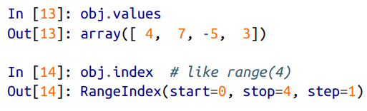
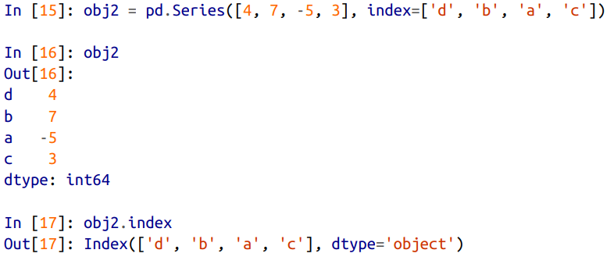
Series

Slide 4
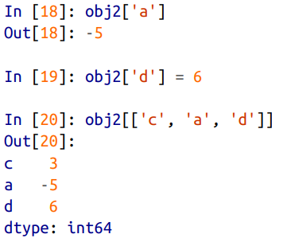
Using indexes to access data

Slide 5
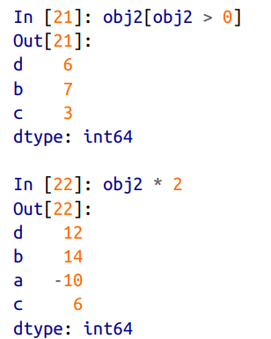

Filtering

Slide 6
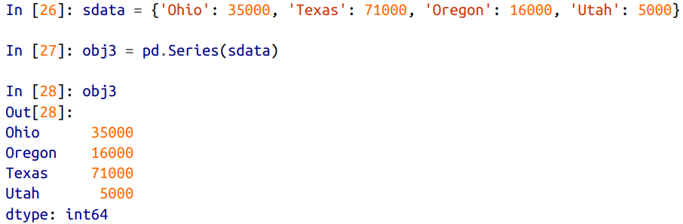
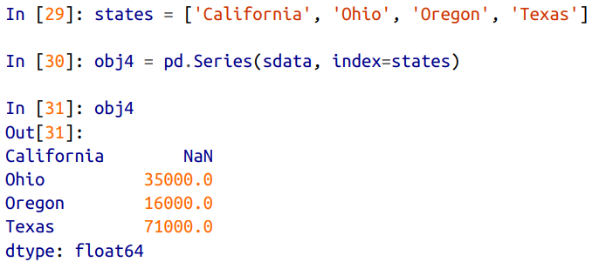
Creating series from dictionary

Slide 7
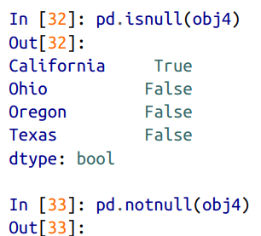
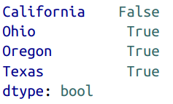
Checking for null values

Slide 8
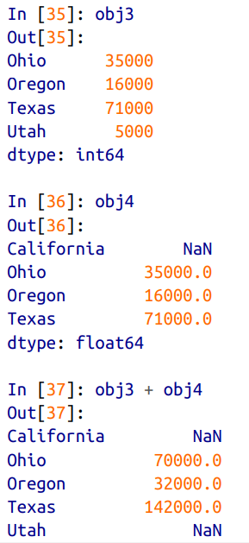
Joining two series

Slide 9
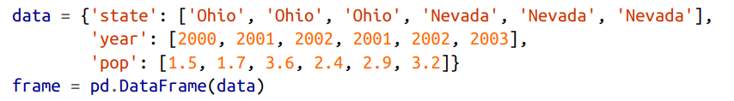
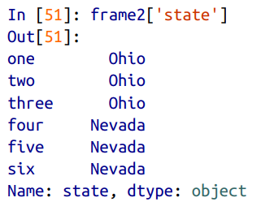
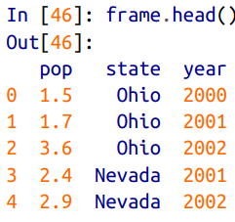
Dataframe

Slide 10
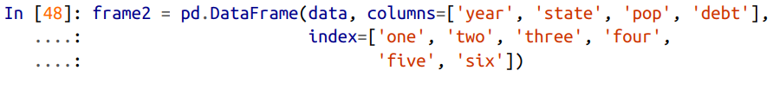
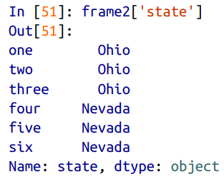
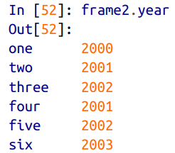
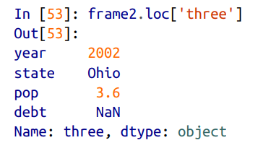

Slide 11
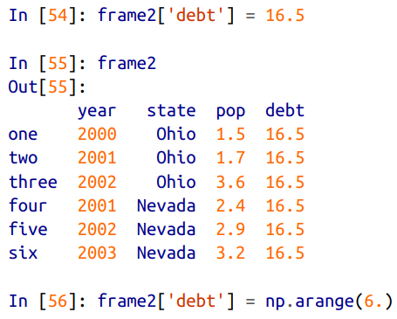
Modifying column values

Slide 12
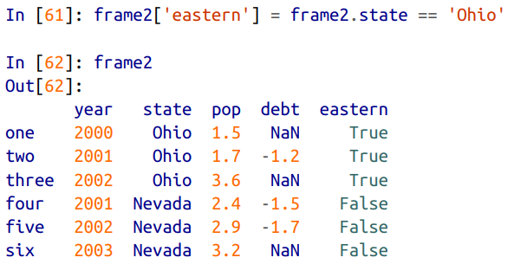
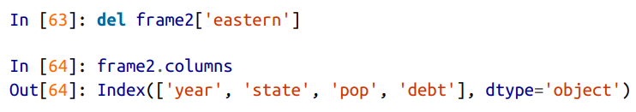
Adding / deleting a new column

Slide 13
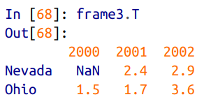
Transpose a dataframe

Slide 14
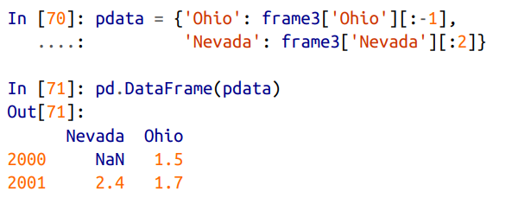
Slicing in dataframe

Slide 15
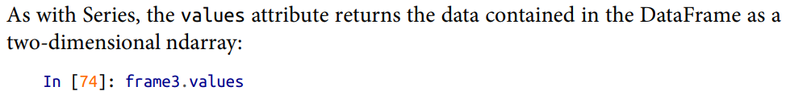
Values attribute

Slide 16
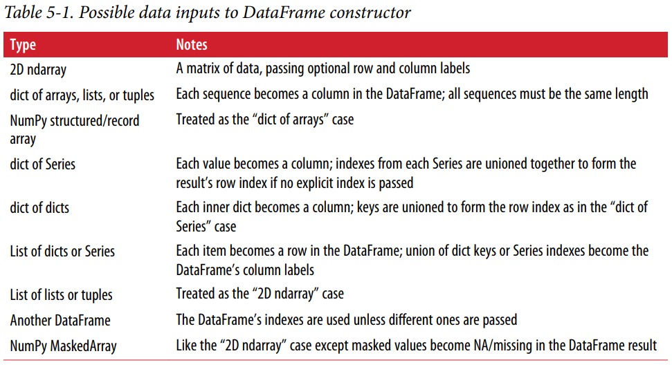

Slide 17
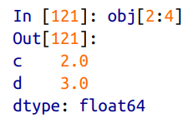
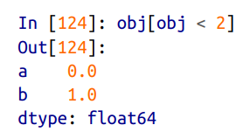
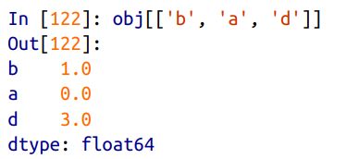
Indexing, selection and filtering

Slide 18
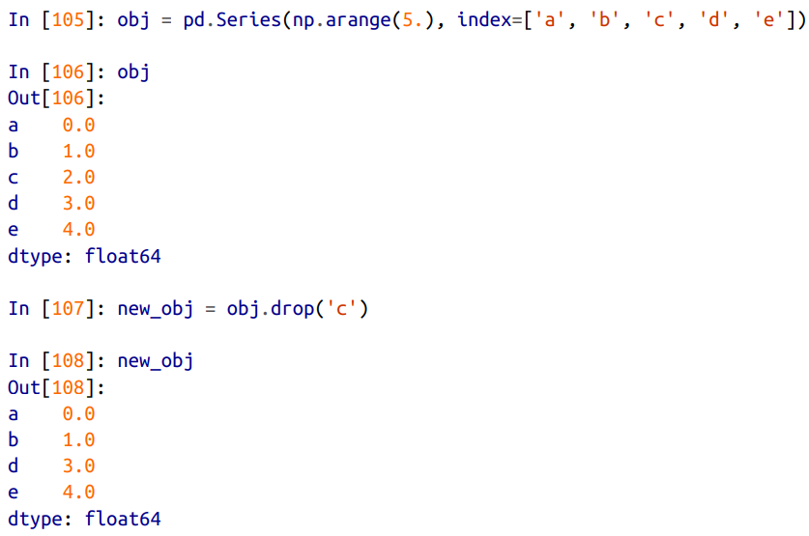
Dropping entries from axis

Slide 19
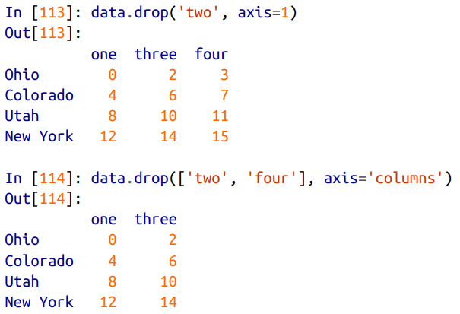
Axis parameter

Slide 20

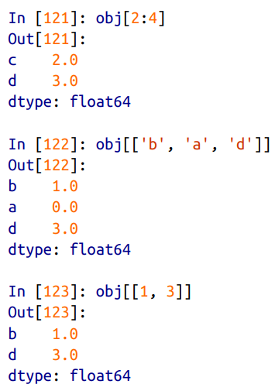

Indexing and slicing

Slide 21
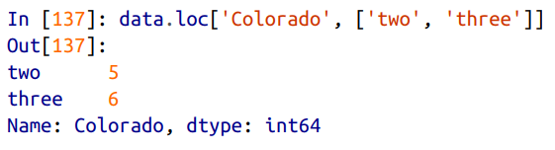
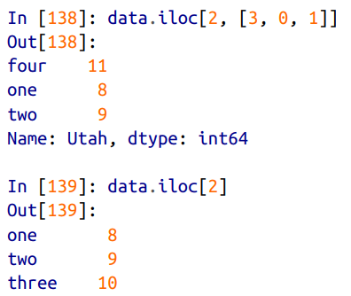
Selection with loc and iloc

Slide 22
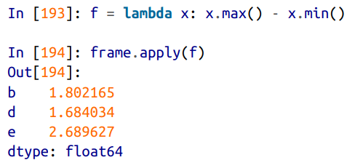
Apply function

Slide 23
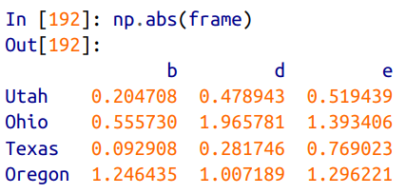
Function application and mapping

Slide 24
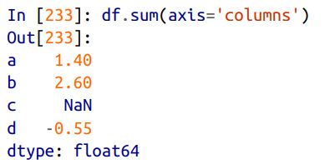
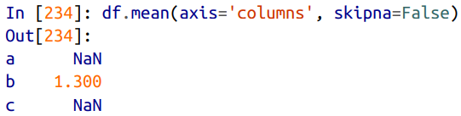
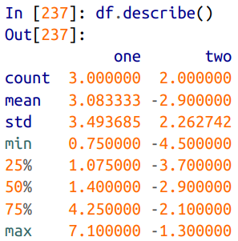
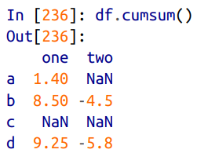
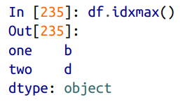
Descriptive statistics

Slide 25
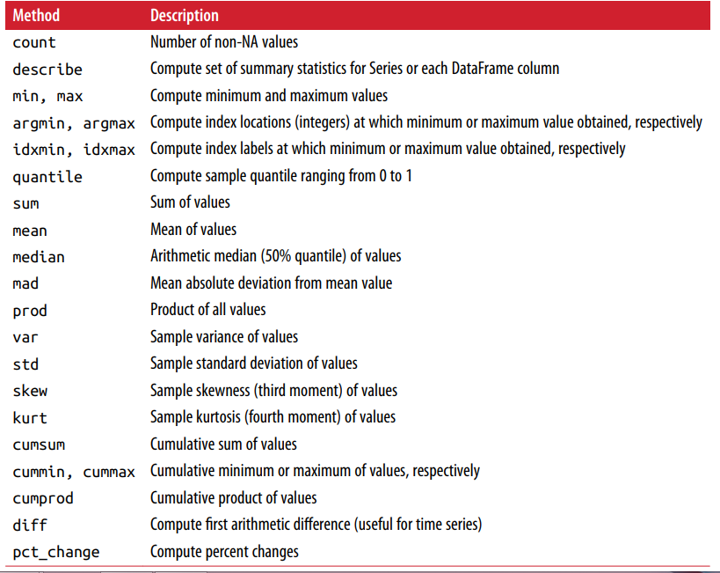

Slide 26
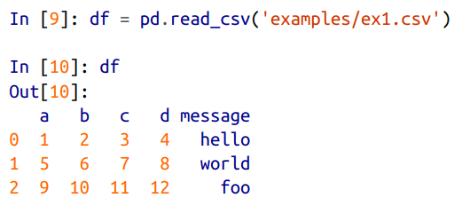
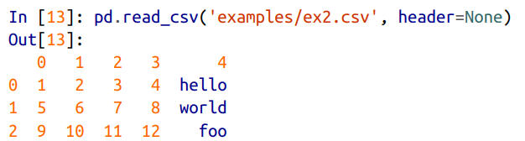
Reading and writing data

Slide 27
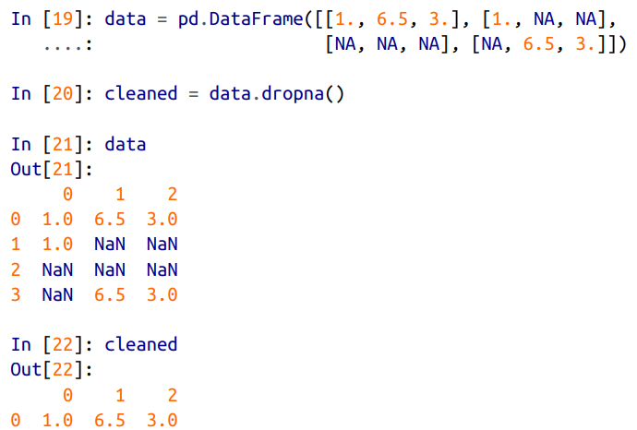
Filtering out missing values

Slide 28
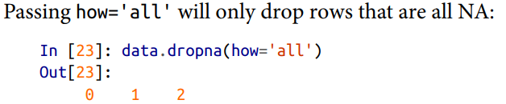

Slide 29

Filling missing data

Slide 30
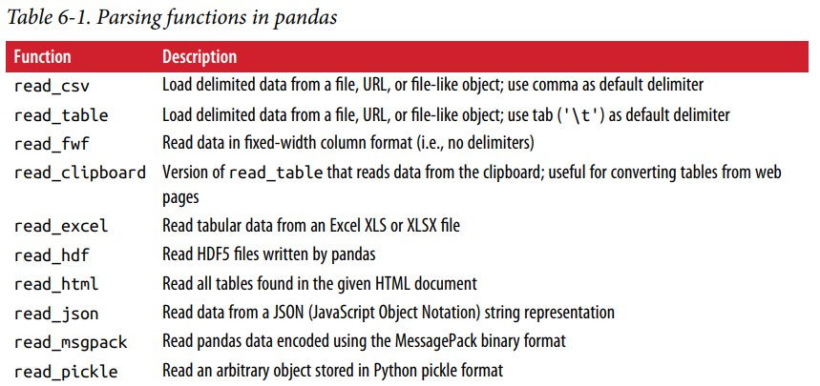
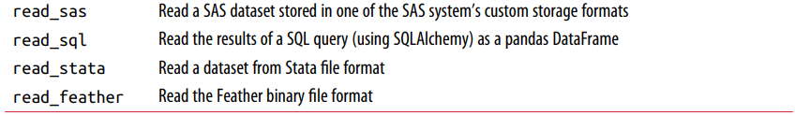
Reading data in pandas

Slide 31
Optional arguments
Indexing Can treat one or more columns as the returned DataFrame, and whether to get column names from the file, the user, or not at all. Type inference and data conversion This includes the user-defined value conversions and custom list of missing value markers.
Datetime parsing Includes combining capability, including combining date and time information spread over multiple columns into a single column in the result.
Iterating Support for iterating over chunks of very large files.
Unclean data issues Skipping rows or a footer, comments, or other minor things like numeric data with thousands separated by commas.

Slide 32
Examples
df = pd.read_csv('examples/ex1.csv')
pd.read_table('examples/ex1.csv', sep=',')
pd.read_csv('examples/ex2.csv', header=None)
pd.read_csv('examples/ex2.csv', names=['a', 'b', 'c', 'd', 'message'])
names = ['a', 'b', 'c', 'd', 'message']
pd.read_csv('examples/ex2.csv', names=names, index_col='message')

Slide 33
Passing regular expression as separator
result = pd.read_table('examples/ex3.txt', sep='\s+')
Skipping rows
pd.read_csv('examples/ex4.csv', skiprows=[0, 2, 3])

Slide 34

Handling null values

Slide 35
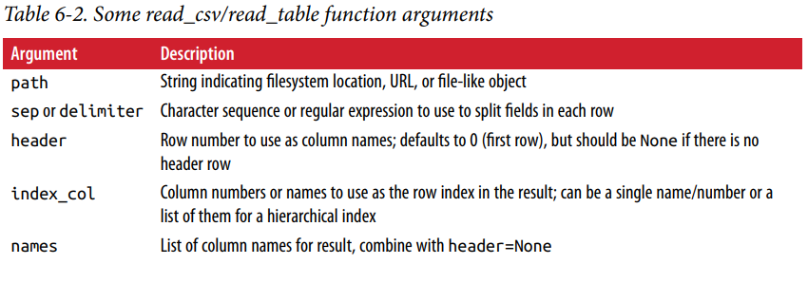

Slide 36
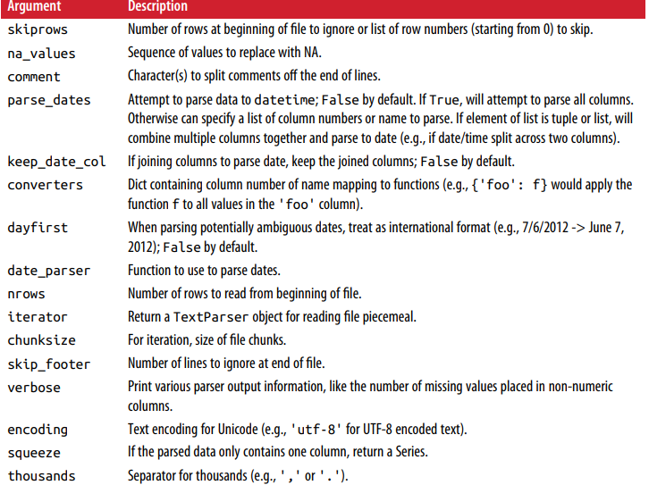

Slide 37
Reading text file in pieces

Slide 38
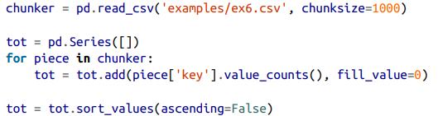
Iterating over chunk

Slide 39

Writing file

Slide 41


Working with delimited format

Slide 42
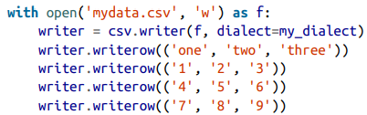
Writing csv data

Slide 43
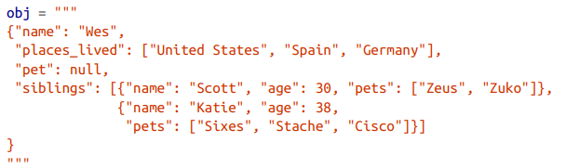
JSON format

Slide 44
The pandas.read_json can automatically convert JSON datasets in specific arrange‐ ments into a Series or DataFrame
The default options for pandas.read_json assume that each object in the JSON array is a row in the table

Slide 45

Web scraping
The pandas.read_html function has a number of options, but by default it searches for and attempts to parse all tabular data contained within tags.

Slide 46


Slide 47
Saving in binary format

Slide 48

HD5 format

Slide 49

Excel format

Slide 50


Interacting with Web API

Slide 51


Slide 52


Interacting with database

Slide 53



Slide 54


