Slide 1
FTS
Fine Time Sync v0.1
Source code (GPLv3): https://github.com/abbbe/fts/
Author: Alexandre Bezroutchko
3/12/2025

Slide 2
My Use Case
Two synchronized wireless accelerometers
  Sample sensors simultaneously
  Timestamps from aligned clocks
  Send data to a remote host for processing
Looking for a library to
  Sync local clock to a remote clock
  Discipline the local timer to a remote timer

Slide 3
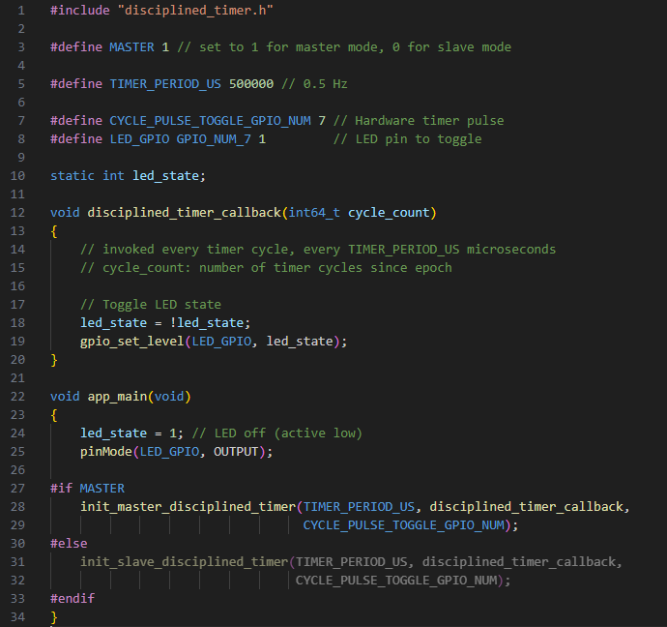
In the ideal world...
Choose a role
Set period
Handle callbacks
No such thing, lets try to get close...

Slide 4
General Idea
Mechanism to measure master/slave clocks offset
Figure out a robust local clock (for master & slave)
Build a Clock Relationship Model
  Slave local clock <=> master local clock translation
Discipline the local timer
  Fine adjustments to timer phase and period
  TEZ to occur simultaneously on master and slave

Slide 5
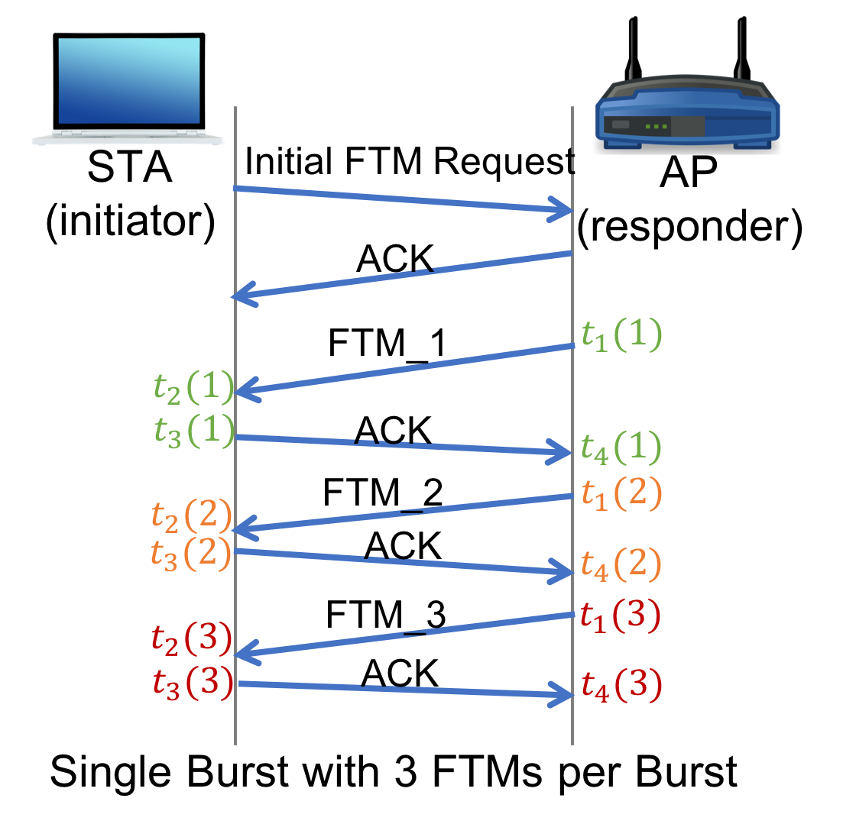
Fine Time Measurements
Designed for ranging
Initiator gets a bunch of reports:
  T1 – responder sent the request
  T2 – initiator got the request
  T3 – initiator sent the response
  T4 – responder got the response
T1/T4 – responder’s MAC clock
T2/T3 – initiator’s MAC clock
The diagram is from https://www.winlab.rutgers.edu/~gruteser/projects/ftm/index.htm

Slide 6
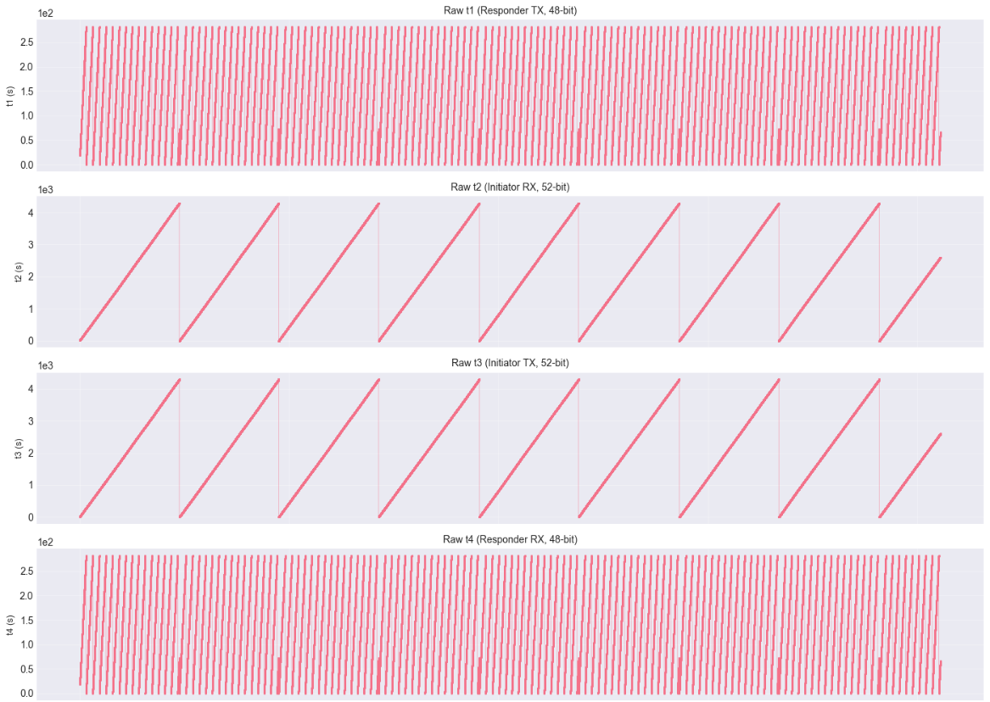
Notes:
281s
71m

Slide 7
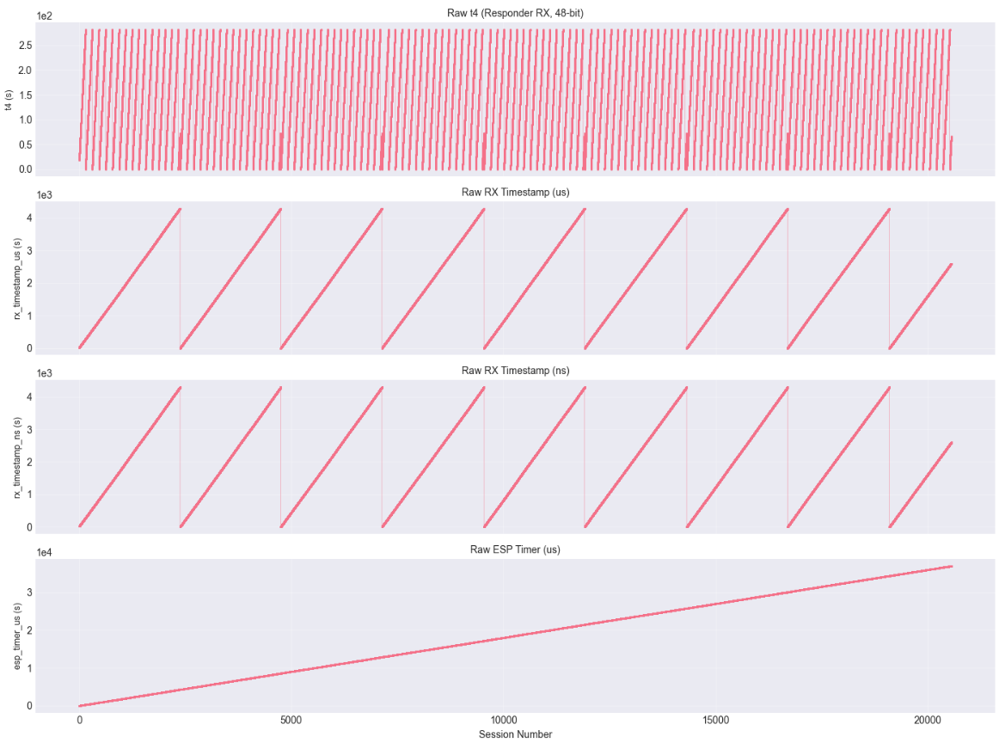

Slide 8
Disciplined Timer
We need a timer to
  Poll sensors (@2 kHz for my use case)
  Send pulses (for easy quality control with an oscilloscope)
GPTimer:
  64bits, up to 40MHz, 25ns period, wide compatibility, no GPIO output
MCPWM:
  16 bits, up to 160MHz, 8.5ns period, limited hw support (not on C3)
Go for MCPWM @40MHz:
  25ns resolution, 2kHz TEZ frequency with 16000 period
  GPIO output, but easy to port to GPTimer if pulses are not needed

Slide 9
Clocks
MAC clock:
  As of March 2025 exposed(*) by API as 32 bits @1us counter
  Must be MSBs of some internal high-res MAC clock
  Runs off same oscillator as MCPWM (different resolution, random offset)
FTM timers: 1ps resolution
  T2/T3 (initiator, local) – 52 bits, sampled off same high-res MAC clock
  T1/T4 (responder) – 48 bits, sampled off remote high-res MAC clock
MAC clock of the master = the master clock
Cycle Counter = floor(master clock / TIMER_PERIOD)
(*) esp_wifi_internal_get_mac_clock_time(), see https://github.com/espressif/esp-idf/issues/15348. Also seen in beacons/TSF (1us resolution) and timestamps of sniffed packets: 1us (or 1ns with https://github.com/espressif/esp-idf/issues/9843 patch)

Slide 10
Robust Local Clock
Track overflows of MAC clock
  32 bits @1us (wrap period 2^32)
  => mac_clock_us
The disciplined timer (MCPWM, ticks at 25ns)
  Clocked off same oscillator as MAC clock
  Track all ticks and overflows, but never mess with tick counts
  Ok to adjust period to alter phase and frequency of TEZ
Sample MAC clock edges against the disciplined timer
  => mac_clock_at_timer_start_ns
The disciplined timer becomes local MAC clock with 25ns resolution!

Slide 11
Architecture
FTM: Fine Time Measurement
  Initialize Wifi
  Initiate and collect FTM measurements
CRM: Clock Relationship Model
  Model master clock with linear regression, kind of:
master_time = slope * local_time + intercept
DTC: Disciplined Timer Controller
  Handle CRM updates, produce timer alignment instructions
DTR: Disciplined Timer Realtime
  TEZ handler: consume alignment instructions from DTC, adjust period & phase
  Pulse GPIO, invoke application callback (i.e. for trigger sensor sampling)

Slide 12
FTM → CRM → DTC ↔ DTR
(Legend: in, out)

Slide 13
FTM
Initiates FTM sessions every 1s
FTM session = 32 reports, each report = 4 timers: T1, T2, T3, T4
Tracks wraps and unwraps (a separate story): 4x 64bit @1ps T-counters
RTT = (t4 - t1) - (t3 – t2)
Local ref time:
  t2_unwrapped_ps
Corresponding remote time (assuming symmetric link):
t1_unwrapped_ps + rtt/2
Feed the list of (local_ps, remote_ps) to CRM module

Slide 14
FTM → CRM → DTC ↔ DTR

Slide 15
CRM: Clock Relationship Model
Maintains a ring buffer of 100x recent FTM reports (local_ps, remote_ps pairs)
Normal “y = a * x + b” linear regression is not enough
  The intercept (b) is projected very far into the past (zero), poor accuracy
  The slope (a) is very close to zero, 1ppm <=> 1.000001 (not much left for mantissa)
  Inverse operation will require floating point division which is slow
To improve accuracy and numeric stability:
  Use centroids (mean_x, mean_y) instead of zero-intercept
  Keep both forward and inverse slope to avoid any divisions later
  Keep slope values minus 1 instead of actual slope values
Feed the CRM model to DTC:
  crm_ref_local_ticks, crm_ref_remote_ticks, crm_slope_lr_m1, crm_slope_rl_m1

Slide 16
FTM → CRM → DTC ↔ DTR

Slide 17
DTC
Gets from CRM
  crm_ref_local_ticks, crm_ref_remote_ticks
  crm_slope_lr_m1, crm_slope_rl_m1
Waits for next TEZ to get timer_base_ticks
  get timer_base_ticks (= the time of last TEZ, in local timer ticks)
Can calculate
  Slave / master timer ticks @ last TEZ
  Master / slave timer ticks @ next TEZ
The latter can be directly used to adjust slave’s TEZ phase
To adjust TEZ period – just multiply by slope

Slide 18
DTC: Timer ticks @ last TEZ
Regression: slave => master
  delta_local_ticks =
timer_base_ticks – crm_ref_local_ticks
  delta_remote_ticks =
    delta_local_ticks + delta_local_ticks * crm_slope_rl_m1
  remote_ticks =
    crm_ref_local_ticks + delta_remote_ticks

Slide 19
DTC: Align to Master Cycle
Figure out the master cycle we are aligning to
  aligned_cycle_count =
(remote_ticks + TIMER_PERIOD_TICKS/2)
/ TIMER_PERIOD_TICKS + 2
  aligned_remote_ticks =
aligned_cycle_count * TIMER_PERIOD_TICKS
+2 because:
  remote_ticks - corresponds to the cycle in progress now
  DTR runs alignment a cycle after, to controls the next cycle after next

Slide 20
DTC: Timer ticks @ next TEZ
Inverse Regression: master => slave
  aligned_delta_remote_ticks =
aligned_remote_ticks – crm_ref_remote_ticks
  aligned_delta_local_ticks =
aligned_delta_remote_ticks + aligned_delta_remote_ticks * crm_slope_lr_m1
  aligned_local_ticks =
crm_ref_local_ticks + aligned_delta_local_ticks
If math ok:
aligned_local_ticks ~ timer_base_ticks + 2 * TIMER_PERIOD_TICKS

Slide 21
DTC: Alignment Instructions
aligned_cycle_counter - cycle number for that TEZ
aligned_local_ticks – the next aligned TEZ
aligned_base_period_fp16 - new timer period, in FP16
  master_base_period_fp16 = (TIMER_PERIOD_TICKS * 65536.0)
  aligned_base_period_fp16 = master_base_period_fp16 +
master_base_period_fp16 * crm_slope_lr_m1

Slide 22
FTM → CRM → DTC ↔ DTR

Slide 23
DTR: Disciplined Timer
MCPWM Timer
  clocked 40MHz @25ns
  period dithering
DTR State
  cycle_counter
  timer_base_ticks
  actual_period_ticks
  shadow_period_ticks
  base_period_fp16
  period_ticks_frac_acc
Shadow register
  Configure period any time
  Have it set on next TEZ
  Avoids race condition
Period dithering
  Update period_ticks from base_period_fp16 & period_ticks_frac_acc

Slide 24
DTR ISR
Initial values (MCPWM)
  cycle_counter = -1
  active_period_ticks = 0
  period_ticks = shadow_period_ticks = TIMER_PERIOD_TICKS
ISR state at middle: @ TEZn+1
Same ISR beginning and ending
Impact of shadow reg
  Set now at TEZn+1
  Affects phase of TEZn+3
Beginning
  cycle_counter++
  timer_base_ticks += active_period_ticks
  active_period_ticks = shadow_period_ticks
Middle: adjusts phase of TEZn+3 (!)
  Dithering or alignment => period_ticks
Ending
  shadow_period_ticks = period_ticks
  shadow_period_ticks => MCPWM HW

Slide 25
DTR: Alignment
DTC tells DTR to align, targeting next TEZ
Next TEZ should happen on aligned_local_ticks
  period_ticks = aligned_period_ticks – timer_base_ticks
  cycle_counter = aligned_cycle_counter + 1
  If math ok:
    period_ticks ~ TIMER_PERIOD_TICKS
    cycle_counter = old_cycle_counter
If period_ticks is too short, have to roll forward (only happens on initial align)
Use adjusted FP16 base period for future cycles
  base_period_fp16 = aligned_base_period_fp16

Slide 26
DTR: Feedback to DTC
Signal TZE => DTC sets alignment close to TZE
Results of last alignment handling
  cycle_counter (=0)
  cycle_counter – old_cycle_counter
  period_ticks
  period_ticks – old_period_ticks (~0)

Slide 27
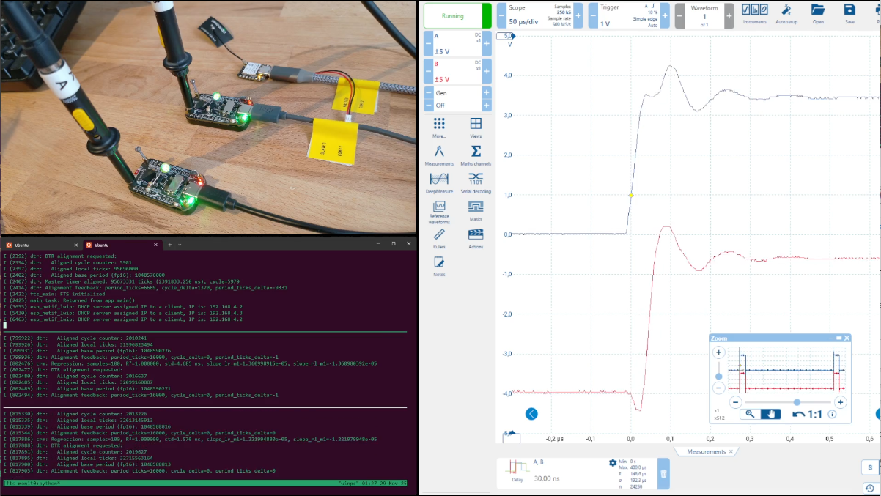
DEMO
Master
  Seeed Studio XIAO ESP32 S3 Sense
  Built in Yellow LED @ GPIO21
Slaves
  2x Waveshare ESP32-S3-LCD-1.47
  Green LED tied to VDD @ GPIO1
  Picoscope 5204 @ GPIO7
Notes:
Here is a demo of a 3 device setup, a master and two slaves. All of them are blinking LEDs in sync at 1 Hz and sending pulses to digital output pins. The outputs are monitored with an oscilloscope.
Unfortunately, the scope is rather old, it lags a bit and and does not gather pulse delay statistics very well in this case (because the relative delay dances around zero and changes sign). But visually we can see that the jitter stays below 100ns most of the time.
This is repeatable across restarts. Let me restart all the devices. I will zoom out a bit to better see the pulses.
First I restart the master. Note it starts blinking out of phase with slaves. Recovery from master loss is not really supported yet, but sometimes it works.
And now I restart the slaves, they resync too. Let me do it few more times
I am leaving the setup running overnight, lets see if it survives in the long run.

Slide 28
THE END

Slide 29
FIXME / TODO
add screenshots from notebooks to show MAC/FTM clock unwrapping
broadcast master clock to allow arbitrary restarts (now must restart all)
check for math problems (we mix signed and unsigned variables), reconsider units (ticks, ps, ns) for all vars
consistent error handling strategy (check current error logs & aborts)

Slide 30
FUTURE
implement as easy to use component / Arduino IDE library
assess the impact of higher RTT / lower RSSI
run MCPWM at higher clock rate (but seems to impact FTM quality)
more FTM sessions, drop outliers & asymmetric entries
use floats (by FPU) instead of doubles (soft emulation)
finer CRM, slope velocity factor
port to GPTimer to support C3
power saving
merge FTM/CRM/DTC: use period-aligned remote_ps as ref

Slide 31
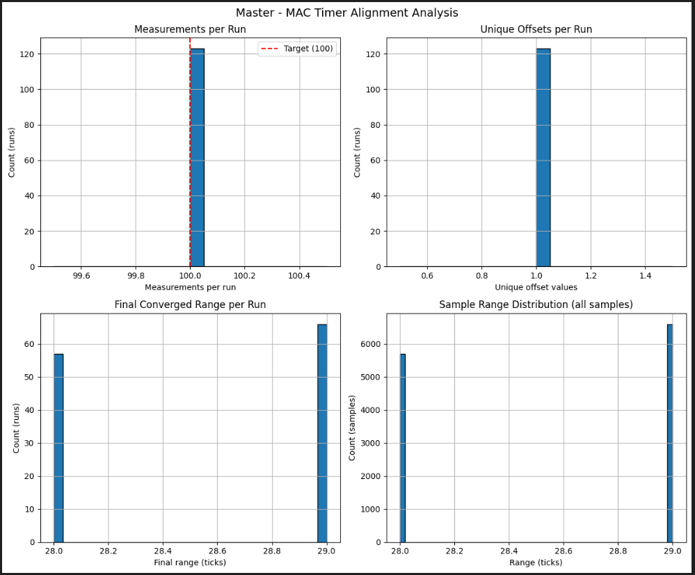
MAC Clock Timer Start Offset Measurements
Quality Control
Set CONFIG_SYNC_MAC_TIMER_ALIGNMENT_TEST_CYCLES=100
120 runs, each run: do 100 measurements, reboot
Gathered data from 3 systems (1x master, 2x slaves)
All runs finish with 100 measurements - nothing breaks
Within each run the algorithm always settles on the same min/max values, 1 unique offset per run
The min / max bounds are 28-29 ticks apart, with roughly same probability << ? try to measure few times and take the narrowest
See docs/mac_timer_align_analysis/

