Slide 1
Deferred Rendering

Slide 2
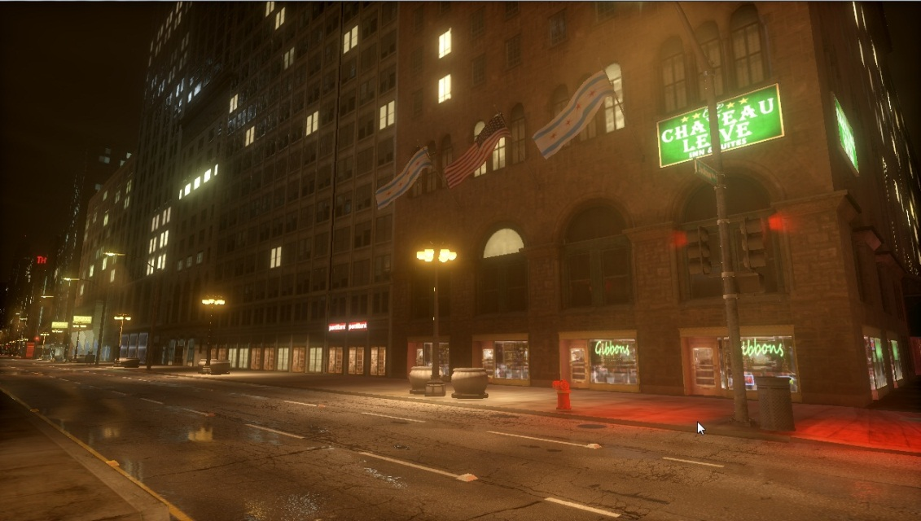
What is deferred rendering?
Deferred lighting/shading/rendering
Multi-pass rendering
Key idea is to flatten out geometry
Really old idea

Slide 3
Why deferred rendering?
Complex scenes with a lot of lights more common
Number of objects + Number of lights
Do lighting calculations in screen space

Slide 4
Main steps
Render geometry to G-buffer
Perform lighting stage
Post-processing

Slide 5
Depth encoding
Depth Resolution is not linear
Unproject and store linear depth
Use frustum to recover view space position from depth

Slide 6

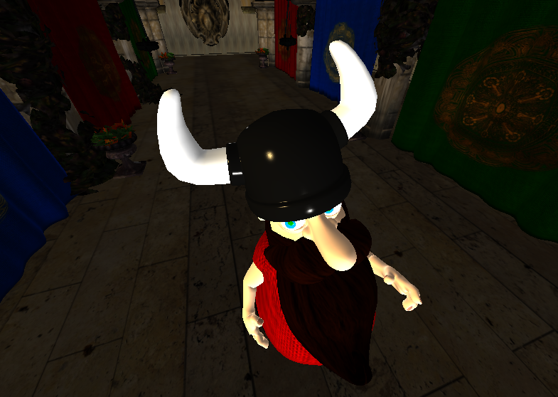
Specular encoding
Encode specular info in free channels

Slide 7
The G-buffer
Three R16G16B16A16F textures
Layout:
R | G | B | A
Normal.x | Normal.y | Normal.z | -
Depth | Specular intensity | Specular roughness | -
Albedo.x | Albedo.y | Albedo.z | -

Slide 8
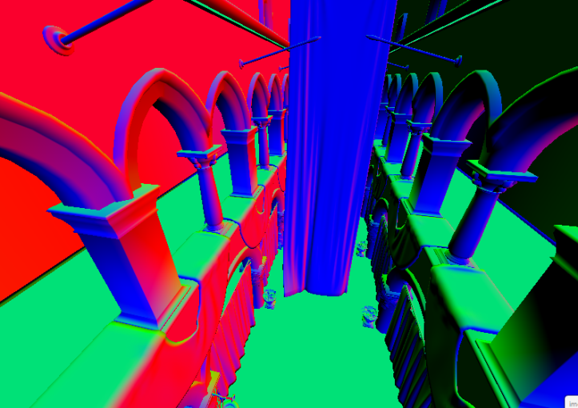
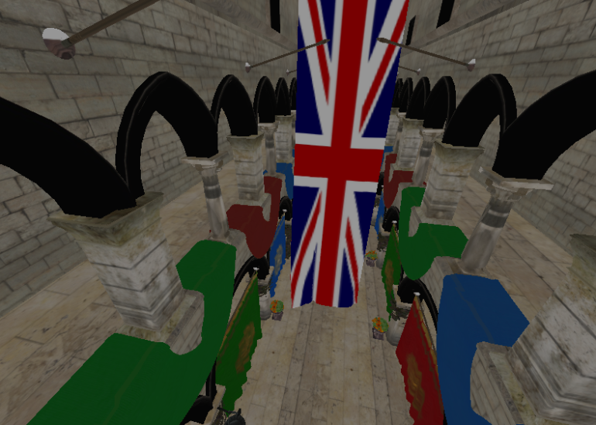
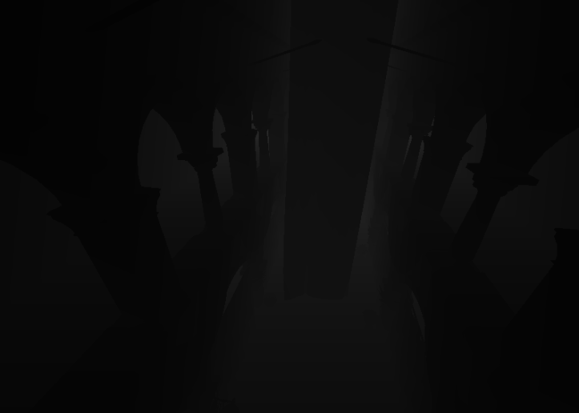
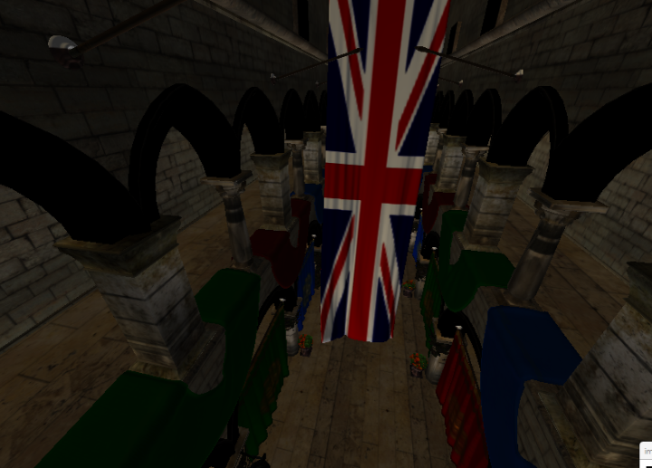
G-buffers
Normals
Albedo color
Depth
Final Comp.

Slide 9
Lighting stage
Render to screen space quad
Simple Phong shading

Slide 10
The Bad
Antialiasing
Transparency
Bandwitdth requirements

Slide 11
Results

Slide 12
Demo

