Slide 1

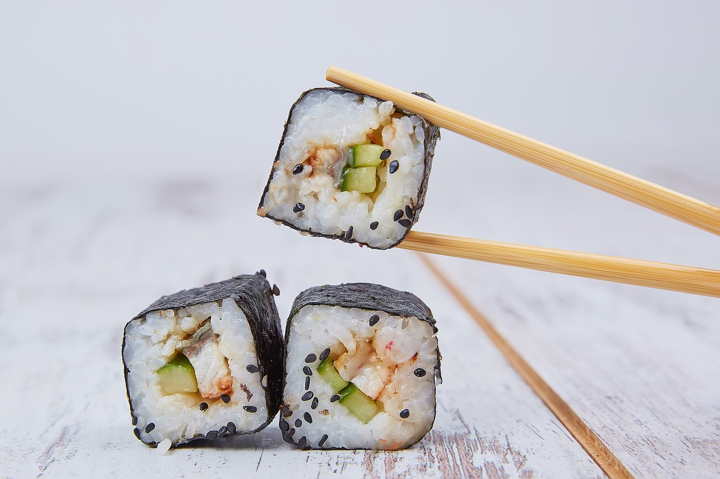
IBM Data Science Professional Certificate Capstone Project – The Battle of Neighborhoods
Evaluating Japanese restaurants in New York City using Python and Machine Learning
Marcelo Abbehusen Magalhães
March, 2021

Slide 2
Painel E&P-EXP
—
Objetivos e funcionalidades
—
Desenvolvido para a Reunião de Acompanhamento de Poços (AQG);
Objetivo: Mostrar informações poço a poço, buscando por campo, bacia ou laboratório;
Mostra quantitativo de amostras, quantas e quais análises já foram feitas, situação da amostra, resumo das análises laboratoriais;
Resumo das atividades laboratoriais já realizadas.

Slide 3
Summary
—
Introduction
Data
Methods
Results
Conclusion

Slide 4
Evaluating Japanese restaurants in New York City using Python and Machine Learning
—
Introduction
—
By the year of 2011, there were about 20 thousand japanese immigrants living in New York City;
According to the 2017 United States Census Bureau, there were 1,466,514 Americans with japanese ancestry living in USA;
New York City is one of the three areas with the highest Asian American Populations (Greater Los Angeles Area, New York Metropolitan Area and San Francisco Bay Area);
This project will attempt to answer the questions “Where should an investor open a Japanese Restaurant in NYC?” and “Where should I go If I want a great and highly rated Japanese food?”.

Slide 5
Evaluating Japanese restaurants in New York City using Python and Machine Learning
—
Data
—
In order to answer the above questions, data on New York City neighborhoods and boroughs, including boundaries, latitude, longitude, restaurants and restaurants ratings are required;
New York City data containing the neighborhoods and boroughs, latitudes, and longitudes will be obtained from the data source: https://cocl.us/new_york_dataset;
All data related to locations and quality of Japanese restaurants will be obtained via the FourSquare API, using the Requests library in Python.

Slide 6
Evaluating Japanese restaurants in New York City using Python and Machine Learning
—
Methods
—
Data will be collected from https://cocl.us/new_york_dataset, cleaned and processed into a dataframe. FourSquare will be used to locate all venues and then filtered by Japanese restaurants. Users ratings will be counted and added to the dataframe;
After the data is preprocessed, It will be sorted based on ratings. Finally, It will be visualized using charts from Python libraries and also divided into different clusters, using machine learning K-Means algorithm, from scikit-learn library.

Slide 7
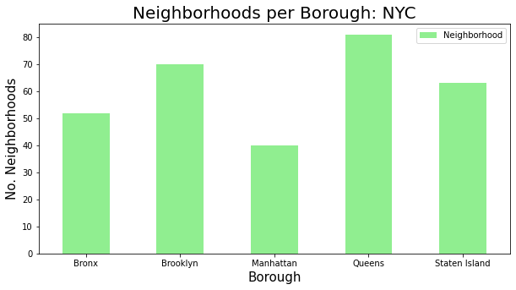
Evaluating Japanese restaurants in New York City using Python and Machine Learning
—
Results
—
Using the Requests library to retrieve New York city data from the URL, the data was visualized in a bar graphic and in a pandas dataframe.
Index | Borough | Neighborhood | Latitude | Longitude
0 | Bronx | Wakefield | 40,89471 | -73,8472
1 | Bronx | Co-op City | 40,87429 | -73,8299
2 | Bronx | Eastchester | 40,88756 | -73,8278
3 | Bronx | Fieldston | 40,89544 | -73,9056
4 | Bronx | Riverdale | 40,89083 | -73,9126
5 | Bronx | Kingsbridge | 40,88169 | -73,9028

Slide 8
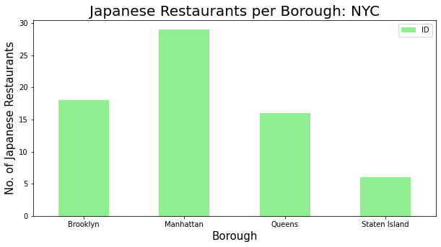
Evaluating Japanese restaurants in New York City using Python and Machine Learning
—
Results
—
Using the Foursquare API, It was able to retrieve data from 69 Japanese Restaurants in New York City, as shown in the table and figures below.
Borough | Neighborhood | ID | Name
Brooklyn | Kensington | 4d5c12a01e43236a87eb1583 | Sake Sushi
Brooklyn | Prospect Heights | 5cb5e5f9a35f4600255406c6 | Maison Yaki
Brooklyn | Williamsburg | 51f9b7b3498eefe896caeb23 | Shalom Japan
Brooklyn | Bedford Stuyvesant | 5b3bcb69bfc6d0002ca9bf17 | Warude
Brooklyn | Brooklyn Heights | 479ccb47f964a5206b4d1fe3 | Iron Chef House
Brooklyn | Cobble Hill | 48a41073f964a52091511fe3 | Hibino

Slide 9
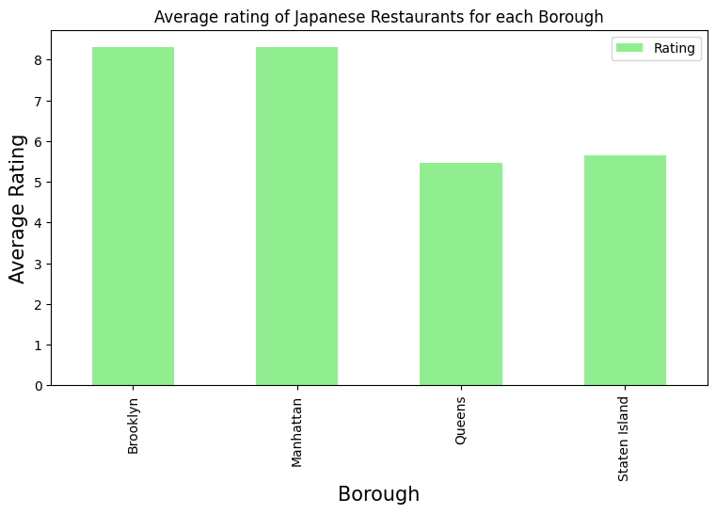
Evaluating Japanese restaurants in New York City using Python and Machine Learning
—
Results
—
After retrieving data from japanese, data from likes and ratings were obtained also via Foursquare API, and the results were grouped by neighborhoods and borougs, as shown in the tables and chart below.
Neighborhood | Average Rating
East Village | 9.25
Cobble Hill | 9.10
North Side | 9.00
Park Slope | 8.90
Downtown | 8.90
Soho | 8.80
Lindenwood | 8.80
Chelsea | 8.80
Boerum Hill | 8.70
Fort Greene | 8.60
Borough | Average Rating
Manhattan | 8.310.526
Brooklyn | 8.306.667
Staten Island | 5.660.000
Queens | 5.472.727

Slide 10
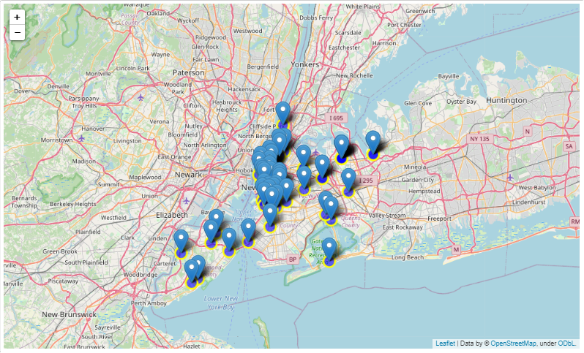
Evaluating Japanese restaurants in New York City using Python and Machine Learning
—
Results
—
Afterwards, the dataset was merged with the latitude/longitude data and finally plotted in a map, using the Folium library.
Borough_x | Neighborhood | Latitude | Longitude | Rating
Brooklyn | Kensington | 40.642.382 | -73.980.421 | 7.9
Brooklyn | Prospect Heights | 40.676.822 | -73.964.859 | 8.1
Brooklyn | Williamsburg | 40.707.144 | -73.958.115 | 8.2
Brooklyn | Bedford Stuyvesant | 40.687.232 | -73.941.785 | 8.2
Brooklyn | Brooklyn Heights | 40.695.864 | -73.993.782 | 8.1
Brooklyn | Cobble Hill | 40.687.920 | -73.998.561 | 9.1
Brooklyn | Carroll Gardens | 40.680.540 | -73.994.654 | 7.8

Slide 11
Evaluating Japanese restaurants in New York City using Python and Machine Learning
—
Results
—
Finally, the K-means algorithm was set to three clusters, that divided the data into three groups:
Cluster 0: Mostly restaurants located in Brooklyn and Manhattan and that had the best ratings, from 7.9 to 9.3;
Cluster 1: Restaurants with no rating, located basically in Queens;
Cluster 2: Restaurants with ratings varying from 6.2 and 7.6, mostly located in Queens and Staten Island.

Slide 12
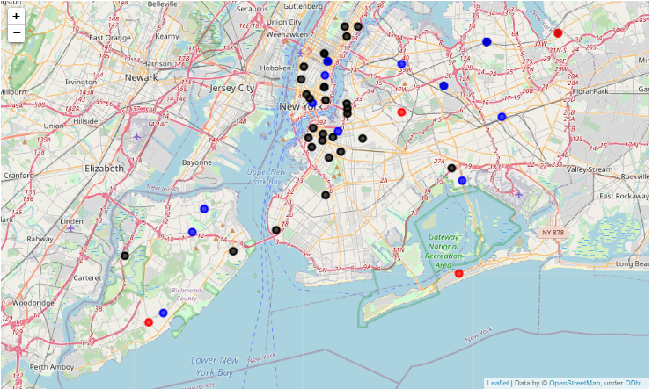
Evaluating Japanese restaurants in New York City using Python and Machine Learning
—
Results
—
The following map shows the restaurants locations according to each cluster. The black spots are cluster 0, the red spots are cluster 1 and the blue are cluster 2.

Slide 13
Evaluating Japanese restaurants in New York City using Python and Machine Learning
—
Conclusions
—
The Manhattan and Brooklyn boroughs were clearly the regions with the higher rated japanese restaurants, labeled as Cluster 0 after KMeans algorithm were implemented. So, If one were to look for a good japanese restaurant, I'd recommend any neighborhood of these areas.
In other words, If a person is looking for a place to open a new Japanese restaurant, I'd recommend the boroughs of Queens or Staten Island, because besides having a small number of restaurants, the existing ones are low rated, which means these areas have potentially less competition. It's necessary to study more features, such as infrastructure, transports and wage rates of these regions, to be able to build a more robust and trustworthy model.

