Slide 1
Project 1: Investment Portfolio
Abigail Smith

Slide 2
Investment Overview
Stocks
Apple
Lux urban Hotels
GameStop
Lululemon
ETF
DFSI
FOREX
Euro to USD
Indices
NDX
Notes:
I would like to preface this whole presentation with the fact that I had little to no knowledge about the specifics of the stock market before this assignment. Thus, I based my investment portfolio on the little knowledge I had, stocks that I or my Friends have invested in, and a few of my selections were random ones I found.
Picked apple because known to be a fairly “safe” stock
Picked because I thought their company sounded interesting. They lease entire hotels on a long-term basis and rent out hotel rooms in the property it leases
A few of my friends owned/bought GameStop Stocks a few years ago when the stock blew up, so I thought it would be fun to see how this stock preforms
I like working out and my favorite athletic brand is privately owned so I picked lululemon who has quickly become a top athletic brand in both mens and womens clothing.
I picked DFSI because someone mentioned it in the chat and I thought it sounded interesting.
I picked the Euro to USD foreign exchange because I want to travel Europe one day and the Euro is the currency of all 20 EU countries
My Indices was the only free to access one
My investment strategy was to split my 100K evenly amongst my 4 stocks, 1 ETF, and 1 Forex.

Slide 3
Pipeline Overview

Slide 4

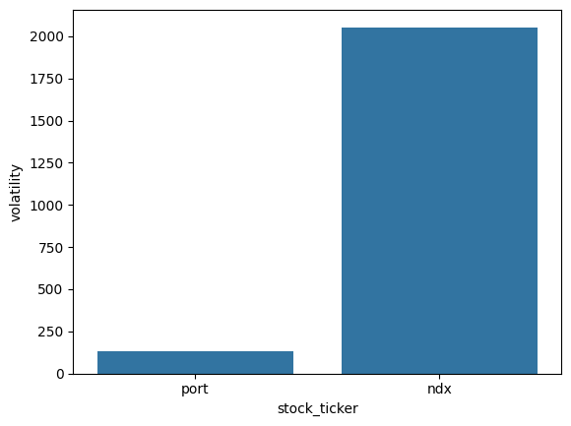
Volatility
Notes:
From this we can see that our portfolio is much less volitile than the overall market which is good because that means we are makeing fairly safe investments.

Slide 5

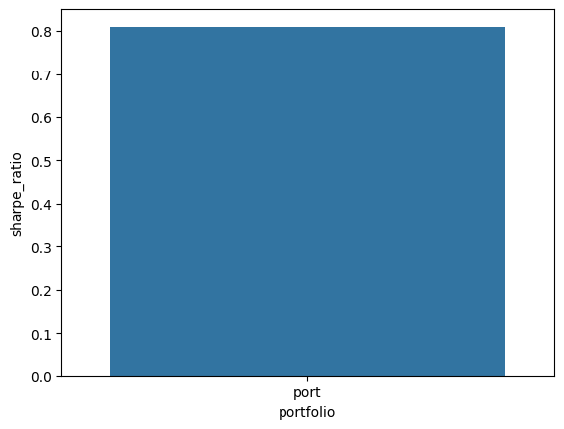
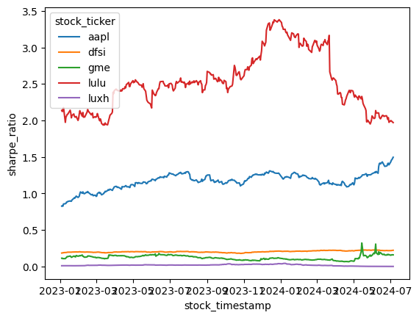
Sharpe Ratio
Notes:
Knowing that a sharpe ratio of less than 1 is poor, we can see that overall our portfolio is doing poorly.
From this graph we can see which of our stocks and ETFs had a high enough return to be worth the instability. Knowing that a sharpe ratio of less than 1 is poor, we can see that gme, dfsi, and luxh are under preforming at all less than .5 consistently. We can also see that aaple and lulu are very good stocks to invest in.

Slide 6
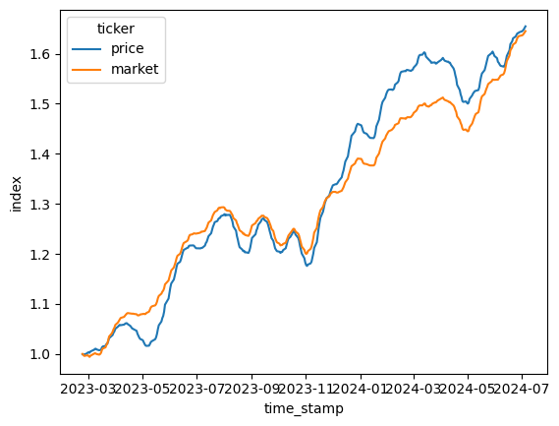
Total stock market index and Total Price index over time
Notes:
From this graph we can see that the market price and Whole Market Index followed almost the same trend over the course of our investment.

Slide 7
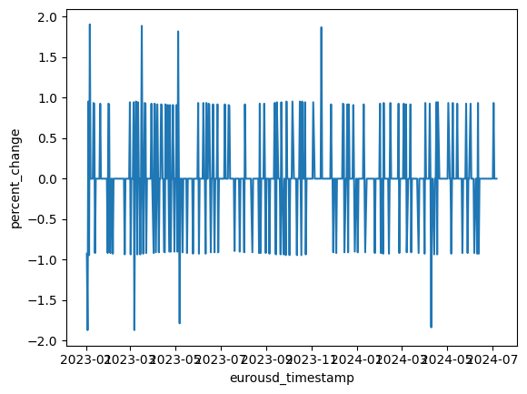
Foreign Exchange Percent change Over time
Notes:
From this fairly chaotic graph was can see that the Euro USD exchange rate was almost constantly fluctuating between positive and negative amounts of about 1 % with a few spikes both up and down to approximately 2%.

Slide 8
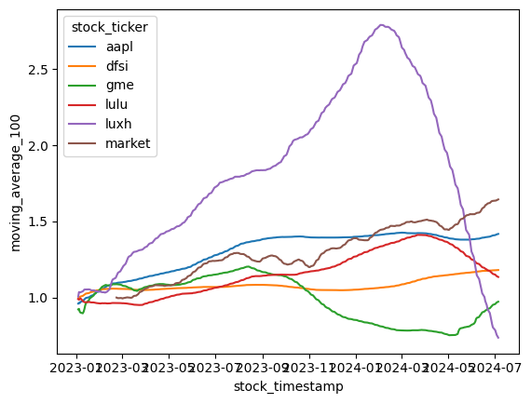
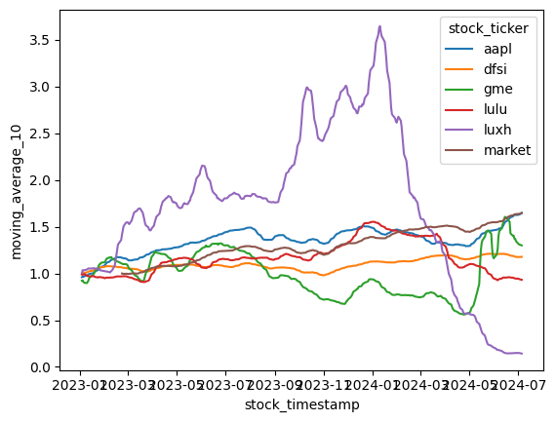
Ten and One hundred day moving Average
100 day moving
10 day moving
Notes:
From the 10 day average graph we can see that the luxh is a very volitile stock as the 10 day average return is constantly changing. We can also see that gme becomes fairly volitile towards the end of 2023 and through 2024 as there are a lot of large changes in the average return. Finally We can see that our other stocks are fairly "safe" stocks as they approximately followed the trend of the market index.
From this graph we can see that, both luxh and gme change a lot over the course of their 100 day averages. We can also see that lulu and aapl are the most stable and "safe" investments in relation to the Market index over a 100 day average. dfsi 100 day average stays fairly stable over the course of our investment, but this is not great as the market increased over the course of the investment

Slide 9
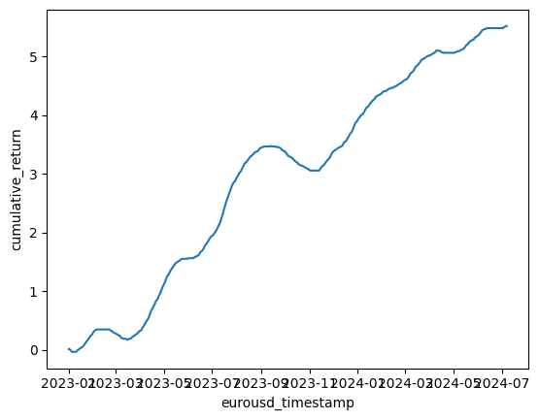
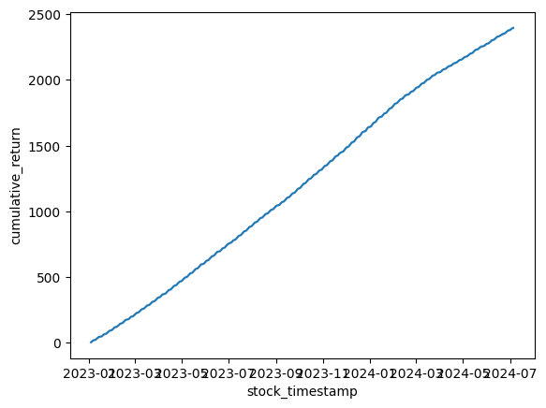
Cumulative returns over time
Forex Returns
Stock and ETF Returns
Portfolio Returns
Notes:
From this graph we can see that over the course of our investment we consistantly made money. We can also see that there were periods during our investment period where we lost money, but the overall trend was positive.
From the upward trend of our stocks returns we know that we are generally making money from our stocks
We can see from the steepness of the line that our portfolio has started to do worse in recent days as the line is less steep indicating that the average return has dropped
Stocks and port look very similar because the foreign exchange return was so small that it did very little to change our graph

Slide 10
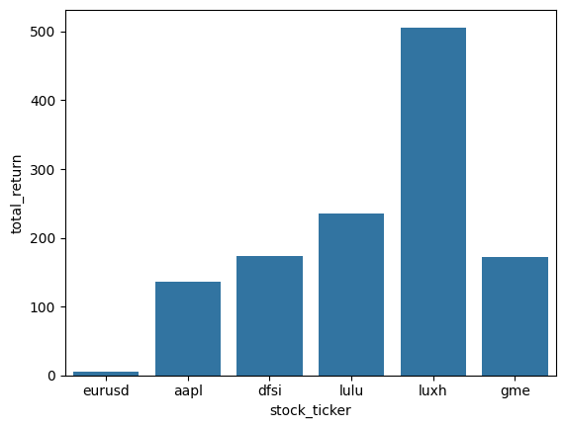
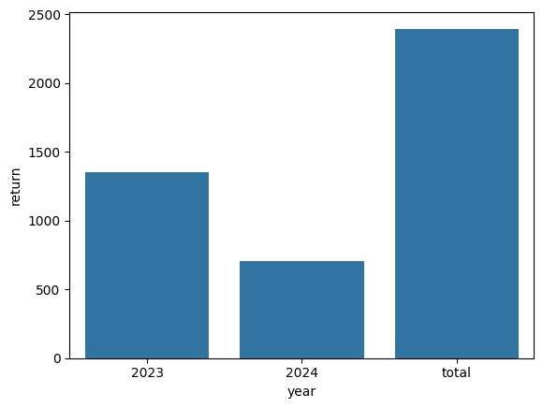
Total Returns
Return per Investment
Return per Year
Notes:
- From this graph we can see that over the course of my investment luxh was by far my highest return an my foreign exchange of the euro to usd was by far the smallest.
- As we can see our two years roughly add up to our total return values. It also appears that we did worse in 2024 than in 2023, but this is not true as 2024 only goes through early July rather than the whole year. Considering we have approximatly half as many data points for 2024 than 2023 it would appear that we are doing about the same if not slightly better in 2024 than in 2023.

Slide 11
Key Takeaways
Notes:
From these graphs although luxh was by far my largest overall return, I should have bought more luxh at the beginning when the return was rapidly increasing and then sold the shares in early 2024 when the stock returns tanked. I should then have taken the money made from selling my luxh stock and bough more aapl and dfsi stocks.
Looking at the resent data from this portfolio I also should begin selling my lulu shares as the returns on lulu are going down on average.
In addition, I should have invested less money in a foreign exchange as it has a very low return value, and I should have been trying to sell my shares when they peaked at 2% and bought more when they tanked to -2% a few months later.

Slide 12
Thank You

