Slide 1
At-home COVID-19 Prediction using Demi methodology
Abigail Morton
Dr. Abdul Hafeez
HI 823
Spring 2026
Notes:
Welcome to my final project presentation on COVID-19 prediction using DEMI methodology.
This project focused on estimating COVID-19 infection probability using only symptoms and information available at home before clinical evaluation.
The analysis used the MIT COVID-CARE Phase II dataset and combined DEMI methodology with repeated LASSO regressions to model symptom progression, direct effects, total effects, and final probabilities.
The project also evaluated symptom relationships such as fever, chills, fatigue, cough, and loss of taste or smell to determine how symptoms influenced COVID-19 positivity.

Slide 2
Core question
Can we screen for COVID-19 before clinical contact?
This project created an AI system that helps predict whether someone may have COVID-19 using only symptoms and information they can notice at home— before going to a clinic or hospital.
The goal was to help people decide:
*Should I get tested?
*Should I isolate?
*Do I need medical care?
Notes:
The primary goal of this project was to estimate COVID-19 infection probability before clinical evaluation.
The system focused entirely on symptoms and risk factors observable at home, allowing prediction prior to laboratory testing or physician evaluation.
DEMI methodology was selected because it models temporal order, causal relationships, direct effects, and total effects rather than functioning as a black-box prediction model.
This improves interpretability and allows symptom progression to be understood clinically.

Slide 3
Dataset
Category | Value
Total participant records | 822
PCR-confirmed results | 559
COVID-positive cases | 58
COVID-negative cases | 501
Total variables collected | 472
Home symptoms/features used | 68
MIT COVID-CASE Phase II Dataset
The files that were used:
1. COVIDCARE_FORSUBMISSION_MIT_CLEANED_Phase_II_2021-12-03.csv
2. COVIDCARE_DEMI_knowledgebase_v4.csv
3.
Notes:
The project used the MIT COVID-CARE Phase II dataset collected in 2021.
The dataset contained 822 participant records across 472 variables including symptoms, demographics, vaccination status, exposure history, and PCR-confirmed COVID-19 results.
Among the participants, 559 individuals had PCR-confirmed testing available, including 58 positive cases and 501 negative cases.
This produced a baseline COVID positivity rate of approximately 10.4 percent.

Slide 4
Study design and methodology
Knowledge base with tier assignments
Apply temporal rules to determine which variables come first
Calculated Pair wise associations and frequences
Ran Lasso Regression with Pair wise and triple interactions
Built a Markov Blanket Network showing parents and child relationships
Implemented the DEMI algorithm to make final predictions
System works in 6 steps.
Advantages of DEMI methodology
• Transparent probability calculations
• Maintains temporal ordering
• Supports causal reasoning
• Allows symptom progression analysis
• Clinically interpretable
• Supports healthcare decision-making

Slide 5
Temporal ordering
Tier 0
Demographics
Age, sex, race, ethnicity
Tier 1
Vaccinations
COVID and Flu Vacciation status
Tier 2
Symptoms
Self-observed symtoms
Tier 3
At-Home Test
Rapid test results
Tier 4
PCR Outcome
Lab confirmed COVID-19
Rules Applied
Same-tier pairs relationship is symmetric
Zero co-occurrences-counts set from marginals
Cross-tier lower tier always comes before higher tier
Moves left to right so that earlier events can not be caused by later events

Slide 6
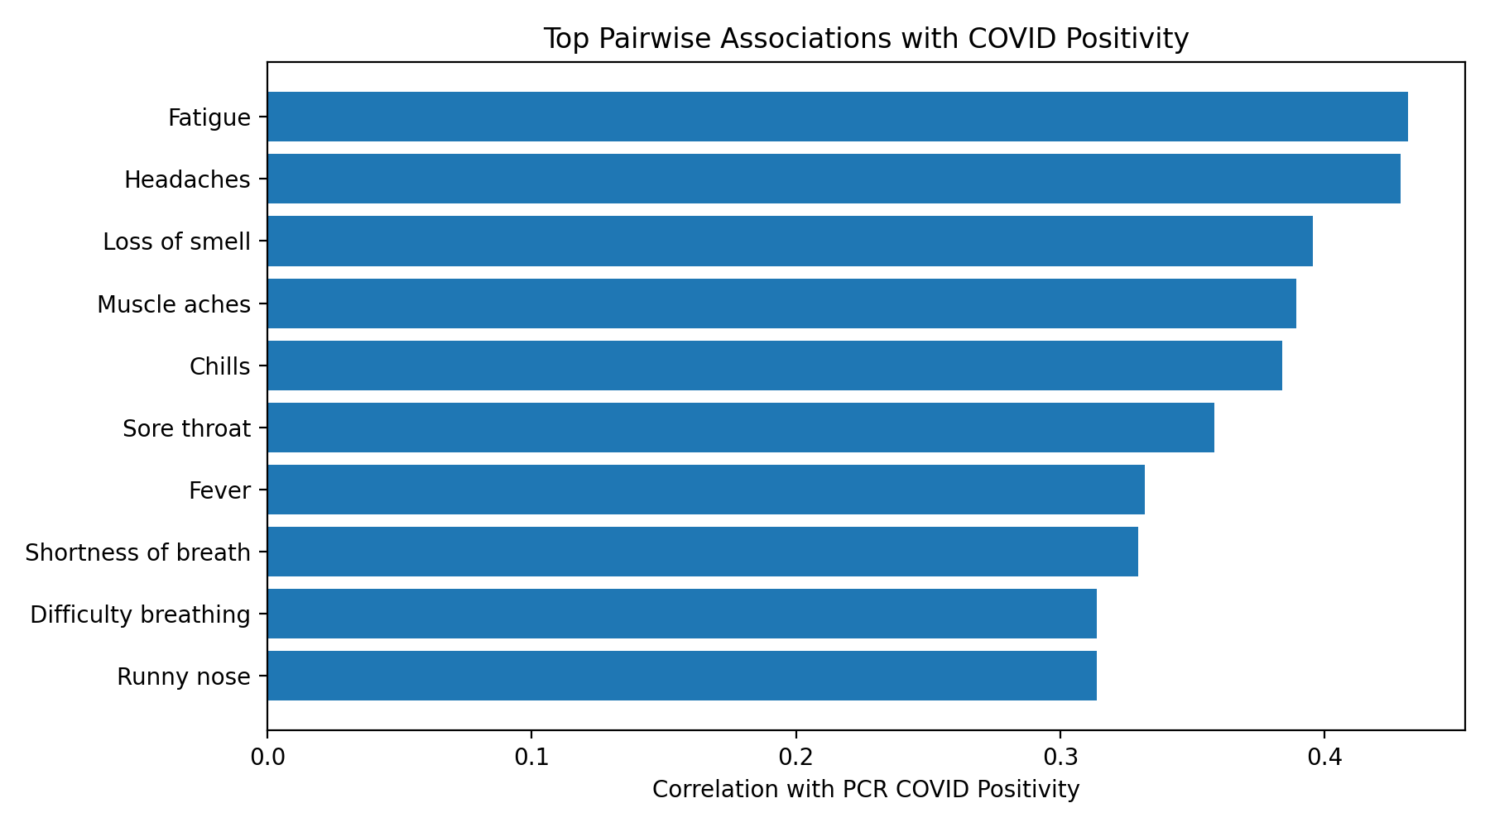
Pairwise associations results
Symptom | Correlation with COVID
Fatigue | 0.4316
Headaches | 0.4289
Loss of smell | 0.3956
Muscle aches | 0.3894
Chills | 0.3839
Fever | 0.3319
Notes:
The DEMI network modeled symptom progression in clinical order. The first step in DEMI methodology was establishing the temporal order of variables. Variables were arranged according to the expected clinical progression of COVID-19. Demographic variables and baseline risk factors occurred first, followed by exposure history, early systemic symptoms, respiratory symptoms, neurological symptoms, and final PCR-confirmed COVID-19 positivity.
The progression generally began with exposure history followed by fatigue and systemic symptoms.
Fever and chills often occurred before respiratory symptoms including cough and sore throat.
Loss of taste and smell emerged as highly specific predictors before PCR-confirmed positivity.

Slide 7
Lasso regression
Repeated LASSO regressions were performed across temporally ordered variables.
LASSO regression was selected because it reduces overfitting, removes weak predictors, and identifies the strongest direct effects.
Variables were only regressed on earlier variables within the temporal sequence.
Weak coefficients less than or equal to ±0.05 were removed.
Models with McFadden R-square values below 0.10 were excluded.
The strongest retained direct predictors included:
known exposure, headaches, loss of smell, fatigue, cough, and chills.
This simplified the network while preserving clinically meaningful relationships.

Slide 8
Markov blanket network
feature | lasso_coefficient | abs_coefficient | relationship_to_target
Known exposure | -0.5472618 | 0.54726179 | Parent / Direct predictor of COVID Positive
Headaches | 0.44034864 | 0.44034864 | Parent / Direct predictor of COVID Positive
Age | 0.27256057 | 0.27256057 | Parent / Direct predictor of COVID Positive
Loss of smell | 0.18096733 | 0.18096733 | Parent / Direct predictor of COVID Positive
Fatigue | 0.16627041 | 0.16627041 | Parent / Direct predictor of COVID Positive
Cough | 0.10501659 | 0.10501659 | Parent / Direct predictor of COVID Positive
Diabetes | 0.07621276 | 0.07621276 | Parent / Direct predictor of COVID Positive
Chills | 0.07561473 | 0.07561473 | Parent / Direct predictor of COVID Positive
Markov blanket is the smallest set of variables that directly predicts a target variable while making all other variables conditionally independent.
In this project, the Markov blanket identifies the strongest direct predictors of PCR-confirmed COVID-19 positivity.

Slide 9
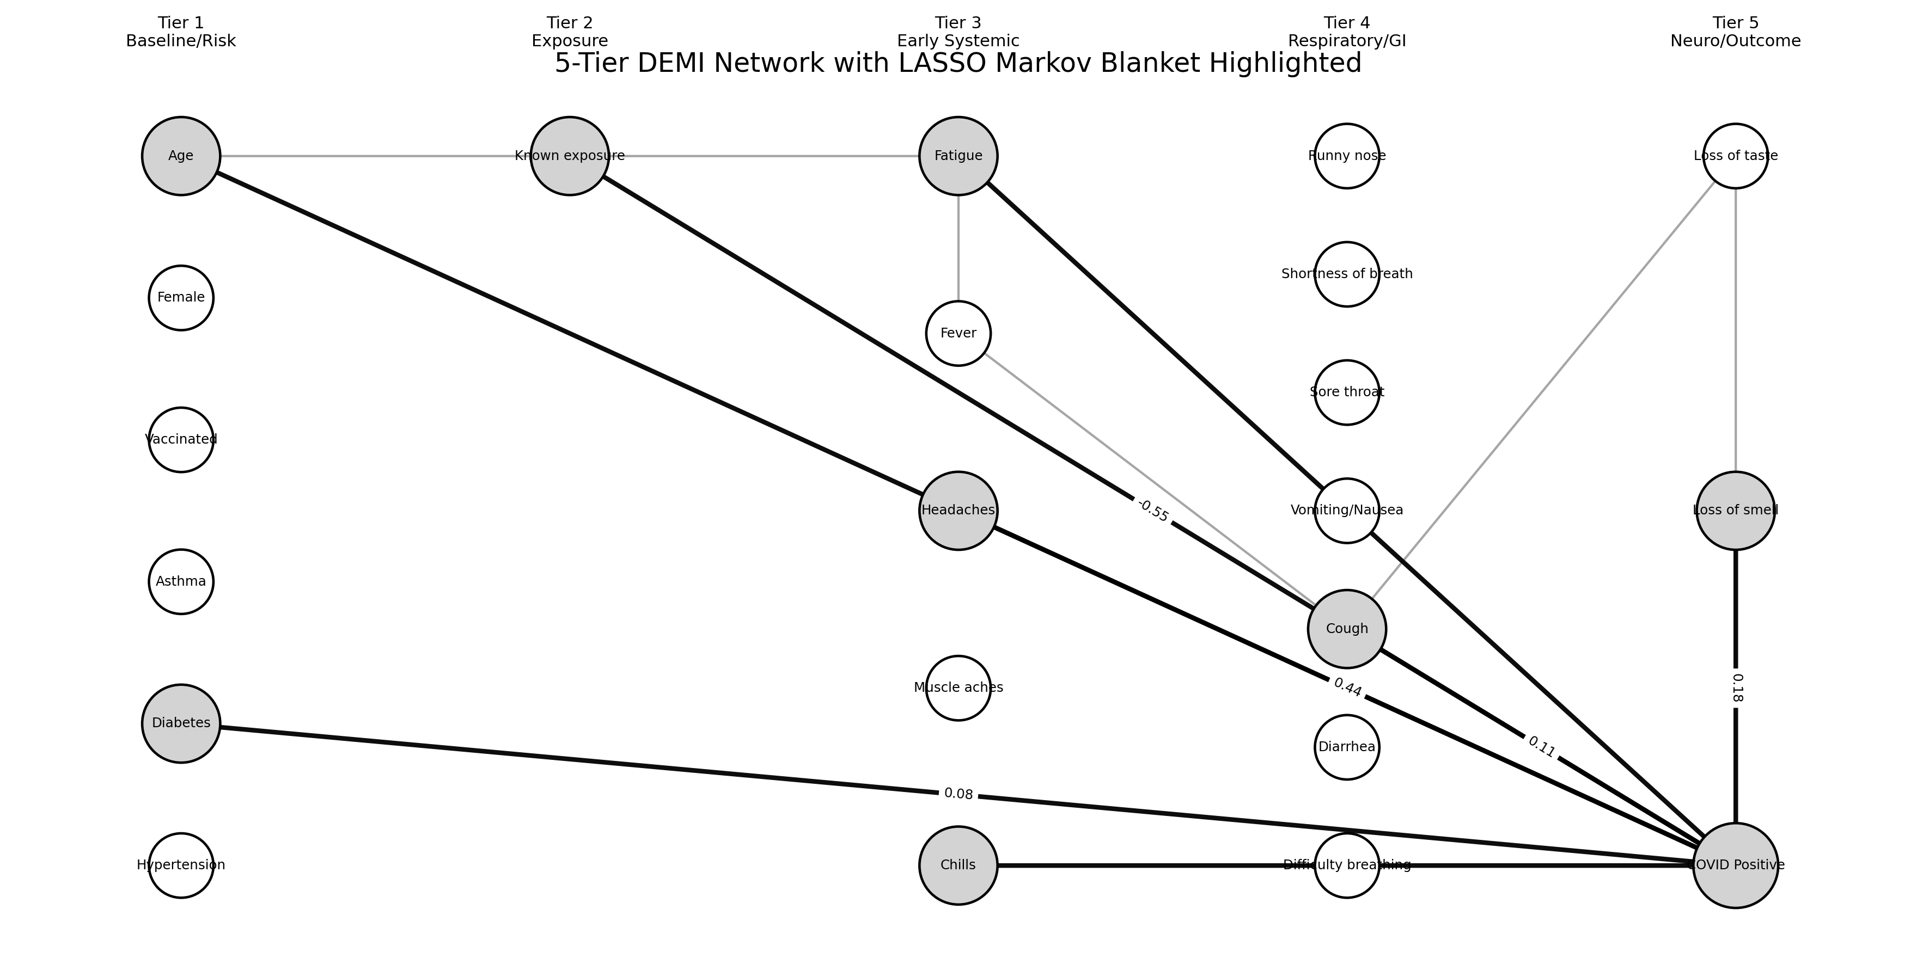
Network visualization
Notes:
Left → right represents temporal progression.
Tier 1 contains baseline risk variables.
Tier 2 contains exposure history.
Tier 3 contains early systemic symptoms.
Tier 4 contains respiratory/GI symptoms.
Tier 5 containshighlighted nodes represent the Markov blanket/direct predictors retained after repeated LASSO regressions.
neurological symptoms and final COVID positivity.
The highlighted nodes represent the Markov blanket/direct predictors retained after repeated LASSO regressions.

Slide 10
DEMI Algorithm predictions
Symptoms, covid probability and recommendations
Temporal Order | Total Effect | Final Probability
Verifying that symptoms and exposure occurred strictly before the PCR test date | Calculating likelihood ratios (LR) to measure how each indicator shifts risk | Combining multiple signals using the odds-likelihood form of Bayes’ Thereom
Notes:
To achieve this, we utilized the DEMI method. Unlike deep learning, which is a "black box," DEMI is transparent. We first ensure Temporal Order—meaning the data we use wasn't influenced by the test result itself. Then, we calculate the 'Total Effect' or Likelihood Ratio for every symptom. Finally, we combine these LRs using Bayes' Theorem to arrive at a final probability. This approach allows a doctor to see exactly why the AI reached its conclusion.
First, variables were organized into temporal order beginning with demographics and exposure history followed by symptoms and PCR positivity.
Second, total effects between symptoms and COVID positivity were calculated.
Third, repeated LASSO regressions identified direct predictors while removing weak coefficients.
Finally, the knowledgebase was used to estimate final COVID-19 probability.

Slide 11
Model comparison
Model | AUC | Accuracy | McFadden_R2 | Percent_Variation_Explained
Logistic | 0.95093333 | 0.95 | 0.20690666 | 20.6906663
GradientBoosting | 0.92453333 | 0.93571429 | 0.33948478 | 33.9484784
LASSO | 0.86213333 | 0.92142857 | -0.1964368 | -19.643683
Multiple predictive models were evaluated including:
Logistic Regression,
Random Forest,
and Gradient Boosting.
Gradient Boosting achieved the highest ROC-AUC performance.
However, DEMI methodology remained the primary focus because DEMI provides:
causal interpretability,
temporal reasoning,
direct effect analysis,
and symptom progression modeling.
model | roc_auc | sensitivity | specificity | f1 | ppv | npv | mcc
Gradient Boosting | 0.87461393 | 0.2754386 | 0.97804391 | 0.37602694 | 0.65079365 | 0.9211025 | 0.37550692
Random Forest | 0.86099905 | 0.46491228 | 0.89820359 | 0.39868421 | 0.35491026 | 0.93558107 | 0.32361384
Logistic Regression | 0.83241412 | 0.7245614 | 0.8502994 | 0.48190719 | 0.36297363 | 0.96385315 | 0.43294047
Notes:
Repeated LASSO regressions were performed across temporally ordered variables.
Weak coefficients less than or equal to ±0.05 were removed from the final network structure.
Models with McFadden R-square values below 0.10 were excluded.
This reduced overfitting and retained only clinically meaningful relationships.

Slide 12
Github repository
The GitHub repository contains:
Python scripts,
CSV outputs,
charts,
network visualizations,
the final report,
and the PowerPoint presentation.

Slide 13
Python Code execution
The Python script:
• loads and cleans data,
• assigns temporal tiers,
• calculates pairwise associations,
• performs repeated LASSO regressions,
• identifies direct predictors,
• builds Markov blanket networks,
• generates DEMI probability predictions,
• and creates visualizations.

Slide 14
Healthcare impact
Potential benefits:
•Earlier COVID screening
Reduced unnecessary ER visits
Better pre-clinical triage
Transparent AI recommendations
Supports telehealth screening
Improved testing decisions
Notes:
The baseline COVID positivity rate in the dataset was approximately 10.4 percent.
Loss of taste and smell emerged as the strongest direct predictors of PCR-confirmed positivity.
Fever and chills demonstrated strong total effects within the network.
The DEMI model also demonstrated strong ability to identify low-risk individuals using symptom combinations.

Slide 15
Limitations
This system still had several limitations:
*It missed about 40% of positive cases.
*The number of positive cases in the dataset was relatively small.
*Symptoms were self-reported.
*The data came from 2021 before newer variants like Omicron.
*The model has not been tested widely in other populations.
Because of this, the tool should only be used as a screening aid — not as a final diagnosis.
Notes:
Several limitations existed within the project.
The dataset included only 58 PCR-positive cases which limited model generalizability.
Symptoms were self-reported and therefore subject to reporting bias.
In addition, the dataset was collected before later variants such as Omicron, which may demonstrate different symptom profiles.

Slide 16
Conclusion
This project showed that AI can help estimate COVID risk using only symptoms and health information available at home.
The tool worked especially well for:
*identifying low-risk individuals
*encouraging early testing
*helping people decide when to see medial care
Although it cannot replace professional testing or doctors, it demonstrates how machine learning can support early health decision-making during infectious disease outbreaks.
Notes:
In conclusion, DEMI methodology provided a clinically useful framework for estimating COVID-19 probability using symptom progression and causal relationships.
The project demonstrated that symptom networks and probabilistic modeling can support early healthcare decision-making before clinical evaluation.
Although the system cannot replace PCR testing or physician diagnosis, it improves interpretability and supports pre-clinical screening decisions.

Slide 17
references
Alemi, F., et al. (2020). DEMI methodology and probabilistic reasoning approaches in healthcare prediction and symptom progression modeling.
Centers for Disease Control and Prevention (CDC). (2021). COVID-19 pandemic data and prevalence estimates. https://www.cdc.gov/covid/
Chen, T., & Guestrin, C. (2016). XGBoost: A scalable tree boosting system. Proceedings of the 22nd ACM SIGKDD International Conference on Knowledge Discovery and Data Mining, 785–794.
Friedman, J., Hastie, T., & Tibshirani, R. (2010). Regularization paths for generalized linear models via coordinate descent. Journal of Statistical Software, 33(1), 1–22.
MIT COVID-CARE Phase II Dataset. (2021). COVID-CARE study dataset used for symptom progression and PCR-confirmed COVID-19 analysis.
Pedregosa, F., et al. (2011). Scikit-learn: Machine learning in Python. Journal of Machine Learning Research, 12, 2825–2830.
Pearl, J. (2009). Causality: Models, reasoning, and inference (2nd ed.). Cambridge University Press.
Tibshirani, R. (1996). Regression shrinkage and selection via the lasso. Journal of the Royal Statistical Society: Series B, 58(1), 267–288.
World Health Organization (WHO). (2021). Coronavirus disease (COVID-19) pandemic. https://www.who.int/emergencies/diseases/novel-coronavirus-2019

