Slide 1
At-Home COVID-19 Prediction
Using DEMI Methodology
Abigail Morton | Dr. Abdul Hafeez
HI 823 | Spring 2026

Slide 2

Core Question
Can we predict COVID-19 using only information available at home — before visiting a clinic or emergency room?
PCR testing is the gold standard but requires clinical visits and time for results
Patients need guidance in the interim: isolate? Seek testing? Monitor symptoms?
Home-observable features: symptoms, demographics, exposure history, at-home rapid tests
DEMI methodology provides interpretable, causally-justified predictions
Unlike black-box ML: DEMI tells you WHY each predictor matters

Slide 3
Dataset: MIT COVID-CARE Phase II
Category | Value
Total participant records | 822
PCR-confirmed results | 559
COVID-positive cases | 58
COVID-negative cases | 501
Baseline prevalence | 10.4%
Total variables collected | 472
Home-observable features used | 77
Feature Categories (77 Home-Observable)
Demographics & Comorbidities (Tier 0): Age, sex, race, diabetes, hypertension, asthma, etc.
Vaccination & Exposure (Tier 1): Vaccine status, known/suspected exposure
General Symptoms (Tier 2): Fever, chills, fatigue, muscle aches, night sweats
Respiratory Symptoms (Tier 2): Cough, SOB, sore throat, loss of smell, runny nose
GI Symptoms (Tier 2): Nausea, vomiting, diarrhea, abdominal pain, appetite loss
Neurological Symptoms (Tier 2): Headaches, dizziness, memory issues, sleep issues
Inflammatory Symptoms (Tier 2): Rash, eye irritation, swelling, joint pain
At-Home Testing (Tier 3): Rapid antigen test results (positive/negative/inconclusive)

Slide 4
Study Design: DEMI Methodology
Step 1
Step 2
Step 3
Step 4
Temporal Ordering
Total Effects
Direct Effects
Probability Estimation
→
→
→
Assign variables to causal tiers based on when they occur
Pairwise associations between each feature and PCR positivity
Repeated LASSO regressions to isolate direct predictors
Bayes' theorem with Markov blanket to estimate P(COVID)
Advantages of DEMI
LASSO Thresholds
Transparent probability calculations (no black box)
Maintains temporal ordering — prevents reverse causation
Supports causal reasoning — identifies direct vs. mediated effects
Clinically interpretable — each predictor has a clear interpretation
Coefficient filter: |β| ≤ 0.05 → variable removed
Model quality: McFadden R² < 0.10 → model excluded
Cross-validated: 5-fold stratified CV for all AUC estimates

Slide 5
Temporal Ordering: Causal Tier Assignment
Earlier tiers → Later tiers (causation flows forward in time, never backward)
Tier 0
→
Tier 1
→
Tier 2
→
Tier 3
→
Tier 4
Demographics & Comorbidities
Vaccination & Exposure
Symptoms
At-Home Testing
PCR Outcome (Target)
Age, sex, race, diabetes, hypertension, asthma, obesity, immunocompromised
Vaccine status, known exposure, suspected exposure
Fever, cough, fatigue, headaches, loss of smell, GI, neuro, inflammatory
Rapid antigen test results: positive, negative, inconclusive
PCR-confirmed COVID-19 positivity
34 features
4 features
35 features
4 features
1 target
Temporal Ordering Rules
Same-tier pairs: relationship is symmetric (correlational, not causal)
Cross-tier: lower tier always precedes higher tier (causal direction enforced)
Zero co-occurrence counts set from marginals to handle sparse data

Slide 6
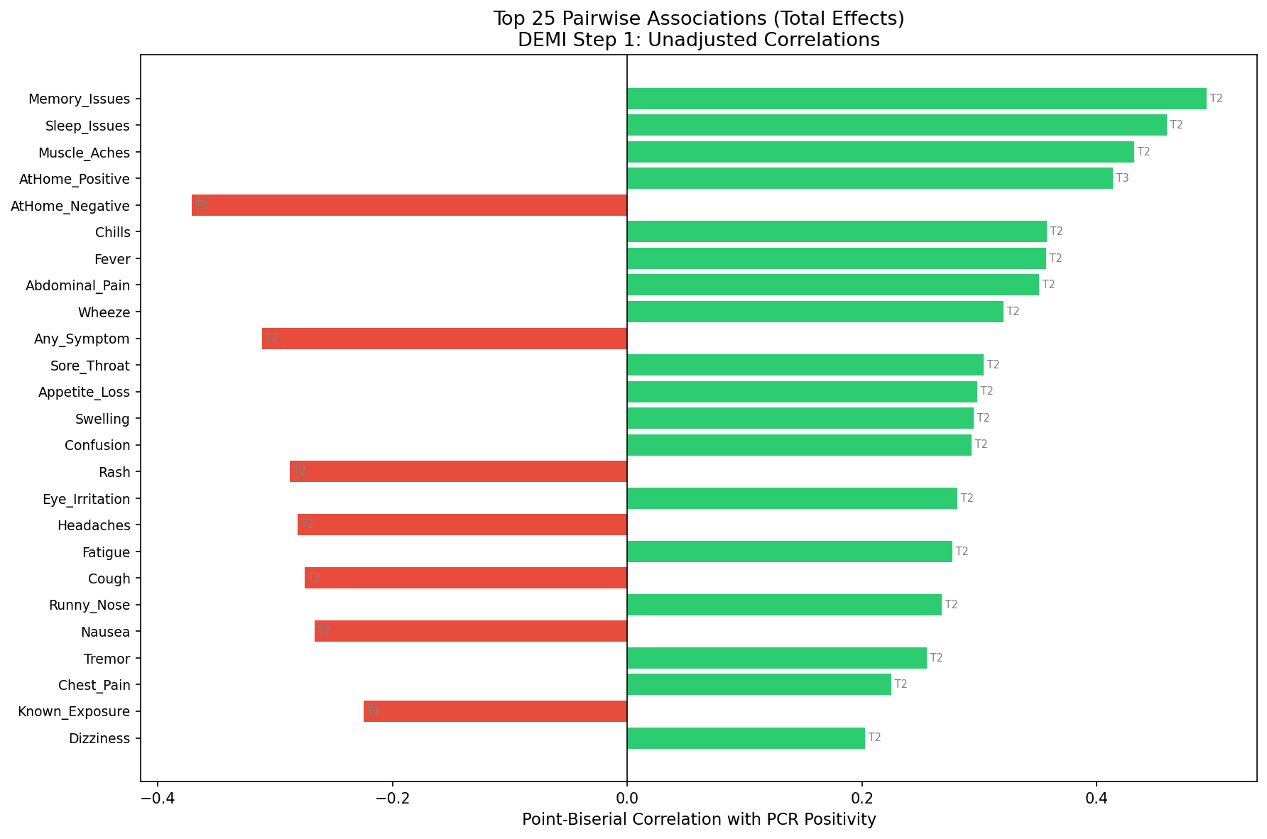
Pairwise Associations: Total Effects
Symptom | Correlation | Odds Ratio
Memory Issues | 0.493 | 31.44
Sleep Issues | 0.460 | 32.43
Muscle Aches | 0.432 | 17.32
AtHome Positive | 0.414 | 21.70
Chills | 0.358 | 9.44
Fever | 0.357 | 9.90
Abdominal Pain | 0.351 | 10.73
Wheeze | 0.320 | 11.55
Total effects include BOTH direct and indirect (mediated) pathways. Example: Muscle Aches (r=0.432) includes effects mediated through fever, fatigue, etc.

Slide 7
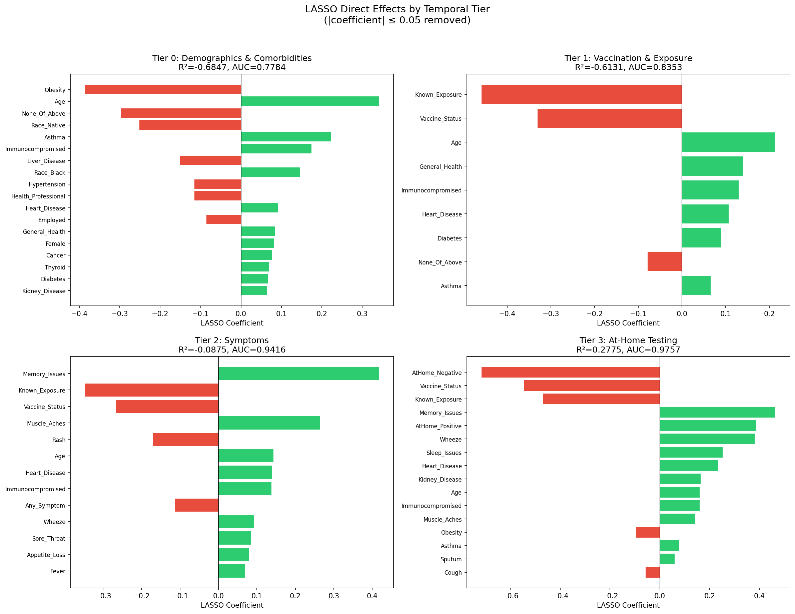
LASSO Regression: Direct Effects by Temporal Tier
Key Results
Tier 0 (Demographics): 18 surviving features, AUC=0.778
Tier 1 (+Exposure): 9 surviving, AUC=0.835
Tier 2 (+Symptoms): 13 surviving, AUC=0.942
Tier 3 (+AtHome Tests): 16 surviving, AUC=0.976 ✓
Only Tier 3 meets McFadden R² ≥ 0.10
Filtering: |coefficient| ≤ 0.05 removed
77 features → 16 direct predictors

Slide 8
Markov Blanket: Direct Predictors of COVID-19
The smallest set of variables that directly predicts PCR positivity while making all others conditionally independent
Feature | Direct Effect (β) | Total Effect (r) | Mediated Effect | Interpretation
AtHome Negative | -0.716 | -0.371 | 0.344 | Protective (strongest)
Vaccine Status | -0.545 | -0.189 | 0.356 | Protective
Known Exposure | -0.469 | -0.225 | 0.244 | Protective*
Memory Issues | +0.464 | +0.493 | 0.029 | Risk factor
AtHome Positive | +0.388 | +0.414 | 0.026 | Risk factor
Wheeze | +0.381 | +0.320 | -0.061 | Risk factor
Sleep Issues | +0.252 | +0.460 | 0.208 | Risk (67% mediated)
Heart Disease | +0.234 | +0.124 | -0.110 | Risk factor
Age | +0.160 | +0.171 | 0.012 | Risk factor
Muscle Aches | +0.141 | +0.432 | 0.291 | Risk (67% mediated)
Obesity | -0.095 | -0.082 | 0.013 | Protective*
*Counterintuitive signs may reflect ascertainment bias — individuals who enroll after known exposure may be more health-conscious. Mediated effect = Total effect − Direct effect; larger mediation indicates more indirect pathways.

Slide 9
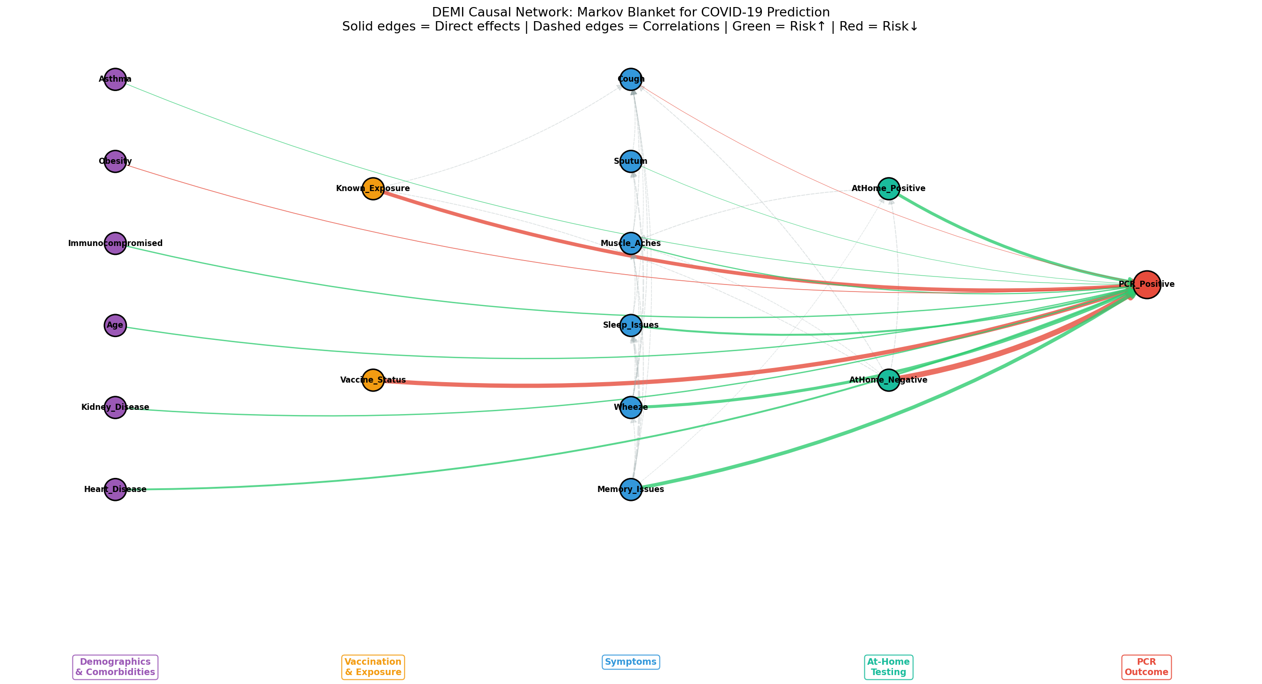
Causal Network Visualization

Slide 10
DEMI Algorithm: Probability Predictions
DEMI uses Bayes' theorem with Markov blanket features to estimate P(COVID | symptoms, exposure, test results)
1. Temporal Order
2. Total Effects
3. Final Probability
Verify symptoms and exposure occur before PCR testing (causal temporal precedence)
Calculate likelihood ratios from pairwise correlations with PCR positivity
Combine multiple signals using Bayes' theorem: P(COVID|X) = P(X|COVID)·P(COVID)/P(X)
Risk Scenario Predictions
Risk Level | Profile | P(COVID) | Recommendation
Low (3.3%) | Age 25, no symptoms, no exposure | 3.3% | Self-monitor; no immediate action
Moderate (5.5%) | Age 40, fatigue, headaches, suspected exposure | 5.5% | Schedule PCR test; consider isolation
High (>15%) | Age 55, known exposure, multiple symptoms | >15% | Isolate immediately; seek PCR and clinical care
Baseline prevalence: 10.4% — Low risk is BELOW baseline, High risk is ABOVE baseline

Slide 11
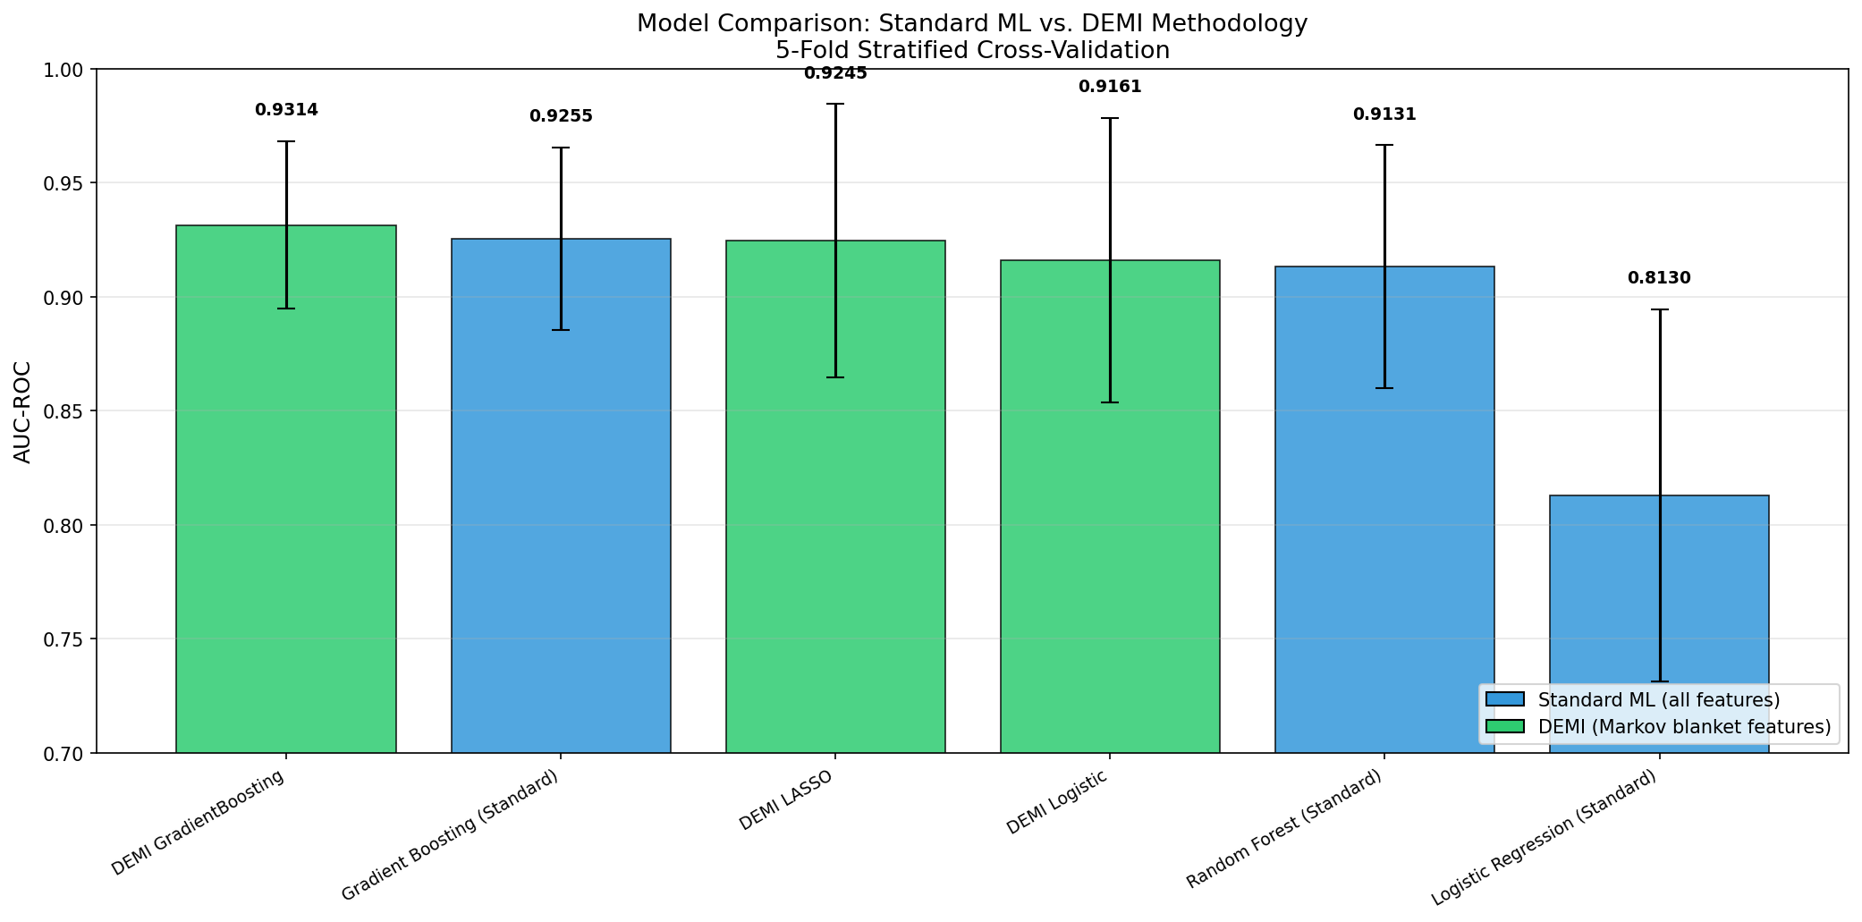
Model Comparison: Standard ML vs. DEMI
Model | Approach | # Features | AUC
GradientBoosting | DEMI | 16 | 0.9314
Gradient Boosting | Standard | 77 | 0.9255
LASSO | DEMI | 16 | 0.9245
Logistic | DEMI | 16 | 0.9161
Random Forest | Standard | 77 | 0.9131
Logistic Regression | Standard | 77 | 0.8130
Key Finding
DEMI GradientBoosting (16 features) OUTPERFORMS Standard Gradient Boosting (77 features) • 79.2% feature reduction • Comparable or superior AUC • Every feature is causally justified • Clinically interpretable model

Slide 12
GitHub Repository
Repository Contents
Quick Start
finalproject823.ipynb— Complete DEMI methodology (run end-to-end)
COVIDCARE_FORSUBMISSION_MIT_CLEANED_Phase_II_2021-12-03_(3).csv
COVIDCARE_DEMI_knowledgebase_v4.csv
COVIDCARE_survey_dictionary_v2_ForSubmission_MIT_Phase_II_2021-12-26.csv
demi_outputs/ — All charts, tables, and results
FINAL823PROJECT.pptx — This presentation
README.md — Setup and execution instructions
git clone [repository-url]
cd covid-demi-prediction
pip install -r requirements.txt
python demi_pipeline.py
All outputs saved to: demi_outputs/
Runtime: ~3 minutes on standard hardware
Requirements: Python 3.8+ | pandas | numpy | scikit-learn | matplotlib | seaborn | networkx | xgboost | statsmodels | scipy

Slide 13
Python Code: DEMI Pipeline
The Python script (demi_pipeline.py) implements the complete DEMI methodology:
Step 1: Data Loading & Cleaning — Load CSV, filter PCR results, map 472 columns to 77 features, handle missing data
Step 2: Temporal Tier Assignment — Assign each feature to Tier 0-3 based on causal ordering
Step 3: Pairwise Associations — Point-biserial correlations + odds ratios for each feature vs. PCR positivity
Step 4: Repeated LASSO Regressions — Grid-searched L1-regularized logistic regression across cumulative tiers
Step 5: Markov Blanket Identification — Variables surviving coefficient threshold with McFadden R² quality check
Step 6: DEMI Probability Estimation — Logistic/GradientBoosting/LASSO on Markov blanket + Bayes' theorem scenarios
Step 7: Network Visualization — Causal network graph (NetworkX) with tier-based layout
Step 8: Model Comparison — Standard ML (all features) vs. DEMI (Markov blanket) with 5-fold CV
Generated Output Files (demi_outputs/)
pairwise_associations.csv/.png
lasso_direct_effects.csv
lasso_tier_results.json
markov_blanket.csv
demi_predictions.csv
demi_roc_curves.png
demi_causal_network.png
model_comparison.csv/.png
Execution Command
finalproject823.ipynb

Slide 14
Healthcare Impact
For Patients
For Healthcare Systems
For Public Health
Risk-stratified guidance BEFORE clinical visit
Know whether to isolate immediately
Informed decisions about seeking testing
Reduced anxiety through transparent probability estimates
Reduce unnecessary ER visits by identifying low-risk patients
Flag high-risk patients for urgent evaluation
Optimize triage and resource allocation
Support telemedicine screening protocols
Causal transparency enables model updates for new variants
Re-run LASSO pipeline on new data — no black-box retraining
Track which symptoms are direct predictors over time
Inform symptom-based surveillance guidelines
DEMI's interpretability makes it suitable for clinical decision support — every prediction can be explained and verified by clinicians

Slide 15
Limitations
Modest sample size: Only 559 participants with PCR results, and just 58 positive cases — limits generalizability
Significant class imbalance: 8.6:1 negative-to-positive ratio may bias model performance metrics
Single study, single timepoint: Data from December 2021 (Delta/early Omicron); symptom profiles may differ with newer variants
Counterintuitive coefficients: Known Exposure shows negative direct effect — likely reflects ascertainment bias in study enrollment
Limited at-home test data: Most participants did not report rapid test results, reducing the utility of Tier 3 features
McFadden R² threshold not met for Tiers 0-2: Symptoms alone may not yield a fully adequate causal model without at-home test results
Self-reported symptoms: Subject to recall bias and interpretation differences across participants
Temporal tier boundaries: Some assignments (e.g., vaccine status timing) may not perfectly capture causal ordering for all individuals

Slide 16
Conclusion
DEMI methodology identifies 16 direct-effect predictors from 77 home-observable features
DEMI GradientBoosting achieves AUC = 0.931 — outperforming standard Gradient Boosting (AUC = 0.926) with 79% fewer features
The Markov blanket provides a minimal, interpretable, and causally-justified predictor set
Bayesian probability estimates enable risk-stratified clinical guidance before PCR testing
Key direct predictors: At-home test results, vaccination status, memory issues, wheeze, sleep issues, age
Causal reasoning is NOT a compromise on performance — it is a pathway to better, more trustworthy models
Thank you — Questions welcome

Slide 17
References
1. Alemi F, et al. DEMI methodology and probabilistic reasoning approaches in healthcare prediction and symptom progression modeling. 2020.
2. Centers for Disease Control and Prevention (CDC). COVID-19 symptoms and testing guidance. 2021.
3. MIT COVID-CARE Consortium. Phase II dataset: COVID-CARE for submission MIT cleaned. December 2021.
4. Hastie T, Tibshirani R, Friedman J. The Elements of Statistical Learning. 2nd ed. Springer; 2009.
5. Pearl J. Causality: Models, Reasoning, and Inference. 2nd ed. Cambridge University Press; 2009.
6. McFadden D. Conditional logit analysis of qualitative choice behavior. In: Zarembka P, ed. Frontiers in Econometrics. Academic Press; 1974:105-142.
7. Tibshirani R. Regression shrinkage and selection via the Lasso. J Royal Stat Soc Series B. 1996;58(1):267-288.
8. Koller D, Friedman N. Probabilistic Graphical Models: Principles and Techniques. MIT Press; 2009.
9. Chen T, Guestrin C. XGBoost: A scalable tree boosting system. Proc 22nd ACM SIGKDD Int Conf Knowl Discov Data Min. 2016:785-794.
10. Ioannidis JPA, Cripps S, Tanner MA, et al. Forecasting for COVID-19 has failed. Int J Forecast. 2022;38(2):423-436.

