Slide 1
Shortest Job First Round Robin Burst Time based Time Quantum Scheduling Algorithm

Slide 2
ABSTRACT
Shortest Job First Round Robin (SJF RR) is a hybrid scheduling algorithm that specializes in priority scheduling of lowest burst time in a single CPU environment
Shortest job first (SJF) or shortest job next, is a scheduling policy that selects the waiting process with the smallest execution time to execute next.
Round robin scheduling is the preemptive scheduling in which every process get executed in a cyclic way

Slide 3
INTRODUCTION
CPU scheduling is a technique that approves one method to use the CPU whilst the execution of every other system is on hold (in waiting for state) due to the unavailability of any useful resource This paper focuses on the improvement of the existing scheduling algorithm based on a : Shortest Job First which ​selects the waiting process with the smallest execution time to execute next ​and the Round Robin which assigns a fixed priority rank to each process.
Burst Time is the time when the process is being executed in the CPU

Slide 4
INTRODUCTION
The two algorithms will be combined with one another to make a new and better version of the older version of the algorithms thus calling it Shortest Job First Round Robin Scheduling Algorithm using Priority Scheduling of Lowest Burst Time.

Slide 5
RELATED WORKS
In the year 2011, [8]Saroj Hiranwal in which first of all we arrange the processes according to the execution time/burst time in increasing order that is smallest the burst time higher the priority of the running process. The smart time slice is equal to the mid-process burst time of all CPU burst time
N Srinivasu, et al [17]: Improved Mean Round Robin with Shortest Job First Scheduling (IMRRSJF) This algorithm has combined elements of each RR two and SJF, ie, the processes are arranged according to the burst-time values and time-quantum is calculated as the square root of the product of mean and highest burst time

Slide 6
METHODOLOGY
3.1 Assumptions:
1. The arrival times of the set of processes are assumed to be 0. 2. The burst times of each process are assumed to be known. 3.2 Proposed Methodology:
The proposed methodology works similarly to Round-Robin with added features of IMRRSJF to efficiently compute for the Time-Quantum and ADRR to be able to lessen the number of Context Switches.

Slide 7
METHODOLOGY
3.3 Approach:
The processes present in the Ready Queue (RQ) are sorted in ascending order. Time Quantum(TQ) is computed using the formula used in IMRRSJF. Time Quantum = Square root of (Mean of Burst-Times*Highest Burst-Time). Each process will now be executed for the TQ. Calculation of the remaining Burst-Time will begin and if the remaining Burst-Time is less than or equal to the TQ, the same process will be executed until it completes. Then it will continue to execute the next process until every process is done. the number of Context Switches.

Slide 8
PSEUDOCODE
Step 1: start Step 2: sort the processes in increasing order of BT // BT = Burst-Time Step 3: compute for the TQ TQ = √(mean of BT*highest BT) // TQ = Time-Quantum
Step 4: keep doing steps 5 and 6 until all processes are done
Step 5a: if rem_BT > 0 //rem_BT = Remaining Burst-Time allocate CPU for time quantum and move on to the next process

Slide 9
PSEUDOCODE
Step 5b: if rem_BT <= TQ >> do step 6 Step 6: else allocate CPU for remaining time then calculate for its WT // WT = Waiting-Time
Step 7: calculate for the processes' TAT // TAT = Turnaround-Time Step 8: calculate the AWT and ATAT // AWT = Average Waiting-Time, ATAT = Average Turnaround-Time Step 9: stop

Slide 10
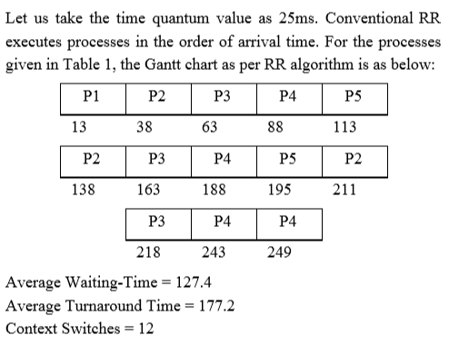
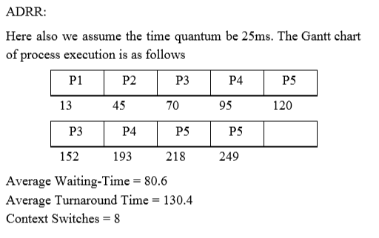
EXPERIMENTS AND RESULTS
Comparison of the performance measures of the proposed algorithm with RR, ADRR, IMRRSJF and S
Round Robin Algorithm: ADRR

Slide 11
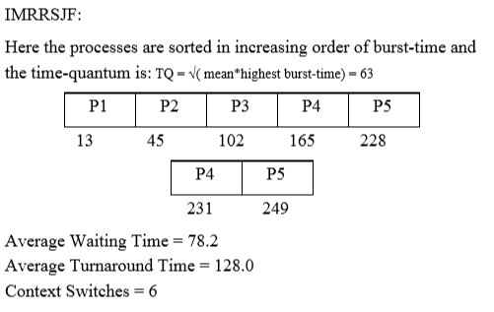
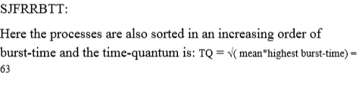
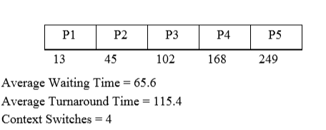
EXPERIMENTS AND RESULTS
IMRRSJF: : SJFRRBTT:

Slide 12
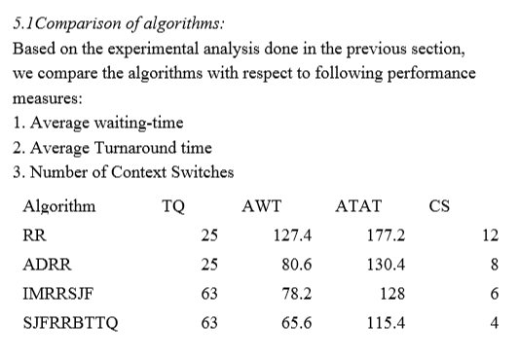
EXPERIMENTS AND RESULTS

Slide 13
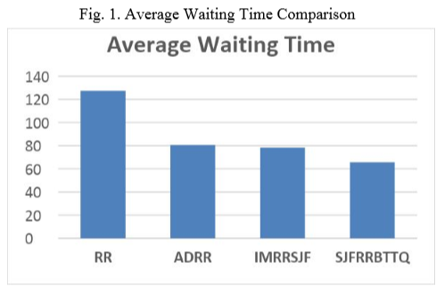
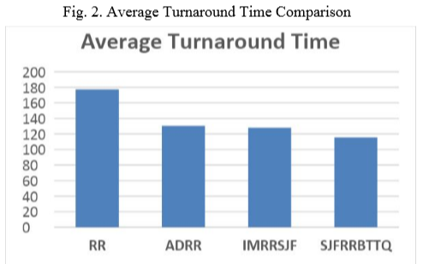
EXPERIMENTS AND RESULTS:
Graphical Comparison of average waiting-time in various algorithms:
Graphical comparison of average turnaround time in various algorithm:

Slide 14
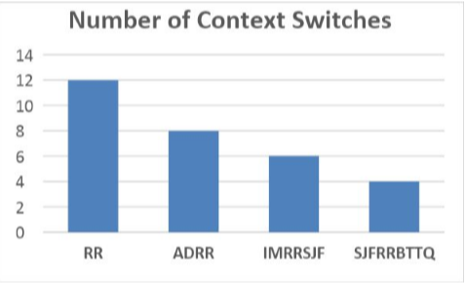
EXPERIMENTS AND RESULTS:
Graphical comparison of the number of Context Switches Fig. 3. Number Of Context Switches Comparison

Slide 15
Conclusion The Proposed Algorithm provides improved performance as is evident from the experiment results of previous section. The number of context switches is lessened compared to RR algorithm. It also reduces both Average Waiting-time and Average Turnaround Time.
Future Works SJFRRBTTQ algorithm can be further enhanced by integrating appropriate strategy to control starvation, and can also be modified to consider arrival-time of the different processes.

Slide 16
END

