Slide 1
Containerization
SE489: DevOps Engineering

Slide 2
Outline
Containerization?
Why we need Docker?
What is Docker?
Docker Example
Docker Case Study
Docker Components

Slide 3
Containerization?

Slide 4
Containerization?
Containerization entails placing a software component and its environment, dependencies, and configuration, into an isolated unit called a container.
This makes it possible to deploy an application consistently on any computing environment, whether on-premises or cloud-based.
A container is a standardized unit of software abstracted from the operating system.
It contains code and all its dependencies that can be transferred and run without changing one environment to another.

Slide 5
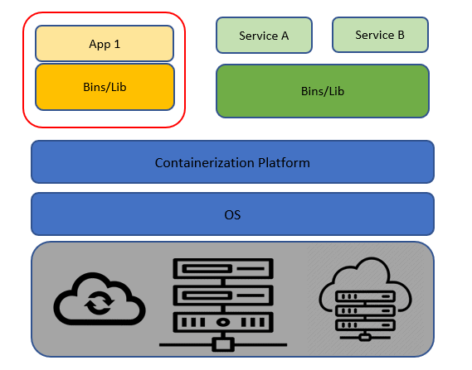
Containerization

Slide 6
Containerization Benefits
Ease of Deployment
Containers are built and deployed from a local image in only a few seconds.
Scalability and Flexibility
Containerized applications are perfect for scaling both up and down.
Consistent
Since containers are standardized units, they will work in any provided environment.

Slide 7
Why Do We Need Containers?
The main advantage of containers is that they are lightweight and portable and thus helps the developer a lot in configuring and deploying their application.
There are many reasons for using Containers but only some of them are listed below:
Lightweight: Share the machine OS, they don’t need a full OS instance per application.
Portable: A package having all their dependencies with them, write the software once and run across different computing environments.
Supports CI/CD: Deployment portability/consistency across platforms and their small size.
Improves utilization: Enable developers and operators to improve CPU and memory utilization.

Slide 8
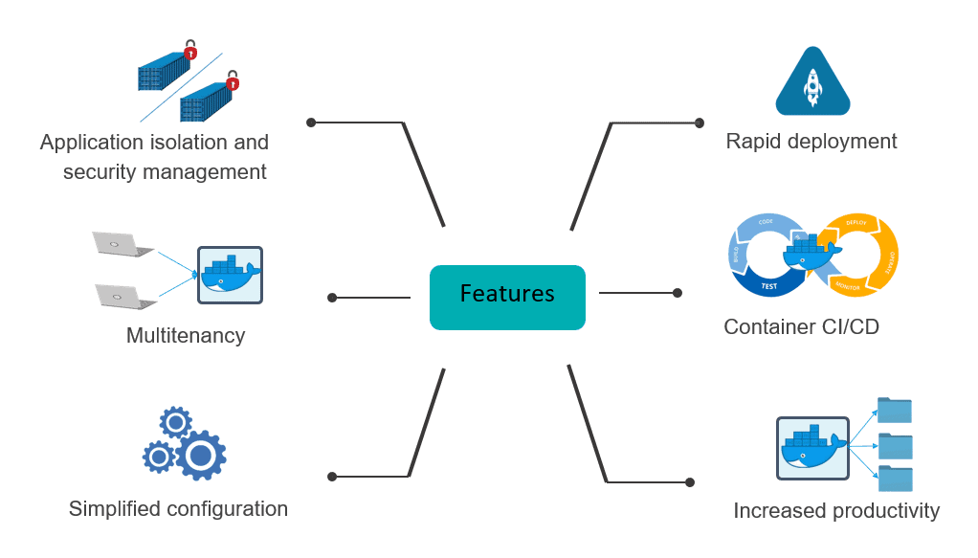
Common Features of Containers

Slide 9
Why we need Docker?

Slide 10



Problems before Docker
An application works in developer’s machine but not in testing or production
This is due to difference in computing environment between Dev, Test, and Prod
Code works on my machine
There is some problem with the code
Development
Production

Slide 11
Problems before Docker
The idea behind microservices is that some types of applications becomes easier to build and maintain when they are broken into smaller, composable pieces that work together
Account Service
Account DB
Online Shopping Service
Product catalog
Product DB
Imagine an online shop with separate microservices for user accounts, product-catalog order processing, and shopping cart
Cart Service
Cart DB
Order Service
Order DB

Slide 12
Problems before Docker
Developing an application requires starting several microservices in one machine.
If you are starting five of those services, you are require five virtual machines.
Virtual Machines for starting multiple services
Host Machine

Slide 13
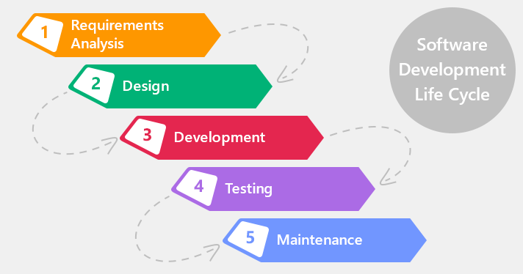
How Docker Solves these problems
You can run several microservices in the same VM by running various Docker containers for each microservice
Provide a consistent computing environment throughout the whole SDLC
Docker Containers
Virtual Machine
Host Machine

Slide 14
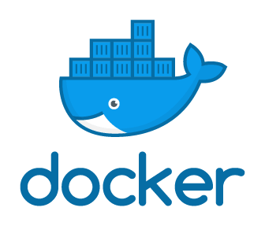
What is Docker?

Slide 15
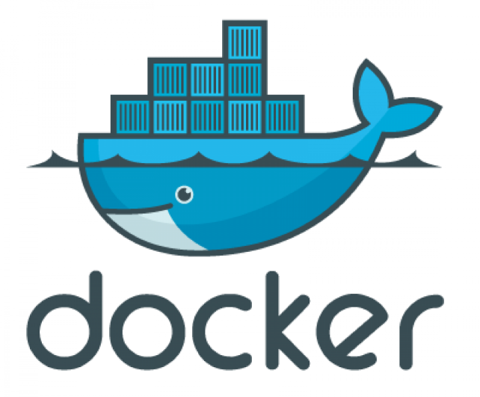
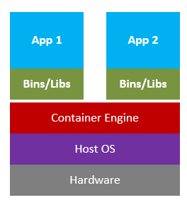
What is Docker?
Docker is a tool designed to make it easier to create, deploy, and run applications by using containers.
Docker contains are lightweight alternatives to Virtual Machines and it used the host OS.
You don’t have to pre-allocate any RAM in containers.

Slide 16
Docker in a Nutshell
Docker files builds a Docker image and that image contains all the project’s code
You can run that image to create as many Docker containers as you want
This image can be uploaded on Docker hub, from Docker hub any one can pull the image and build a container.
Container
Staging Server
Container
Docker File
Docker Hub
Image
Container
Docker Image
Docker Container
Container
Production Server
Container
Virtual Machine
Image
Container

