Slide 1
Introduction

Slide 2
Introduction
As the size and complexity of software is increasing
software organizations are facing the pressure of delivering high-quality software within a specific time, budget, and available resources.
The software development life cycle consists of a series of phases, including
requirements analysis
Design
Implementation
Testing
Integration
and maintenance.
Software professionals want to know which tools to use at each phase in software devel opment and desire effective allocation of available resources.

Slide 3
Introduction
The software planning team attempts to estimate the cost and duration of software development
The software testers want to identify the fault-prone modules
The software managers seek to know which tools and techniques can be used to reduce the delivery time and best utilize the man-power.
In addition, the software managers also desire to improve the software processes so that the quality of the software can be enhanced.
Traditionally, the software engineers have been making decisions based on their intuition or individual expertise without any scientific evidence or support on the benefits of a tool or a technique.

Slide 4
Introduction
Empirical studies are verified by observation or experiment and can provide powerful evidence for testing a given hypothesis.
Like other disciplines, software engineering has to adopt empirical methods that will help to plan, evaluate, assess, monitor, control, predict, manage, and improve the way in which software products are produced.

Slide 5
Introduction
An empirical study of real systems can help software organizations assess
large software systems quickly, at low costs. The application of empirical techniques is especially beneficial for large-scale systems, where software professionals need to focus their attention and resources on various activities of the system under development.
For example:
developing a model for predicting faulty modules allows software organizations to identify faulty portions of source code so that testing activities can be planned more effectively.
Empirical studies such as surveys, systematic reviews and experimental studies, help software practitioners to scientifically assess and validate the tools and techniques in software development.

Slide 6
Software Engineering
The initial debate on software as an engineering discipline is over now.
It has been realized that without software as an engineering discipline survival is difficult.
Engineering compels the development of the product in a scientific, well formed, and systematic manner.
Core engineering principles should be applied to produce good quality maintainable software within a specified time and budget

Slide 7
Software Engineering
The software engineering discipline facilitates the completion of the objective of delivering good quality software to the customer following a systematic and scientific approach.

Slide 8
Empirical Software Engineering (ESE)
An area of research that emphasizes the use of empirical methods in the field of software engineering.
It involves methods for evaluating, assessing, predicting, monitoring, and controlling the existing artifacts of software development.

Slide 9
ESE
ESE applies quantitative methods to the software engineering phenomenon to understand software development better.
ESE has been gaining importance over the past few decades because of the availability of vast data sets from open source repositories that contain information about software requirements, bugs, and changes.

Slide 10
Overview of Empirical Studies
Empirical study is an attempt to compare the theories and observations using real-life data for analysis.
Empirical studies usually utilize data analysis methods and statistical techniques for exploring relationships.
They play an important role in software engineering research by helping to form well-formed theories and widely accepted results.

Slide 11
Overview of Empirical Studies
The empirical studies provide the following benefits:
Allow to explore relationships
Allow to prove theoretical concepts
Allow to evaluate accuracy of the models
Allow to choose among tools and techniques
Allow to establish quality benchmarks across software organizations
Allow to assess and improve techniques and methods

Slide 12
Steps of Empirical Studies
Formation of research questions
Formation of a research hypothesis
Gathering data
Analyzing the data
Developing and validating models
Deriving conclusions from the obtained results

Slide 13
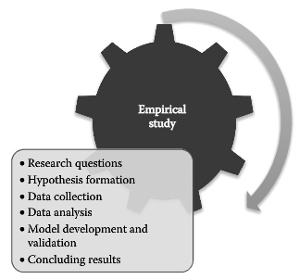
Steps of Empirical Studies

Slide 14
Empirical Studies
Empirical study allows to gather evidence that can be used to support the claims of efficiency of a given technique or technology.
Thus, empirical studies help in building a body of knowledge so that the processes and products are improved resulting in high-quality software.
Empirical studies are of many types, including surveys, systematic reviews, experiments, and case studies.

Slide 15
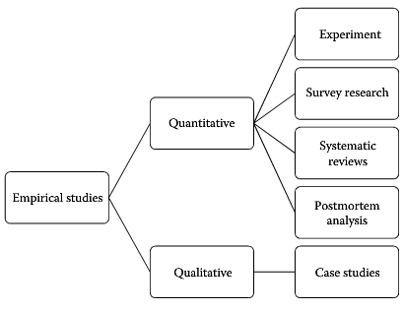
Types of Empirical Studies

Slide 16
Types of Empirical Studies
The studies can be broadly classified as quantitative and qualitative.
Quantitative research is the most widely used scientific method in software engineering that applies mathematical or statistical-based methods to derive conclusions.
Quantitative research is used to prove or disprove a hypothesis (a concept that has to be tested for further investigation).
The aim of a quantitative research is to generate results that are generalizable and unbiased and thus can be applied to a larger population in research.
It uses statistical methods to validate a hypothesis and to explore causal relationships.

Slide 17
Types of Empirical Studies
In qualitative research, the researchers study human behavior, preferences, and nature.
Qualitative research provides an in-depth analysis of the concept under investigation and thus uses focused data for research.
Understanding a new process or technique in software engineering is an example of qualitative research.
Qualitative research provides textual descriptions or pictures related to human beliefs or behavior.
It can be extended to other studies with similar populations but generalizations of a particular phenomenon may be difficult.
Qualitative research involves methods such as observations, interviews,
and group discussions.
This method is widely used in case studies.

Slide 18
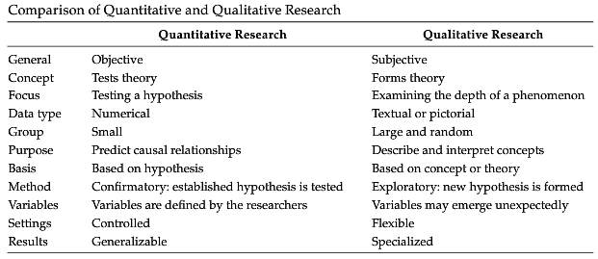
Quantitative vs Qualitative

Slide 19
Experiment
An experimental study tests the established hypothesis by finding the effect of variables of interest (independent variables) on the outcome variable (dependent variable) using statistical analysis.
If the experiment is carried out correctly, the hypothesis is either accepted or rejected.
For example, one group uses technique A and the other group uses technique B, which technique is more effective in detecting a larger number of defects?
The researcher may apply statistical tests to answer such questions.
Experiments are small scale and must be controlled.
The experiment must also control the confounding variables, which may affect the accuracy of the results produced by the experiment.
The experiments are carried out in a controlled environment and often referred to as controlled experiments (Wohlin 2012).
The key factors involved in the experiments are independent variables, dependent variables, hypothesis, and statistical techniques.

Slide 20

Steps in experimental research

Slide 21
Experiment
A controlled experiment involves varying the variables (one or more) and keeping everything else constant or the same and are usually conducted in small or laboratory setting.
Comparing two methods for defect detection is an example of a controlled experiment in software engineering context.

Slide 22
Case Study
Case study research represents real-world scenarios and involves studying a particular phenomenon
Case study research allows software industries to evaluate a tool, method, or process
The effect of a change in an organization can be studied using case study research.
Case studies increase the understanding of the phenomenon under study.
For example, a case study can be used to examine whether a unified model language (UML) tool is effective for a given project or not.
The initial and new concepts are analyzed and explored by exploratory case studies, whereas the already existing concepts are tested and improvised by confirmatory case studies.

Slide 23
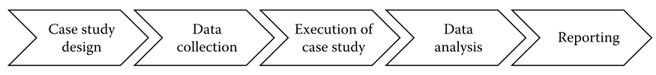
Case Study Steps

Slide 24
Survey Research
Survey research identifies features or information from a large scale of a population.
For example, surveys can be used when a researcher wants to know whether the use of a particular process has improved the view of clients toward software usability features.
This information can be obtained by asking the selected software testers to fill questionnaires.
Surveys are usually conducted using questionnaires and interviews. The questionnaires are constructed to collect research-related information.

Slide 25
Survey Research
Preparation of a questionnaire is an important activity and should take into consideration the features of the research.
The effective way to obtain a participant’s opinion is to get a questionnaire or survey filled by the participant.
The participant’s feedback and reactions are recorded in the questionnaire.
The questionnaire/survey can be used to detect trends and may provide valuable information and feedback on a particular process, technique, or tool.
The questionnaire/survey must include questions concerning the participant’s likes and dislikes about a particular process, technique, or tool.
The interviewer should preferably handle the questionnaire.

Slide 26
Survey Research
Surveys are classified into three types:
descriptive, explorative, and explanatory.
Exploratory surveys focus on the discovery of new ideas and insights and are usually conducted at the beginning of a research study to gather initial information.
The descriptive survey research is more detailed and describes a concept or topic.
Explanatory survey research tries to explain how things work in connections like cause and effect, meaning a researcher wants to explain how things interact or work with each other.
For example, while exploring relationship between various independent variables and an "outcome variable, a researcher may want to explain why an independent variable affects the outcome variable.

Slide 27
Systematic Reviews

