Slide 1
Linked List Components
Abbos Aliboev 2023041080
2025.01.09

Slide 2
Problem Definition (1)
Source: Leetcode - 817
Title: Linked List Components
Difficulty: Medium
Array, Hash Table, Linked List, Data Structer

Slide 3
Problem Definition (2)
You are given the head of a linked list containing unique integer values and an integer array nums that is a subset of the linked list values.
Return the number of connected components in nums where two values are connected if they appear consecutively in the linked list.

Slide 4
Problem Definition (2)
Example 1:
Input: head = [0,1,2,3], nums = [0,1,3]
Output: 2
Explanation: 0 and 1 are connected, so [0, 1] and [3] are the two connected components.
Example 2:
Input: head = [0,1,2,3,4], nums = [0,3,1,4]
Output: 2
Explanation: 0 and 1 are connected, 3 and 4 are connected, so [0, 1] and [3, 4] are the two connected components.
Constraints:
The number of nodes in the linked list is n.
1 <= n <= 104
0 <= Node.val < n
All the values Node.val are unique.
1 <= nums.length <= n
0 <= nums[i] < n
All the values of nums are unique.

Slide 5
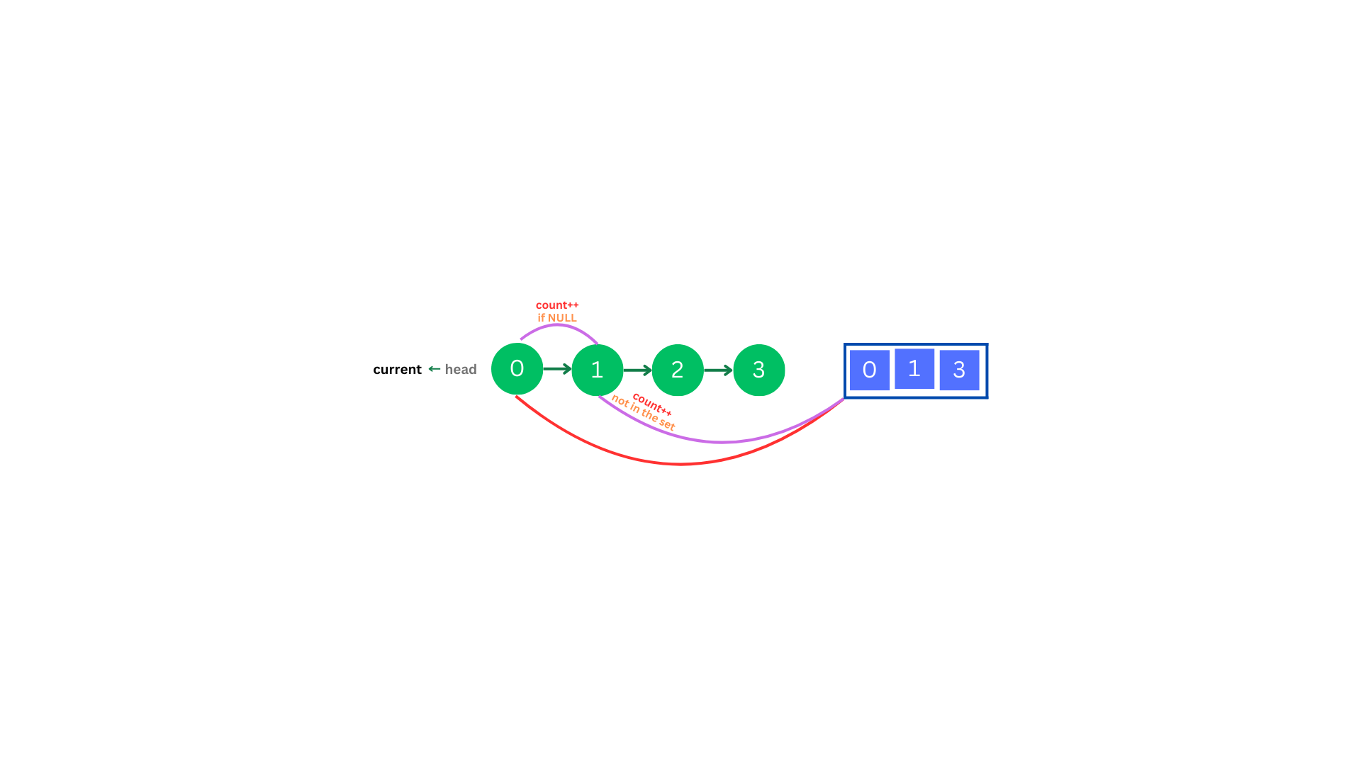
Solution (1-0)
1. Insert nums into a set for fast membership checks (O(1) on average).
2. Traverse the linked list from head to the end.
3. Check membership: If current->val is in the set, but the next node is either nullptr or not in the set, increment the component count.
4. Return the count of connected components.

Slide 6
Solution (1-1)

Slide 7
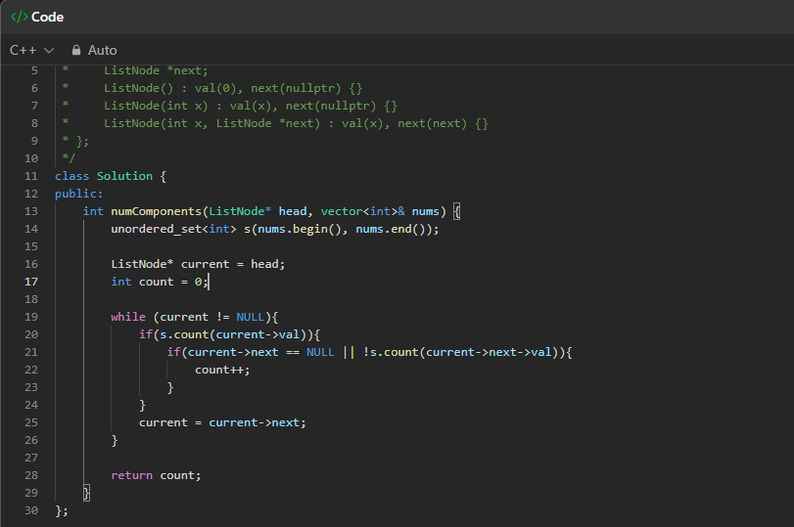
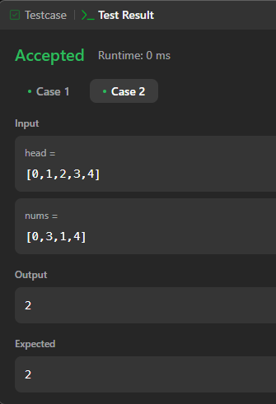
Solution (2-0)

Slide 8
What you have learned
1. Learned the differences between set (ordered) and unordered_set (hash-based), and how they impact insertion and lookup complexities.
2. Explored how searching in an array (or vector) typically uses linear or binary search, depending on data ordering.
3. Practiced comparing these approaches in terms of efficiency and how they handle duplicates.
4. Gained insights into selecting the right data structure for optimal performance in various scenarios.

Slide 9
Questions and Answers

Slide 10
Greetings

