Slide 1



2026 ICCAS
MobiCare: Edge AI
Integration of Fall Prevention, Detection, and Rehabilitation
24/7 Real-Time Monitoring and Instant Response Platform for Elderly Living Alone in a Super-Aged Society
Team Choco Haim
Damin Kim, Jonghyeok Park, Ali, Seongwoo Cho

Slide 2


Content
01
02
03
Service Overview
Limitations of Existing Solutions
Core Technology
- Integrated 3-stage: Prevention-Detection-Rehabilitation
- Targeting elderly living alone in a super-aged society
- 24/7 indoor monitoring
- Key message and operating principle
- Resistance to wearing wearable devices
- CCTV limited to recording only
- Lack of AI analysis
- YOLOv11 Pose Estimation
- Lightweight Edge AI model
- ST-GCN + Physics Rescue
- Alert system within 3 seconds
04
05
06
Personalized Service
Performance Improvement
Expected Impact
- Settings based on user profile
- Family notification integration
- Real-time dashboard
- Weekly health trend analysis
- Fall detection accuracy metrics
- Data collection and visualization
- Experimental results analysis
- Reduced false fall-detection rate
- Faster detection time (1 hour to 3 sec)
- Extended independent living period

Slide 3



Team Choco Haim
Demo Video

Slide 4
Team Choco Haim
Research Background and Motivation
20% Fall Incidence Among Adults 65+
Rising Trend of Elderly Living Alone
Limitations of Existing Wearable Devices
- Fall incidence among adults 65+ reaches 20%
- Falls are a leading cause of injury in older adults
Difficulty responding immediately due to the rise in elderly living alone
Rapid detection and response after a fall is critical to improving survival rates
- Continuously rising number of single elderly households
- Shortage of 24-hour caregivers and cost issues
Risk of being left unattended for 1-2+ hours after a fall
- Growing need for a real-time monitoring system
- Low usage rate due to uncomfortable fit
- Difficulty charging and managing batteries
- Monitoring impossible if the device is refused
- Camera-based contactless monitoring emerging as an alternative

Slide 5
Team Choco Haim
System Overview
Camera-Based
Fall Detection
24/7 Real-Time Monitoring
3-Stage Alert System
- Contactless monitoring via CCTV cameras
- Extracting 17 COCO keypoints with YOLOv11n-pose
- Predicting fall probability with an ST-GCN model
- Handling the grey zone with a Physics Rescue filter
- Real-time Edge AI processing (~19 FPS)
- 30-frame sliding window method
- Runs on Jetson Orin Nano Super
- Live video via MJPEG streaming
- Sends an alert upon fall detection
- Supports push notifications, SMS, and KakaoTalk
- Instant notification to caregivers and administrators
- Provides fall location and time information

Slide 6


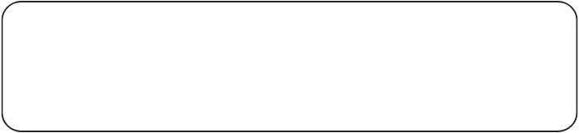
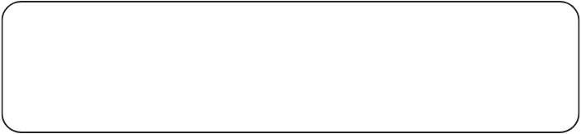
Team Choco Haim
Limitations of Existing Solutions and Improvements
Limitations of Existing Solutions
MobiCare's Innovative Improvements
- Smartwatch: detects only after a fall, high resistance to wearing
- Home CCTV: recording only, no AI or alerts
- Hospital rehab: 1-2 visits/week, no daily monitoring
- Detection mat: fixed spots only, not portable, no rehab function
- Integrated solution: Prediction to Prevention, Instant Detection to Alert, Rehab to Recovery
- Equipment: only a standard camera + smartphone (family app) needed
- No additional sensors or wearables required
- Full-body motion tracking (17 joints)

Slide 7

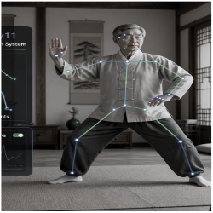
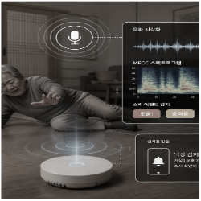

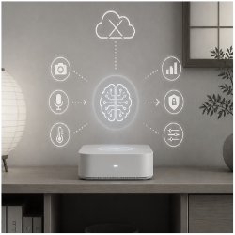
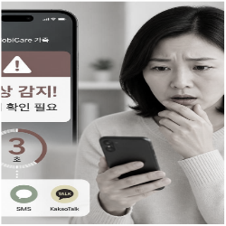
Team Choco Haim
Core Technology Architecture
01
YOLOv11 Pose Estimation
03
ST-GCN + Physics
Rescue
- Real-time tracking of 17 joints
- Fall pattern detection
- Balance score calculation
- Primary verification with ST-GCN
- Physics Rescue assists discrimination at the fall/non-fall boundary (grey zone)
02
Lightweight Edge AI Model
04
Instant Alert System
- Runs on edge devices
- Low latency, no cloud required
- Privacy protection
- Sends alert within 3 seconds
- Push / SMS / KakaoTalk
- Family app integration

Slide 8


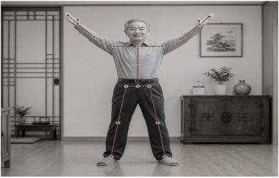
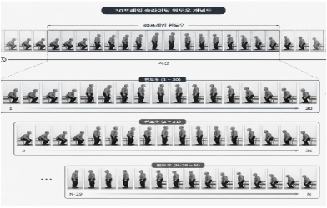
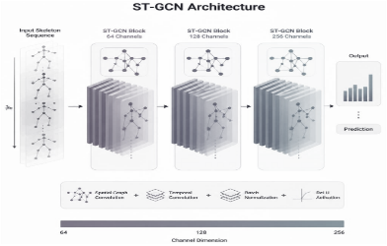
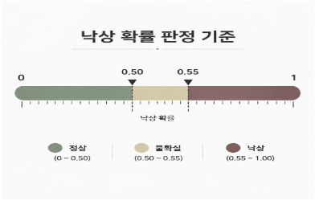
Team Choco Haim
Core Architecture (Stage 1)
YOLOv11n-pose Keypoint Extraction
30-Frame Sliding Window
ST-GCN Fall Probability Prediction
Stage 1 Decision Criteria
- Extract 17 COCO keypoints
- (x, y, confidence) coordinates
- Low confidence threshold set at 0.1
- 30 FPS real-time processing
- Window size: 30 frames (~1.6 sec)
- Stride: 15 frames (~0.8 sec)
- Real-time processing speed: ~19 FPS
- Continuous motion pattern analysis
- 9-block structure (64 to 128 to 256 channels)
- 3.1M parameters, 12.5MB model
- Outputs fall probability p
- p≥0.55: fall confirmed
- p≥0.55: FALL (confirmed)
- 0.50≤p<0.55: Physics filter activates
- p<0.50: NO-FALL
- Uncertain range passed to stage 2

Slide 9



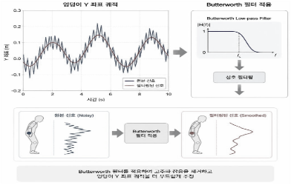
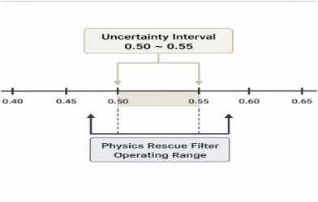
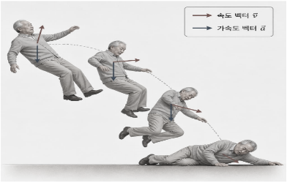
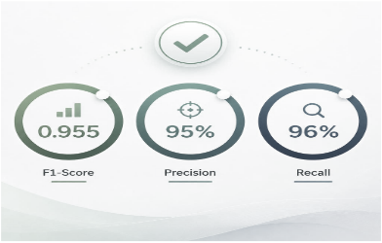
Team Choco Haim
Core Architecture (Stage 2)
Grey Zone (0.50-0.55) Handling
Physics Rescue Filter
Velocity/Acceleration Threshold Verification
Stage 2 Performance Improvement
- Applies Butterworth low-pass filter
- Analysis based on hip Y-coordinate
- Velocity and acceleration calculation
- Activates only for stage 1 uncertain range
- ST-GCN probability range 0.50-0.55
- Physics filter makes the final decision
- Stage 1 confirmed decisions remain unchanged
- Rescue mode reduces false positives
- Velocity threshold applied
- Acceleration threshold applied
- Fall verified using physical laws
- Fall confirmed if verification passes
- Fall F1-score of 0.955 achieved
- Precision 95%, Recall 96%
- Accuracy 98.7%
- Reduced false positives, improved accuracy

Slide 10



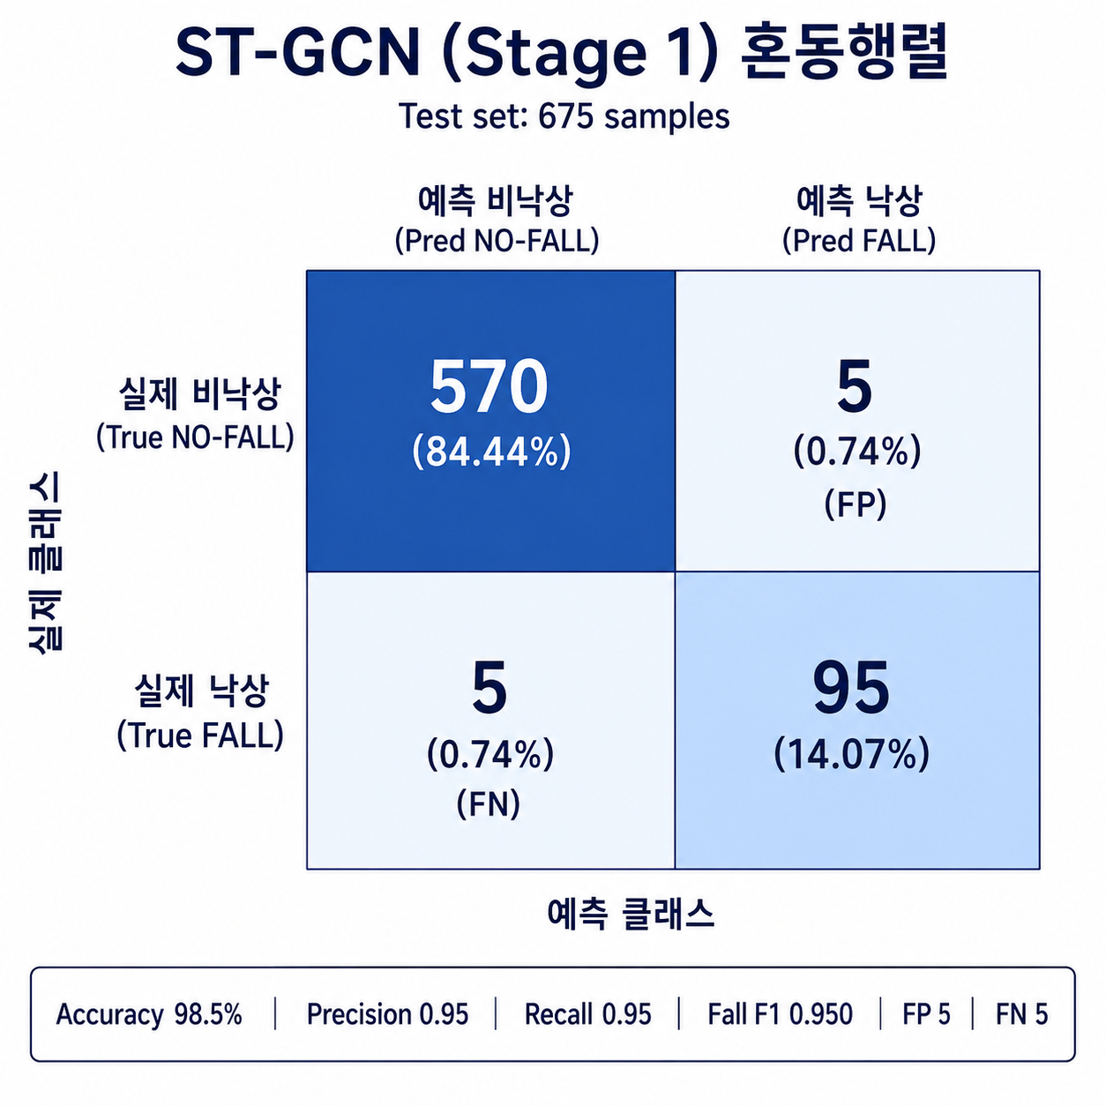
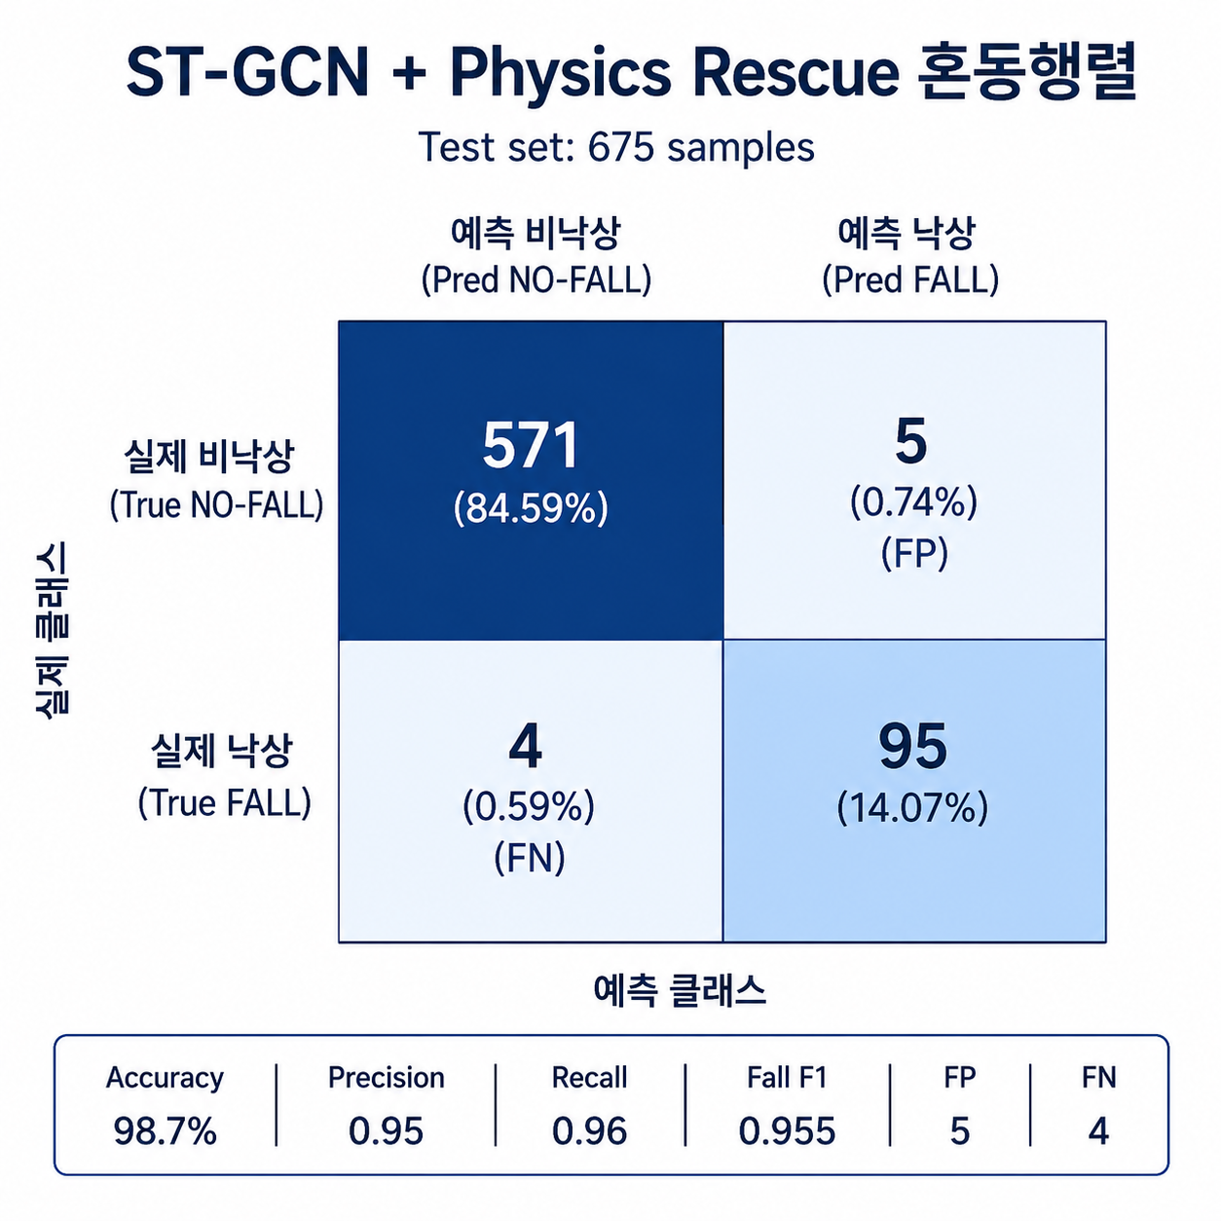
Team Choco Haim
Performance Improvement
Before
After

Slide 11



Team Choco Haim
Expected Impact and Social Value
1
2
3
Individual-Level Impact
Societal-Level Impact
Technical-Level Impact
- Reduced false fall-detection rate
- Detection time: 1 hour to 3 sec
- Enables participation in daily rehabilitation
- Extended independent living period
- Reduced healthcare costs
- Eased psychological burden on families
- Applicable to nursing hospitals
- Improved real-time detection accuracy
- Privacy protection via edge devices
- Scalability through caregiver alerts and app integration

Slide 12

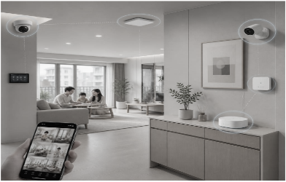
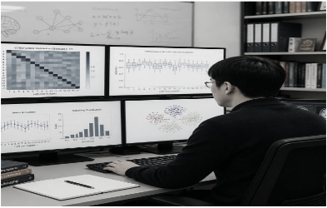
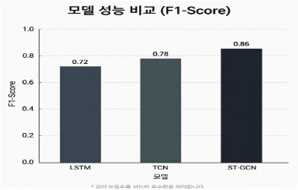

Team Choco Haim
Conclusion and Future Work
Completed Implementation
Future Experiment Plan
Baseline Comparison
Final Vision
- Integrated Edge AI platform
- ST-GCN + Physics Rescue
- Fall F1-score of 0.955 achieved
- Real-time alert system
- LOSO cross-validation
- Extend to subjects 1-17
- Real-world data collection
- LSTM baseline
- TCN baseline
- Comparison for paper submission
- Protecting the lives of elderly living alone
- Supporting a dignified life
- A solution for the super-aged society

